Slide 1
Lipids

Slide 2
Lipids
Lipids are
Biomolecules that contain fatty acids or a steroid nucleus.
Soluble in organic solvents but not in water.
Named for the Greek word lipos, which means “fat.”
Extracted from cells using organic solvents.

Slide 3
Types of Lipids
The types of lipids containing fatty acids are
Waxes.
Fats and oils (triacylglycerols).
Glycerophospholipids.
Prostaglandins.

Slide 4
Structures of Lipids

Slide 5
Fatty Acids

Slide 6
Fatty Acids
Fatty acids
Are long-chain carboxylic acids.
Typically contain 12-18 carbon atoms.
Are insoluble in water.
Can be saturated or unsaturated.

Slide 7
Fatty Acid Formulas
The formulas for fatty acids are written as
Condensed formulas.
Line-bond formulas.
For example caprylic acid with 8 carbon atoms.
CH₃—(CH₂)₆—COOH
CH₃—CH₂—CH₂—CH₂—CH₂—CH₂—CH₂—COOH

Slide 8
Saturated Fatty Acids
Saturated fatty acids have
Single C–C bonds.Molecules that fit closely together in a regular pattern.Strong attractions between fatty acid chains.High melting points that make them solids at room temperature

Slide 9
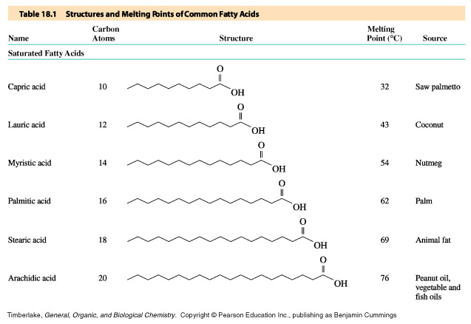
Some Saturated Fatty Acids

Slide 10
Unsaturated Fatty Acids
Unsaturated fatty acids
Have one or more double C=C bond
Typically contain cis double bonds.

Slide 11
Properties of Unsaturated Fatty Acids
Unsaturated fatty acids
Have “kinks” in the fatty acid chains.
Do not pack closely.
Have few attractions between chains.
Have low melting points.
Are liquids at room temperature.
“kinks” in chain

Slide 12
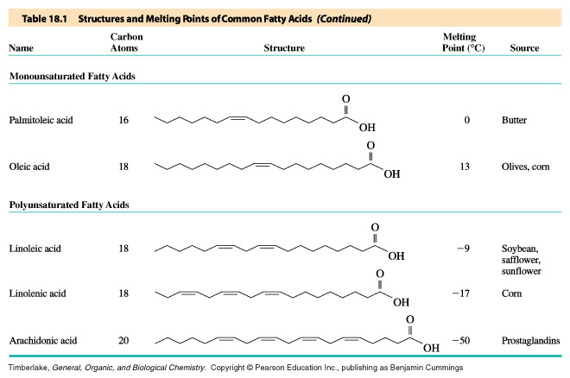
Unsaturated Fatty Acids

Slide 13
Comparing Melting Points of Some Fatty Acids

Slide 14
Learning Check
Assign the melting points of –17°C, 13°C, and 69°C to the correct fatty acid. Explain.
stearic acid (18 C) saturated
oleic acid (18 C) one double bond
linoleic acid (18 C) two double bonds

Slide 15
Solution
Stearic acid is saturated and would have a higher melting point than the unsaturated fatty acids. Because linoleic has two double bonds, it would have a lower mp than oleic acid, which has one double bond.
stearic acid mp 69°C saturated
oleic acid mp 13°C
linoleic acid mp -17°C most unsaturated

Slide 16
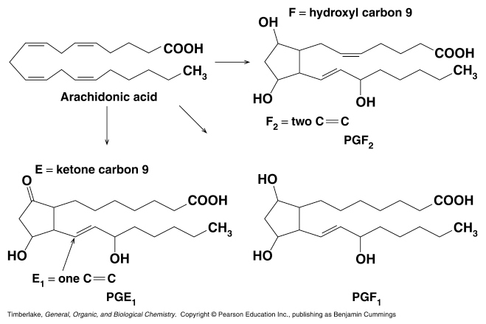
Prostaglandins
Prostaglandins have
20 carbon atoms in their fatty acid chains.
An OH on carbon 11 and 15.
A trans double bond at carbon 13.
C 13
C 15
C 11

Slide 17
Prostaglandins in the Body
Prostaglandins are
Produced by injured tissues.
Involved in pain, fever, and inflammation.
Not produced when anti-inflammatory drugs such as aspirin inhibit their synthesis.

Slide 18
Omega-6 and Omega 3- Fatty Acids
Fatty acids
In vegetable oils are mostly omega-6 with
the first C=C at C6.
linoleic acid
CH₃─(CH₂)₄─CH=CH─CH₂─CH=CH─(CH₂)₇─COOH
6
In fish oils are mostly omega-3 with the
first C=C at C3.
linolenic acid
CH₃─CH₂─(CH=CH─CH₂)₃─(CH₂)₆─COOH
3

Slide 19
Some Omega-6 and Omega-3 Fatty Acids

Slide 20
Learning Check
Write a fatty acid with 10 carbon atoms that is:
A. saturated
B. monounsaturated omega-3
C. monounsaturated omega-6

Slide 21
Solution
Write a fatty acid with 10 carbon atoms that is:A. saturated
CH₃—CH₂—CH₂—CH₂—CH₂—CH₂—CH₂—CH₂—CH₂—COOH
B. monounsaturated omega-3
CH₃—CH₂—CH=CH—CH₂—CH₂—CH₂—CH₂—CH₂—COOH
C. monounsaturated omega-6
CH₃—CH₂—CH₂—CH₂—CH₂—CH=CH—CH₂—CH₂—COOH

