Slide 1

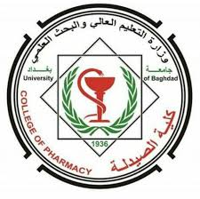
Practical Human Anatomy and Histology
Lab. 4
first stage
Department Of Clinical Laboratory Sciences

Slide 2
Learning Objectives
1-Identification of heart chambers, major vessels on models/pro-sections.
2-Microscopic identification of heart wall, arteries, veins, and capillaries.

Slide 3
Chambers of Heart
The heart is a conical hollow muscular organ situated in the middle mediastinum and is enclosed within the pericardium. It pumps blood to various parts of the body to meet their nutritive requirements.
The heart is composed of 4 chambers:
Right atrium
Right ventricle
Left atrium
Left ventricle

Slide 4
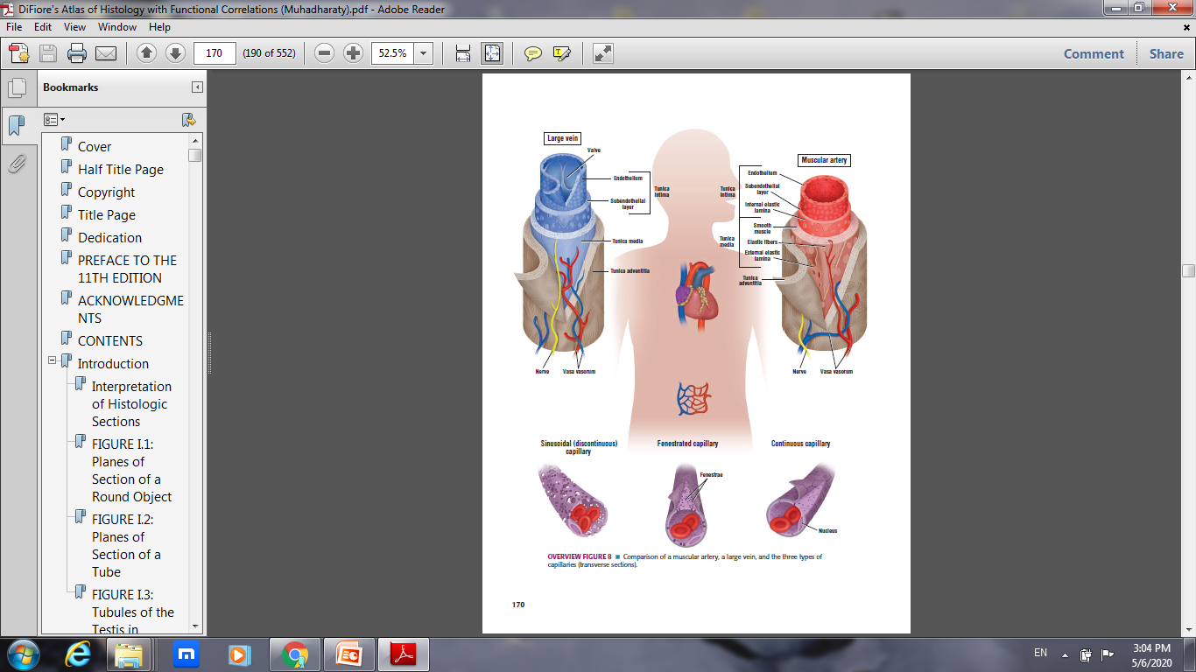
Circulatory system

Slide 5
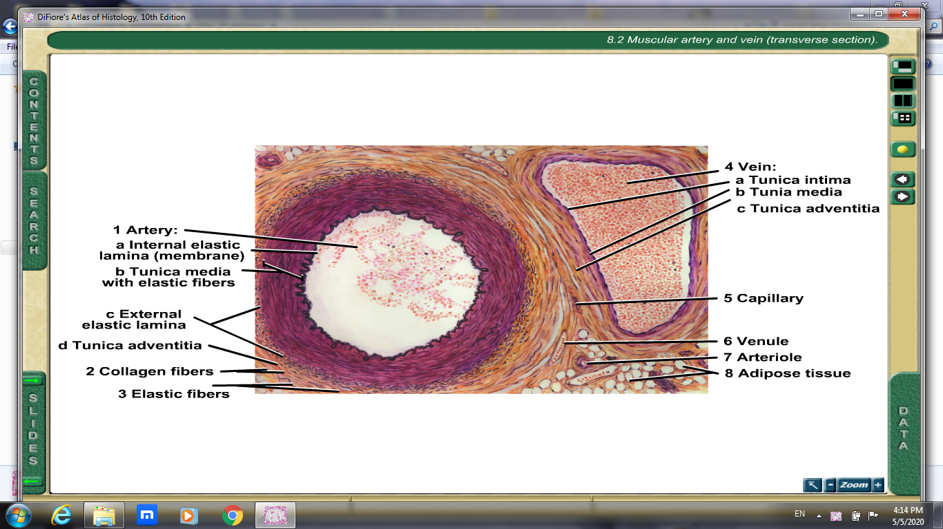

Slide 6
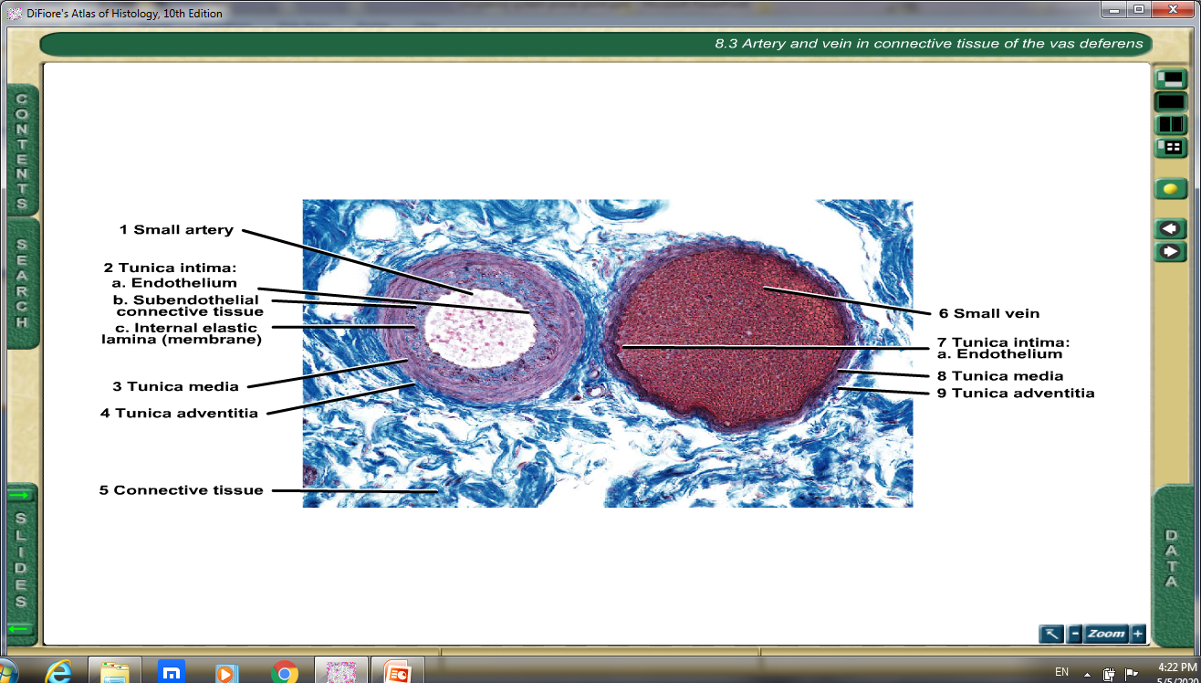

Slide 7
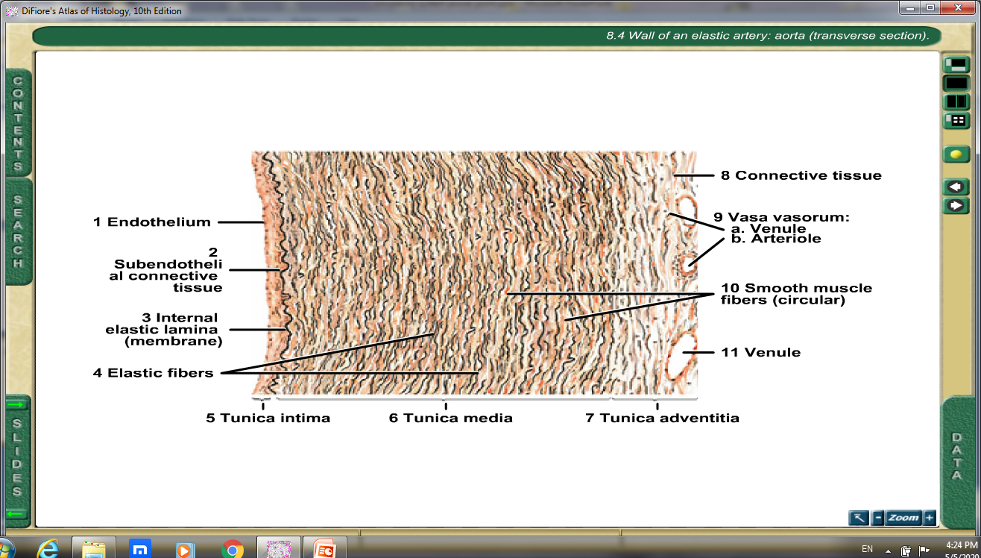

Slide 8
