Slide 1


Practical Human Anatomy and Histology
Lab. 2
first stage
Department Of Clinical Laboratory Sciences

Slide 2
Learning Objectives
1-Preparation of tissue glass slide.
2- Identification of various epithelial tissue slides.
3- Identification of various connective tissue slides (including cartilage and bone).
4- Identification of muscular tissue slides (skeletal, cardiac, smooth).

Slide 3
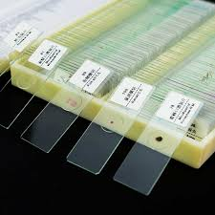
Preparation of tissue glass slide

Slide 4
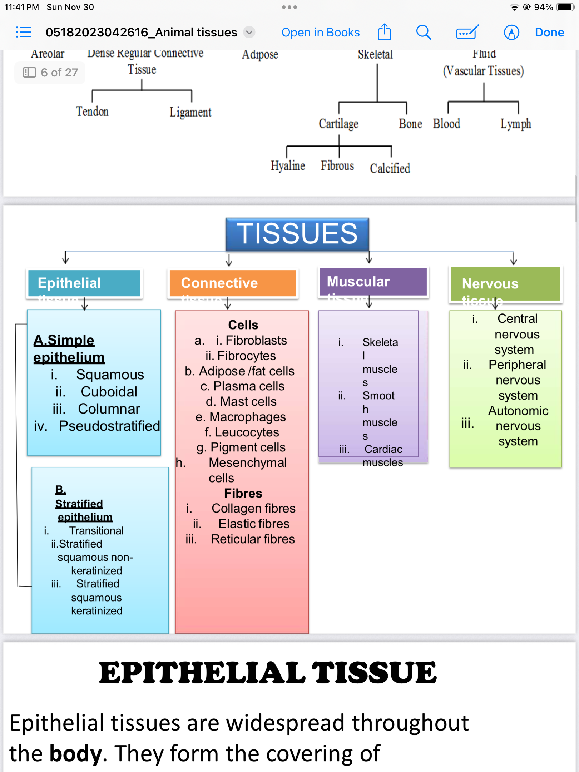
Tissues of Human body:

Slide 5
Epithelial Tissues:
Epithelial tissues are widespread throughout the body. They form the covering of all body surfaces, line body cavities and hollow organs, and are the major tissue in glands.
Function:
i. Protection
ii. Secretion
iii. Absorption
iv. Forms glands & ducts
Epithelium can be simple or stratified

Slide 6
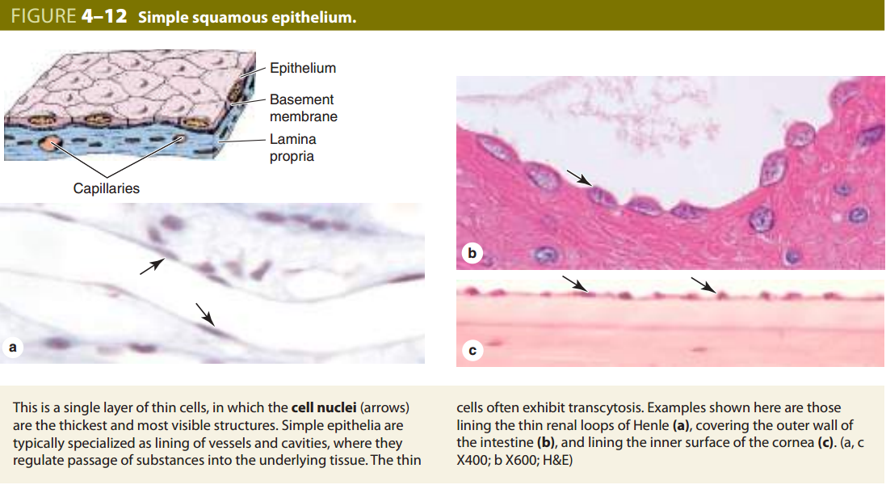

Slide 7
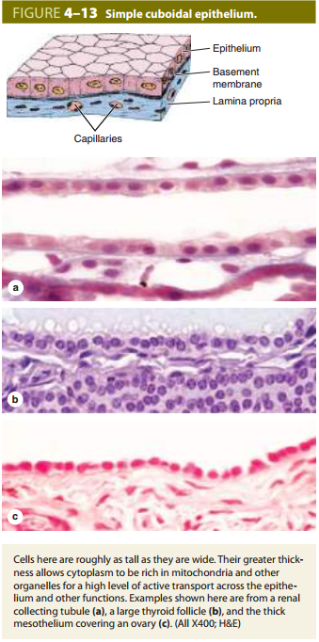
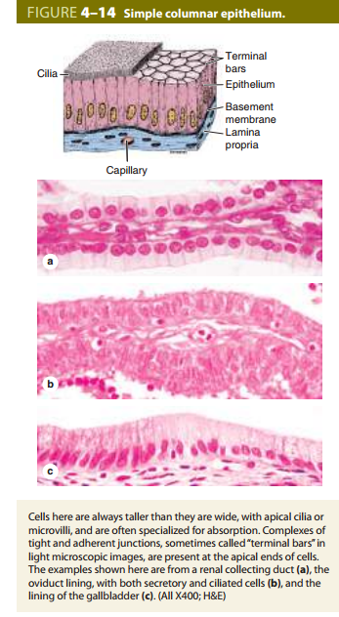

Slide 8
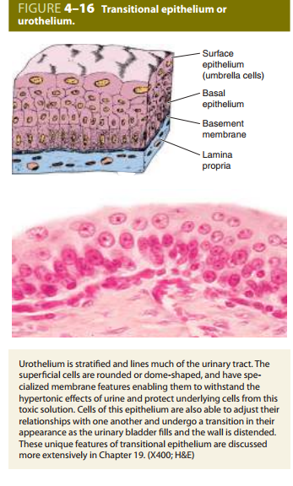
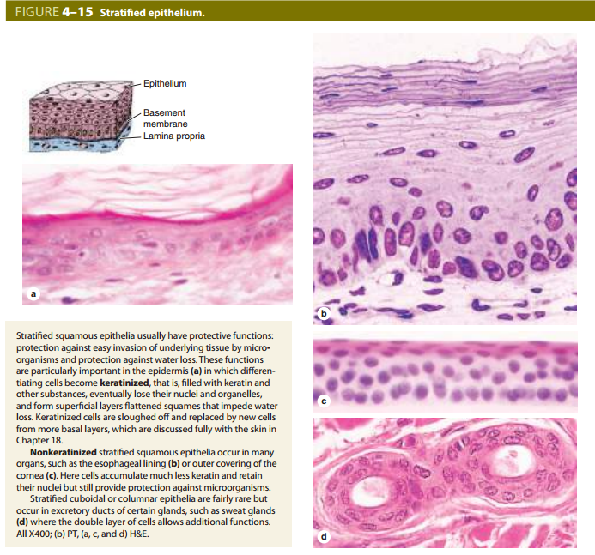

Slide 9
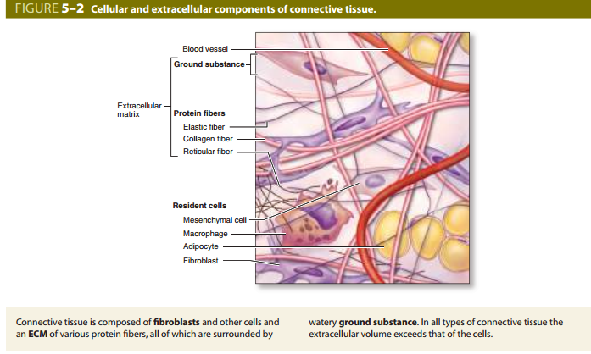
Connective Tissue
provides support, binds together, and protects tissues and organs of the body.
Connective tissue consists of three main components: cells, protein fibers, and an amorphous ground substance.

Slide 10
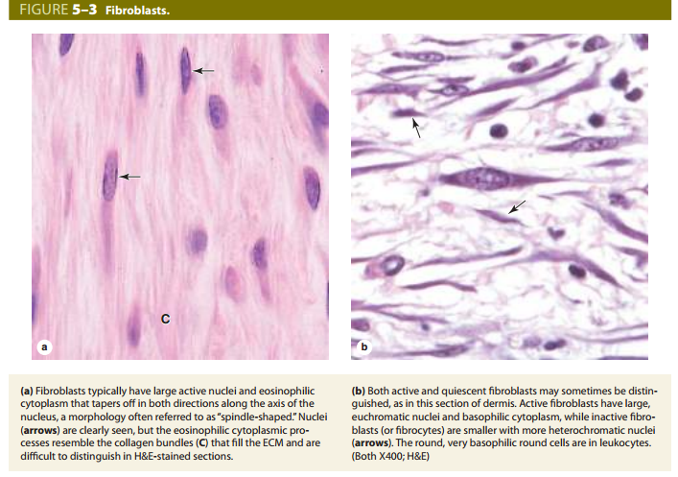
Cells of connective tissues
divided into two types:
1- Fixed cells
2- Transient cells
Fixed Cells:
are normal components of connective tissue.
1-Fibroblasts
produce and maintain the extracellular matrix. They are the most common cell type in connective tissue.

Slide 11
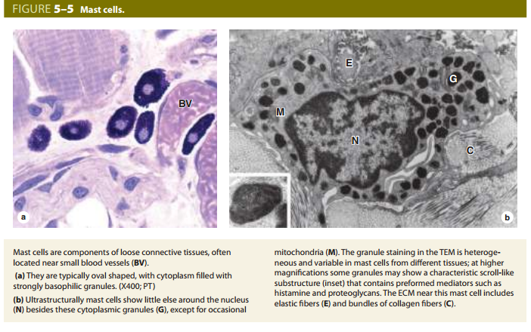
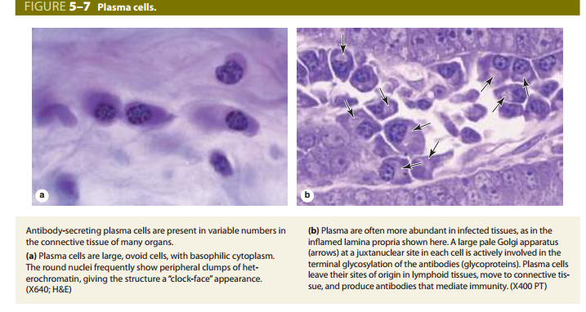

Slide 12
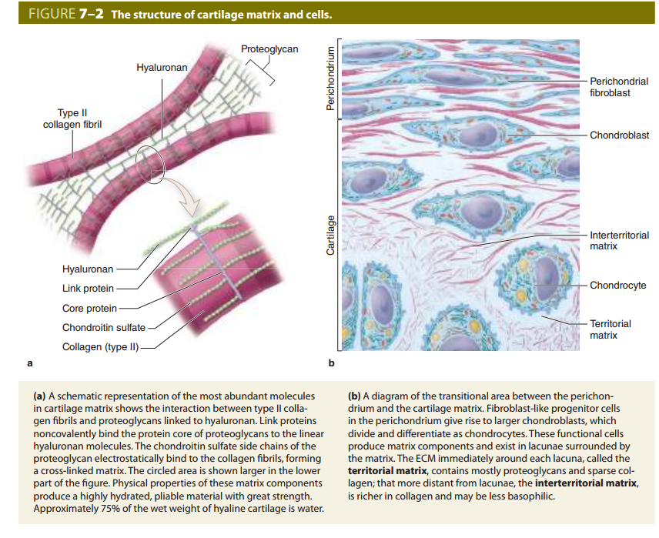

Slide 13
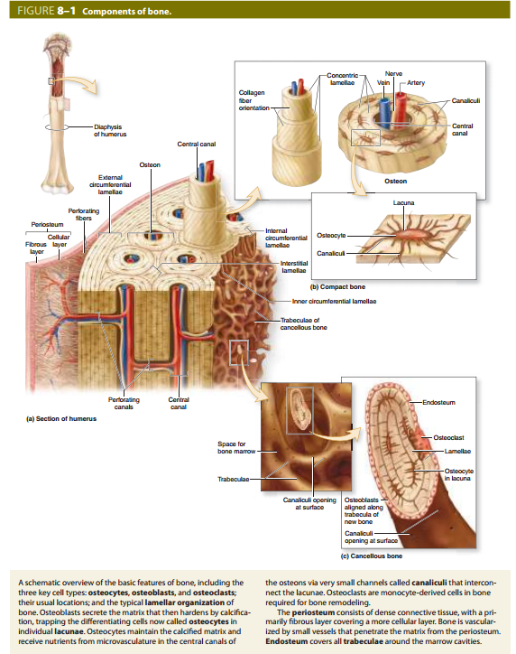

Slide 14
Muscular Tissue:
There are three types of muscles:
Skeletal muscle- e contains bundles of very long, multinucleated cells with cross-striations. e.g. muscles in tongue, diaphragm, eyes, and upper esophagus
b. Smooth muscles- they are present in the viscera e.g. muscle in the wall of stomach.
c. Cardiac muscle- it is seen only in the heart. Contraction of this muscle helps in pumping of blood throughout our body.

Slide 15
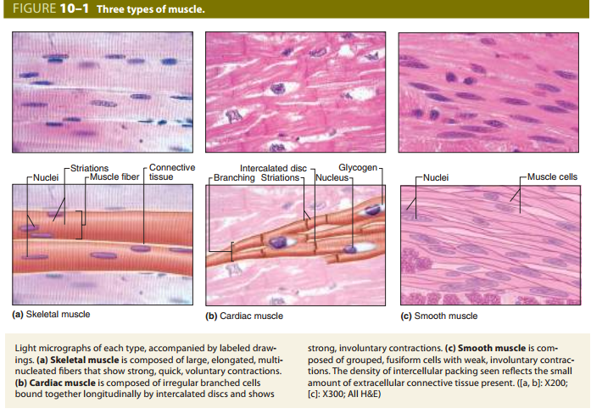

Slide 16
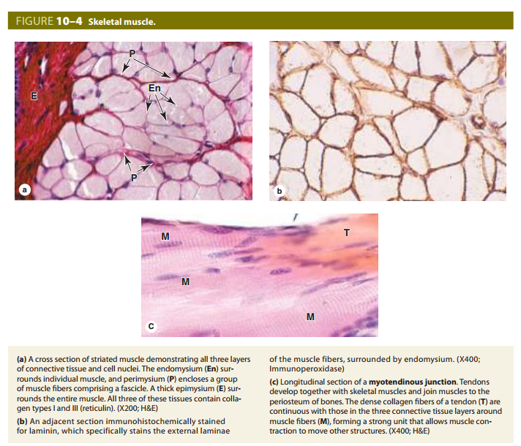

Slide 17
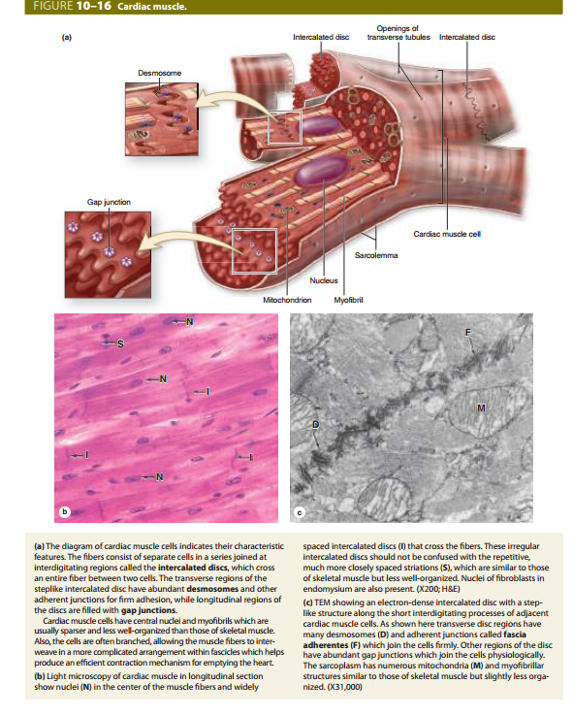

Slide 18
