Slide 1
جامعة بغداد
كلية التربية للعلوم الصرفة/ابن الهيثم
قسم علوم الحاسبات
المرحلة الاولى
تركيـــــب الحاســـــــــــــوب
2024 – 2025
المحاضره الرابعة
Data Storage
أ.م.سميره شمس

Slide 2
Data Storage
Classified according to the access method:
Sequential Access Media is a storage system where the data is stored and read in a fixed order. One example of this is video cassette.
Random-access media is a form of computer data storage; allow stored data to be accessed directly in any random order such as hard disks, floppy disk, CD, and DVD.

Slide 3
1- Hard Disk
Is a data storage device used for storing and retrieving digital information using rapidly rotating disks (platters) coated with magnetic material. HD retains its data even when powered off, it is found in the basic unit of compute (case) that is built –into the system unit.
HD consists of one or more rigid ("hard") rapidly rotating disks (platters) with magnetic heads arranged on a moving actuator arm to read and write data to the surfaces.
The hard disk platters spin at a high rate of speed, typically 5400 to 7200 revolutions per minute (RPM). Storage capacities of hard disks for personal computers range from 10 GB to 120 GB (one billion bytes are called a gigabyte).

Slide 4
Hard Disc contains mechanical and electronic parts:
Mechanical parts:
One Platter or several platters coated with magnetic material.
Reading and writing heads.
Arm holds the Reading and writing heads.
Mechanical system to move the arm.
Motor to rotate the platters.
Electronic Parts: Is electronic panel on the down of hard disk, and responsibility of this section is control of reading and writing process on the hard disk and also control the motor which rotates platters

Slide 5
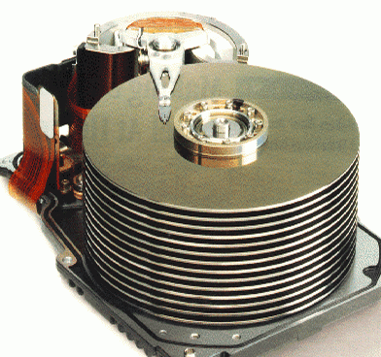
Hard Disk
Data storage on the platters, when an increases the number of platters, increases the storage Capacity of hard disk. The platters made of aluminum and the modern platter made ​​from glass-reinforced ceramic which is the best performance to resistance of high temperatures. For each platter content two reading and writing heads, one for read and other for write which their location one of the down of platter and the other on the top of platter.

Slide 6
2-Compact Disc
A compact disk (CD), also called an optical disc, is a flat round, portable storage. It is a small plastic disc used for the storage of digital data, covered with a transparent coating so that it can be read by a laser beam. It is popular because low cost and easy to use. The capacity of a CD-ROM is 650 MB of data or about 70 minutes of audio.
A CD player has three major mechanical components:
Drive motor:
The drive motor rotates the disc between 200 and 500 revolutions per minute.
B. Laser and lens system: Reads the information using a laser beam.

Slide 7
C. Tracking mechanism:
Their function is to move the laser system so that the laser beam to trace the spiral path, and must be the accuracy of this system is very high so you can move the laser system.
The stored data on the disc is convert to the sets of data that can be handled, and then send it to Digital to Analogue Converter (DAC). The main function of the cylinder operator is the focus of the laser beam on the data path, when the laser beam reaches to the cylinder passes through a layer of plastic and then reflected when it collides with a layer of aluminum. When reflected the laser beam 1, and when the laser beam not reflect 0.

Slide 8
