Slide 1
جامعة بغداد
كلية التربية للعلوم الصرفة/ابن الهيثم
قسم علوم الحاسبات
المرحلة الاولى
تركيـــــب الحاســـــــــــــوب
2025-2024
المحاضرة الاولى
أ.م. سميره شمس

Slide 2
Introduction
Computer are everywhere: at work, at school, and the home. People use all types and sizes of computers for a variety of reasons and in a range of places. While some computers sit on top of a desk or on the floor, mobile computers and mobile devices are small enough to carry. Mobile devices, such as many cell phones, often are classified as computers. Computers are a primary means of local and global communication for billions of people.

Slide 3
Introduction
Consumers use computers to correspond with businesses, employees with other employees and customers, students with classmates and teachers, and family members and military personnel with friends and other family members. In addition to sending simple notes, people use computers to share photos, drawings, documents, calendars, journals, music, and videos.

Slide 4
Introduction
Through computers, society has instant access to information from around the globe. Local and national news, weather reports, sports scores, airline schedules, telephone directories, maps and directions, job listings, credit reports, and countless forms of educational material always are accessible. From the computer, you can make a telephone call, meet new friends, share opinions or life stories, book flights, shop, fill prescriptions, file taxes, take a course, receive alerts.

Slide 5
Computer Generation
The history of computer development is often referred to in terms of five distinct eras, or "generations" of computing devices. Each generation of computer is characterized by a major technological development that fundamentally changed the way computers operate.

Slide 6
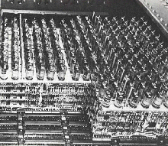
First Generation
The first computers used vacuum tubes for circuitry, magnetic drums and magnetic cores for memory, and were often enormous, taking up entire rooms. They were very expensive to operate and in addition to using a great deal of electricity, generated a lot of heat, which was often the cause of malfunctions.
Vacuum tube processing unit in a first-generation computer

Slide 7
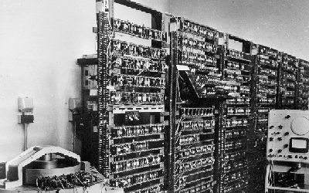
Second Generation
Transistors replaced vacuum tubes and ushered in the second generation of computers. The transistor was far superior to the vacuum tube, allowing computers to become smaller, faster, cheaper, more energy-efficient and more reliable than their first-generation predecessors.

Slide 8
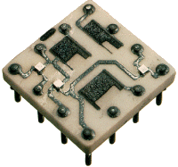
Third Generation
The third generation is characterized by the development of the integrated circuit - a complete electrical circuit whose components (transistors, capacitors,) are put onto a small "chip" made of silicon. Users interacted with third generation computers through keyboards and monitors and interfaced with an operating system, which allowed the device to run many different applications at one time.

Slide 9
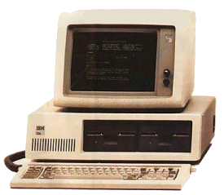
Fourth Generation
The fourth generation computers started with the invention of Microprocessor. The Microprocessor contains thousands of ICs.Which makes it, more powerful and reliable, small in size, fast processing than previous generations.

Slide 10
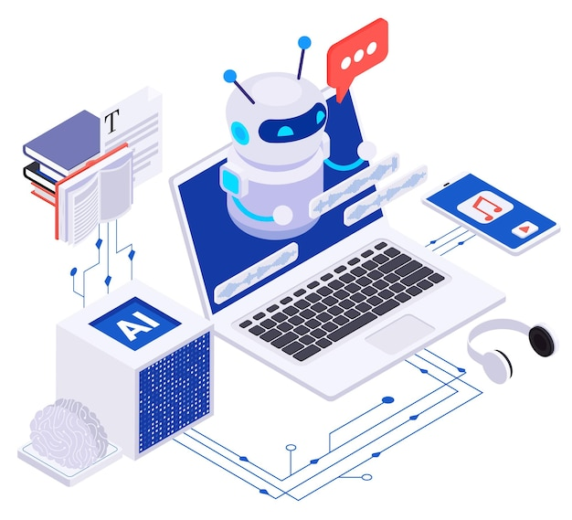
Fifth Generation
The Fifth Generation of Artificial Intelligence and robotics. Increase in speed and storage capacity, and Development in the field of networking.

Slide 11
Definition of computer organization
Computer organization is a study of a Computer Architecture. E.g. Memory, Registers, RAM, ROM, CPU, ALU architecture, what different parts makes a computer.
Data Representation:
Data Representation refers to the methods used internally to represent information stored in a computer. Computers store lots of different types of information:
Numbers.
Text.
Graphics of many varieties (stills, video, animation).
Sound.

Slide 12


Memory Structure in Computer
Memory consists of bits (0 or 1)
a single bit can represent two pieces of information
bytes (=8 bits)
a single byte can represent 256 = 2×2×2×2×2×2×2×2 $=2^{8}$
Unit | Abbreviation | Pronounced | Approximate Value (bytes) | Actual Value (bytes)
Kilobyte | KB | Kill-uh-bite | 1,000 | $$2^{10}=1,024$$
Megabyte | MB | Mehg-uh-bite | 1,000,000 1 million | 1,048,576 1024k =$2^{10}.2^{10}=2^{20}$
Gigabyte | GB | Gig-uh-bite | 1,000,000,000 1 billion | 1,073,741,824
Terabyte | TB | Terr-uh-bite | 1,000,000,000,000 1 trillion | 1,009,511,627,776

Slide 13
Binary Number
Normally we write numbers using digits 0 to 9. This is called decimal numbers (base10). However, any positive integer (whole number) can be easily represented by a sequence of 0's and 1's. Numbers in this form are said to be binary numbers in (base 2).
Decimal numbers use a positional system based on powers of 10 to indicate their value. The number 1 2 3 is really 1 hundred +2 tens + 3 ones. The value of each position is determined by ever-higher powers of 10, read from left to right.
Base 2 works the same way, just with different powers. The number 101 in base 2 is really 1 four + 0 twos +1 one (which equals 5 in base 10).

Slide 14
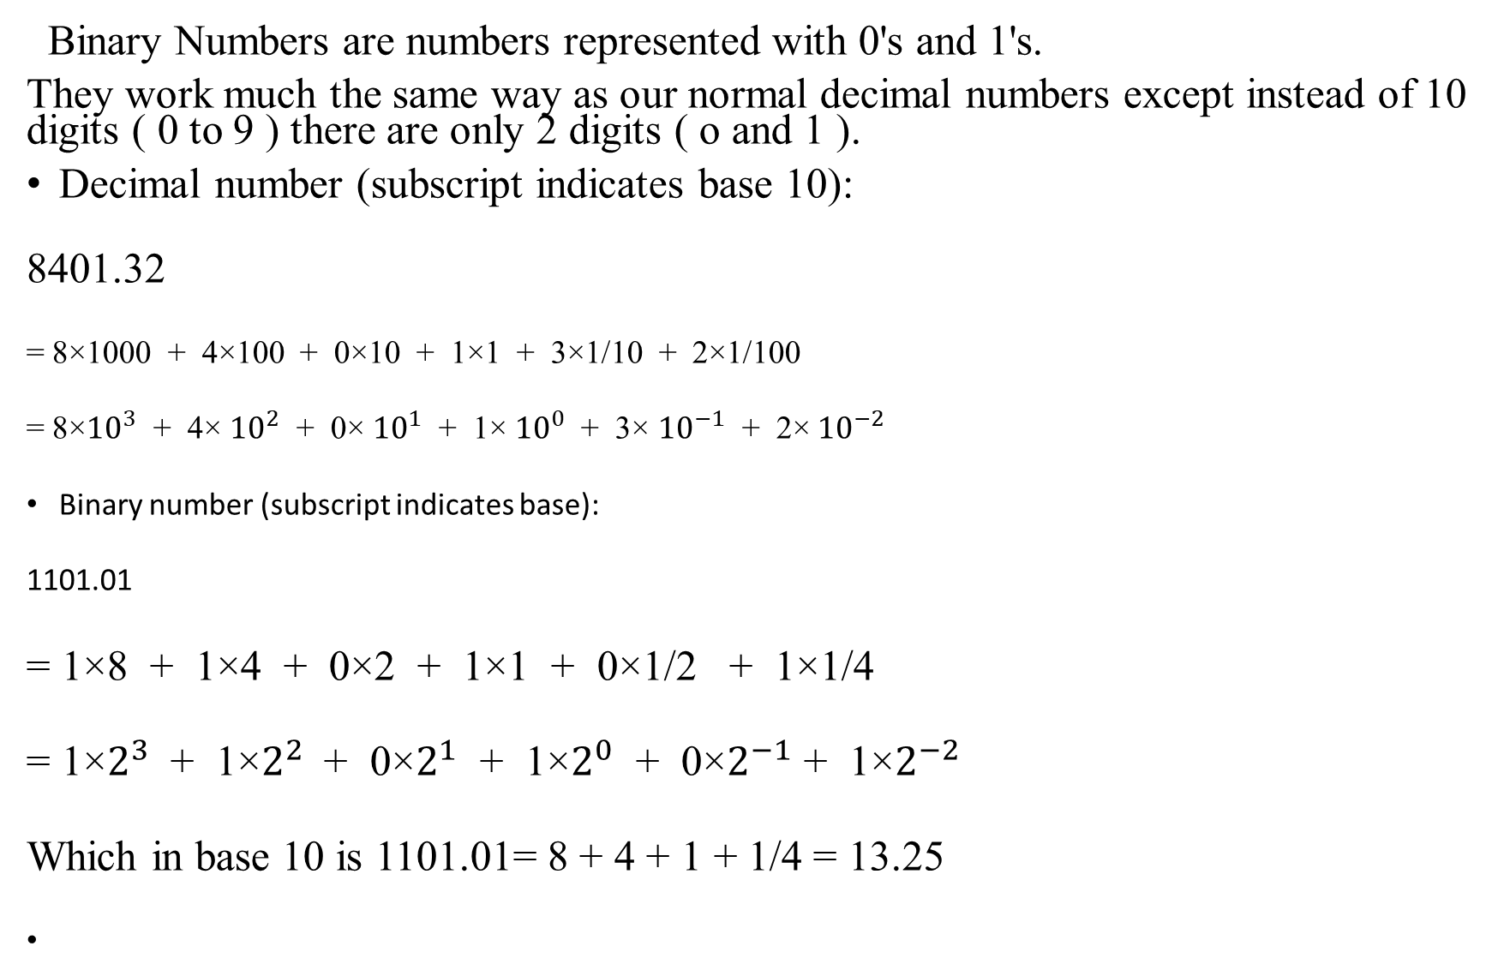
Binary Representation of Numbers
Binary Numbers are numbers represented with 0's and 1's.
They work much the same way as our normal decimal numbers except instead of 10 digits ( 0 to 9 ) there are only 2 digits ( o and 1 ).
Decimal number (subscript indicates base 10):
8401.32
= 8×1000 + 4×100 + 0×10 + 1×1 + 3×1/10 + 2×1/100
= 8×${10}^{3}$ + 4× ${10}^{2}$ + 0× ${10}^{1}$ + 1× ${10}^{0}$ + 3× ${10}^{−1}$ + 2× ${10}^{−2}$
Binary number (subscript indicates base):
1101.01
= 1×8 + 1×4 + 0×2 + 1×1 + 0×1/2 + 1×1/4
= 1×$2^{3}$ + 1×$2^{2}$+ 0×$2^{1}$ + 1×$2^{0}$ + 0×$2^{−1}$ + 1×$2^{−2}$
Which in base 10 is 1101.01= 8 + 4 + 1 + 1/4 = 13.25

Slide 15
Text
Text can represented easily by assigning a unique numeric value for each symbol used in the text. For example, the widely used ASCII code (American Standard Code for Information Interchange) defines 128 different symbols and assigns to each a numeric code between 0 and 127.
In ASCII, an "A" is 65, "B" is 66, "a" is97, "b" is 98, and so forth. When you save a file as plain text", it is stored using ASCII.
ASCII format uses 1 byte per character 1byte gives only 256 (128 standard and non-standard) possible characters. The code value for any character can be
Converted to base 2 so any written message made up of ASCII characters can be converted to a string of 0ʹs and 1ʹs.

Slide 16
Graphics
Graphics that are displayed on a computer screen consist of pixels: the tiny"dots " of color that collectively"paint " a graphic image on a computer screen.
The pixels are organized into many rows on the screen. In one common configuration, each row is 640 pixels long, and there are 480 pixel colomn.
Another configuration (and the one used on the screens in the lab) is 800 pixels per row with 600 colomn, which is referred to as a " resolution of 800×600". Each pixel has two properties: its location on the screen and its color.

Slide 17
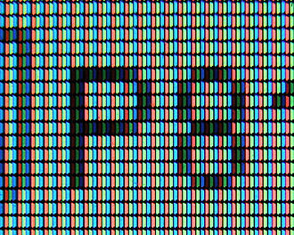
Graphics
A pixel's color is represented by a binary code, and consists of a certain number of bits. Ina monochrome (black and white) image, only 1 bit is needed per pixel: 0 for black, 1 for white, for example. A 16 color image requires 4 bits per pixel. Modern display hardware allows for 24 bits per pixel, which provides an astounding array of 16.7 million possible colors for each pixel.

Slide 18
المـصــادر
1- Introduction to computers for Peter Norton’s 2003
2- THE INTEL MICROPROCESSORS 8086/8088, 80186/80188, 80286, 80386, 80486, Pentium, Pentium Pro Processor, Pentium II, Pentium III, Pentium 4,
and Core2 with 64-Bit Extensions Architecture, Programming, and Interfacing
Eighth Edition BARRY B. BREY 2009.
3- "Fundamentals of computer organization and architecture"
By John wiley & Sons, 2005.
4- "Fundamentals of computer organization and architecture"
By John wiley & Sons, 2015.
5- Introduction to computers for Peter Norton’s 2014.

