Slide 1
جامعة بغداد
كلية التربية للعلوم الصرفة/ابن الهيثم
قسم علوم الحاسبات
المرحلة الاولى
تركيـــــب الحاســـــــــــــوب
2025-2024
المحاضرة الثانية
أ.م. سميره شمس

Slide 2
Computer Architecture
Definitions of Computer:
A computer is an electronic device, operating under the control of instructions stored in its own memory that can accept data, process the data according to specified rules, produce results, and store the results for future use.
Data and Information:
Computers process data into information. Data is a collection of unprocessed items, which can include text, numbers, images, audio, and video. Information conveys meaning and is useful to people

Slide 3
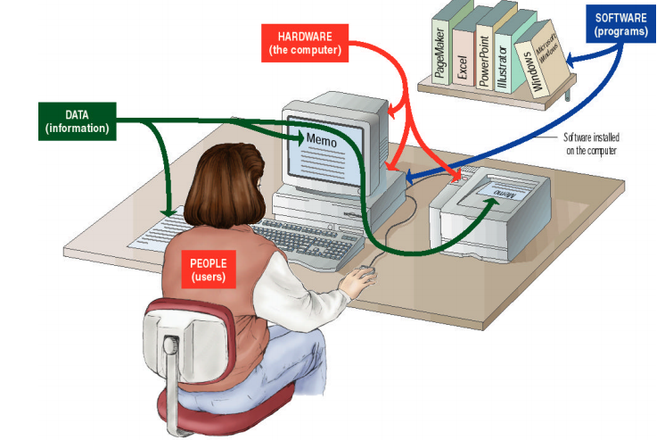
Complete Computer System consists of four parts:
1- Hardware 2- Software 3- Users, and Data
Hardware: is any part of the computer you can touch, such as (Disk, CD, CPU, Memory, I /O Device).
Software: is a set of instructions that tells the computer what to do and how to do it, such as (Word Processing, Computer Games and programs.
Users: Are people who use the software on the computer to do some tasks.
Data: consists of individual facts or bits of information, the computer reads and stores data of all kinds, words, number, images or sound.

Slide 4
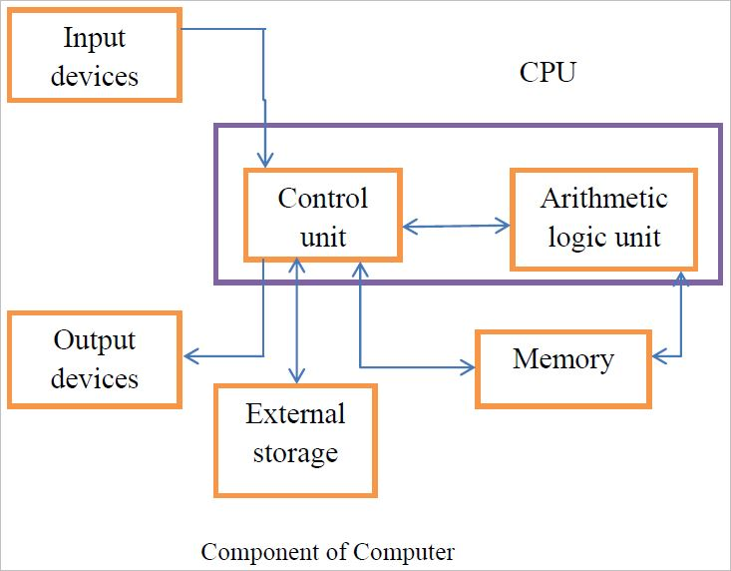
Central Processing Unit(CPU)
Every PCʹs system unit contains at least one chip called microprocessor or CPU, attached on the motherboard, to perform computer processing. The CPU follows the instructions of the software (or a program) to process data producing information.

Slide 5
Parts of CPU
A- Arithmetic and Logic Unit (ALU):
Performs arithmetic operations such as (Addition, subtraction, multiplication and division) and logical operations such as (OR, AND, XOR) and controls the speed of those operations.

Slide 6
B- Control Unit
The control unit has the following functions:
1- Read and interpret program instructions.
2- Directing operations inside the CPU.
3- Control the flow of data and instructions to and from main memory and input and output controllers units.

Slide 7
Parts of CPU
C- Register:
Fast memory used for storing the numbers in processor that he wants to perform his calculations, the arithmetic and logic unit cannot perform any mathematical operation only after bringing the numbers that wants conducting operations on them to register.
The register size is very important because determined data size that can the computer conducting the calculating, the size can be 32 bit or 64 bit.

Slide 8
2- Memory
Is like an electronic scratch pad inside the computer. When you launch a program it is loaded into and run form memory. Data used by the program is also loaded into memory for fast access.
As new data is entered into the computer it is also stored in memory _ but only temporarily. The most common type of memory is called random access memory, or RAM.

Slide 9
3- Input and output devices (I\O devices):
A computer would be useless if you could not interact with it because the machine could not receive instruction or deliver the results of its work.
Input devices accept data and instructions from the users or from another computer system (such as a computer on the Internet).
Output devices return processed data to the user or to another computer system.

Slide 10
4- Storage device
The computer needs a place to keep program files and related data when they are not in use. The purpose of storage is to hold data permanently. Computer users often confuse storage with memory, although the functions of storage and memory are similar, they work in different ways.

Slide 11
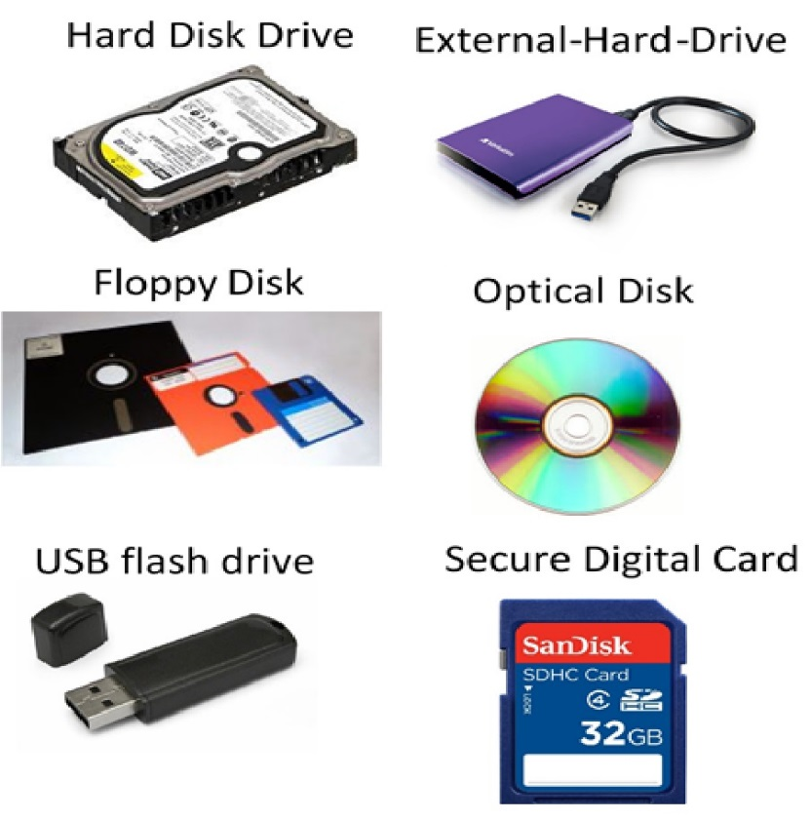
There are three major distinctions between storage and memory:
1-There is more room in storage than in memory.
2- Contents are retained in storage when the computer is turned off, whereas the program or the data you put into memory disappear when you shut down the computer.
3- Storage is very slow compared to memory, but it is much cheaper than memory.

Slide 12
The Bus
A bus is a path between the components of computers. There are two main buses in computer: the internal (or system) bus and the external (or expansion) bus.
The system bus resides the motherboard and connects the CPU to other devices that reside on the motherboard.
An expansion bus connects external devices, such as the keyboard, mouse, modem, printer, and so on, to the CPU. Cables from disk drives and other internal devices are plugged into the bus. The system bus has two parts: the data bus and the address bus.

Slide 13
The Data Bus
The data bus is an electronic path that connects the CPU, memory, and the other hardware devices on the motherboard. The bus is a group of parallel wires.
The number of wires in the bus affects the speed, at which data can travel between hardware components, because each wire can transfer 1 bit of data at a time, an 8-wire bus can move 8 bits at a time. A 16-bit bus can transfer 2 bytes, and a 32-bit bus can transfer 4 bytes at a time

Slide 14
Newer model computers have a 64-bit data bus, which transfers 8 bytes at a time.
However, buses now are also being measured according to their data transfer rates the amount of data they can transfer in a seconds. The performance of computer buses usually is measured in megabits per second (Mbps) or megabytes per second (Mbps).

Slide 15
The Address Bus
The Address Bus is a set of wires similar to the data bus. The Address Bus connects only the CPU and RAM and carries only memory addresses. Each byte in RAM is associated with a number, which is it memory address.
We have another type of bus is a Control bus to transmits control signals between different parts of the computer.

Slide 16
Machine Cycles
Each time the CPU executes an instruction, it takes a series of steps. The completed series of steps is called a machine cycle itself can be divided into parts:
the instruction cycle and the execution cycle.
At the beginning of the machine cycle (that is, during the instruction cycle), the CPU takes two steps:
Fetching: before the CPU can execute an instruction, the control unit must retrieve (or fetch) a command or data from the computer’s memory.
Decoding: before a command can be executed, the control unit must break down (or decode) the command into instructions that correspond to those in the CPU’s instruction set.

Slide 17
At this point, the CPU is ready to begin the execution cycle:
Executing: the CPU executes a command.
Storing: the CPU may be required to store the results of an instruction in memory (but this condition is not always required).
Depending on the type of processor in use, a machine cycle may include other steps. Although the process is complex, the computer can accomplish it an incredible speed, translating millions of instructions every second.

Slide 18
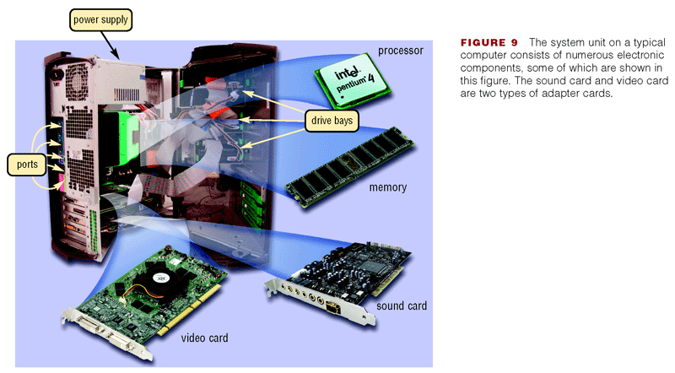
Mother Board
A motherboard is the physical arrangement in a computer that contains the computer's basic circuitry and components. On the typical motherboard, the circuitry is affixed to the surface of a firm planar surface. The computer components included in the motherboard are processor, Memory, basic input/output system (BIOS), VGA and audio.

Slide 19
Mother Board
The motherboard provides many jobs where the
1- distribution of electrical energy from power supply to the parts that are installed it
2- provide connectors (Ports) for each of the keyboard and mouse, printer, etc.
3- The basic function of the motherboard is acting as communication environment and basic connections for all components where pass through the data and information to move from one part to another of the components of the device.

Slide 20
Ports
is a connection point or interface between a computer and an external or internal device. Internal ports may connect such devices as hard drives and CD ROM or DVD drives; external ports may connect modems, printers, and other devices.
Types of computer ports include:
1- Serial Ports: send and receive one bit at a time via a single wire pair such as modem, mouse.
2- Parallel Ports: send multiple bits at the same time over several sets of wires such as printer.
The main difference between a serial and parallel port is the way information is communicated: a parallel port is only able to transfer information from the hard drive, while a serial port can transfer information both to and from a hard drive..

Slide 21
Ports
3- Industry Standard Architecture (ISA): is a computer bus standard for IBM compatible.
4- Universal Serial Bus (USB) Ports: the most common type of computer port used in today's computers. It can be used to connect keyboards, , game controllers, printers, scanners, digital cameras, and removable media drives can be used to connect many devices including all previously mentioned plus keyboards, scanners.

Slide 22
Ports
5- Accelerated Graphics Port: The Accelerated Graphics Port (AGP) is a high-speed point-to-point channel for attaching a video card to a computer's motherboard, primarily to assist in the acceleration of 3D computer graphics.
It is designed especially for the throughput demands of 3-D graphics.
6- Peripheral Component Interconnect (PCI): is a computer bus for attaching hardware devices in a computer. These devices can take either the form of an integrated circuit fitted onto the motherboard itself.

Slide 23
Interface
In computer technology, there are several types of interface:
1- User interface – the keyboard, mouse, menus of computer system. The user interface allows the user to communicate with the operating system.
2- Software interface – the language and codes that the applications use to communicate with each other and with the hardware.
3- Hardware interface – the wires, plugs and sockets that hardware devices use to communicate with each other.

