Slide 1
Chemical Safety and
Security
Fourth Lecture
First stage
First semester
2023 -2024
Assistant professor:
Wasan abdul Razzaq Ruaa Muhammed Dhedan

Slide 2
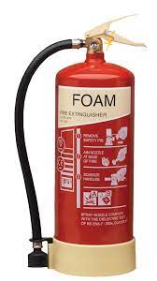
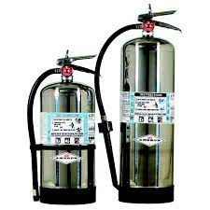
Chemical safety rules
2- Foam extinguishers (cream label)
The foam smothers the fire in solids and liquids (Class A and B), but not in burning fats or cooking oils (Class F), so foam fire extinguishers are used on burning liquids such as petrol, paint or turpentine. A foam extinguisher can also be used on some electrical fires if they have been tested and if fired from 1 meter away.
Asst. Prof. Wasan abdul Razzaq Asst. Prof. Ruaa Muhammed Dhedan

Slide 3
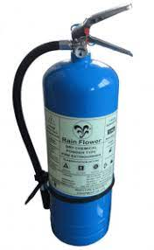
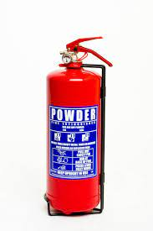
3-Dry powder extinguishers (blue label)
Powder fire extinguishers are used for fighting burning solids, liquids and gases (Class A, B and C fires). Specialist powder extinguishers are designed to tackle type D fires involving combustible metals such as lithium, magnesium, or aluminum.
They work by the powder forming a crust which smothers the fire and stops it from spreading.
Asst. Prof. Wasan abdul Razzaq Asst. Prof. Ruaa Muhammed Dhedan

Slide 4
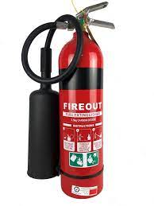
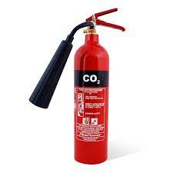
4- CO2 extinguishers (black label)
These contain only pressurised carbon dioxide gas and therefore leave no residue. Carbon Dioxide (CO2) extinguishers are used on fires involving burning liquids (Class B), and electrical fires, such as of large computer equipment, so are practical in offices. CO2 works by suffocating the fire and does not cause damage to the electrical items or cause the system to short circuit.
Asst. Prof. Wasan abdul Razzaq Asst. Prof. Ruaa Muhammed Dhedan

Slide 5
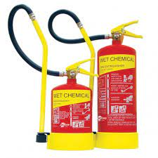
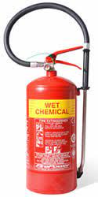
5- Wet chemical extinguishers (yellow label)
These are the only extinguishers apart from water mist suitable for Class F oil fires (fats and cooking oils) and are mainly used in kitchens with deep fat fryers. They can also be used on Class A and some can be used on Class B fires
Asst. Prof. Wasan abdul Razzaq Asst. Prof. Ruaa Muhammed Dhedan

Slide 6
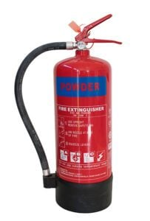
A dry powder fire extinguisher Which fire extinguisher types to use
• Class A fire extinguisher – water, water mist, foam, dry powder, wet chemical.
• Class B fire extinguisher – water mist, foam, dry powder, CO2, some wet chemical
• Class C fire extinguisher – water mist, dry powder
• Class D fire extinguisher – specialist dry powder
• Electrical fire extinguisher – CO2
• Class F fire extinguisher – water mist, wet chemical.
Asst. Prof. Wasan abdul Razzaq Asst. Prof. Ruaa Muhammed Dhedan

Slide 7
Fire extinguishers for electrical fires
For electrical fires, CO2 fire extinguishers should be used. By displacing the oxygen in the air, they help to suffocate the fire and prevent it from spreading while leaving no residue, making them harmless to electrical equipment.
Fire blankets, hoses, and buckets.
Asst. Prof. Wasan abdul Razzaq Asst. Prof. Ruaa Muhammed Dhedan

Slide 8
Thank you

