Slide 1
Chemical Safety and
Security
First stage
First semester
2023 -2024
Assistant professor:
Wasan abdul Razzaq Ruaa Muhammed Dhedan

Slide 2
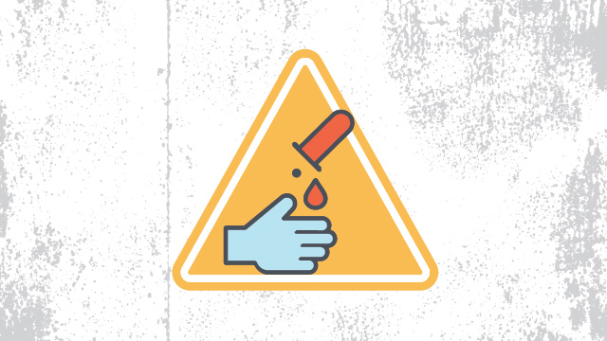
Occupational safety and health
Chemical safety rules
Asst. Prof. Wasan abdul Razzaq Asst. Prof. Ruaa Muhammed Dhedan
Chemical safety rules
Since almost every lab uses chemicals of some sort, chemical safety rules are a must. Following these policies helps employees avoid spills and other accidents, as well as damage to the environment outside of the lab. These rules also set a clear procedure for employees to follow in the event that a spill does occur, in order to ensure it is cleaned up properly and injuries are avoided.

Slide 3
Every chemical should be treated as though it were dangerous.
Do not allow any solvent to come into contact with your skin.
All chemicals should always be clearly labeled with the name of the substance, its concentration, the date it was received, and the name of the person responsible for it.
Before removing any of the contents from a chemical bottle, read the label twice.
Never take more chemicals from a bottle than you need for your work.
Asst. Prof. Wasan abdul Razzaq Asst. Prof. Ruaa Muhammed Dhedan

Slide 4
General lab safety rules
Do not put unused chemicals back into their original container.
Chemicals or other materials should never be taken out of the laboratory.
Chemicals should never be mixed in sink drains.
Flammable and volatile chemicals should only be used in a fume hood.
If a chemical spill occurs, clean it up right away.
Ensure that all chemical waste is disposed of properly.
Asst. Prof. Wasan abdul Razzaq Asst. Prof. Ruaa Muhammed Dhedan

Slide 5
Chemistry lab safety rules
As chemistry labs are one of the most common types, these basic chemistry lab safety rules are relevant to many scientists, dealing with the safe performance of common activities and tasks in the average chemistry lab:
Before you start an experiment, make sure you are fully aware of the hazards of the materials you'll be using.
When refluxing, distilling, or transferring volatile liquids, always exercise extreme caution.
Always pour chemicals from large containers to smaller ones.
Never pour chemicals that have been used back into the stock container.
Never tap flasks that are under vacuum.
Chemicals should never be mixed, measured, or heated in front of your face.
Water should not be poured into concentrated acid. Instead, pour acid slowly into water while stirring constantly. In many cases, mixing acid with water is exothermic.
Asst. Prof. Wasan abdul Razzaq Asst. Prof. Ruaa Muhammed Dhedan

Slide 6
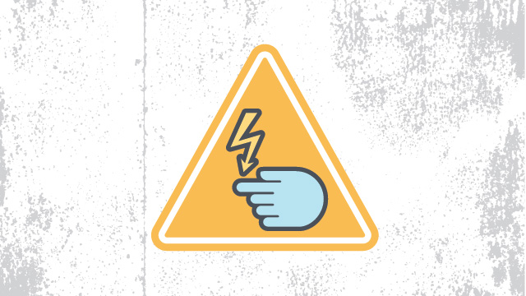
Electrical safety rules
Like almost every other workplace, laboratories contain electronic equipment. Electrical safety rules help prevent the misuse of electronic instruments, electric shocks and other injuries, and ensure that any damaged equipment, cords, or plugs are reported to the appropriate authorities so they can be repaired or replaced.
Asst. Prof. Wasan abdul Razzaq Asst. Prof. Ruaa Muhammed Dhedan

Slide 7
Before using any high voltage equipment (voltages above 50Vrms ac and 50V dc), make sure you get permission from your lab supervisor.
High voltage equipment should never be changed or modified in any way.
Always turn off a high voltage power supply when you are attaching it.
Use only one hand if you need to adjust any high voltage equipment. It's safest to place your other hand either behind your back or in a pocket.
Make sure all electrical panels are unobstructed and easily accessible.
Whenever you can, avoid using extension cords.
Asst. Prof. Wasan abdul Razzaq Asst. Prof. Ruaa Muhammed Dhedan

Slide 8
Thank you

