Slide 1
Communication with a patient’s family

Slide 2
COMMUNICATION is one of the most powerful tools in
MEDICINE

Slide 3
Important notes
HUMAN BODY is a set of interrelated systems : change in one system can result in changes in the other systems.
Similarly , a person’s medical problems and illness have an impact on other systems that person inhabits , of which the FAMILY is probably the most significant
GOOD medical care partly depends on our ability to communicate effectively with patients.
In almost all cases, we also have to communicate with the patient’s family and, occasionally with other relatives or friends.

Slide 4
Important notes
we need to consider their views and beliefs as these may influence those of the patient.
Some of the important issues that may arise when dealing with a patient’s family:
Making an assessment of social support
Family beliefs : affect illness and treatment (non-compliance of treatment).

Slide 5
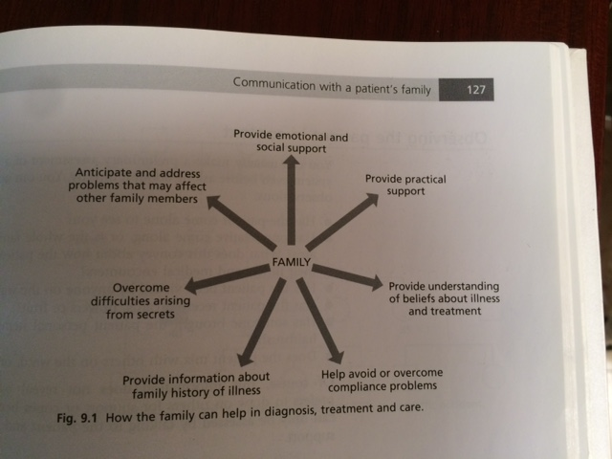

Slide 6
Observing the patient in context
You can usually make a preliminary assessment of a patient’s support system even before asking about it directly. You can make the following observations:
Has the patient come alone to see you?
Has one relative come along, or is the whole family in the waiting area?
Has the patient been visited by anyone on the ward?
Has the patient received cards, flowers or fruit?
Has someone brought the patient personal items( e.g. toothbrush, hairbrush)?
Does the patient mix with others on the ward or remain apart?

Slide 7
Identifying the patient’s family
  Ask about the family and friends to identify those who are most likely to provide practical and emotional support:
  “Whom do you regard as your close family?”
“Are you currently in a relationship with anyone?”
“Who else knows that you are here today?”
“You mentioned a partner: what about other family members such as brothers, sisters, parents ?”

Slide 8
A person who experiences ill health does not do it in a social vacuum

Slide 9
The family’s influence on care and treatment
The patient’s concerns about the course and outcome of the illness are usually influenced by his or her previous experience of illness, by the illness of family and friends, and by commonly held beliefs about the specific illness.
The sick role: sickness make us more dependent on others and hence it can influence our relationships.

Slide 10
Treatment compliance and the role of family beliefs
It is important to address beliefs about illness and care , not only because this can help family members to cope and adjust to changing circumstances and relationships , but also because it may directly affect the patient’s compliance with treatment.
Many times , patients may not follow doctor’s instructions ,or not taking prescribed medications, although they are still coming regularly to see their doctors. The result is a game without end, a source of frustration and annoyance to the doctor. This is sometimes maintained by misunderstanding on the part of the patient, or the doctor not fully appreciating the patient’s and relatives’ views.

Slide 11
To avoid a potential impasse you should: check whether the patient understands the treatment goals and the role of medication. Give the patient the opportunity to ask questions and raise concerns. Also , ask if the relatives have any concerns.

Slide 12
Responding to and managing the concerns and fears of relatives
Each family member will cope with and adjust to a relative’s illness differently, depending on roles in the family. Some family members are better at providing practical rather than emotional support. Others are repelled by the illness, while some families organize a 24-hour vigil and take it in turns to be with the patient at all times.

Slide 13
Relatives are most of the times anxious and make a lot of inquiries which can cause a number of difficulties:
They may approach different members of the care team for information and especially medical students and junior doctors ,which might put them in a difficult situation.
May seek out “different doctors” caring for the patient in a drive to ‘get the truth ’ or a word of hope in a seemingly hopeless situation. This might cause some doctors to give false hope.
They might attempt to control the dissemination of information to others ( including the patient). This will add to the complexity of care and relationships.

Slide 14
Responding to and managing the concerns and fears of relatives(continued)
The ways in which the family responds to illness can also create problems in communication and management . Relatives can:
Not recognize (deny) that a problem exists and so not take appropriate action.
Believe all problems can be solved and take action when it is not necessary or appropriate.
Mishandle a problem by applying the wrong solution .

Slide 15
Guidelines for dealing with a patient’s family
Acknowledge their support.
Speak to them and give them time to raise issues or concerns.
Where possible, provide them with a room where they can be alone.
Identify a care worker (nurse or doctor) whom they can contact. Tell them how they will be contacted if the patient’s health deteriorates.
Before giving information to relatives, first give it to the patient and check whether you have the patient’s permission to discuss it with others.
Ask the patient who in the family can be given what information.

Slide 16
Guidelines for dealing with a patient’s family
7. Write up a summary in the notes of important discussions with relatives so that your colleagues know what has been said to them.
8. Where secrets arise, talk to colleagues about how you might deal with them. As a general rule, remember that the patient decides what information, if any, can be given to others. When in doubt , tell the relatives to ask the patient if you are not free to discuss something with them.
9. If the patient is very unwell, encourage the relatives to make frequent, but short visits.
10. Do not examine the patient (unless a child) in front of relatives.
11. Do not carry out procedures (such as taking blood) in front of relatives. Ask them to leave the room
12. Do not discuss family issues in ward rounds.

Slide 17
Informed Consent

Slide 18
Definition
Informed consent is a process for getting permission before conducting a healthcare intervention on a person.
A health care provider may ask a patient to consent to receive therapy before providing it, or a clinical researcher may ask a research participant before enrolling that person into a clinical trial.
Informed consent is collected according to guidelines from the fields of medical ethics and research ethics.

Slide 19
Who can give informed consent?
An informed consent can be said to have been given based upon a clear appreciation and understanding of the facts, implications, and consequences of an action.
Impairments to reasoning and judgment that may prevent informed consent include basic intellectual or emotional immaturity, high levels of stress such as PTSD or a severe intellectual disability, severe mental illness, intoxication, severe sleep deprivation, Alzheimer's disease, or being in a coma.

Slide 20
What if the patient is unable to give informed consent?
Some acts can take place because of a lack of informed consent.
In cases where an individual is considered unable to give informed consent, another person is generally authorized to give consent on his behalf, e.g., parents or legal guardians of a child (though in this circumstance the child may be required to provide informed assent) and conservators for the mentally ill.

Slide 21
In cases where an individual is provided insufficient information to form a reasoned decision, serious ethical issues arise.

Slide 22
Elements of valid informed consent
For an individual to give valid informed consent, three components must be present: disclosure, capacity and voluntariness.
While Disclosure requires the doctor to supply the patient with the information necessary to make an autonomous decision, the doctor must ensure that patient has adequate comprehension of the information provided. This latter requirement implies that the consent form be written in lay language suited for the comprehension skills of subject population, as well as assessing the level of understanding during the meeting.

Slide 23
2- Capacity pertains to the ability of the patient to both understand the information provided and form a reasonable judgment based on the potential consequences of his/her decision.
3- Voluntariness refers to the patient’s right to freely exercise his/her decision making without being subjected to external pressure such as coercion, manipulation, or undue influence.

Slide 24
Competency of the patient
The ability to give informed consent is governed by a general requirement of competency.
In common law jurisdictions, adults are presumed competent to consent.
This presumption can be rebutted, for instance, in circumstances of mental illness or other incompetence.
This may be prescribed in legislation or based on a common-law standard of inability to understand the nature of the procedure.
In cases of incompetent adults, a health care proxy makes medical decisions.
In the absence of a proxy, the medical practitioner is expected to act in the patient's best interests until a proxy can be found.

Slide 25
Competency of the patient
By contrast, 'minors’ (which may be defined differently in different jurisdictions) are generally presumed incompetent to consent, but depending on their age and other factors may be required to provide Informed assent.
In some jurisdictions (e.g. much of the U.S.), this is a strict standard.
In other jurisdictions (e.g. England, Australia, Canada), this presumption may be rebutted through proof that the minor is ‘mature’ (the ‘Gillick standard ).

