Slide 1
SGL / 3rd Year
Immune disturbance module
Immune compromised
(Deficient) patients

Slide 2
Objectives
At the end of this session, students will be able to:
•Define immune compromised patient (ICP).
•Determine the mechanism.
•Identify the causes
•Describe Clinical presentation of ICP
•Mention lab. Investigation
•Outline the principles of treatment.

Slide 3
Case1
•A 30 year old woman presented with fever, chills, sweating, cough, rusty sputum, and right sided pleuritic chest pain.
•O/E Temp.38.3⁰c, Blood
pressure
20 cycle/
110/80mmHg, Respiratory rate
minute, Pulse rate 115beat/minute
•Chest examination revealed signs of Right sided pneumonia.

Slide 4
•Patient gave
relevant
Hx of
recurrent
severe infections in form of pneumonia( 4 episodes), sinusitis( 5 episodes), ear infection ( 3 episodes), skin suppurative lesions (2 episode) and gastroentreritis ( 3 episodes).

Slide 5
Questions
What do you think this patient have?
How to explain her clinical presentation? 3- Mention the causes of her problem.
What other expected clinical features she may develop?
List the basic investigations you would send for.
What are the lines of treatment?

Slide 6
Answers
QUESTION 1:
According to patient Hx who recently has another episodes of pneumonia in addition to her recurrent severe attack of infection at multiple unusual sites. This patient has clinical features suggestive of immune compromised ( deficiency) condition

Slide 7
QUESTION 2
•Fever is a common symptom. The hypothalamus resets in infection, so that heat production and heat loss are balanced in favor of a higher temperature.
•Chills are a secondary symptom associated with fever, developing as a consequence of increased muscular activity that produces heat and raises the body temperature.

Slide 8
• Sweating occurs
when the hypothalamus
returns to its normal set point and senses the higher body temperature, stimulating perspiration to evaporate excess body heat.
• Cough: is the most frequent symptom of respiratory disease and is caused by stimulation of sensory nerves in the mucosa of the pharynx, larynx, trachea and bronchi.

Slide 9
• Sputum: a
mixture of saliva and mucus
coughed up from the respiratory tract, Irritation of the respiratory system causes both inflammation of the air passages and a notable increase in mucus secretion.

Slide 10
• Pleuritic chest pain: Pleurisy (pleuritis) is an
inflammation of the pleura , the lining surrounding the lungs. The inflamed pleural layers rub against each other on lungs expanding to breathe in air or coughing. This can cause sharp pain called pleuritic chest pain.

Slide 11
QUESTION 3
▪The causes of her immune compromised
state is either
Primary immune deficiency:
➢Or secondary immune deficinecy

Slide 12
QUESTION 4
Other C/F this patient may develop:
1) Autoimmune diseases
like SLE
2) Susceptibility to malignancy.
like lymphoma

Slide 13
QUESTION 5
Basic and early investigations are:
• CBC.complete blood count
• Sputum for gram stain and culture and sensitivity
• CXR.
• Blood for complement : C3, C4, and CH50
• Blood for total lymphocyte count
• Serum immunoglobulins & protein and urine electrophoresis

Slide 14
Question 6: Outlines of treatment
Treatment empirical till investigation completed:
IV anti biotic
Infection: Drugs: IV AB, Long-term prophylaxis with antifungal agents, and trimethoprim-sulfamethoxazole.
Abscesses: Surgical drainage
Specific treatment depends upon the nature of the defect.

Slide 15
Immune Deficiency
Immune deficiency: is a state in which the immune system’s ability to fight diseases (mostly infectious diseases) is compromised or entirely absent.
Categorized as either primary disorder (congenital) secondary disorder ( acquired)
Most cases of immunodeficiency are secondary.

Slide 16
Clinical features of immune deficency:
Recurrent infections:
Frequent, severe, by unusual organisms & at unusual sites
Autoimmunity
Susceptibility to malignancy

Slide 17
Causes of immune deficiency :
▪Primary :
Phagocyte deficiency (↓) Complement Pathway ↓ Adaptive immune system (IS) ↓
▪Secondary:
Physiological Infection
Iatrogenic
Malignancy
Biochemical & Nutritional
Others

Slide 18
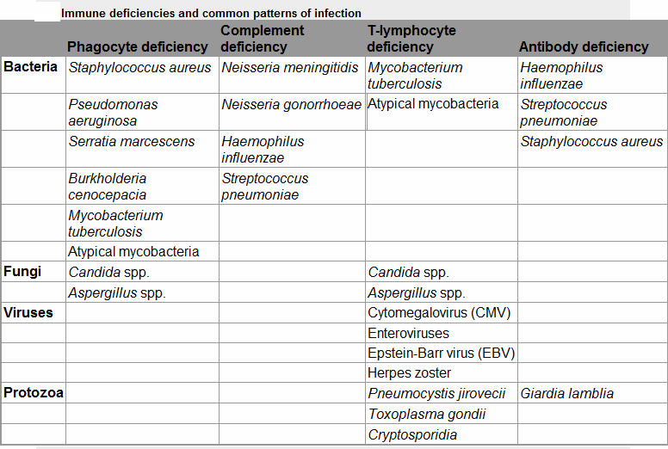

Slide 19
A. Phagocyte deficiency (↓) : Causes
↓WBC Adhesion
Chronic Granul Dis ↓ Cytokine & Cytokine
receptors
Staphyl.aureaus Aspegillus
TB TB
Bacterial Infection

Slide 20
Management:
Drugs: IV AB, Longterm prophylaxis with antifungal agents, and trimethoprim sulfamethoxazole.
Surgical drainage of abscesses
Specific treatment depends upon the nature of the defect.
and stem cell transplantation

Slide 21
B. Complement Pathway deficiency
▪ Genetic deficiencies.
▪ Deficiency of the regulatory protein C1 inhibitor --→ recurrent angioedema.
▪C1, C2 and C4 ------→autoimmune disease (severe SLE)
▪ Classical and alternative pathway components : recurrent infection with encapsulated bacteria particularly Neisseria species
▪Mannose-binding lectin deficiency is very common

Slide 22
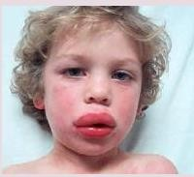
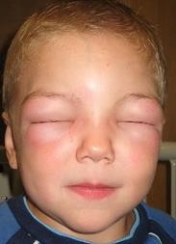
Angioedema

Slide 23
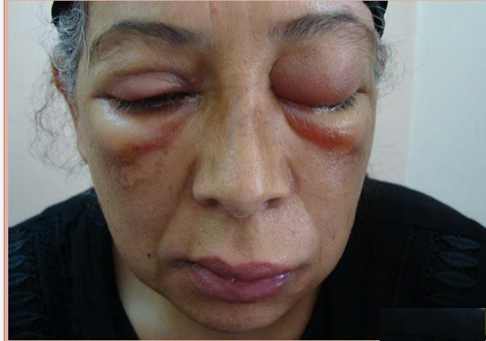
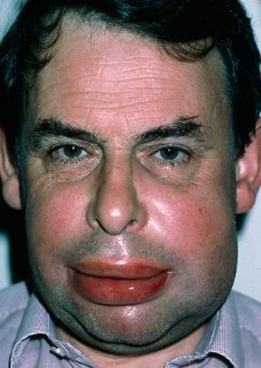
Angioedema

Slide 24
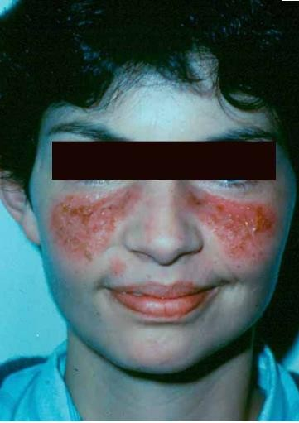
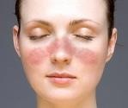
Typical rash of SLE

Slide 25
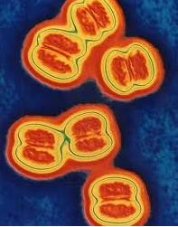
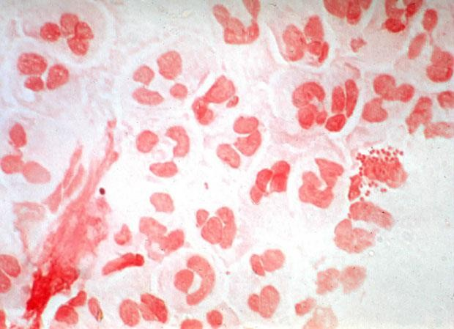
Encapsulated Neisseria Species.

Slide 26
Investigations:
Blood for complement : C3 and C4 (routinely), CH50
Treatment:
No definitive treatment
Vaccination: with meningococcal, pneumococcal and H. influenzae B vaccines to boost their adaptive immune responses
Life-long prophylactic penicillin
Screening family members at-risk.

Slide 27
C.1⁰Deficiency of Adaptive immune system
primary
Combined ↓ T lymph ↓
B & T lymphocytes
- DiGeorge syndrome
- Bare lymphocyte syndromes
-Autoimmune lymphoprolif. Syndrome
proliferative
↓ B lymph
- Selective IgA deficiency
- Common variable immune deficiency (CVID)
specific IgG deficiency
overlap syndrome
*in clinical practise we have cases of common variable immune deficiency presented as recurrent infection and autoimmune disease and the pt. later on discovered as rheumatoid arthritis

Slide 28
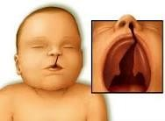
Primary T-lymphocyte Deficiencies
Sequelae:
1)DiGeorge syndrome:
cleft palate and lips

Slide 29
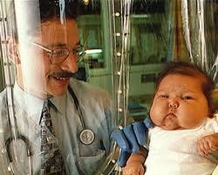
2)Bare lymphocyte syndromes:
29

Slide 30
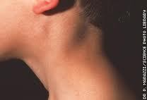
3) Autoimmune lymphoproliferative syndrome:
with lymphadenopathy

Slide 31
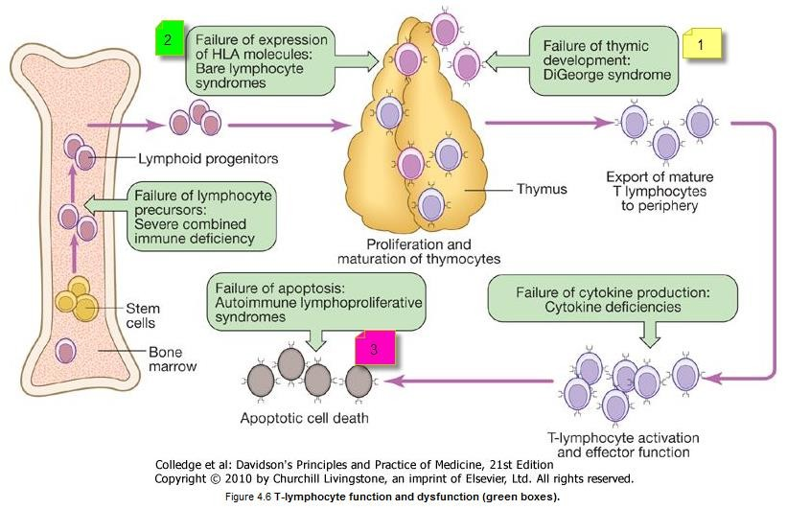

Slide 32
Investigations Blood Ix investigation
▪Total lymphocyte count
▪Serum immunoglobulins
▪Functional tests of T-cell and/or an HIV test Treatment:
▪Anti-Pneumocystis and antifungal prophylaxis
▪Aggressive management of specific infections
▪Immunoglobulin replacement may be indicated if disease is associated with defective antibody production

Slide 33
▪Stem cell transplantation ---→in bare lymphocyte syndromes
▪Thymic transplantation -→ in DiGeorge syndrome

Slide 34
3) Primary B lymphocyte deficiency(Ab ↓):
1)Selective IgA deficiency:
▪is the most common primary immune deficiency
▪Mostly, an incidental finding with no clinical sequelae
▪30% of individuals experience recurrent mild respiratory and gastrointestinal infections.

Slide 35
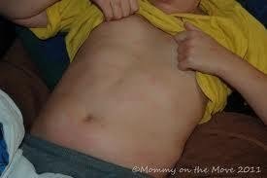
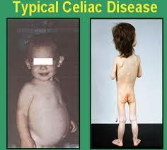
Selective IgA deficiency
cachexic child with rash and typical celiac disease

Slide 36
2)Common variable immune deficiency (CVID):
➢Unknown cause
➢Characterized by low serum IgG levels and failure to make antibody responses to exogenous pathogens
➢Complications: Antibody-mediated autoimmune diseases & increased risk of malignancy.

Slide 37
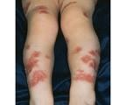
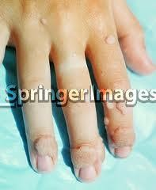
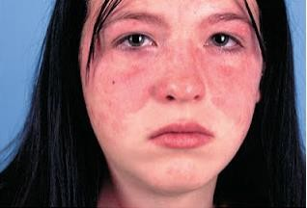
vasculitic lesions,purpuric rash
malar rash of SLE
viral infection

Slide 38
3)Specific antibody deficiency [functional IgG antibody deficiency]
4)There is overlap between specific antibody
deficiency, IgA deficiency and CVID,^{common variable}
immune deficiency
and some patients may progress to a more global antibody deficiency over time

Slide 39
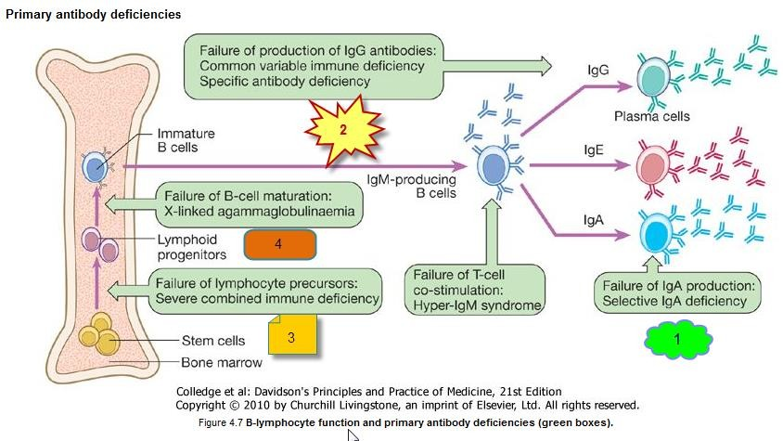

Slide 40
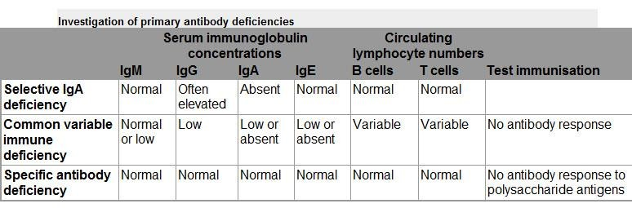
Investigations:
Serum immunoglobulins & protein and urine electrophoresis
Specific antibody :measuring IgG antibodies against tetanus, H. influenzae and
S. pneumonia
40

Slide 41
Management:
intravenous immunoglobulin
The mainstay of treatment is IVIG & life-long.
AB: Aggressive treatment of infections, and prophylactic antibiotics
Immunization is in selective IgA deficiency
[generally not effective (because of the defect in IgG antibody production)].
live vaccines should be avoided ^{bec. those risk for infection}

Slide 42
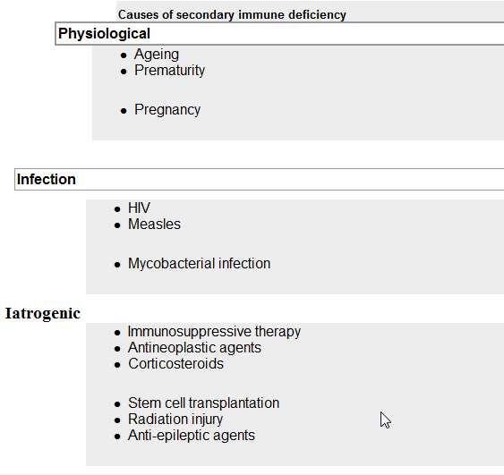

Slide 43
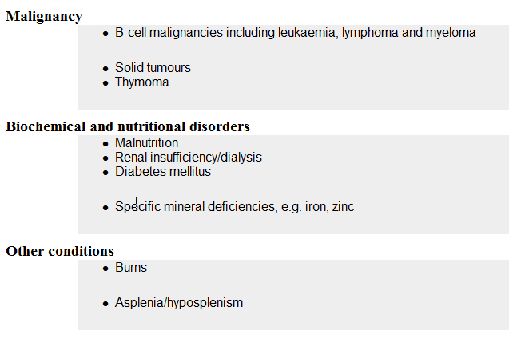
like breast cancer

Slide 44
➢2 ⁰ >> 1⁰ immune deficiencies
secondary more common than primary immune deficienc
➢Infection is a common cause of secondary immune deficiency, particularly HIV infection, measles and other viral illnesses
➢Immune deficiency is also an expected side-effect of some drugs (immune suppressive)
➢May be an idiosyncratic effect of other agents, particularly anti-epileptic medication
➢Physiological immune deficiency occurs at the extremes of life

Slide 45
Case 2
A 20 year old man presented to the
emergency
department with high grade fever and severe headache of 3 days duration associated with vomiting, and disturbed consciousness. On examination there was neck stiffness. Meningitis was suspected so Cerebrospinal aspiration was done in the emergency room and was turbid and result revealed Neisseria meningitides. Regarding this patient, which one of the following expected immune deficiency is correct?
A.Antibody deficiency B.Phagocyte deficiency C.Complement deficiency D.T- lymphocyte deficiency

Slide 46
Conclusions
▪Immune compromised patient =immunodeficient
causes are either congenital or acquired
▪Commonest cause is secondary
Commonest clinical presentation infections at unusual sites and organisms.
is recurrent
by unusual
Early diagnosis and treatment are important.

Slide 47

THANK YOU
47

