Slide 1
Environmental Biotechnology

Slide 2
Environmental Biotechnology
BSc. Course 2024 - 2025
Dr. Alyaa M. Zyara
Department of Biology
College of Science for Women
University of Baghdad

Slide 3
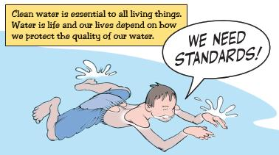
Water and Wastewater
Water is an essential
factor of life.
House as well as industry
consume water and give out wastewater.
To reduce industrial pollution, restrain the use of hazardous materials and reduce waste, environmental laws are being practiced worldwide.

Slide 4
Several legislations target “point-source” emissions to avoid pollution from particular discharge points like chimneys and waste pipes. Other prohibitions deal with pollution from the start of an industrial process.
Significant roles in an environmental regulatory process are played by governments, environmental lawyers, regulatory agents, industrial managers and green activists involving constant interactions to address various issues.
Legislation means setting standards, and this can be used to ensure that drinking water quality is acceptable for consumers.

Slide 5
The first international guidelines to ensure safe drinking water were proposed by the WHO in 1958.
The aim of the guidelines is to minimize the risks affecting drinking water quality.
In general, all countries as well as individual states have standard regulations that vary depending on the source of water, climate, geographical location, and economic, political, and cultural issues.

Slide 6
The first formal integration of the environmental impact assessment (EIA) process in a legislative figure was introduced by the National Environmental Policy Act (NEPA) in the United States. Numerous countries such as Australia, Canada, Sweden and New Zealand adopted such legislation soon after that.
Over the last two decades, EIA has progressed in most of the UN Environment Programme member nations due to increasing global environmental issues, including climate change, loss of biodiversity and degradation in water quality.

Slide 7
Water and Wastewater
Industrial wastewater is the effluent delivered out of a particular industry. It can be a by-product of oil and gas or mining and chemical manufacturing companies, also a by-product of food and industries that is essential in the making of the clothes ect.
Its quality and quantity depends upon nature of industry, raw materials used, manufacturing process and house keeping.
Their characteristics vary widely from industry to industry.

Slide 8
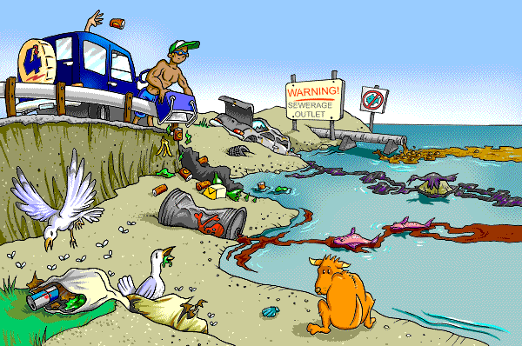
Water is said to be polluted when it changes its quality or composition either naturally or as a result of human activities, thus becoming unsuitable for domestic, agricultural,
industrial, recreational uses and for the
survival of wildlife.
A water pollutant can
be defined as an agent
affecting aesthetic,
physical, chemical and
biological quality of
water.

Slide 9
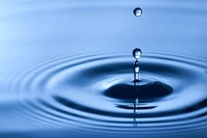
What is Water Quality?

Slide 10
Water and Wastewater
A- Physical Parameters
1- Suspended Solids
Solids suspended in water may consist of inorganic or organic particles. Inorganic solids such as clay, silt and other soil constituents are common in running surface water as rivers and streams. Organic material such as plant fibers and biological solids as algal cells and bacteria are also common constituents of surface waters.
Sanitary sewage usually contains large quantities of suspended solids that are mostly organic in nature.
The organic content of both total and suspended solids can be determined by heating the residues at 600°C for one hour.
The organic fraction of the residues will be converted to carbon dioxide, water vapor and other gases.

Slide 11
A- Physical Parameters
2- Turbidity
Turbidity is the property of
absorption of light or its scattering by suspended material in water.
Both absorption and scattering are influenced by size and surface characteristics of the suspended material.
Colloidal material of clay, silt, rock fragments and metal oxides from the soil, vegetable fibers and microorganisms cause turbidity, also soaps, detergents and emulsifying agents produce stable colloids that result in turbidity.
The colloidal material associated with turbidity provides adsorption site for chemicals, that may be harmful or cause undesirable tastes and odors and shield pathogenic biological organisms from disinfection.
Jackson turbidity unit (JTU) was based on light absorption
Nephelometric turbidity unit (NTU) is based on light scattering principle.

Slide 12
A- Physical Parameters
3- Color
Pure water as rain water is colorless.
Running water carries suspended solids which cause apparent color.
Color contributed by dissolved solids is known as true color which remains permanently.
Colored water is not aesthetically acceptable for domestic as well as industrial use for example:
Iron oxide causes reddish water and manganous oxide gives brown or blackish water. Color is a visible pollutant.
Fresh sanitary sewage is grey in colour and its colour deepens with time. Stale or septic sewage is dark in colour.
Results are expressed in true color units (TCUs).

Slide 13
A- Physical Parameters
4- Taste & Odor
Odor is mainly caused because of gases of decomposition of organic matter. Minerals, metals and salts from the soil, end products from biological reaction and constituents of wastewater attribute taste and odor to water.
For domestic consumption water should be free from odor and its taste should be agreeable.
Threshold Odor Number (TON) is an index of odor.
Odor causes more a psychological stress than any direct harm.
Offensive odors reduce appetite for food, lower water consumption, impair respiration, nausea, result in vomiting and mental perturbation and in extreme cases leads to deterioration of personal and community pride, interfere in human relations discouraging capital investments, lowering socio-economic status and deterring growth and decline in value and sales.

Slide 14
A- Physical Parameters
5- Temperature is one of the most important parameters.
Temperature is a catalyst, a depressant, an activator, a restrictor, a stimulator, a controller and a killer.
It affects the self purification of streams.
Rise in temperature enhances toxicity of poisons and intensity of odor besides changing the taste.
Temperature has an effect on most chemical reactions that occur in natural water systems.
Aerobic digestion ceases at a temperature greater than 50°C.
At less than 15°C anaerobic digestion is affected as methane bacteria become inactive.
Most chemical reactions involving dissolution of solids are accelerated by increased temperatures.

Slide 15
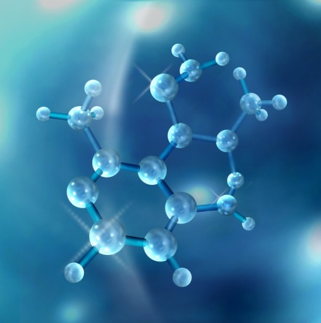
Testing Water Quality Chemical Parameters
pH
Specific Conductance
Nutrients
Nitrates
Phosphates
Heavy Metals
Pesticides
Herbicides
Industrial Wastes
Alkalinity
Pharmaceuticals
Surfactants
Oxygen
Etc……..
3. Davis et al.(2005)

Slide 16
B- Chemical Parameters
Total dissolved solids, alkalinity, hardness, fluorides, metals, organics and nutrients are chemical parameters of concern in water quality management.
1- Total Dissolved Solids (TDS)
Dissolved solids result mainly because of prolonged contact of water with the salts of different catchments.
They may be of organic or inorganic origin .
Inorganic substances are minerals and metals.
Decay products of vegetable and animal origin
give rise to organic matter.
Dissolved salts may produce colour, taste and odor of which some are objectionable.

Slide 17
B- Chemical Parameters
Domestic water should be colorless,
odorless but of agreeable taste.
Presence of dissolved solids alone
gives taste.
2- Alkalinity
Alkalinity is the ability of water to neutralize acids.
CO₃^{2–}, HCO₃–, OH–, H SiO₃–, H₂BO₃–, HPO₄– and NH₃ which are quite common in atmosphere and soil contribute to alkalinity.

Slide 18
B- Chemical Parameters
These compounds result from the dissolution of mineral substances in the soil and atmosphere.
Phosphates from detergents and fertilizers and insecticides of agricultural land may also cause alkalinity.
Alkalinity is classified as (i) hydroxide alkalinity or caustic alkalinity (ii) carbonate alkalinity and (iii) bicarbonate alkalinity.

Slide 19
Hydroxide alkalinity occurring at a pH greater
than 8.3 (generally above 10) causes bitter taste, affects
the lacrimal fluid around the eye ball of swimmers,
whereas bicarbonate alkalinity occurring below
a pH of 8.3 (but above 4.5)
mainly causes scale
formation in boilers
and incrustations
in pipe lines.

Slide 20
B- Chemical Parameters
3- Hardness
Waters which readily give lather with soap are soft waters.
Those which do not readily give lather are hard waters.
Hardness is due to dissolved divalent metallic cations as Ca⁺⁺, Mg⁺⁺, Fe⁺⁺, Mn⁺⁺ and Sr⁺⁺ and anions as bicarbonates, chlorides and SO₄ of which the most abundant in natural waters are Ca⁺⁺, and Mg⁺⁺.
Hardness is the sum of the calcium and magnesium ions.
Carbonate hardness is due to bicarbonates of Calcium and Magnesium which can be easily removed by simple means as boiling and hence is called temporary hardness.

Slide 21
Alkalinity alone causes carbonate hardness.
Noncarbonate hardness due to chlorides and sulphates of Calcium and Magnesium cannot be removed that easily and hence is called permanent hardness.
Greater soap consumption by hard waters is an economic loss.

Slide 22
B- Chemical Parameters
3- Hardness

Slide 23
B- Chemical Parameters
4- Flouride
It is an ingredient of igneous and sedimentary rocks.
Fluoride is rarely found in appreciable quantities in surface waters but appears in certain ground waters.
Concentrations of approximately 1 mg/ in drinking water help to prevent dental cavities in children (dental carries).
During the formation of permanent teeth, fluoride combines chemically with tooth enamel resulting in harder and stronger teeth that are more resistant to decay.
Excessive intakes of fluoride can result in discoloration of enamel of teeth called mottling (Dental Fluorosis).
Excessive dosages of fluoride can also result in fluorosis of bones and other skeletal abnormalities (Skeletal Fluorosis).

Slide 24
B- Chemical Parameters
5- Inorganic Salts
Inorganic salts, which are present in most industrial wastes as well as in natural soils, render the water hard and make it undesirable for industrial, municipal and agricultural use.
Salts of nitrogen and phosphorous promote the growth of microscopic plant life (algae) resulting in eutrophication of lakes

