Slide 1
Biosensor
Dr. Alyaa M. Zyara

Slide 2
Biosensor
History
Professor Leland C. Clark is known as the father of the biosensor. On 15 April 1956 the biosensor that he invented was named after him as “Clark electrode” measured oxygen level in blood.
In 1975 Clarks ideas became commercial reality with the successful re-launch of the yellow springs instrument company (Ohio) glucose analyzer based on the amperometric detection of H2O2.
1977 Karl cammann interduced the term “biosensor”.

Slide 3
Biosensors are analytical tools used for the analysis of biomaterials from a mixture of analytes to get information about their composition, structure and function by converting a biological response into an electrical signal.
These tools consist of :
1- A biological recognition element spread over a signal transducer and measure the concentration of a specific analyte in the sample mixture.
2- Biosensors allow detection of a broad spectrum of analytes in complex samples and show great promise in different areas of investigation, for example, clinical diagnostics, food analysis, bioprocess and environmental monitoring as given below. Depending on the method of signal transduction. the biosensors may be classified into six groups, including electrochemical, mass, magnetic, optical, micromechanical and thermal.

Slide 5
A typical biosensor consists of the following components:
Analyte: This is the substance of interest to be detected. For example, glucose is an “analyte” in a biosensor designed to detect glucose.
Bioreceptor: This specifically recognizes the analyte. Some examples of bioreceptors include enzymes, cells, aptamers, deoxyribonucleic acid (DNA) and antibodies. The interaction of bioreceptor with the analyte is associated with the process of signal generation (in the form of light, heat, pH, charge or mass change, etc.), which is also known as biorecognition.

Slide 6
Transducer: The transducer converts one form of energy into another. The role of a transducer in a biosensor is to convert the effect of biorecognition into a quantifiable signal. The process of energy conversion is also known as a signal generation. A transducer produces optical or electrical signals proportional to the amount of analyte–bioreceptor interactions.
Electronics: A biosensor has an inbuilt system that processes the transduced signal and setup for display. It comprises complex electronic circuitry that executes conditioning of signals such as amplification and conversion of signals into the digital form. The display unit of the biosensor then quantifies the processed signals.

Slide 7
Display: The display unit consists of a user interpretation system such as the liquid crystal display of a computer or a directly connected printer that generates numerical values or curves. This part of a biosensor often consists of a combination of hardware and software that generates results in a user-friendly mode. The output signal on display can be numeric, graphic, tabular or an image, depending on the demand of the end user.

Slide 10
CHARACTERISTICS OF A BIOSENSOR
The performance of the biosensor largely depends on the optimization of certain characteristics:
Selectivity
Selectivity is the most important feature of a biosensor, which is the ability of a bioreceptor to detect a specific analyte in a sample containing other admixtures and contaminants. The best example of selectivity is the interaction of an antigen with the antibody in which antibodies act as bioreceptors and are immobilized on the surface of the transducer. A solution (commonly a buffer) containing the antigen is then exposed to the transducer where antibodies interact only with the antigens.

Slide 11
b. Reproducibility
Reproducibility is the ability of the biosensor to generate identical responses for a repeat or similar experimental set-up. The reproducibility is defined by the precision and accuracy of the transducer and electronic circuitry used in a biosensor.
Precision is the quality of the sensor to provide similar results every time a sample is measured, and accuracy represents the capacity of the sensor to provide a mean value approximate to the real value when a sample is measured repeatedly. Reproducible signals provide high dependability and robustness to the interpretation of the biosensor response.

Slide 12
c. Stability Stability is the most crucial feature for a biosensor application because it requires steps involving long incubation or continuous monitoring. The stability of a biosensor can be affected by the temperature-sensitive response of transducers and electronics. Therefore, to ensure a stable response of the sensor, appropriate regulation of electronics is required. Another factor, that is, the affinity of the bioreceptor, can also influence the stability of a biosensor, which is the degree to which the analyte binds to the bioreceptor. Another factor that might affect the stability of measurement is the susceptibility of the biosensor to degradation over a period.

Slide 13
d. Sensitivity The minimum amount of analyte that can be detected by a biosensor defines its limit of detection (LOD) or sensitivity. In several medical and environmental monitoring applications, a biosensor is required to detect analyte concentration of as low as ng/ml to fg/ml to confirm the presence of traces of analytes in a sample. For instance, a prostate-specific antigen (PSA) concentration of 4 ng/ml in the blood is associated with prostate cancer, for which doctors suggest biopsy tests. Hence, sensitivity is an important property of a biosensor.

Slide 14
e. Linearity Linearity is the characteristic that shows the accuracy of the measured response (for a set of measurements with different concentrations of the analyte) to a straight line, mathematically depicted as y = mc, where c is the concentration of the analyte, y is the output signal, and m is the sensitivity of the biosensor. The linearity of the biosensor depends on the resolution of the biosensor and concentration range of analytes. The resolution of the biosensor is defined as the smallest change in the concentration of an analyte that is required to bring a change in the response of the biosensor. Depending on the application, a good resolution is required, as most biosensor applications involve not only detection of the analyte but also the measurement of the concentrations of the analyte. Another term associated with linearity is a linear range, which is defined as the range of analyte concentrations for which the response of biosensor changes linearly with the concentration.

Slide 15
Types of Biosensors
The key part of a biosensor is the transducer, which uses the physical change associated with the reaction for conversion into a quantifiable signal. It can be:
The heat absorbed or liberated in the reaction (calorimetric biosensors)
Changes in the distribution of charges causing an electrical potential to be
produced (potentiometric biosensors)
The transfer of electrons produced in a redox reaction (amperometric
biosensors)

Slide 16
6. The emission of light during the reaction or a difference in the absorbance
of light between the reactants and products (optical biosensors)
7. Effects due to the mass of the reactants or products (piezo-electric
biosensors)
There are three so-called generations of biosensors: First-generation biosensors in which the normal product of the reaction diffuses to the transducer and causes the electrical response; second-generation biosensors which involve specific “mediators” between the reaction and the transducer in order to generate improved response; and third-generation biosensors where the reaction itself causes the response and no product or mediator diffusion is directly involved.

Slide 17
Electrochemical biosensors are simple devices which measure electronic current by changes in conductance carried by bio-electrodes. The transducer often produces a low electrical signal superimposed on a relatively high and noisy base- line.
Calorimetric Biosensors
Many enzyme-catalyzed reactions are exothermic, that is, generating heat, which may be used as a basis for measuring the rate of reaction and also the concentration of the analyte. The temperature changes are usually dictated by employing thermistors located at the entrance and exit of small packed bed columns containing immobilized enzymes within an environment of constant temperature

Slide 18
Optical Biosensors
In the optical biosensors, determining changes in absorption of light between the reactants and products of a reaction or measuring the light output by a luminescent process is possible. The former usually involves the use of widely established colorimetric test strips that are disposable single-use cellulose pads infused with enzyme and reagents.
For diabetes patients, monitoring blood glucose level is very important. In this type of biosensor, a simple technique is used—paper strips saturated with the reagents, for example, glucose oxide, horseradish peroxidase and a chromogen. Using the portable reflectance meter, the intensity of the color of the dye can be measured. The glucose strips, in which the calorimetric test strips of cellulose cov- ered with the suitable enzymes and reagents can be used at home for the measure- ment of blood and the urine parameters, are very popular worldwide.

Slide 19
Immunosensors
Biosensors may be used in conjunction with enzyme-linked immunosorbent assays (ELISA). The principles behind the ELISA technique to detect and amplify an antigen-antibody reaction; the amount of enzyme-linked antigen bound to the immobilized antibody is determined by the relative concentration of the free and conjugated antigen and quantified by the rate of an enzymatic reaction.

Slide 20
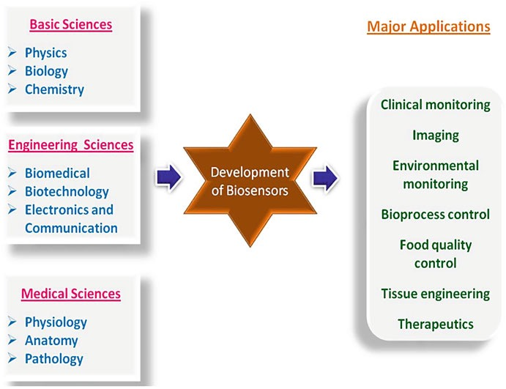
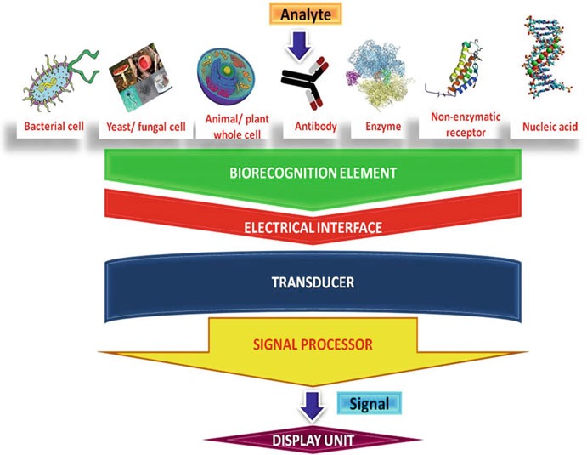
Working principle of biosensor

Slide 22
Microbes
The use of micro-organisms as biological elements in biosensors is
based on the measurement of their metabolism. Microbial cells have the advantage of being cheaper than enzymes or antibodies,
can be more stable, and can carry out several complex reactions
involving enzymes and cofactors. Conversely, they are less selective
than enzymes, they have longer response and recovery times, and may require more frequent calibration.

Slide 23
APPLICATIONS
Glucose monitoring , pregnancy test in diabetes patients -historical market driver
Environmental applications e.g. the detection of pesticides and river water contaminants such as heavy metal ions.
The pollution of the natural water environment caused by heavy metals and various ions poses severe hazards to human health. To solve this problem, there is a need of portable, low-cost tools for fast analyses of heavy metals. A DNA optical biosensor can be used for the detection of heavy metal ions, for example, mercury ions (Hg2+), which are ubiquitous and highly toxic pollutants in the environment. This type of biosensor is portable, fast and low-cost with in situ screening of Hg2+.
.

Slide 24
The algal blooms of cyanobacteria produce harmful toxins such as brevetoxins and microcystins due to the eutrophication of aquatic systems, and therefore reliable and cost-effective systems are needed for the early detection of such toxins. An electrochemical aptasensor has been applied to the sensitive detection of brevetoxin-2,
arine neurotoxin, using gold electrodes functionalized with cysteamine self- assembled monolayer. Biosensors have also been reported for the detection of the toxin okadaic acid in water samples mixed with seawater and contaminated with alga and in shellfish.
Remote sensing of airborne bacteria e.g. in counter-bioterrorist activities
Remote sensing of water quality in coastal waters by describing online different aspects of clam ethology (biological rhythms, growth rates, spawning or deathrecords) in groups of abandoned bivalves around the world.

Slide 25
Determining levels of toxic substances before and after bioremediation
Routine analytical measurement of folic acid, biotin, vitamin B12 and
pantothenic acid as an alternative to microbiological assay
Drug discovery and evaluation of biological activity of new compounds
Detection of toxic metabolites such as mycotoxins inS2.

