Slide 1
Blood Types

Slide 2
Blood Types
There are four different types of blood (A, B, AB, O)
They are determined by the protein (antigen) found on the RBC surface.
Type A has protein (antigen) A on the RBC.
Type B has protein (antigen) B on the RBC.
Type AB has both protein (antigen) A and B on the RBC.
Type O has neither protein (antigen) on the RBC.

Slide 3
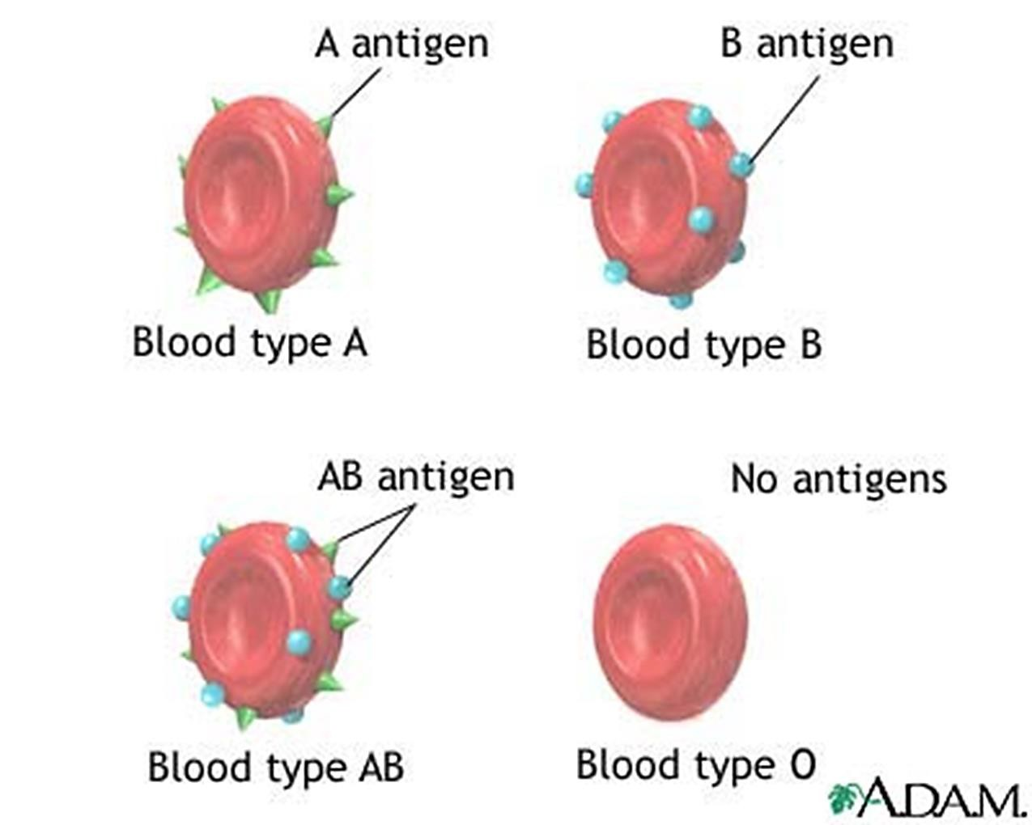


Slide 8
Notes
Blood from the donor to the recipient must be compatible.
The donor’s and the recipient’s blood is typed and cross-matched to prevent hemolytic transfusion reactions.
Transfusion reactions occur if the donor’s and the recipient’s blood are incompatible, in which the recipient’s preformed antibodies attack the donor’s red cells, resulting in their destruction and hemolysis.

Slide 9
Notes
Type A individuals have Anti-B antibodies in the plasma.
Type B individuals have Anti-A antibodies in the plasma.
Type AB individuals do not have Anti-A and Anti-B antibodies in the plasma.
Type O individuals have A and B antibodies in the plasma.

Slide 10
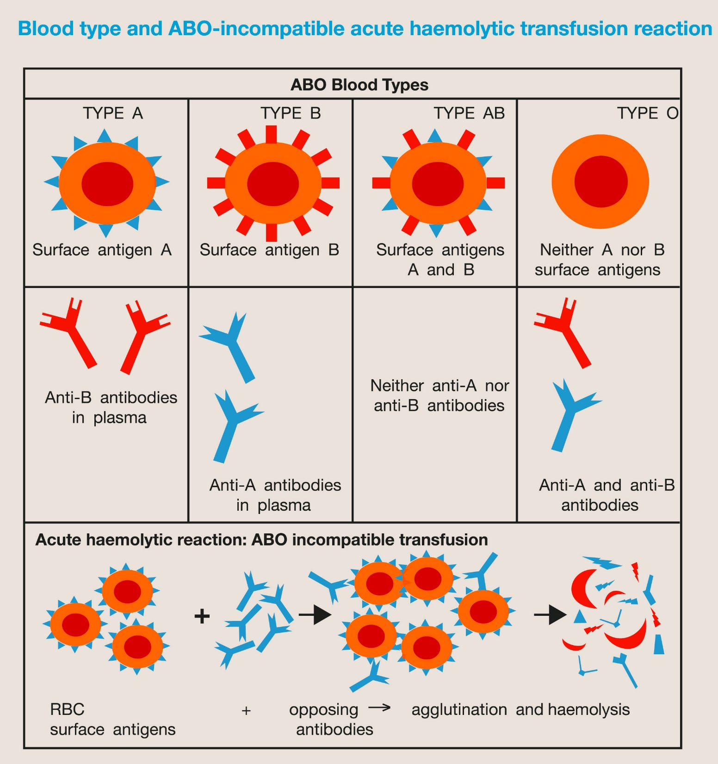

Slide 11
Notes
Type O blood is the universal donor, since it does not have either the A or the B antigens on the surface of the RBCs.
Type AB blood is the universal recipient, since it does not have either the Anti-A or the Anti-B antibodies in the plasma.
Type O positive is the most common blood type.

Slide 12
Rhesus Blood Group
The Rhesus (Rh) antigens are a part of proteins expressed on the surface of the RBC membrane.
The function of these antigens is unknown; however, they may play a role in membrane stability and ammonium transport.
The significance of the Rh blood group is related to the fact that the Rh antigens are highly immunogenic.
In the case of the D antigen, individuals who do not produce the D antigen will produce anti-D antibodies if they encounter the D antigen on transfused RBCs or on fetal RBCs.
For this reason, the Rh status is routinely determined in blood donors, transfusion recipients, and in mothers-to-be.

Slide 13
Hemolytic Disease of the Newborn
Hemolytic disease of the newborn (HDN), or erythroblastosis fetalis, is a clinically important and potentially life-threatening condition.
HDN results from Rh-negative maternal antibodies attacking Rh-positive fetal RBCs. Typically, it is the second Rh-positive fetus that is affected.
The first fetus inherits the paternal D antigen, and maternal and fetal blood mixing occurs during the pregnancy.
Once mixing occurs, the gravida begins producing anti-D antibodies. This constitutes alloimmunization, as the gravida is D-negative.

Slide 14
Hemolytic Disease of the Newborn
In the subsequent D-negative pregnancy, IgG antibodies cross the placenta and attack the D antigens on fetal RBCs.
This leads to hemolysis that may result in jaundice, anemia, kernicterus, and possibly death.

Slide 15
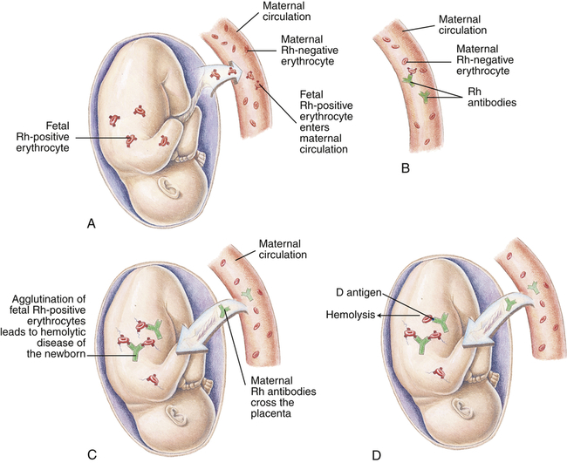
Hemolytic Disease of the Newborn

Slide 16
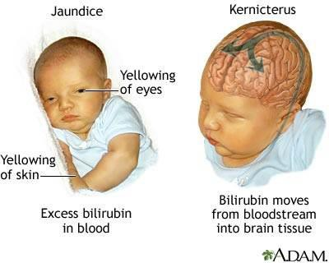
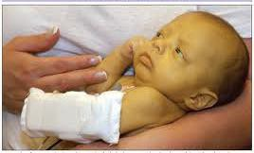
Erythroblastosis Fetalis

Slide 17
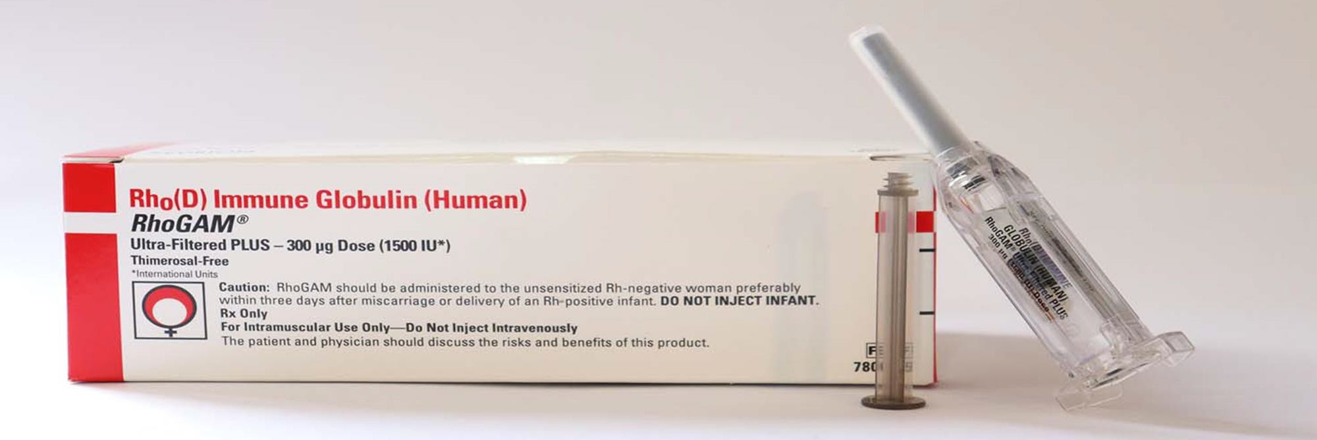
Hemolytic Disease of the Newborn
HDN can be prevented by the administration of Rho(D) immune globulin (anti-D immune globulin).
Anti-D immune globulin is a commercial biological antibody derived from human plasma that targets RBCs positive for the D antigen.
Anti-D immune globulin should be given at weeks 26 to 28 and again within 72 hours of delivery of an Rh-positive infant.

Slide 18
Testing for Compatibility
Blood transfusion
Blood transfusion is required in cases of severe loss of blood and in life-threatening anemias.
It is essential to know that the donor’s blood type is compatible with that of the recipient.
Compatibility testing involves 2 steps:
Determination of blood type.
Cross-match test.

Slide 19
Cross-match test
Cross-Matching test: is a test performed prior to a blood transfusion to determine whether donor blood is compatible (or incompatible) with recipient blood.
It has become part of a series of pre-transfusion tests known as compatibility testing.
Compatibility is determined through:
matching of different blood group systems, and the most important systems of which are the ABO and Rh systems.
and/or by directly testing for the presence of antibodies in the plasma of the recipient against a sample of donor tissues or blood.

Slide 20
Cross-match test
Major and Minor cross-match tests
The major crossmatch: involves testing or mixing the patient’s serum with donor cells(RBCs) to determine whether the patient has an antibody directed against an antigen on the donor's cells, which may cause a hemolytic transfusion reaction or decreased cell survival of donor cells. This is the most important cross-match.
The minor crossmatch: involves testing or mixing the patient’s cells with donor plasma to determine whether there is an antibody in the donor’s plasma
directed against an antigen on the patient’s cells.
The minor cross-match test has been completely eliminated in most blood banks because donor samples are screened beforehand for the more common Abs.

Slide 21
The main functions of the cross-match test are:
Prevent transfusion reactions
Increase in vivo survival of red cells
It is a final check of ABO compatibility between donor and patient. ( Double checks for ABO errors)
.4. It may detect the presence of an antibody in the patient’s serum that will react with antigens on the donor RBCs.

Slide 22
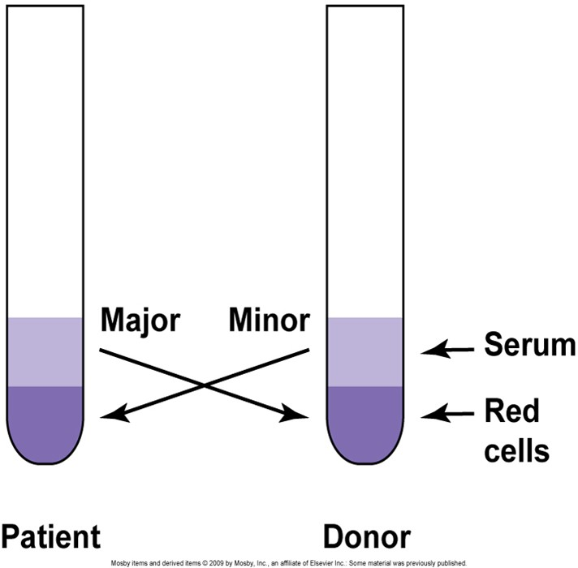
Major vs. Minor Cross match
Why is the minor cross match unnecessary?
Donated units are tested for antibodies Most blood is transfused as packed cells, having little antibodies

Slide 23
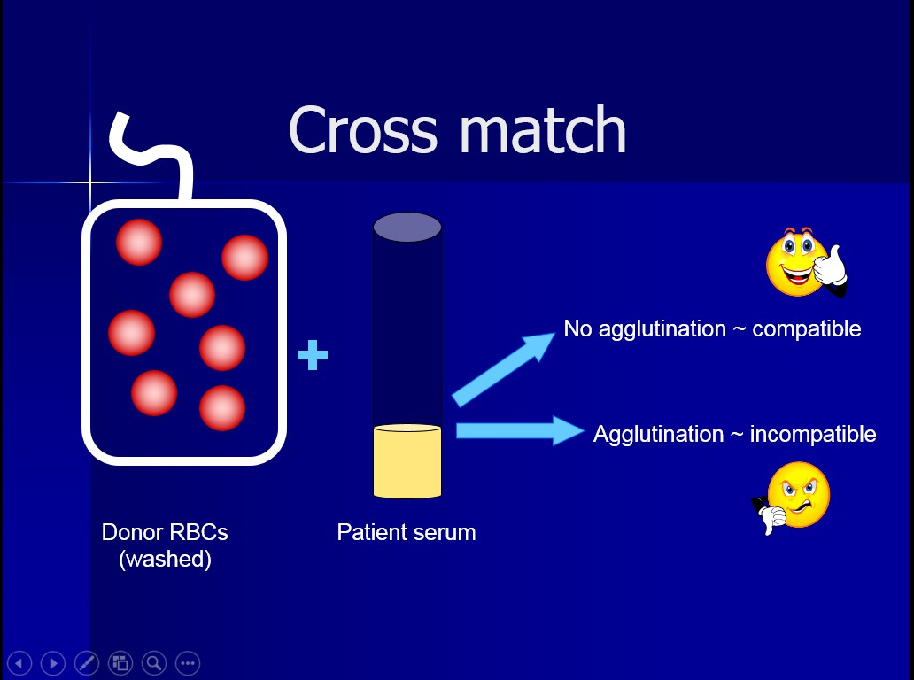
Cross match

Slide 24

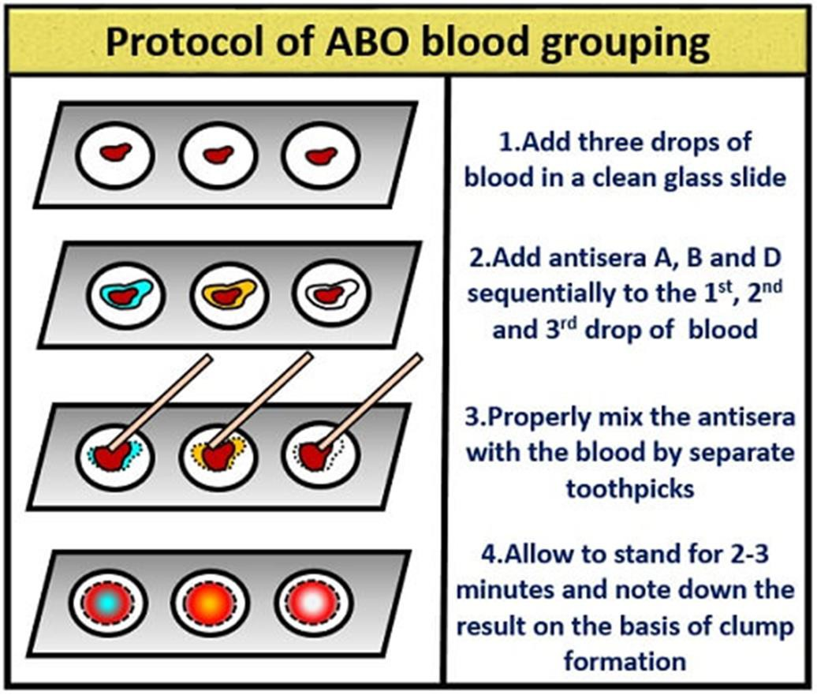
Note:
Agglutination with anti D is slow and does not show clearly. It may be necessary to wait for 20 minutes and use a magnifying glass.

Slide 25
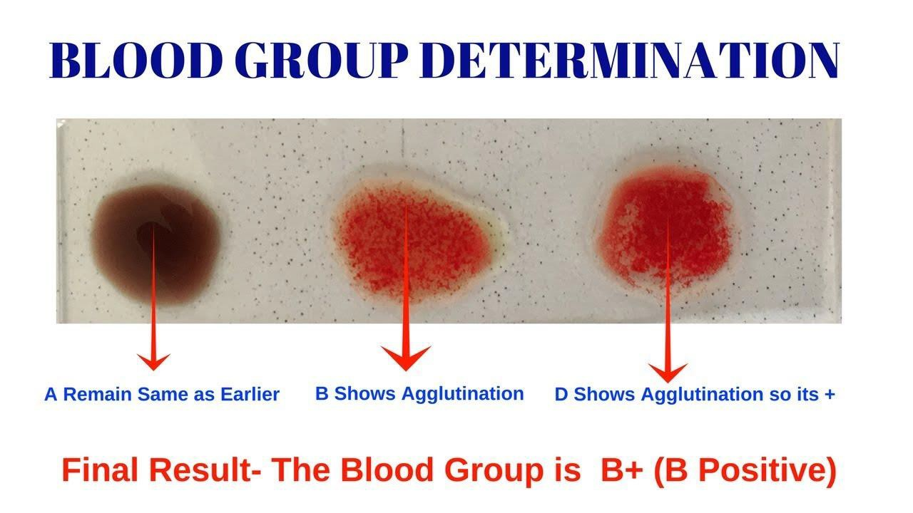
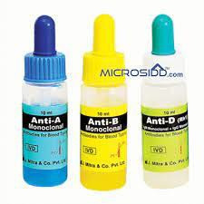
Slide No.
1
Slide No.
2
Slide No.
3
Anti-A
Anti-B
Anti-D
Blood group

Slide 26



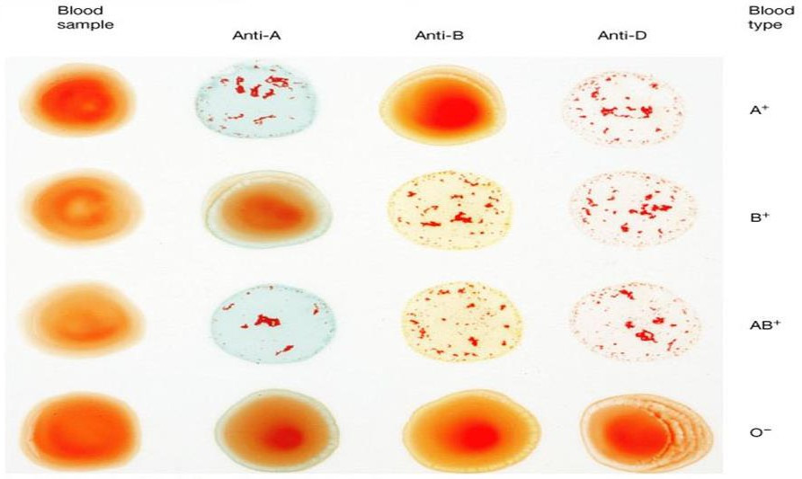
ABO-Rh Blood Grouping

Slide 27


