Slide 1
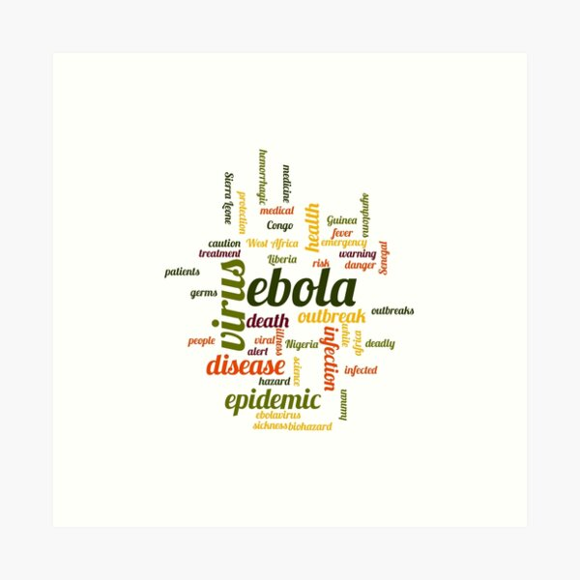
Hemorrhagic fever

Slide 2
Viral hemorrhagic fever (Group A disease) must be notified immediately.
School exclusion: until medical clearance.
Crimean-Congo, Ebola, Lassa and Marburg viral hemorrhagic fevers are subject to quarantine.

Slide 3
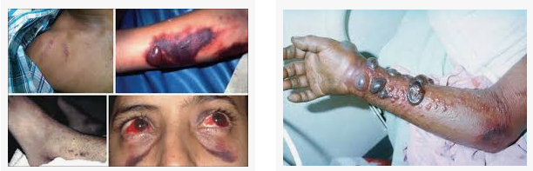


Slide 4
Viral haemorrhagic fever:
is a general term for a severe illness, sometimes associated with bleeding, that may be caused by a number of viruses.
The term is usually applied to disease caused by :
Arenaviridae (Lassa fever, Junin and Machupo),
Bunyaviridae (Crimean-Congo haemorrhagic fever, Rift Valley Fever, Hantaan haemorrhagic fevers),
Filoviridae (Ebola and Marburg)
Flaviviridae (yellow fever, dengue, Omsk haemorrhagic fever, Kyasanur forest disease).

Slide 5
Identification
Clinical features
Clinically apparent infections with any of these viruses may present with similar symptoms.
*Fever is typically insidious in onset and accompanied by *severe headache, *myalgia and malaise. Other symptoms include *retrosternal chest pain, *cough, *abdominal pain, *diarrhea, *conjunctivitis, *facial swelling, *proteinuria and jaundice.

Slide 6
A bleeding diathesis leads to mucosal bleeding, haematemesis, melaena and haematuria.
Severe infections are complicated by massive hemorrhage and multi-organ failure.

Slide 7
Case fatality rates vary greatly:
Lassa fever virus has a case fatality rate of 1% of infected cases but 25% of hospitalized cases.
Crimean-Congo hemorrhagic fever virus has a case fatality rate of 2–50%.
Marburg virus has a case fatality rate of 25% and Ebola virus is 50–90%.

Slide 8
Method of diagnosis
All suspected VHF clinical specimens are tested under the highest bio-security level (BSL–4) laboratory conditions. Diagnosis is typically made using specific PCR tests supported by viral isolation and serology. Appropriate specimens are:
unclotted blood, tissue or nose and throat swabs for viral PCR
unclotted blood, urine, tissue or nose and throat swabs for virus isolation
clotted blood for serology.

Slide 9
Incubation period
The incubation period varies according to the causative agent:
Lassa fever virus is usually 6–21 days
Crimean-Congo hemorrhagic fever virus is usually one to three days (range 1–12 days)
Marburg virus is usually three to nine days
Ebola virus is usually 2–21 days.

Slide 10
The high case fatality rate means that it is important that the diagnosis is made and treatment is commenced as early as possible.
Viral hemorrhagic fevers should be considered in the differential diagnosis of every patient with an unexplained fever who has been exposed to the infection in an area with endemic VHF during the preceding three weeks.

Slide 11
Reservoir
The reservoir for Lassa fever virus is a rodent known as the *multimammate rat of the genus Mastomys spp.
The reservoirs for Crimean-Congo hemorrhagic fever virus are* hares, birds and Hyalomma spp. of ticks. Domestic animals such as sheep, goats and cattle may act as amplifying hosts.

Slide 12
Mode of transmission
Many VHF viruses cycle naturally amongst wild animals, such as bats, rodents (for example rats and mice), and monkeys, with spread between animals either directly or by biting insects.
The viruses only make occasional breakthroughs into the human population.
Infection in humans can occur through:
contact with infected rodent droppings or urine - Lassa fever, Venezuelan haemorrhagic fever
contact with infected animals - Crimean Congo haemorrhagic fever, Kyasanur Forest disease
bite from or crushing of an infected tick - Alkhurma haemorrhagic fever, Crimean Congo haemorrhagic fever
bite from an infected mosquito - Rift Valley fever

Slide 13
Period of communicability
Communicability of viral hemorrhagic fevers depends on the infective agent:
Lassa fever virus is communicable via person to person spread during the acute febrile phase. Virus is excreted in the urine for up to three to nine weeks from the onset of the illness.
Crimean-Congo hemorrhagic fever virus communicability is unknown. The virus is highly infectious in the hospital setting where it has been transmitted to health care personnel by accidental needle stick injury.

Slide 14
Marburg and Ebola virus are communicable as long as blood and secretions contain virus. Virus has been isolated in seminal fluid 60 days after the onset of infection.

Slide 15
Crimean-Congo hemorrhagic fever
The Crimean-Congo haemorrhagic fever (CCHF) virus causes severe viral haemorrhagic fever outbreaks.
CCHF outbreaks have a case fatality rate of up to 40%.
The virus is primarily transmitted to people from ticks and livestock animals. Human-to-human transmission can occur resulting from close contact with the blood, secretions, organs or other bodily fluids of infected persons.
CCHF is endemic in Africa, the Balkans, the Middle East and Asia
There is no vaccine available for either people or animals.

Slide 16
Crimean-Congo haemorrhagic fever (CCHF) is a widespread disease caused by a tick-borne virus (Nairovirus) of the Bunyaviridae family. The CCHF virus causes severe viral haemorrhagic fever outbreaks.
CCHF is endemic in Africa, the Balkans, the Middle East and Asian countries – the geographical limit of the principal tick vector.

Slide 17
The Crimean-Congo haemorrhagic fever virus in animals and ticks
The hosts of the CCHF virus include a wide range of wild and domestic animals such as cattle, sheep and goats. Many birds are resistant to infection, but ostriches are susceptible and may show a high prevalence of infection in endemic areas, where they have been at the origin of human cases. For example, a former outbreak occurred at an ostrich abattoir in South Africa. There is no apparent disease in these animals.

Slide 18
Animals become infected by the bite of infected ticks and the virus remains in their bloodstream for about one week after infection, allowing the tick-animal-tick cycle to continue when another tick bites. Although a number of tick genera are capable of becoming infected with CCHF virus, ticks of the genus Hyalomma are the principal vector.

Slide 19
Transmission
The CCHF virus is transmitted to people either by tick bites or through contact with infected animal blood or tissues during and immediately after slaughter. The majority of cases have occurred in people involved in the livestock industry, such as agricultural workers, slaughterhouse workers and veterinarians.
Human-to-human transmission can occur resulting from close contact with the blood, secretions, organs or other bodily fluids of infected persons. Hospital-acquired infections can also occur due to improper sterilization of medical equipment, reuse of needles and contamination of medical supplies.

Slide 20
Signs and symptoms
The length of the incubation period depends on the mode of acquisition of the virus. Following infection by a tick bite, the incubation period is usually one to three days, with a maximum of nine days. The incubation period following contact with infected blood or tissues is usually five to six days, with a documented maximum of 13 days.

Slide 21
Onset of symptoms is sudden, with fever, myalgia, (muscle ache), dizziness, neck pain and stiffness, backache, headache, sore eyes and photophobia (sensitivity to light). There may be nausea, vomiting, diarrhoea, abdominal pain and sore throat early on, followed by sharp mood swings and confusion. After two to four days, the agitation may be replaced by sleepiness, depression and lassitude, and the abdominal pain may localize to the upper right quadrant, with detectable hepatomegaly (liver enlargement).

Slide 22
Other clinical signs include tachycardia (fast heart rate), lymphadenopathy (enlarged lymph nodes), and a petechial rash (a rash caused by bleeding into the skin) on internal mucosal surfaces, such as in the mouth and throat, and on the skin. The petechiae may give way to larger rashes called ecchymoses, and other haemorrhagic phenomena. There is usually evidence of hepatitis, and severely ill patients may experience rapid kidney deterioration, sudden liver failure or pulmonary failure after the fifth day of illness.
The mortality rate from CCHF is approximately 30%, with death occurring in the second week of illness. In patients who recover, improvement generally begins on the ninth or tenth day after the onset of illness.

Slide 23
Diagnosis
CCHF virus infection can be diagnosed by several different laboratory tests:
enzyme-linked immunosorbent assay (ELISA) ;
antigen detection;
serum neutralization;
reverse transcriptase polymerase chain reaction (RT-PCR) assay; and
virus isolation by cell culture.

Slide 24
Patients with fatal disease, as well as in patients in the first few days of illness, do not usually develop a measurable antibody response and so diagnosis in these individuals is achieved by virus or RNA detection in blood or tissue samples.
Tests on patient samples present an extreme biohazard risk and should only be conducted under maximum biological containment conditions. However, if samples have been inactivated (e.g. with virucides, gamma rays, formaldehyde, heat, etc.), they can be manipulated in a basic biosafety environment

Slide 25
Treatment
General supportive care with treatment of symptoms is the main approach to managing CCHF in people.
The antiviral drug ribavirin has been used to treat CCHF infection with apparent benefit. Both oral and intravenous formulations seem to be effective.

Slide 26
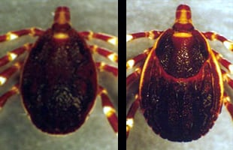
Prevention and control
Controlling CCHF in animals and ticks
Ticks of the genus Hyalomma are the principal vector of Crimean-Congo haemorrhagic fever. Photo: Robert Swanepoel/NICD South Africa

Slide 27
It is difficult to prevent or control CCHF infection in animals and ticks as the tick-animal-tick cycle usually goes unnoticed and the infection in domestic animals is usually not apparent. Furthermore, the tick vectors are numerous and widespread, so tick control with acaricides (chemicals intended to kill ticks) is only a realistic option for well-managed livestock production facilities.

Slide 28
For example, following an outbreak at an ostrich abattoir in South Africa (noted above), measures were taken to ensure that ostriches remained tick free for 14 days in a quarantine station before slaughter. This decreased the risk for the animal to be infected during its slaughtering and prevented human infection for those in contact with the livestock.
There are no vaccines available for use in animals.

Slide 29
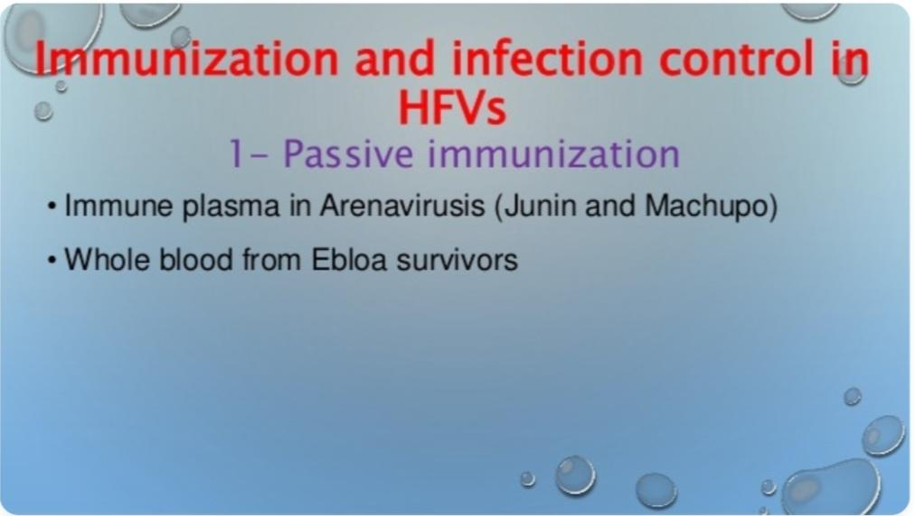

Slide 30
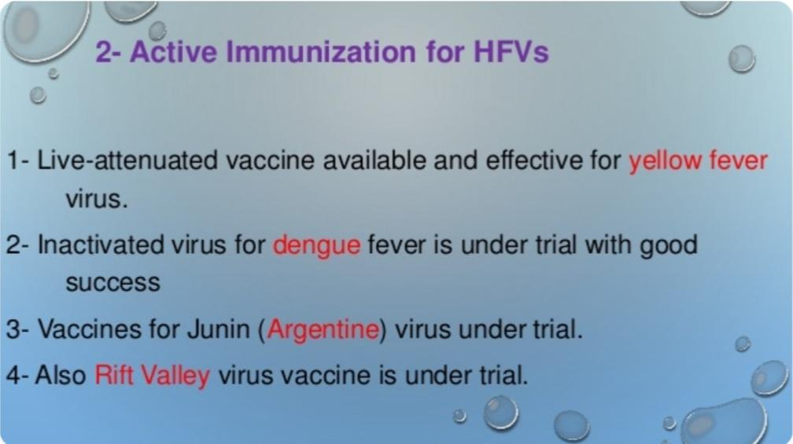

Slide 31
Reducing the risk of infection in people
Although an inactivated, mouse brain-derived vaccine against CCHF has been developed and used on a small scale in eastern Europe, there is currently no safe and effective vaccine widely available for human use.
In the absence of a vaccine, the only way to reduce infection in people is by raising awareness of the risk factors and educating people about the measures they can take to reduce exposure to the virus.
Public health advice should focus on several aspects

Slide 32
Reducing the risk of tick-to-human transmission:
  wear protective clothing (long sleeves, long trousers);
  wear light coloured clothing to allow easy detection of ticks on the clothes;
  use approved acaricides (chemicals intended to kill ticks) on clothing;
  use approved repellent on the skin and clothing;
  regularly examine clothing and skin for ticks; if found, remove them safely;
  seek to eliminate or control tick infestations on animals or in stables and barns; and
  avoid areas where ticks are abundant and seasons when they are most active.

Slide 33
Reducing the risk of animal-to-human transmission:
  wear gloves and other protective clothing while handling animals or their tissues in endemic areas, notably during slaughtering, butchering and culling procedures in slaughterhouses or at home;
  quarantine animals before they enter slaughterhouses or routinely treat animals with pesticides two weeks prior to slaughter.

Slide 34
Reducing the risk of human-to-human transmission in the community:
  avoid close physical contact with CCHF-infected people;
  wear gloves and protective equipment when taking care of ill people;
  wash hands regularly after caring for or visiting ill people.

Slide 35
Controlling infection in health-care settings
Health-care workers caring for patients with suspected or confirmed CCHF, or handling specimens from them, should implement standard infection control precautions. These include basic hand hygiene, use of personal protective equipment, safe injection practices and safe burial practices.
As a precautionary measure, health-care workers caring for patients immediately outside the CCHF outbreak area should also implement standard infection control precautions.

Slide 36
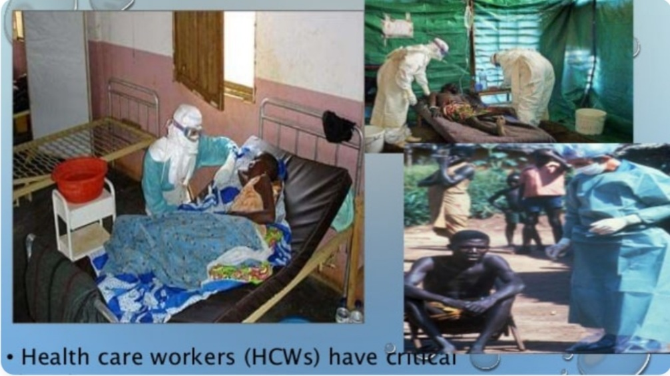

Slide 37
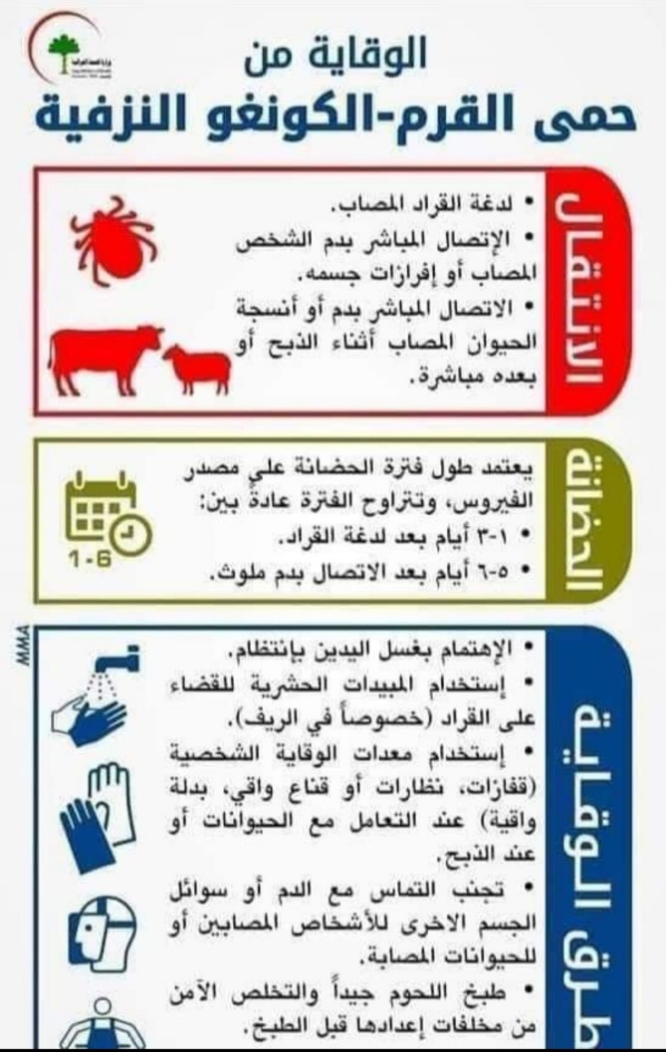
نشرة وزارة الصحة

