Slide 1
Fifth lecture
Fungi
Dr. Teeba H. Mohammad

Slide 2
Dimorphic fungi (Histoplasma, Coccidioides, Blastomyces)
The dimorphic fungi are characterized by having two morphotypes or shapes. They generally exist as filamentous molds in the environment; at mammalian body temperature, they transition to a spherical yeast form.
Dimorphic fungi that are major pathogens of humans and other animals include Histoplasma capsulatum, Coccidioides immitis, Blastomyces dermatitidis, Paracoccidioides brasiliensis, Sporothrix schenckii.
Here, we focus on Coccidioides and Histoplasma as key dimorphic fungal pathogens.
Coccidioides and Histoplasma are both capable of causing disease in otherwise healthy humans. When inhaled, spores of both fungi initiate infection. In most cases, both diseases are prevented from leaving the lung by the patient’s immune response, which forms granulomas around the fungi .

Slide 3
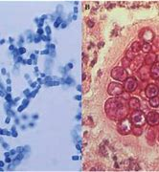
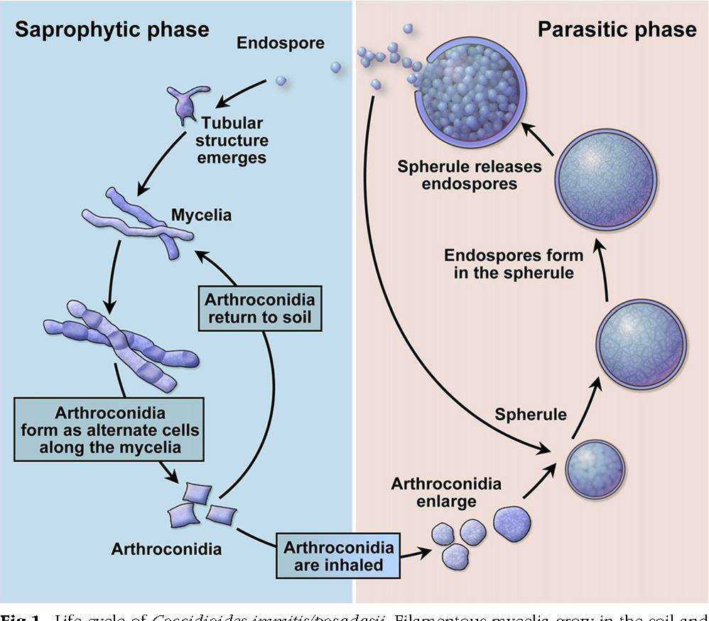
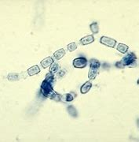
Coccidioides immitis

Slide 4
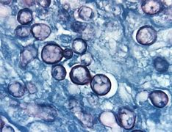
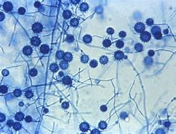
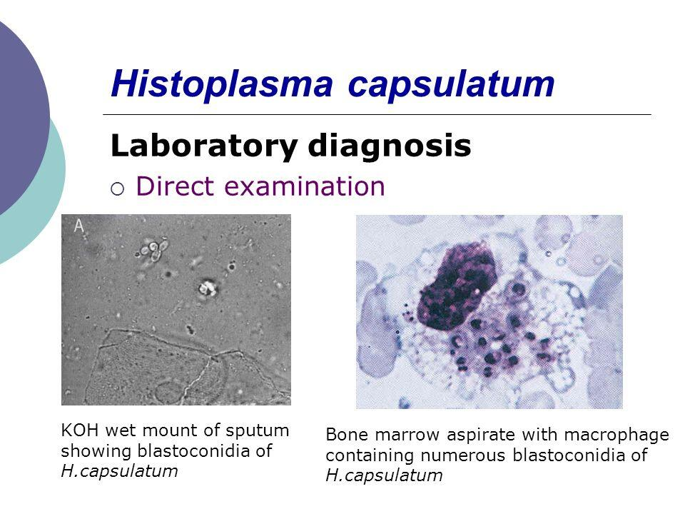

Slide 5
At least 10% infected with coccidioidomycosis annually seek medical treatment for pneumonia, with 1% of these patients requiring life-long antifungal therapy to avoid a fatal outcome, at a cost exceeding $30,000/year.
Coccidioides is endemic in arid zones of the Americas, and coccidioidomycosis is most common in highly populated areas of Arizona and California.
The fungus evolved to use small desert rodents as a substrate and has jumped hosts to humans and domesticated dogs and horses. Soil disturbance, whether by natural causes or human activity, aerosolizes the spores and leads to infection.
Global climate change is certain to alter the distribution of this arid zone fungus. Specifically, C. immitis has already been identified in eastern Washington State, far outside of the traditionally defined area where it is endemic .

Slide 6
Histoplasmosis is found in the Americas, Africa, India, Asia, Australia, and Europe has evolved to associate with bats and birds.
Disturbance of bat and bird roosts can lead to inhalation of spores and infection.
As with coccidioidomycosis, most hosts are unaware of their condition because their immune systems control the infection with granulomas, but a significant percentage seek treatment for pneumonia or flulike symptoms, and a small percentage require life-long antifungal therapy.
Although Histoplasma, Coccidioides, can cause disease in otherwise healthy hosts, it has a higher incidence in immunocompromised humans and where viral therapy is uncommon. Mortality in AIDS patients infected with HIV reaches 30%.

Slide 7
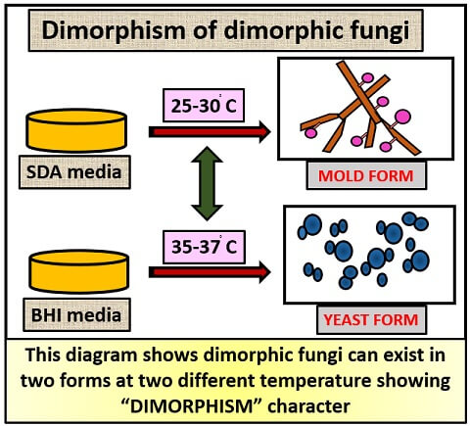
Dimorphism in fungi is likely to have arisen independently a number of times. The polyphyletic nature of dimorphism is evident in the distribution of organisms with this capability across the fungal kingdom . Dimorphic fungi exist in the three major phyla of fungi: the Ascomycota, Basidiomycota, and Zygomycota. In the Ascomycota, they are distributed across several orders and are closely related to many non- dimorphic fungi.

Slide 8
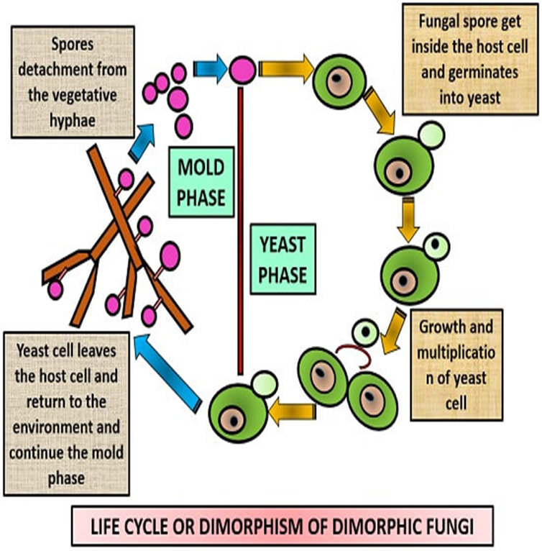

Slide 9
Pneumocystis
Considered for a long time an enigmatic pulmonary unicellular parasite of unknown biological significance in man and other mammals, it is now well established that the ascomycetous Pneumocystis genus contains numerous host species-specific species widely spread across ecosystems.
Interestingly, advances in this field have had a beneficial impact on the understanding of the natural history of Pneumocystis infection. On the basis of the identification of several species in the genus and the demonstration that each Pneumocystis species can only infect its own specific host new patterns of Pneumocystis pneumonia (PcP) epidemiology are emerging.

Slide 10
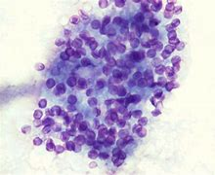
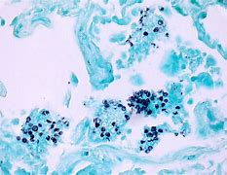

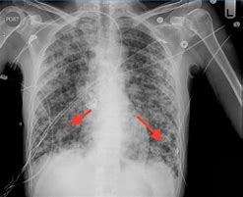
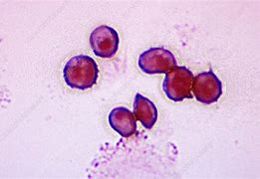

Slide 11
The Pneumocystis genus: from Protoctists to Fungi
Pneumocystis was named and described as a new biological entity. The choice of the Latin name stems from the tropism of the organism for the lungs (Pneumo-), its round shape (-cystis).
At this time, Pneumocystis was hypothetically linked with coccidian protozoa. The controversy about the taxonomic classification of Pneumocystis, especially its fungal vs. protozoan nature, began and continued to gain momentum until the end of the 1980s.
However, since 1988 many pieces of evidence have been brought together that indicate that Pneumocystis belongs in the group of Fungi.
gene encoding a protein that showed Saccharomyces cerevisiae and Candida albicans was characterized in Pneumocystis.
Today, pulmonary cysts have been placed in the classification of fungi due to the similarity of their genetic and phenotypic characteristics with fungal groups.

Slide 12
phylum : Ascomycota
subphylum: Taphrinomycotina
Order: Pneumocystidales
Class: Pneumocystidomycetes
Family: Pneumocystidaceae
Genus: Pneumocyst

Slide 13
Pneumocystis jirovecii
is a fungus that causes serious pneumonia in individuals with weakened immune systems. It coevolved with humans and is highly adapted to living in the lungs of healthy people without causing symptoms. Healthy carriers can spread the fungus from one human to another through airborne transmission.
Pneumocystis pneumonia was rare before the HIV/ AIDS epidemic but quickly became an AIDS-defining illness, afflicting approximately 75% of people with AIDS.
Pneumocystis pneumonia remains a frequent opportunistic infection has been increasing in prevalence in patients not infected with HIV, including those with lung disease, inflammatory or autoimmune disease, or cancers of the blood or lymph systems, or those who had received transplants.

Slide 14
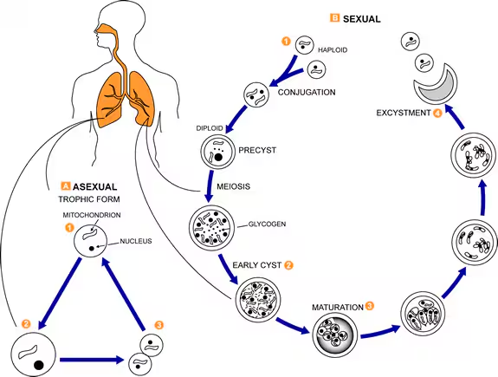
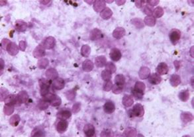
Life cycle of Pneumocystis

