Slide 1
Hypothesis Testing

Slide 2
What is Hypothesis?
A hypothesis is an assumption that is made based on some evidence. This is the initial point of any investigation that translates the research questions into predictions. It includes components like variables, population and the relation between the variables. A research hypothesis is a hypothesis that is used to test the relationship between two or more variables.
Characteristics of Hypothesis
Following are the characteristics of the hypothesis:
The hypothesis should be clear and precise to consider it to be reliable.
If the hypothesis is a relational hypothesis, then it should be stating the relationship between variables.
The hypothesis must be specific and should have scope for conducting more tests.
The way of explanation of the hypothesis must be very simple and it should also be understood that the simplicity of the hypothesis is not related to its significance.

Slide 3
Sources of Hypothesis
Following are the sources of hypothesis:
The resemblance between the phenomenon.
Observations from past studies, present-day experiences and from the competitors.
Scientific theories.
General patterns that influence the thinking process of people.
Types of Hypothesis
There are six forms of hypothesis and they are:
Simple hypothesis
Complex hypothesis
Directional hypothesis
Non-directional hypothesis
Null hypothesis
Associative and casual hypothesis

Slide 4
Null Hypothesis
It provides a statement which is contrary to the hypothesis. It’s a negative statement, and there is no relationship between independent and dependent variables. The symbol is denoted by “H_{O}”.
Example: All lilies have the same number of petals is an example of a null hypothesis.
Functions of Hypothesis
Following are the functions performed by the hypothesis:
Hypothesis helps in making an observation and experiments possible.
It becomes the start point for the investigation.
Hypothesis helps in verifying the observations.
It helps in directing the inquiries in the right direction.

Slide 5
Hypothesis Testing
Investigators conducting studies need research questions and hypotheses to guide analyses. Starting with broad research questions (RQs), investigators then identify a gap in current clinical practice or research. Any research problem or statement is grounded in a better understanding of relationships between two or more variables.
Example of Research Question: Is Drug 23 an effective treatment for Disease A?
Research questions do not directly imply specific guesses or predictions; we must formulate research hypotheses. A hypothesis is a predetermined declaration regarding the research question in which the investigator(s) makes a precise, educated guess about a study outcome. This is sometimes called the alternative hypothesis and ultimately allows the researcher to take a stance based on experience or insight from medical literature. An example of a hypothesis is below.
Research Hypothesis: Drug 23 will significantly reduce symptoms associated with Disease A compared to Drug 22.

Slide 6
The null hypothesis states that there is no statistical difference between groups based on the stated research hypothesis.
P Values
P values are used in research to determine whether the sample estimate is significantly different from a hypothesized value. The p-value is the probability that the observed effect within the study would have occurred by chance if, in reality, there was no true effect. Conventionally, data yielding a p<0.05 or p<0.01 is considered statistically significant. While some have debated that the 0.05 level should be lowered, it is still universally practiced. Hypothesis testing allows us to determine the size of the effect.
An example of findings reported with p values are below:
Statement: Drug 23 reduced patients' symptoms compared to Drug 22. Patients who received Drug 23 (n=100) were 2.1 times less likely than patients who received Drug 22 (n = 100) to experience symptoms of Disease A, p<0.05.
Or

Slide 7
Statement:
Individuals who were prescribed Drug 23 experienced fewer symptoms (M = 1.3, SD = 0.7) compared to individuals who were prescribed Drug 22 (M = 5.3, SD = 1.9). This finding was statistically significant, p= 0.02.
For either statement, if the threshold had been set at 0.05, the null hypothesis (that there was no relationship) should be rejected, and we should conclude significant differences. Noticeably, as can be seen in the two statements above, some researchers will report findings with < or > and others will provide an exact p-value (0.000001) but never zero. When examining research, readers should understand how p values are reported. The best practice is to report all p values for all variables within a study design, rather than only providing p values for variables with significant findings. The inclusion of all p values provides evidence for study validity and limits suspicion for selective reporting/data mining.

Slide 8
To test a hypothesis, researchers obtain data on a representative sample to determine whether to reject or fail to reject a null hypothesis. In most research studies, it is not feasible to obtain data for an entire population. Using a sampling procedure allows for statistical inference, though this involves a certain possibility of error.

Slide 9
Chi-Square Test Definition
A chi-square test is a statistical test that is used to compare observed and expected results. The goal of this test is to identify whether a disparity between actual and predicted data is due to chance or to a link between the variables under consideration. As a result, the chi-square test is an ideal choice for aiding in our understanding and interpretation of the connection between our two categorical variables.
A chi-square test or comparable nonparametric test is required to test a hypothesis regarding the distribution of a categorical variable. Categorical variables, which indicate categories such as Blood groups or Gender, can be nominal or ordinal. They cannot have a normal distribution since they can only have a few particular values.
It is used to calculate the difference between two categorical variables, which are:
As a result of chance or
Because of the relationship

Slide 10
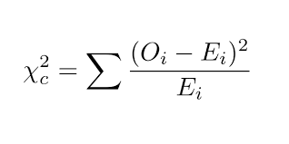
Formula For Chi-Square Test
Where
c = Degrees of freedom
O = Observed Value
E = Expected Value
The degrees of freedom in a statistical calculation represent the number of variables that can vary in a calculation. The degrees of freedom can be calculated to ensure that chi-square tests are statistically valid.
Example : Consider a data sample consisting of five positive integers. The values of the five integers must have an average of six. If four of the items within the data set are {3, 8, 5, and 4}, the fifth number must be 10. Because the first four numbers can be chosen at random, the degrees of freedom is four.
The Observed values are those you gather yourselves.
The expected values are the frequencies expected, based on the null hypothesis.

Slide 11
Example: A researcher conducts a survey to investigate the severity of Covid-19 patients in residents of different cities in Iraq. Separate random samples of residents were evaluated as shown in the two-way table which summarizes the condition of these patients. Do these data provide convincing evidence at the α = 0.05 level that the distributions of severity of symptoms differ for residents of Baghdad, Mosul, and Basrah?
 | Baghdad | Mosul | Basrah | Total
Not sever | 690 | 1177 | 702 | 2569
Sever | 250 | 242 | 221 | 713
Very Sever | 40 | 28 | 50 | 118
Life threatening | 20 | 13 | 30 | 63
Total | 1000 | 1460 | 1003 | 3463
1) STATE the Hypothesis
H₀: There is no difference in the true distributions of severity of symptoms for residents
H_{a}: There is a difference in the true distributions of severity of symptoms for residents

Slide 12
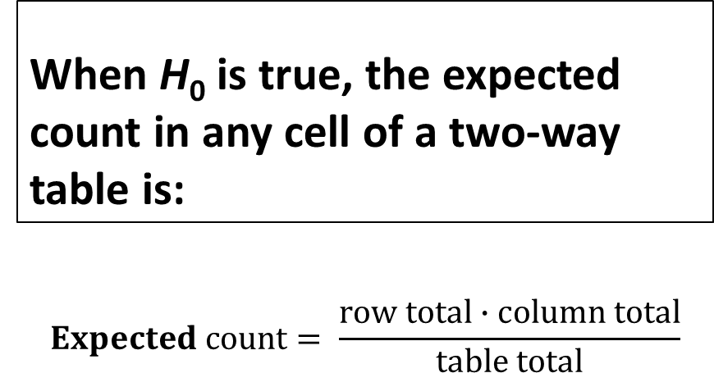
Observed | Baghdad | Mosul | Basrah | Total
Not sever | 690 | 1177 | 702 | 2569
Sever | 250 | 242 | 221 | 713
Very Sever | 40 | 28 | 50 | 118
Life threatening | 20 | 13 | 30 | 63
Total | 1000 | 1460 | 1003 | 3463
2) Calculate Expected values
Calculating Expected Counts for a
Chi-Square Test Based on Data in a
Two-Way Table
When H₀ is true, the expected count in any cell of a two-way table is:
$$Expected count= \frac{row total∙column total}{table total}$$
Expected | Baghdad | Mosul | Basrah | Total
Not sever | 741.8 | 1083.1 | 744.1 | 2569
Sever | 205.9 | 300.6 | 206.5 | 713
Very Sever | 34.1 | 49.7 | 34.2 | 118
Life threatening | 18.2 | 26.6 | 18.2 | 63
Total | 1000 | 1460 | 1003 | 3463
=(2569*1000)/3463
=741.8

Slide 13
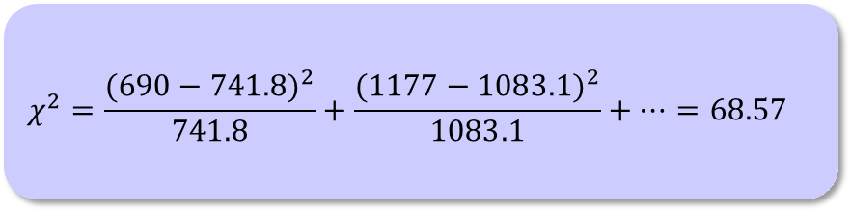
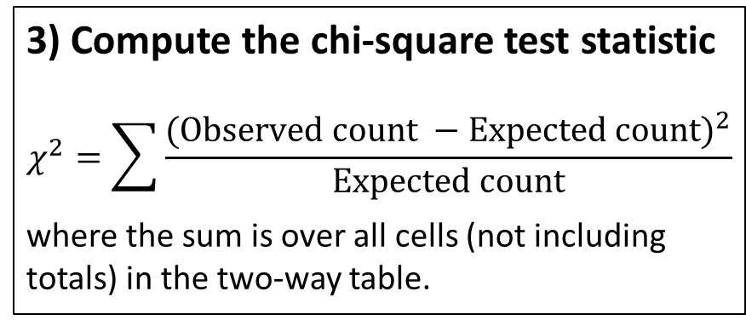
Observed | Baghdad | Mosul | Basrah | Total
Not sever | 690 | 1177 | 702 | 2569
Sever | 250 | 242 | 221 | 713
Very Sever | 40 | 28 | 50 | 118
Life threatening | 20 | 13 | 30 | 63
3) Compute the chi-square test statistic
$$χ^{2}=\sum{\frac{{(Observed count −Expected count)}^{2}}{Expected count}}$$
where the sum is over all cells (not including totals) in the two-way table.
Expected | Baghdad | Mosul | Basrah | Total
Not sever | 741.8 | 1083.1 | 744.1 | 2569
Sever | 205.9 | 300.6 | 206.5 | 713
Very Sever | 34.1 | 49.7 | 34.2 | 118
Life threatening | 18.2 | 26.6 | 18.2 | 63
$$χ^{2}=\frac{{(690−741.8)}^{2}}{741.8}+\frac{{(1177−1083.1)}^{2}}{1083.1}+⋯=68.57$$
Statistics | Baghdad | Mosul | Basrah
Not sever | 3.6 | 8.1 | 2.4
Sever | 9.4 | 11.4 | 1.0
Very Sever | 1.0 | 9.5 | 7.3
Life threatening | 0.2 | 6.9 | 7.6

Slide 14
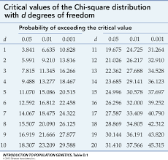
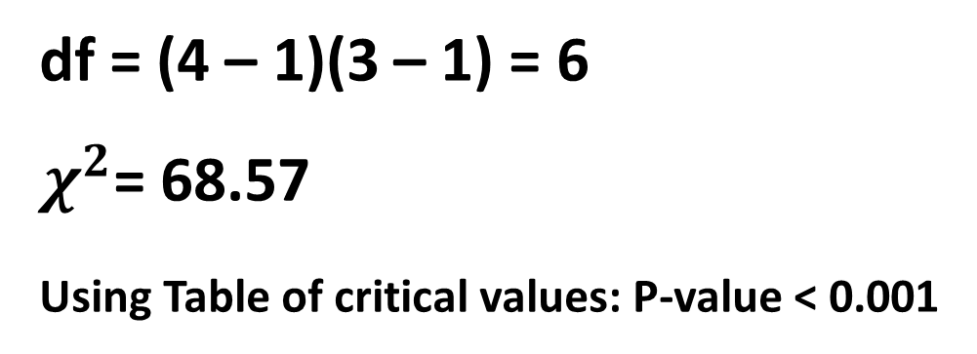
4) The P-value is the area to the right of χ² under the chi-square density curve with degrees of freedom
= (num. of rows – 1)(num. of columns – 1).
df = (4 – 1)(3 – 1) = 6
$χ^{2}$= 68.57
Using Table of critical values: P-value < 0.001
CONCLUDE
Because the P-value < α = 0.05, we reject H₀. There is convincing evidence that there is a difference in the true distributions of severity for residents of the cities.

Slide 15
common uses:
1) Goodness-of-Fit Test (Chi-squared goodness-of-fit test): This test is used when you want to determine if the observed data fits a specific theoretical or expected distribution. For example, you might want to check if the distribution of blood types in a population follows the expected proportions (e.g., ABO blood group distribution).
Example: Blood Type Distribution
Imagine a researcher wants to determine if the distribution of blood types in a population follows the expected proportions based on the ABO blood group system. According to the ABO blood group system, there are four major blood types: A, B, AB, and O. The expected distribution in a specific population, based on historical data or known genetic frequencies, is as follows:
Blood Type A: 40%
Blood Type B: 10%
Blood Type AB: 4%
Blood Type O: 46%

Slide 16
The researcher collects data from a sample of 500 individuals in the population and records their blood types. The observed distribution in the sample is as follows:
Blood Type A: 200 individuals
Blood Type B: 80 individuals
Blood Type AB: 10 individuals
Blood Type O: 210 individuals
The researcher wants to know if the observed distribution significantly differs from the expected distribution based on the ABO blood group system. To do this, they perform a Chi-squared goodness-of-fit test:

Slide 17
Step 1: Formulate Hypotheses
Null Hypothesis (H0): The observed distribution of blood types in the population follows the expected distribution based on the ABO blood group system.
Alternative Hypothesis (Ha): The observed distribution of blood types in the population does not follow the expected distribution based on the ABO blood group system.
Step 2: Set Significance Level
The researcher decides on a significance level (e.g., α = 0.05), which represents the probability of making a Type I error (rejecting the null hypothesis when it's true).
Observed Counts
Blood Type A B AB O
---------------------------------------------
Observed 200 80 10 210

Slide 18
Step 3: Create a Contingency Table
Blood Type Expected Count (E) Observed Count (O)
A 0.40 * 500 = 200 200
B 0.10 * 500 = 50 80
AB 0.04 * 500 = 20 10
O 0.46 * 500 = 230 210
Step 4: Calculate the Chi-squared Statistic
The formula for the Chi-squared statistic is:
χ² = Σ [(O - E)² / E]
Calculate χ²:
χ² = [(200 - 200)² / 200] + [(80 - 50)² / 50] + [(10 - 20)² / 20] + [(210 - 230)² / 230]

Slide 19
Step 5: Determine the Degrees of Freedom
Degrees of freedom (df) in this test equal the number of categories minus 1. In this case, df = 4 - 1 = 3.
Step 6: Find the Critical Value or P-value
Using the Chi-squared distribution table or a calculator, you can find the critical value or p-value associated with χ² and df.?????
Step 7: Make a Decision
If the calculated χ² is greater than the critical value or if the p-value is less than the chosen significance level (α), then you reject the null hypothesis.
If χ² is less than the critical value or if the p-value is greater than α, you fail to reject the null hypothesis.

Slide 20
2) Chi-squared Test for Independence (Chi-squared test of association): This test is used to examine the relationship between two categorical variables. In medicine, it's often employed to investigate whether there is a significant association between two factors, such as smoking status and the development of lung cancer. The test is performed on a contingency table to determine if there is a statistically significant association or independence between the two variables.
Null Hypothesis (H0): There is no association between the variables.
Alternative Hypothesis (Ha): There is an association between the variables.
Example: Drug Efficacy and Patient Outcomes
Suppose a pharmaceutical company has developed a new drug designed to treat a specific medical condition, and they want to determine if the drug's efficacy is associated with the age group of patients. They have conducted a clinical trial involving 200 patients, and they collect data on whether each patient's condition improved or not after taking the drug. Additionally, they categorize patients into two age groups: "Young" (under 40 years old) and "Old" (40 years old and above).

Slide 21
The data collected is organized in a contingency table:
Patient Outcome
Age Group Improved Not Improved
--------------------------------------------------------------
Young (Under 40) 60 40
Old (40 and above) 45 55
In this contingency table:
The pharmaceutical company is interested in determining whether there is a statistically significant association between the age group of patients and their treatment outcomes (improved or not improved) when using this new drug.???
To analyze this association, they can perform a Chi-squared Test for Independence.

Slide 22
3) Chi-squared Test for Homogeneity: This test is used when you have two or more independent samples, and you want to determine whether the proportions of certain categorical outcomes are similar across these samples. For example, it can be used to compare the success rates of different treatments for a particular medical condition.
Null Hypothesis (H0): The proportions are the same across all groups.
Alternative Hypothesis (Ha): The proportions are different across at least one group.
Example: Comparing Treatment Outcomes in Different Hospitals
Imagine a study that aims to compare the success rates of a specific surgical procedure for a particular medical condition across three different hospitals. The researchers want to determine if there is a significant difference in the success rates among these hospitals. They collect data on the outcomes of the surgical procedure for 300 patients (100 patients from each hospital) and categorize the outcomes into "Successful" and "Unsuccessful.“??????
Here's the data organized in a contingency table:

Slide 23
Surgical Outcome
Hospital Successful Unsuccessful
--------------------------------------------------------
Hospital A 75 25
Hospital B 85 15
Hospital C 60 40
In this contingency table:
The researchers want to determine if the proportion of successful outcomes is the same across all three hospitals or if there is a significant difference. To do this, they can use the Chi-squared Test for Homogeneity.

