Slide 1


University of Baghdad
College of Medicine
2024-2025
Title: Entamoeba histolytica
Grade: 3rd grade
Module: ID
Speaker: Assistant professor Suha Abdullah AL-Fakhar
Date:7 /11/2024

Slide 2


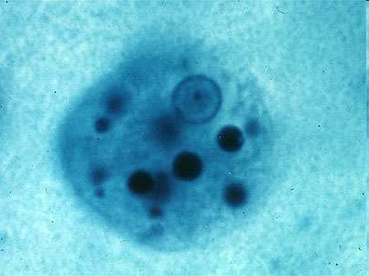
GIT protozoa Entamoeba histolytica
(the intestinal pathogenic amoebae of man)

Slide 3

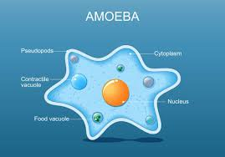
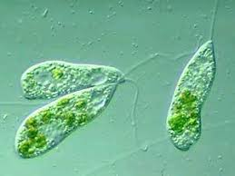
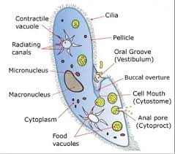
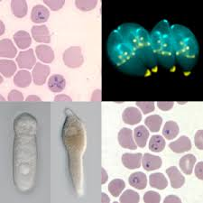
The Protozoa are classified according to the type of the locomotion organelles:
1- Sarcodina ( amoebae )
2- Mastigophora ( flagellates )
3-Ciliata ( Ciliates )
4- Apicomplexa(undulating membrane).

Slide 4
Objectives:
• Define E.histolytica &Amoebiasis .
• Know the distribution of Amoebiasis.
• Describe the habitat of E.histolytica .
Explain the types and sites of amoebic infection ( amoebiasis) in man.
Enumerate the forms of E.histolytica.
List the mode of transmission and Describe the life cycle of E.histolytica .
Enumerate the clinical symptoms and pathogenicity and pathology of E.histolytica .
• Determine the diagnosis of amoebiasis.
• Mention the prevention of amoebiasis.

Slide 5
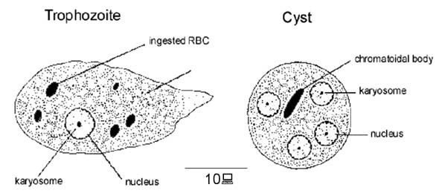
Entamoeba histolytica
Intestinal Pathogenic amoebae
Entamoeba histolytica

Slide 6

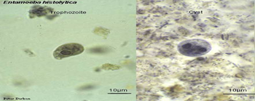
Troph. and Cyst of E.histolytica
Troph.
Cyst

Slide 7
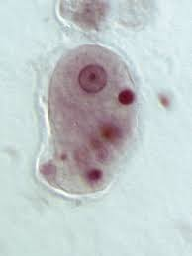
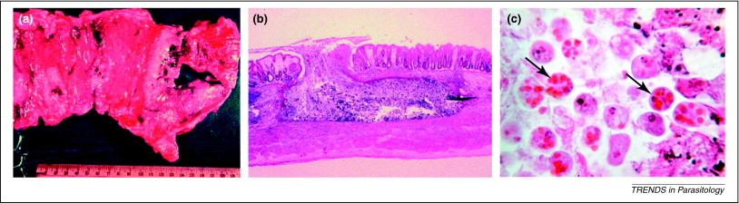
E. histolytica: as its name suggests (histo–lytic = tissue destroying), is pathogenic; infection can be asymptomatic or can lead to amoebic dysentery or amoebic liver abscess. E. histolytica is a major cause of morbidity and mortality wherever sewage facilities are inadequate, particularly in third world countries and countries in civil conflict or war.
E.histolytica Troph.

Slide 8
Dysentery is an inflammatory disease of the intestine ,especially of the colon ,which always results in severe diarrhea and abdominal pains. Other symptoms may include fever and a feeling of incomplete defecation. The disease is caused by several types of infectious pathogens such as bacteria, viruses and parasites.

Slide 9
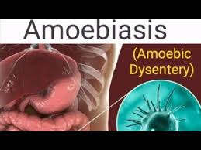
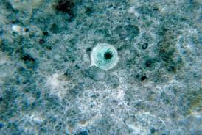
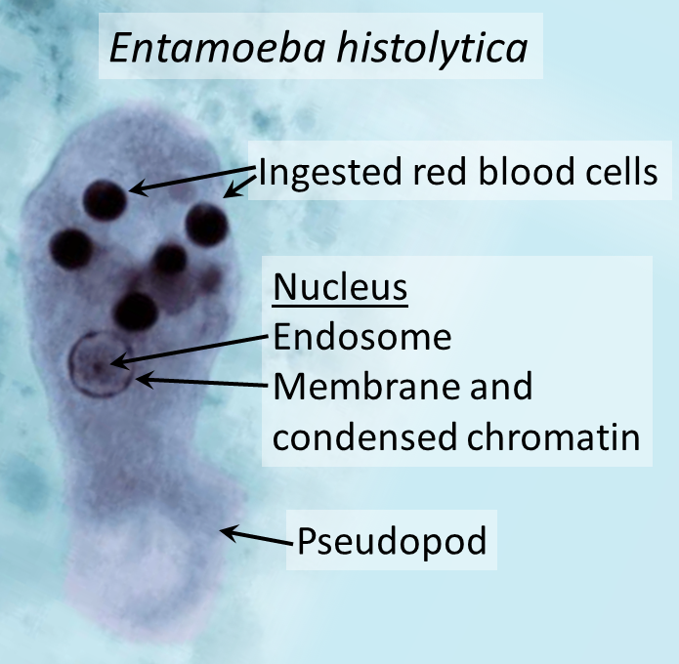
Disease caused by Entamoeba histolytica called :
amoebiasis, amoebic colitis or amoebic dysentery.
cyst
troph.

Slide 10

Amoebiasis, amoebic colitis or amoebic dysentery:
Amoebiasis is an infection caused by E.histolytica
E. histolytica is now known to consist of 2 genetically distinct species : E. histolytica, which is pathogenic(invasive parasite) and E. dispar, which is non-pathogenic(noninvasive parasite) .
Cysts of the two species are identical, but can be distinguished by molecular techniques after culture of the trophozoite. E. histolytica can be distinguished from all amoebae except E. dispar, and from other intestinal protozoa, by microscopic appearance.

Slide 11

Distribution:
Amoebiasis occurs world-wide, although much higher incidence rates are found in the tropics and subtropics. the rates of infection are higher in crowded areas with poor personal hygiene and low socioeconomic status e.g. mental hospitals, prisons and children homes.

Slide 12
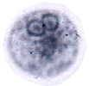
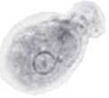
Entamoeba histolytica
cosmopolitan distribution
worldwide incidence: 0.2-50%
no animal reservoirs
typical fecal-oral life cycle
  inhabits large intestine
facultative virulent pathogen
  estimated 50 million cases/year
  100,000 deaths/year
cyst
Entamoeba dispar
morphologically identical
non-pathogenic
trophozoite

Slide 13
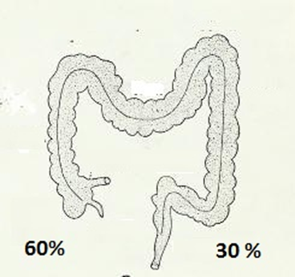
Types of E. histolytica Infection: in Man(according to the location)
There are two types of amoebiasis:
1.Intestinal amoebiasis (primary infection).
2.Extra-intestinal amoebiasis (secondary infection)).
Sites of Intestinal Infection:
The infection may occurs at any point of large intestine, but the most frequent primary sites are the cecum (about 60%) and the sigmoid-rectal region (about 30%).

Slide 14
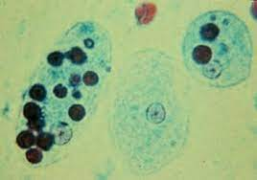
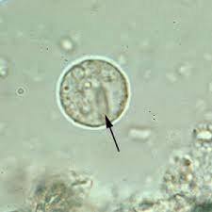
The Forms of E.histolytica
Since E. histolytica can exist in two forms, both forms are present in contaminated food and drinks:
Trophozoites (free amoeba)
Infective cysts (which are surrounded by a protected wall)
Ingesting the trophozoite form is not harmful—the trophozoites usually die in the acidic stomach of a person. However, the cysts form are quite resistant to various environmental conditions, and are thus able to survive in the acidic contents of the stomach and go on to cause infection.

Slide 15
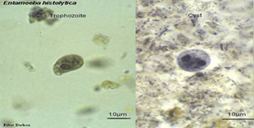
Troph.&Cyst of E.histolytica
  Cysts are transmitted by ingestion of contaminated food or water, or spread directly by person-to-person contact.
  Trophozoites emerge from the cysts in the small intestine and then pass on to the colon, where they multiply..

Slide 16
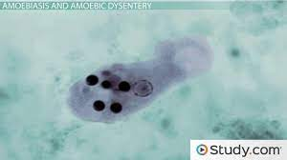
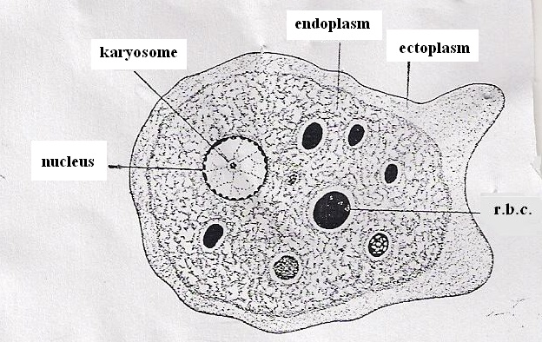
Trophozoite of E.histolytica
Morphology: The majority of trophozoites measure from 15 to 30 ㎛. The hyaline ectoplasm, sharply separated from the endoplasm, constitutes about one-third of the entire trophozoite. The thin, fingerlike ectoplasmic pseudopodia are extended rapidly. Hematoxylin staining reveals a nuclear membrane, the inner surface of which is lined with uniform chromatin. The small, deeply staining karyosome is centrally located. The trophozoite ingests RBCs which may be seen in fresh specimen or stained smear.
Troph. of E.histolytica

Slide 17
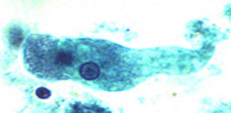
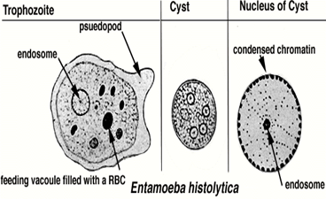

Slide 18
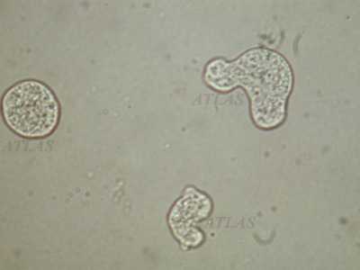
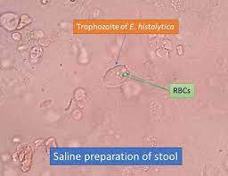
Live trophozoites of Entamoeba histolytica. Note the extending pseudopodia from the ectoplasm.

Slide 19
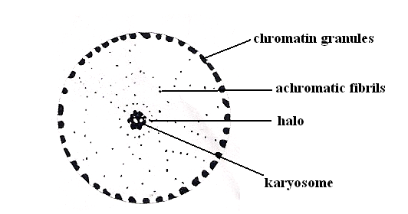
The trophozoite contain single spherical nucleus surrounded by nuclear membrane. The chromatin materials found on inner surface of nuclear membrane with regularly distributed granule and in the center of the nucleus there is a karyosome.
The nucleus is called histolytica type nucleus.
Histolytica type nucleus

Slide 20
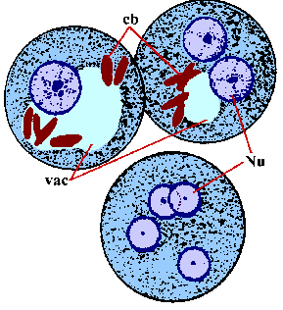
Cyst of E.histolytica
The round or oval cysts measure 10 to 20 ㎛ in diameter, and contain one to four nuclei and sausage-shaped chromatoid bodies.
Cyst with Chromatoidal Body: Early stages of cyst formation of have chromatoidal bodies (nucleic acids) present. These bodies can vary in size but always have rounded ends . Diffuse glycogen mass also present in the cytoplasm .

Slide 21
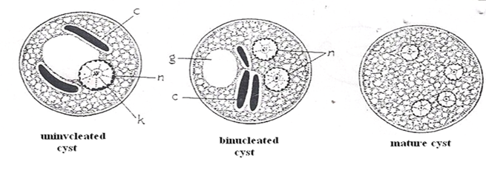
Cyst of Entamoeba histolytica, 5-20 ㎛ in size. Chromatoid bodies are often present with thick rodlike masses. The number of nuclei is 1-4.

Slide 22
The active (trophozoite) stage exists only in the host and in fresh loose feces; cysts survive outside the host in water, in soils, and on foods, especially under moist conditions on the latter. And for up 45minutes under fingernails.
The cysts are readily killed by heat and by freezing temperatures, and survive for only a few months outside of the host.When cysts are swallowed they cause infections by excysting (releasing the trophozoite stage) in the digestive tract.

Slide 23



Mode of transmission:
1- Feco – oral route (ingestion of contaminated food and water ) through exposure to human feces or through flies .
2- Cyst passing carriers .
3- Sexual transmission also occurs mainly in homosexual .

Slide 24
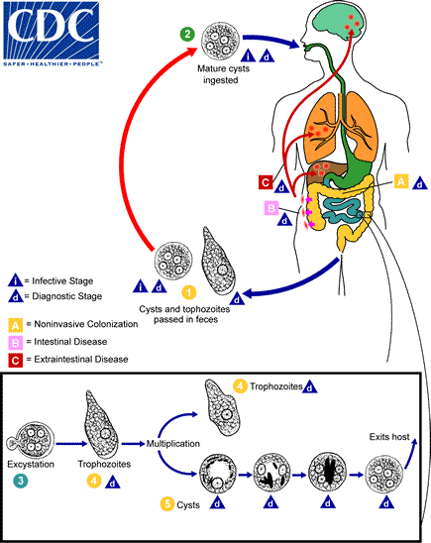
The Life Cycle of E.histolytica
Life cycle of E.histolytica

Slide 25

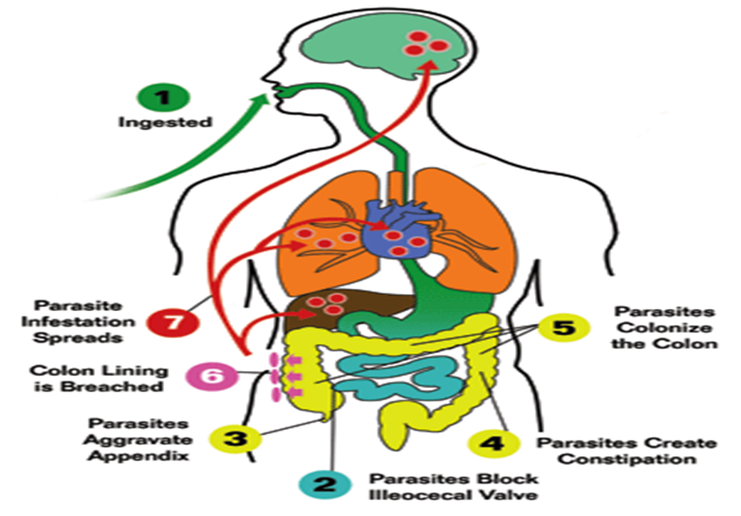
Life Cycle of E.histolytica
< Infection occurs by ingestion of cysts (generally from fecally contaminated food or water)
< Excystation occurs in the ileum of the small intestine
< Trophozoites multiply by binary fission in the large intestine. Most remain in the lumen of the intestine, however, some may invade the intestinal mucosa, enter the bloodstream and develop in extraintestinal sites.
< Cyst formation is triggered by the dehydration of gut contents in asymptomatic carriers.

Slide 26
Clinical Symptoms of Amoebic Dysentery :
1.Asymptomatic /Carrier state(non-invasive):
A. parasitic with low virulence.
B. inoculation is low.
C. immune system is intact.
2.Symptomatic Intestinal amoebiasis(invasive).
3.Symptomatic (Extraintestinal Amoebiasis).
Amoebiasis can be present with no,mild ,or sever symptoms may include abdominal pain ,diarrhea,or bloody diarrhea.

Slide 27
Symptoms:
can include:
1.fulminating dysentery(watery diarrhea which can contain blood ,mucus or pus).
2.bloody diarrhea,
3.weight loss,
4.fatigue,
5.abdominal pain, and amoeboma(nodular inflammatory thickening around an ulcer occurring mostly in cecum and may lead to intestinal obstruction).
6.Flatulenc.
7.fever and chills.
8.vomiting & nausea.

Slide 28
In acute amebiasis, there is severe dysentery with numerous small stools(foul smell) containing blood, mucus and necrotic mucosa accompanied by acute abdominal pain, tenderness and fever.
Chronic amebiasis is characterized by recurrent attacks of dysentery with gastrointestinal disturbance.
In extraintestinal amebiasis, the liver is invaded chiefly, resulting amebic hepatitis or liver abscess. It is characterized by an enlarged, tender liver, with pain in the upper right hypochondrium. Less frequently, lung abscess, splenic abscess, brain abscess or cutaneous amebic lesions are seen.

Slide 29
Pathogenicity:
Factors affecting the severity of amoebic infection depends on:
1.Host factors(stress, malnutrition such as vitamin C deficiency ,alcoholism, host immunity).
2.Parasite factors (virulence of strain, size of inoculum).
3.Enviromental factors: (pH, bacterial flora, intestinal mucus).

Slide 30
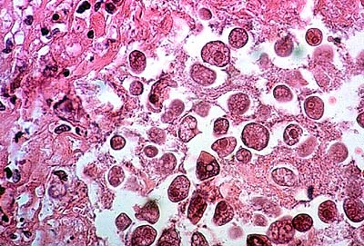
Entamoeba histolytica
Pathology
The first step in the pathogenicity of E. histolytica infection includes colonization of the trophozoites on Intestinal mucosa .
The second step includes destruction and invasion of Intestinal wall through entrance Amoebae the intestinal mucosa by their pseudopodial movements which cause displacement of the cells.

Slide 31
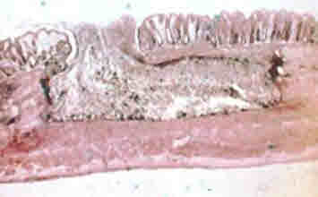

flasked-shaped ulcer’
•trophozoites at boundary of necrotic and healthy tissue .
trophozoites ingesting host cells .
•dysentery (blood and mucus in feces)

Slide 32
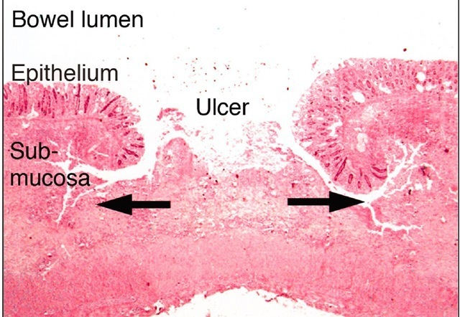
Cont.Pathology of E.histolytica
The lesions produced by E. histolytica are primarily intestinal, and secondarily extraintestinal. The intestinal lesions are confined to the large intestine, frequently cecal and sigmoidorectal regions. The typical flask-like primary ulcers to large necrotic areas are produced.

Slide 33
The amoeba can actually 'bore' into the intestinal wall, causing lesions and intestinal symptoms, and it may reach the blood stream. From there, it can reach different vital organs of the human body, usually the liver, but sometimes the lungs, brain, spleen, etc. A common out of this invasion of tissues is a liver abscess, fatal if untreated. Ingested red blood cells are sometimes seen in the amoeba cell cytoplasm.

Slide 34
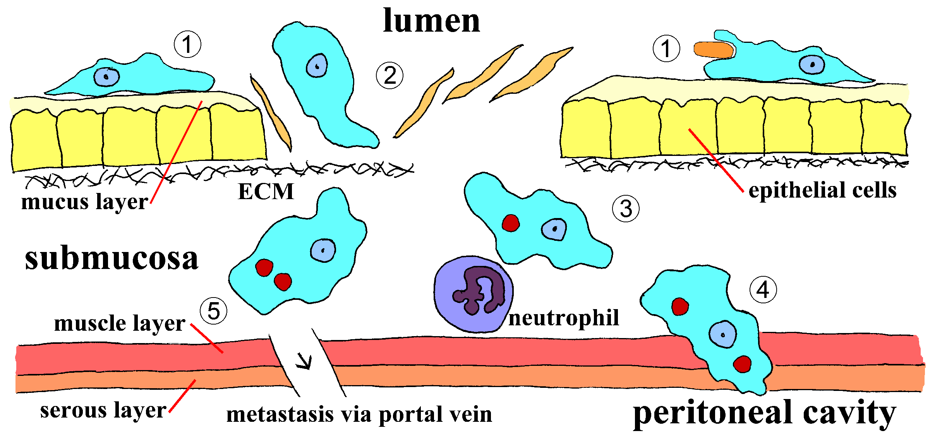
penetration of mucus layer
contact-dependent killing of epithelial cells
breakdown of tissues (extracellular matrix)
contact-dependent killing of neutrophils, leukocytes, etc.

Slide 35
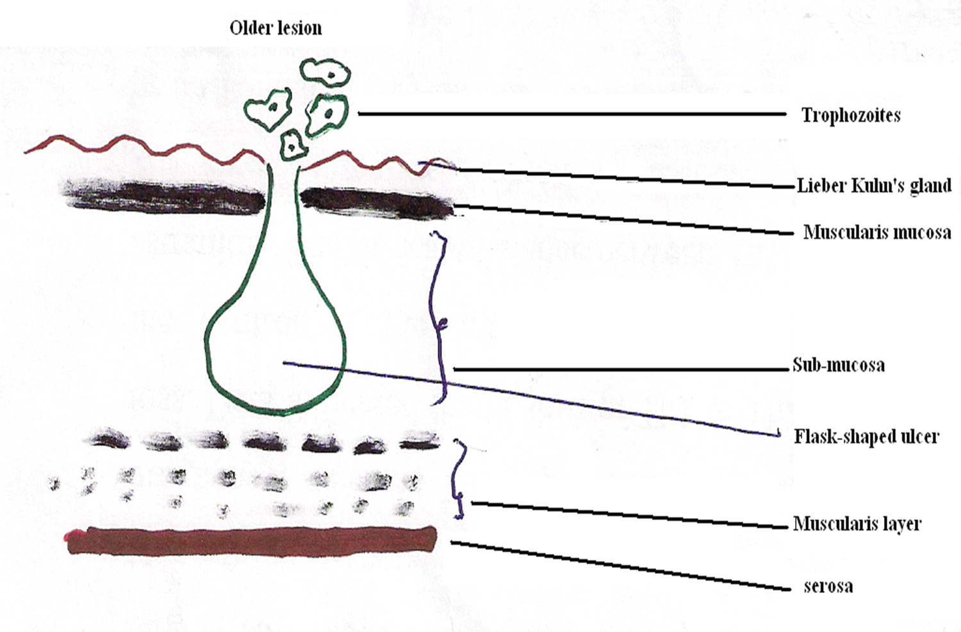

Slide 36
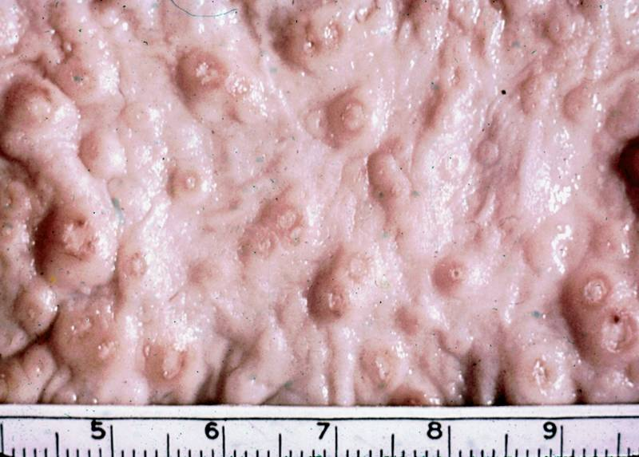
ulcers with raised borders
little inflammation between lesions

Slide 37
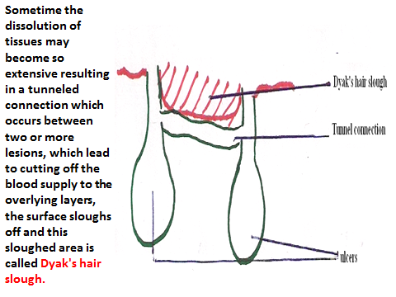

Slide 38
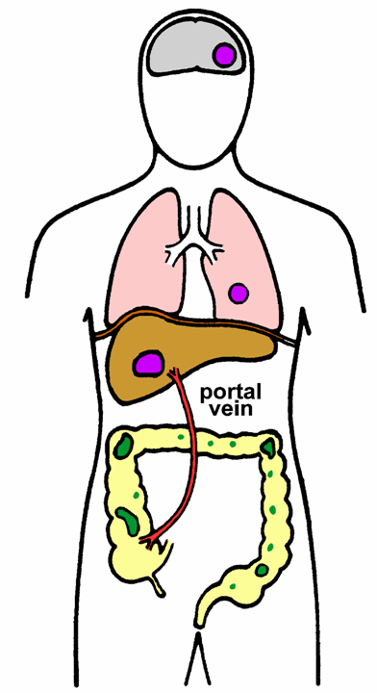
Extraintestinal Amebiasis
metastasis via blood stream
primarily liver (portal vein)
  other sites less frequent
ameba-free stools common
high antibody titers.

Slide 39
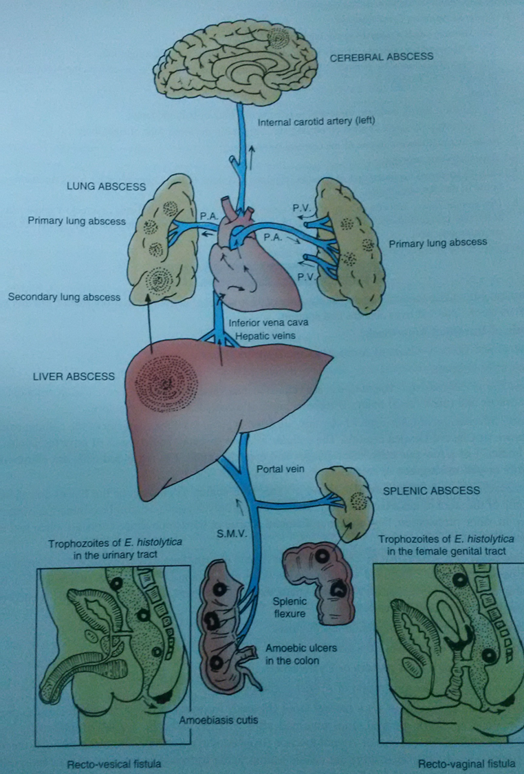

Slide 40
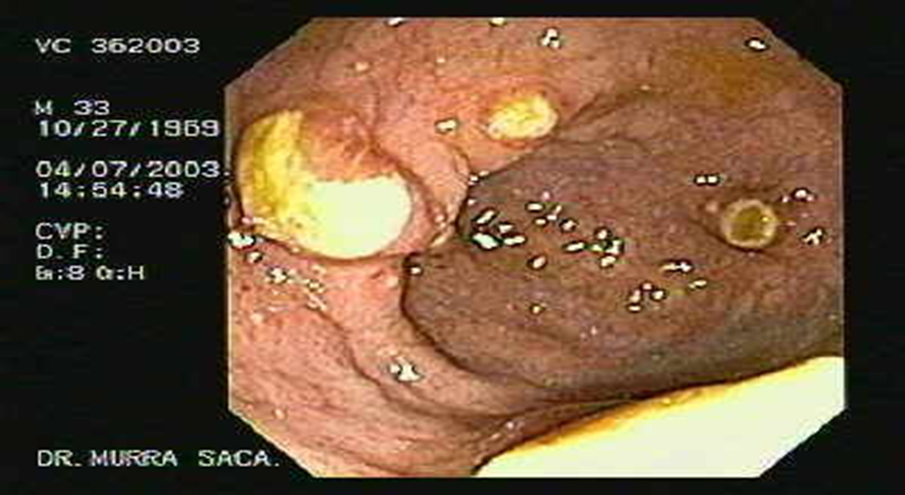
Hepatic amebiasis: The trophozoite reaches the liver through the portal system, provoking enzymatic focal necrosis of hepatocytes and multiple micro-abscesses that coalesce to develop a single lesion whose central cavity contains a homogeneous thick liquid, with typically reddish brown and yellow color similar to "anchovy paste". Right upper quadrant pain, and fever are the predominant symptoms of hepatic amebiasis. hepatomegaly Jaundice is reported in cases with multiple lesions .

Slide 41
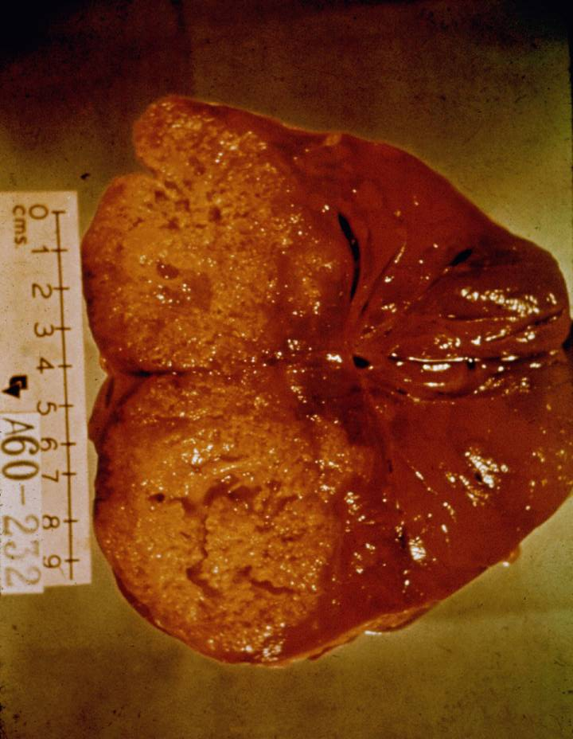
Amebic Liver Abscess
chocolate-colored ‘pus’
  necrotic material
  usually bacteria free
common laboratory findings include:leukocytosis without elevated eosinophilia,elevated alkaline phosphatase,elevated of ESR .

Slide 42
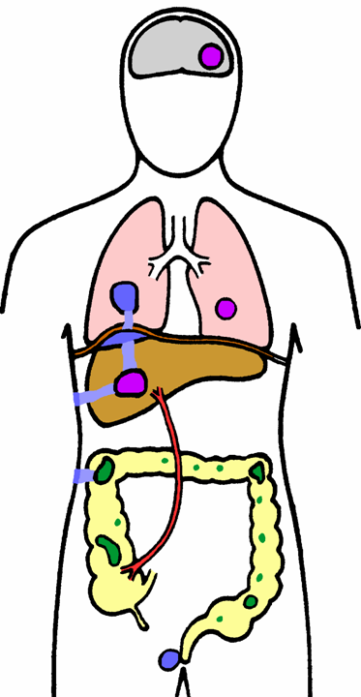
Pulmonary Amebiasis
rarely primary
rupture of liver abscess through diaphragm
2º bacterial infections common
fever, cough, dyspnea, pain, vomica

Slide 43
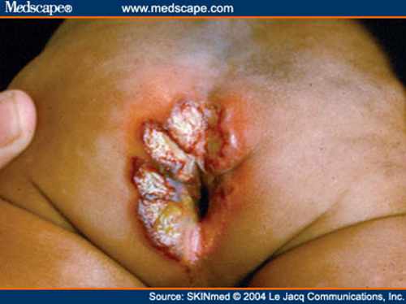

Cutaneous amoebiasis:
is a rare reported complication of amoebic infection ,it involve abdominal wall as a result of surgical interference of colostomy or amoebic liver abscess aspirate or directly from fistulous tracts that arise from intestinal ulcer or hepatic abscess. Also it involve anal and perianal areas by direct extension of rectal lesion .Genital organs may involved mainly in homosexuals.

Slide 44
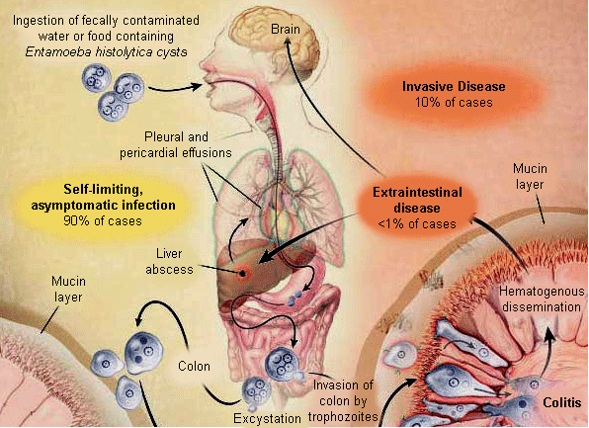
Secondary menigoecephalitis(cerebral amoebiasis):
Primary amoebic meningoecephalitis(PAM)is caused by Nagleria fowleri ( a free living amoebae) ,while secondary meningo ecephalitis is caused by E.histolytica .Cerebral amebiasis is a rare and dreadful complication of E. histolytica infection. The clinical symptoms of cerebral amoebiasis are usually preceded by gastrointestinal, hepatic or respiratory symptoms, History of headache or sensorial disturbances are the most common initial presentations of cerebral amebiasis history of convulsions and tendency to sleep. Amebic brain abscesses may be single or multiple and commonly involve cortical and deep gray matter.

Slide 45
Complications of Intestinal Amoebiasis
1 - Appendicitis.
2 - Perforation.
3 - Peritonitis.
4-Haemorrhage.

Slide 46
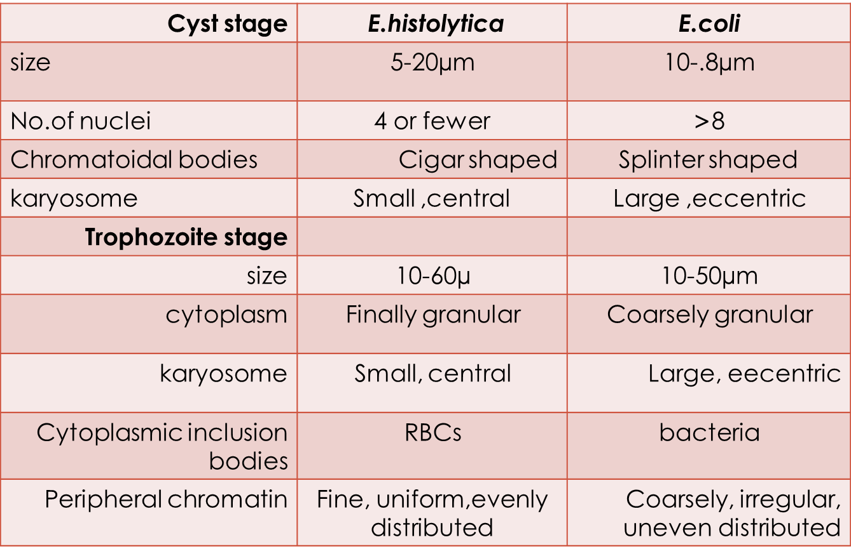

Slide 47
Diagnosis of amoebiasis depend on :
1-Clinical signs and symptoms .
2- Laboratory diagnosis
3- Radiological exam. and different image methods.
4-Sigmoidoscpic or colonoscopic examination.
In case of hepatic abscess can be diagnosed via aspiration(wet and permanent preparations but it is dangerous .

Slide 48
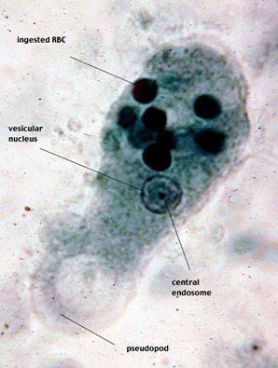
Laboratory Diagnosis of E.histolytica :
A. It can be diagnosed by (GSE), troph. of E.histlolyica may be seen in a fresh diarrheic fecal smear emulsified in a drop of normal saline to detect the presence of ingested RBCs in the vacuoles of the cytoplasm which consider the diagnostic feature of E.histolyitca troph.
E.histolytica troph.

Slide 49
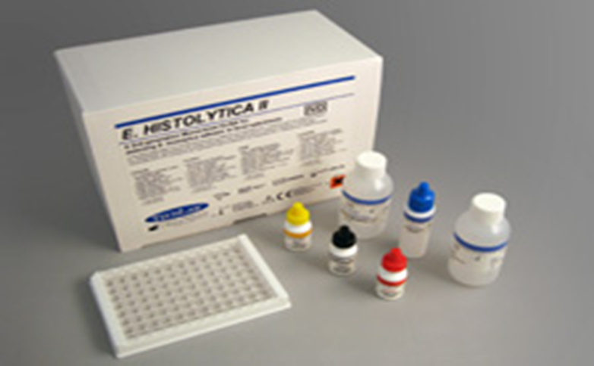
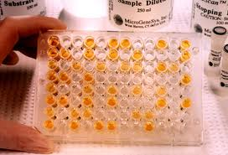
B. Immunologic methods( in extra intestinal amoebiasis): ELISA or RIA can also be used, in case of suspected for E.histolytica but not recovered.
ELISA method

Slide 50
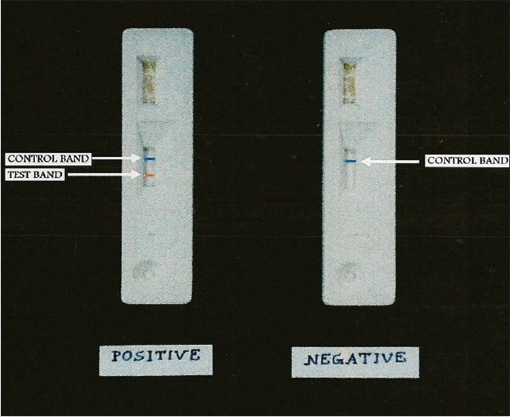
C. stool antigen detection tests offer a practical, sensitive, and specific way for the clinical laboratory to detect intestinal E. histolytica, but unfortunately these tests require fresh (not formalin-preserved) stool for analysis .
stool antigen detection tests

Slide 51
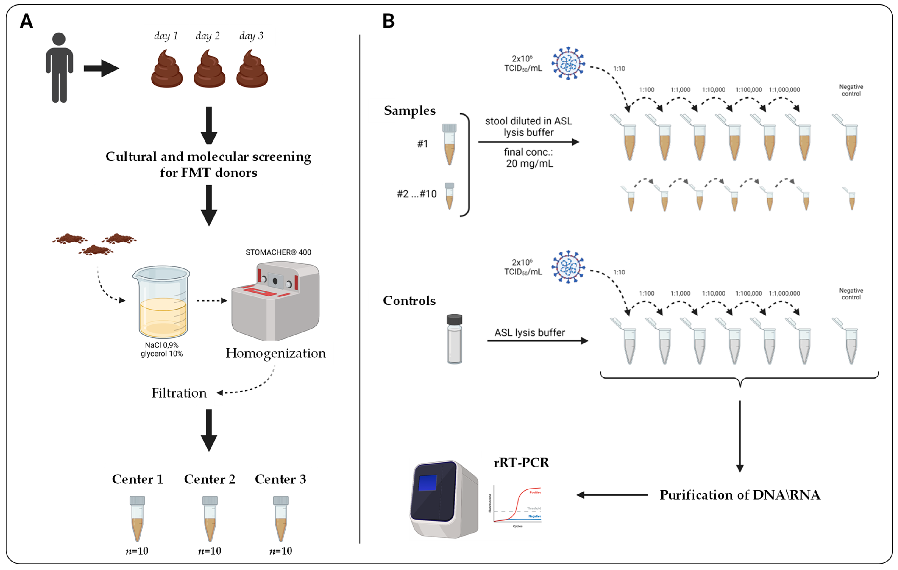
D.Stool molecular studies: with high sensitivity and specificity,but is considered to be more expensive .

Slide 52
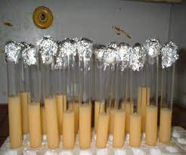

E.Culture on a specific media for recovering E.histolytica troph. such as TYI-S-33 or Robinson's media.

Slide 53


Trophozoitet of E.histolytica
Trophozoites of E.coli

Slide 54




Cyst of E.coli
Young Cyst of E.histolytica
Young cyst of E.coli

Slide 55

Cyst with Chromatoidal Body: Early stages of cyst formation of have chromatoidal bodies (nucleic acids) present. These bodies can vary in size but always have rounded ends.
Cyst of E.histolytica

Slide 56


Prevention of amoebiasis
Environmental sanitation is necessary to prevent water and food contamination. Boiling or filtration of drinking water is a safe and effective way of prevention, and avoidance of consuming contaminated food is essential.

Slide 57

THANK YOU FOR LISTEN

