Slide 1
Colorimetric Assay of Sulfa Drugs
Bratton and Marshall Method

Slide 2
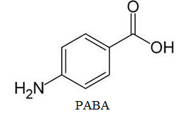
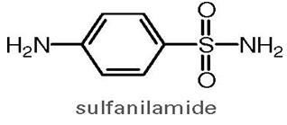
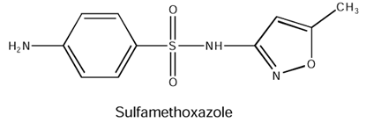
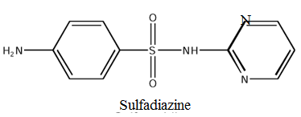
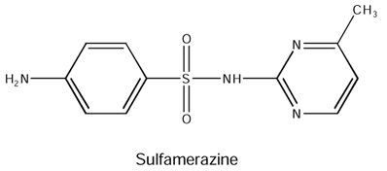
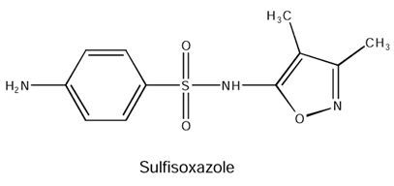
structures

Slide 3
Introduction
The sulfonamide antibacterial drugs were first effective chemotherapeutic agents that could be used systemically for the cure of bacterial infections in humans.
Today there are a few sulfonamides and especially sulfamethoxazole–trimethoprim combination that are used for opportunistic infections in patients with AIDs as treatment or prophylaxis, cerebral toxoplasmosis, also useful in urinary tract infections because of their high excretion fraction through the kidneys, and in burn therapy.
Mechanism of action: sulfonamides are structural analogs of PABA ; they competitively inhibit the net biosynthesis of folate coenzymes that will inhibit bacterial growth and cell division. Thus Sulfonamides are bacteriostatics.

Slide 4
properties
Most of sulfonamides are slightly soluble in water so the main disadvantage is their crystallization in renal tubules.
Sulfonamides are weak acids and they form salts with bases example sodium salts which are very soluble in water.

Slide 5
Assay principle
The method of analysis is based on the presence of the free primary aromatic amine group.
Diazotization: is the reaction in which the free aromatic amine group reacts with nitrous acid (unstable formed by reaction of NaNO2 with mineral acid) to form a diazonium salt and coupling the diazo-compound with N-(1-naphthyl)-ethylene diamine.
A pink color is obtained and the intensity of the color is compared with standards produced by treating Known amount of sulfonamides in a similar manner and measured in the region of 540-550 nm.

Slide 6
Assay principle
Diazonium salts formed should used immediately or it may undergo decomposition.
Diazonium salts are weak electrophiles that react with coupling reagents which are aromatic compounds containing strong electron releasing groups such as (OH, NH2, NHR) rich in electrons leading to formation of azo bond and the resulting compound is an azo dye (colored compound due to the high conjugation).
Excess nitrous acid is removed by addition of sulfamic acid.

Slide 7
Bratton Marshall Method
sulfa drugs show deviation from Beer’s law (the system does not obey Beer’s law), as a result another method is used called Bratton Marshall method:
    Abs. unknown* conc. standard
    Conc. of unknown= ---------------------------------------------
    Abs. standard

