Slide 1
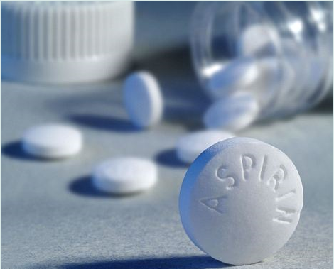

Quantitative Assay of Aspirin Tablets
2021 - 2022
Back Titration

Slide 2

Methods of Analytical Chemistry is of two types:
1- Qualitative Analysis:
It determines the presence or absence of a particular compound, but not the mass or concentration.
By definition , qualitative analysis do not measure quantity.
2- Quantitative Analysis:
It determines how much of each component , or of specified components is present in a given sample.
Methods of Quantitative Chemical Analysis :
1-Volumetric ( Titrimetric ) analysis.
2-Gravimetric analysis.
3-Spectrophotometric analysis.

Slide 3
Requirements For a Titrimetric Assay:
The reaction can be represented
by a chemical equation.
The reaction should be relatively fast.
The reaction should be complete & irreversible.
The end point should be easily detected.

Slide 4
Types of Titration:
1- Forward titration (direct titration).
2- Back titration (indirect titration).
Back Titration:
It includes the addition of an excess of a std. solution to a weighted amount of a sample and then the excess un-reacted std. solution is determined by titration with another std. solution.
Back Titration Is Used For:
1- Volatile substances, e.g., NH3 .
2- Insoluble or slightly soluble substances, e.g. CaCO3
3- Substances for which the quantitative reaction
proceeds rapidly only in the presence of excess
of reagent, e.g., Lactic acid & Aspirin.
4- Substances which decompose on heating, e.g. ,
Formaldehyde.

Slide 5
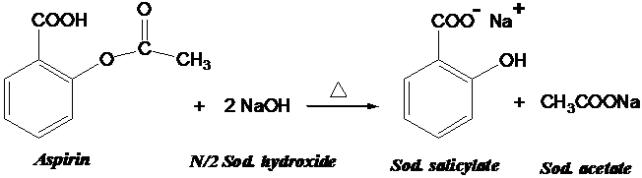
Assay Of Aspirin
Principle:
The determination of the amount of aspirin present in a tablet dosage form is done by alkaline hydrolysis of aspirin using N/2 NaOH standard solution followed by back titrating of the excess unreacted alkali using N/2 HCl std. solution & phenol red as indicator.

Slide 6
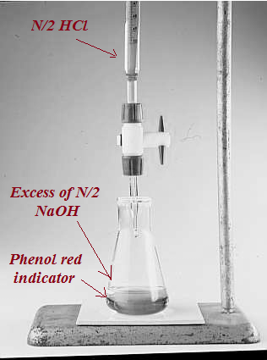
Titration of the excess un-reacted alkali with N/2 HCl std. solution using phenol red indicator
Aspirin readily dissolved in dilute NaOH solution and hydrolyzed completely by gentle boiling for 10 minutes with an excess of a base.

Slide 7
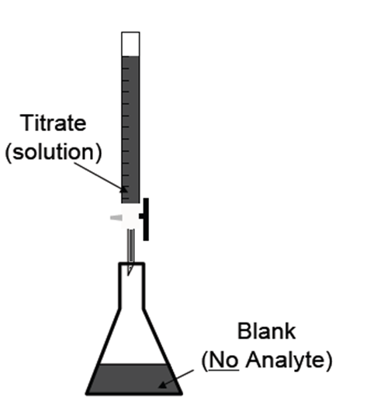
As in other quantitative determination involving boiling with a standard alkali , cooling and back titrating the excess, it’s necessary to carry out
a blank experiment
without the aspirin
In order to:
1- Minimize any error due
to small unavoidable
losses.
2- Heating and cooling an
alkaline liquid results
in an apparent change
in strength if certain
indicators are used .
A separate determination, the sample being omitted, under exactly the same experimental conditions as employed in the actual analysis of the sample.

Slide 8
This change may be due to the interaction of the reagent with the glass or due to , the absorption of atmospheric CO2 ,
CO2 is rapidly absorbed by the hot alkaline solution to form sodium carbonate .
In the back titration with the standard acid the librated CO2 causes a color change of the indicator before the actual end point.
False end point

Slide 9
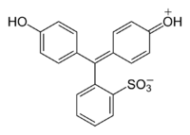
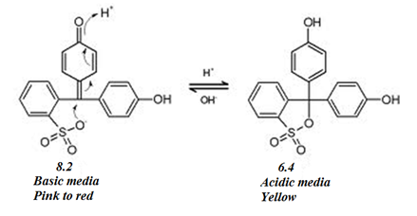
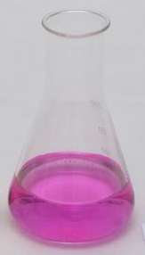
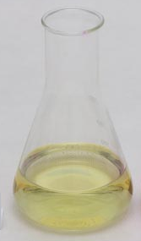
Phenol Red Indicator:
It’s also known as phenolsulfonphthaline
( PSP ) is a pH indicator .

Slide 10
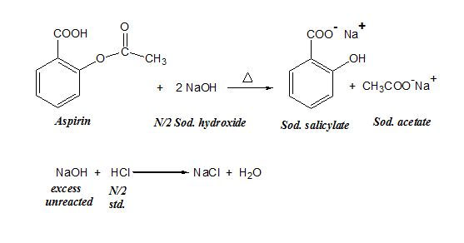
Chemical
Factor

Slide 11
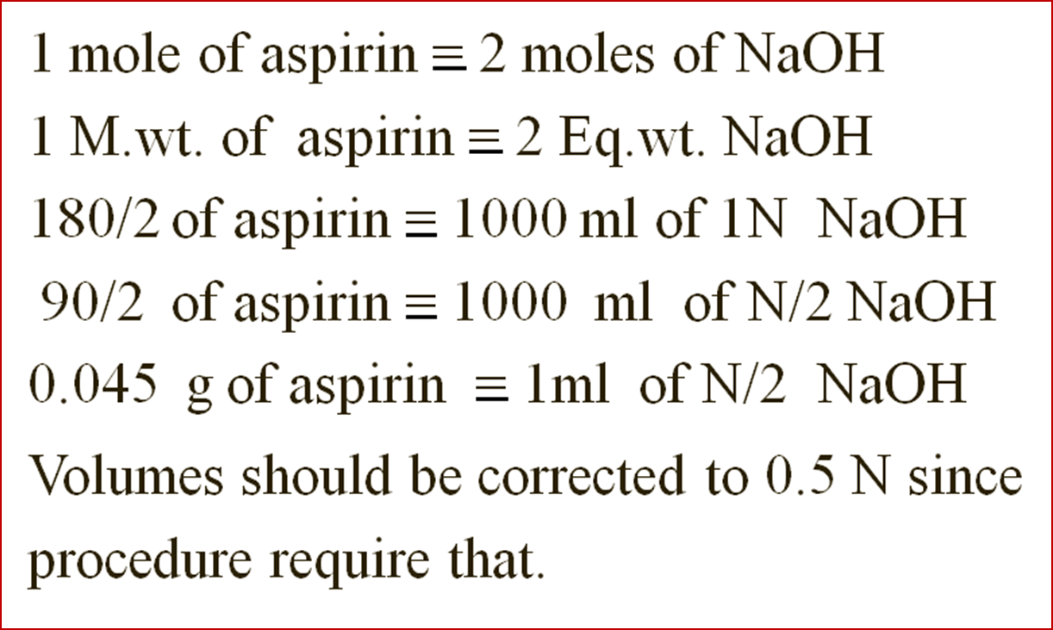
Chemical Factor

Slide 12
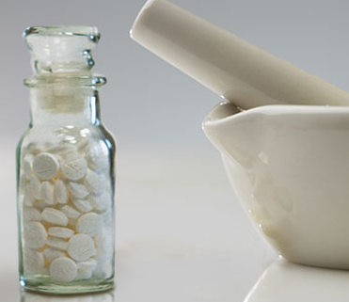
A student had crushed 20 aspirin tablets ( 0.3 g aspirin each ) , recorded the weight of the powder as 6.5 g & he quantitatively analyzed aspirin by back titration .
Using 0.325 g of crushed powdered sample, N/2 NaOH & N/2 HCl std. sln. He recorded the results in the following data table:
Blank exp. | Sample exp.
_____ | 0.325 g | Weight of the powdered aspirin used
30.61 ml | 30.61 ml | Volume of 0.49 N NaOH used
28 ml | 21.5 ml | Volume of 0.51 N HCL consumed
Each 0.045 g of aspirin 1 ml of 0.5 N NaOH std. sln.
1 ml of 0.5 N HCl std. sln.

Slide 13
1- Calculate the average weight of an individual
aspirin tablet?
Answer:
The average wt. of an individual tablet = 6.5 / 20
= 0.325 g
2- How many grams of aspirin ( pure ) is present in
the 0.325 gm student's sample?
Answer:
1st We should correct the normality of the used HCl to
0.5 N: N1*V1=N2*V2, 0.51*21.5=0.5*V2 V2=21.93 ml of 0.5N HCl reacted with excess unreacted NaOH
2nd We should also correct the normality of blank: N3(N1)*V3=N4(N2)*V4, 0.51*28=0.5*V4, V4=28.56 ml of 0.5N HCl consumed in blank experiment

Slide 14
3rd Calculate the volume of 0.5 N HCl reacted with
pure aspirin indirectly: V4-V2=28.56-21.93=6.63ml 0.5N HCl (V5)
4th Calculate the amount of pure aspirin present in the
sample by using the calculated Chemical Factor.
Each 1ml of 0.5 N HCl is equivalent to 0.045 g of Aspirin.
6.63(V5)*0.045= 0.29835 gm aspirin in the one 0.3gm aspirin tablet

