Slide 1


2024-2025
Sulfa drugs
(Sulfonamides)

Slide 2

Sulfonamides:
The sulfonamide antimicrobial drugs were the 1st effective chemotherapeutic agents that had been used for curing the bacterial infection of human wounds during the world war II.

Slide 3
Mechanism of Action:
Sulfonamides are structural analogs of PABA. They competitively inhibit the action of dihydropteroate synthase thereby preventing the addition of PABA to pteridine diphosphate & blocking the net biosynthesis of folate coenzymes. This action arrest bacterial growth and cell division so they are bacteriostatic.
Folates and folate coenzymes are biosynthesized from dietary folic acid in humans and other organisms.
Bacteria and protozoa must biosynthesize their own folates and final folate coenzymes from PABA and pteridine diphosphate. Microbes cannot assimilate folic acid from the growth medium or from the host possibly due to the fact that their cell wall may be impermeable to folic acid.

Slide 4
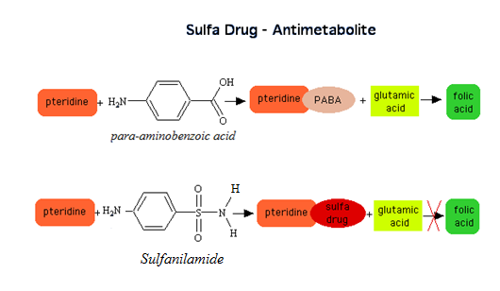

Slide 5
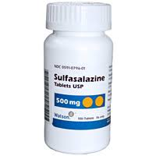
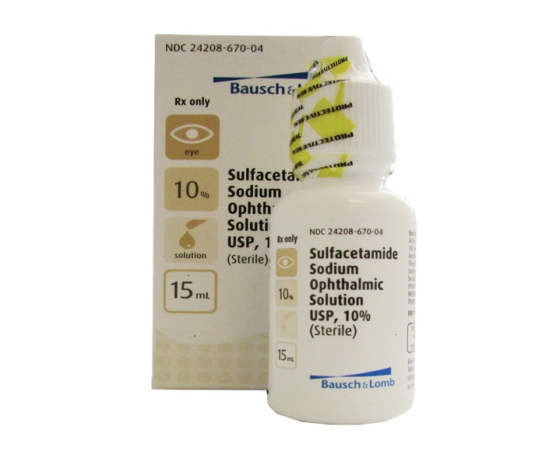
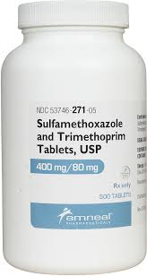
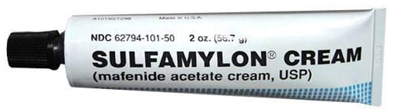

On the basis of their use Sulfonamides can be grouped in to :
a- Oral absorbable systematic used agents such as Sulfamethoxazole.
b- Oral non-absorbable designed agents (e.g. colon targeting) such as Sulfasalazine.
c- Topical agents such as Sodium Sulfacetamide, Mafenide Acetate, Silver Sulfadiazine.

Slide 6
Nomenclature of the sulfonamides:
Sulfonamide is a generic term that denotes 2 general different cases:
A- The Antibacterial Sulfonamides:
1- Aniline substituted sulfonamides,
(unsubstituted Sulfonamide).
e.g. : Sulfanilamide,
4-aminobenzenesulfonamide
2- Nonaniline substituted sulfonamides.
e.g. : Mafenide, 4-(aminomethyl)
benzenesulfonamide

Slide 7
3- Prodrugs that are cleaved to generate active
sulfonamides.
e.g. Sulfasalazine,
5-[p-(2-pyridylsulfamoyl)phenylazo] salicylic acid.

Slide 8
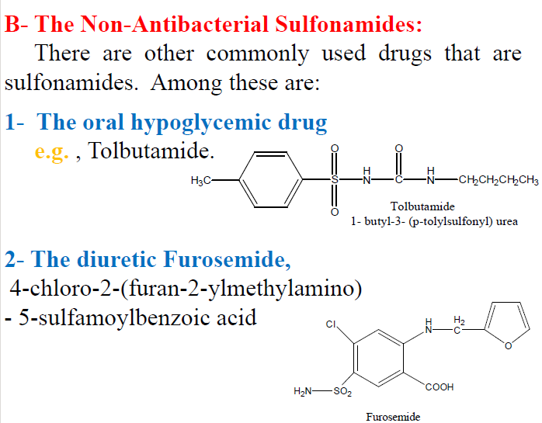

Slide 9
3- Other diuretic chlorthalidone,
Preparation of sulfa drugs:
The preparation of sulfonamides is very similar until the last step(amination step which is critical for preparation of different sulfonamides). The procedure is simple and one can start with benzene or a host of other intermediates.
The Chlorosulfonation of acetanilide is considered to be the step of interest.

Slide 10
The sequence of reactions is as follows:
# Acetylation of aniline
using acetic anhydride is
done for protection of the
amine group of aniline.

Slide 11
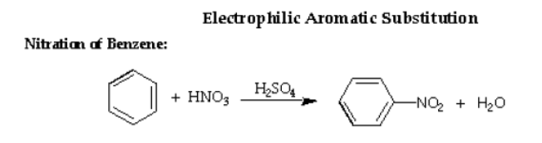
Nitration of benzene:
The nitration of benzene is conducted with a mixture of conc. nitric and conc. sulfuric acid ( Nitrating mixture ) diluted with a small amount of water.
Generally, in it's typical reactions the benzene ring serves as a source of electrons, i.e. as a base*, thus the compounds with which it reacts are deficient in electrons, i.e. electrophilic reagents or acids.
So the typical reactions of the benzene ring are Electrophilic Aromatic Substitution reactions ( EAS ).
* Lewis base is an electron – pair donor.
Lewis acid is an electron –pair acceptor.

Slide 12
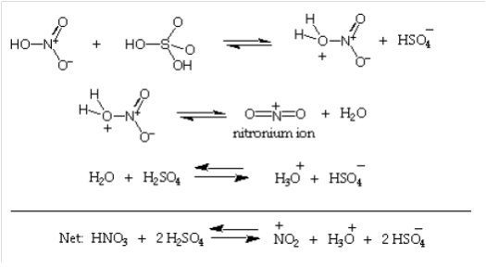
Mechanism of Nitration:
The commonly accepted mechanism for nitration with a mixture of Nitric acid and Sulfuric acid involves the following sequence of reactions:
Step I:
The generation of the electrophile.

Slide 13
Step I generates the nitronium ion ⁺ NO₂ (electrophilic reagent). Sulfuric acid serves as the acid and the much weaker nitric acid serves as a base.
The very strong acid H₂SO₄ causes HNO₃ to ionize in the sense HO ⁻ …⁺ NO₂, rather than in the usual way, H⁺… ⁻ ONO₂.
Needing electrons nitronium ion finds them in the π cloud of benzene ring.

Slide 14
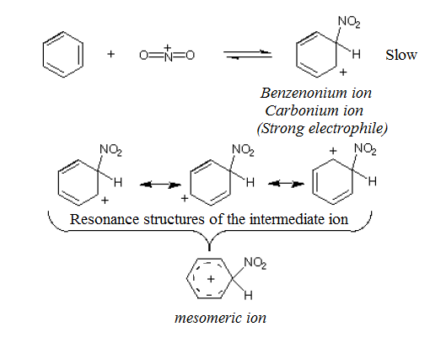
Step II:
Electrophilic attack on aromatic π system forms the carbocation.
** Mesomeric effect: is the re-distribution of electrons which takes place in
unsaturated and especially in conjugated systems via their π-orbitals.

Slide 15
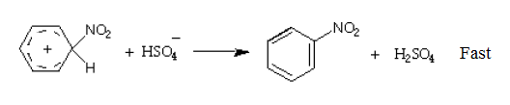
Step III:
Re-aromatization
Attachment of the nitronium ion to the aromatic ring destroy the aromatic character of the ring.
HSO₄ ⁻ abstracts a proton to yield the substitution product ( Nitrobenzene ) which retains the resonance – stabilized ring.

Slide 16
Properties of Nitrobenzene :
1- It is a heavy oily liquid (pale yellow).
2- It has high B.P= 210 ⁰ C,(if its pure). It is heat stable.
3- It has a characteristic odor like almond.
4- It is immiscible with water but soluble in organic solvents
to be separated by ether extraction.
5- It has appreciable vapor pressure, so it is volatile with steam.
Resonance of Nitrobenzene:

Slide 17
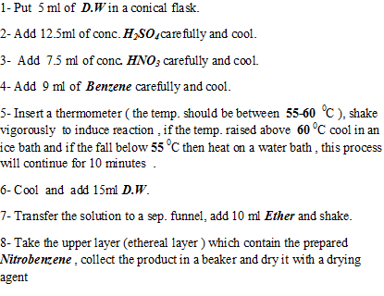
Procedure:

Slide 18
Notes:
1- Care should be taken when working with ether, (flammable), keep away all flames.
2- Do not distill to dryness, if traces of m-dinitrobenzene is present in the mixture they may decompose explosively.
3- Optimum temperature of the reaction is necessary
Between 55-60 ⁰C , high temp. should
be avoided since dinitration and poly-
nitration are more likely to occur
also oxidative breakdown of the
aromatic ring may occur .

Slide 19
Safety and Health
Nitrobenzene is highly toxic and readily absorbed through the skin causing possibly palpitation, convulsions or rarely death. Prolonged exposure may cause serious damage to the CNS, impair vision, cause liver or kidney damage, anemia and lung irritation. Inhalation of vapors may induce headache, nausea, fatigue, dizziness, cyanosis, weakness in the arms and legs and in rare cases may be fatal. Additionally, ingestion may cause GIT irritation and internal bleeding. It is classified by USEPA as human carcinogen.
It is classified as extremely hazardous substance in the US.

Slide 20
Safety and Health
Nitric acid is corrosive acid and a powerful oxidizing agent reacting violently with many compounds. It may cause chemical burns due to acid hydrolysis of protein (amides) and fats (esters) decomposing living tissues like skin and flesh. Concentrated nitric acid stains human skin yellow due to its reaction with keratin. These stains turn orange when neutralized.
It is not considered a carcinogen or mutagen.
The standard first aid treatment for acid spills on the skin is irrigation with large quantities of water for at least 10-15 minutes to cool the tissue surrounding the acid burn and to prevent secondary damage. Contaminated clothing is removed immediately and the underlying skin washed thoroughly.

Slide 21
Safety and Health
Benzene is classified as a carcinogen. It is a cause of bone marrow failure leading to aplastic anemia. It is also linked with more than one leukemia type. There is no safe exposure level even tiny amounts can cause harm. Benzene targets liver, kidney, lung, heart and brain causing DNA strand breaks and chromosomal damage i.e. it is teratogenic and mutagenic.

