Slide 1
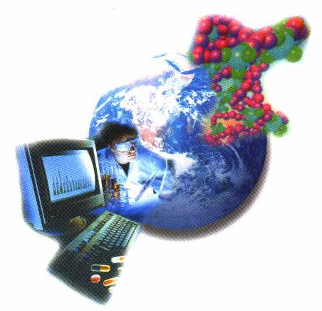
Biotechnology -02
Bioinformatics

Slide 2
DEFINITION
One of the field that associated with biotechnology
is an interdisciplinary field that develops methods and software tools for understanding biological data. As an interdisciplinary field of science, bioinformatics combines computer science, statistics, mathematics and engineering to study and process biological data.
Bioinformatics addresses biological problems by using computational technique and make rapid organization and analysis possible.
Application techniques from computer Science to problem from biology.
Computational biology involves the development and application of data-analytical and theoretical methods, mathematical modeling and computational simulation techniques to the study of biological problems. The field is broadly defined and includes foundations in computer science, applied mathematics, animation, statistics, biochemistry, chemistry, biophysics, molecular biology, genetics, genomics, ecology, evolution, anatomy, neuroscience, and visualization

Slide 3
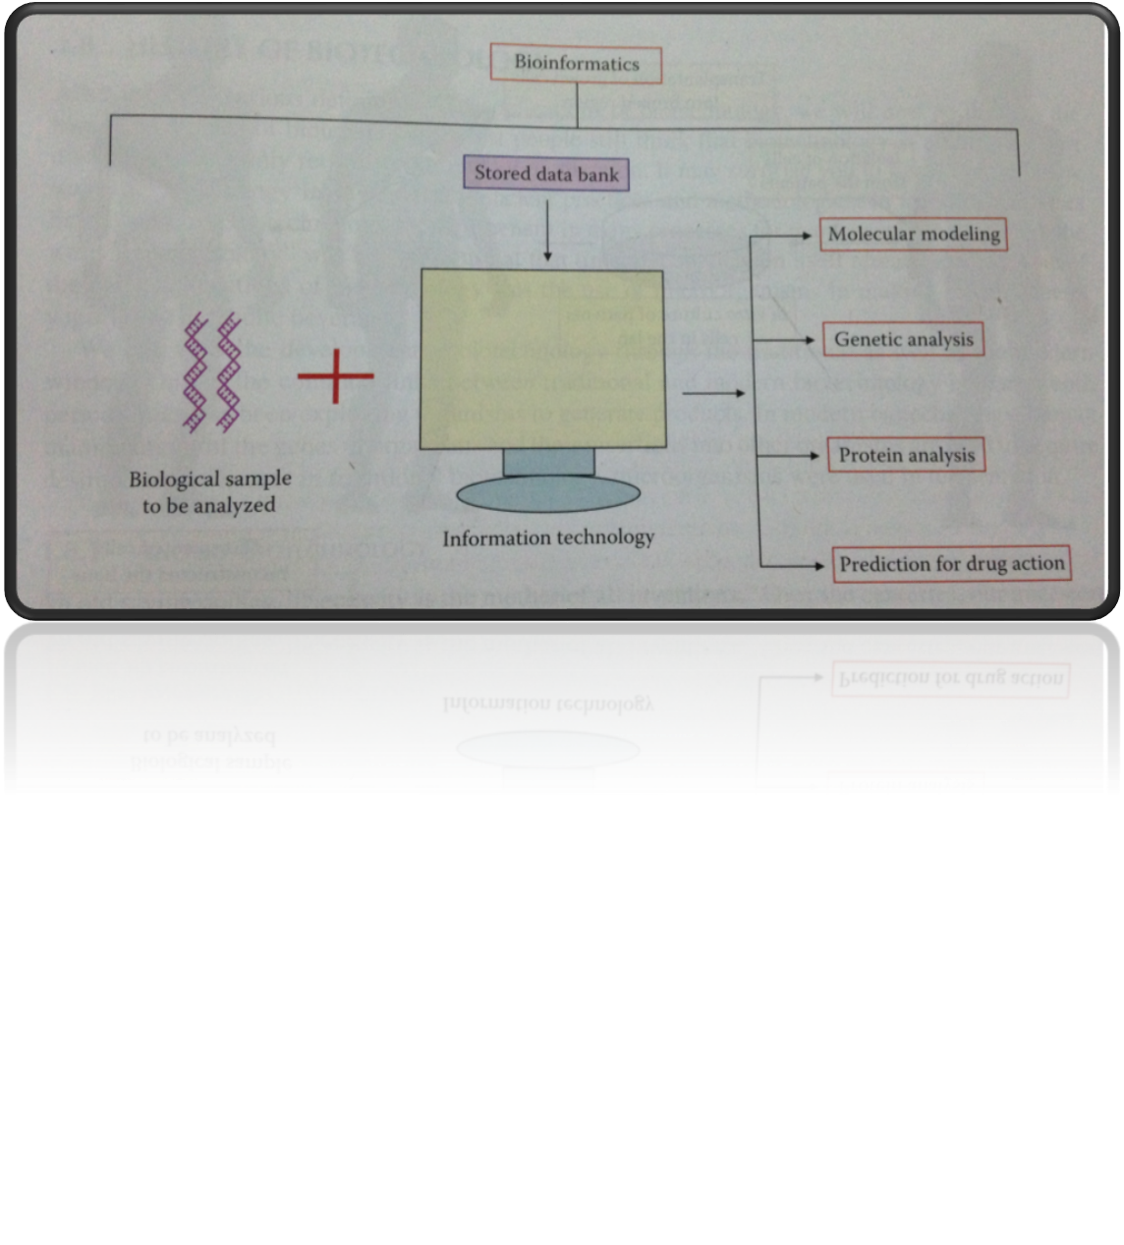
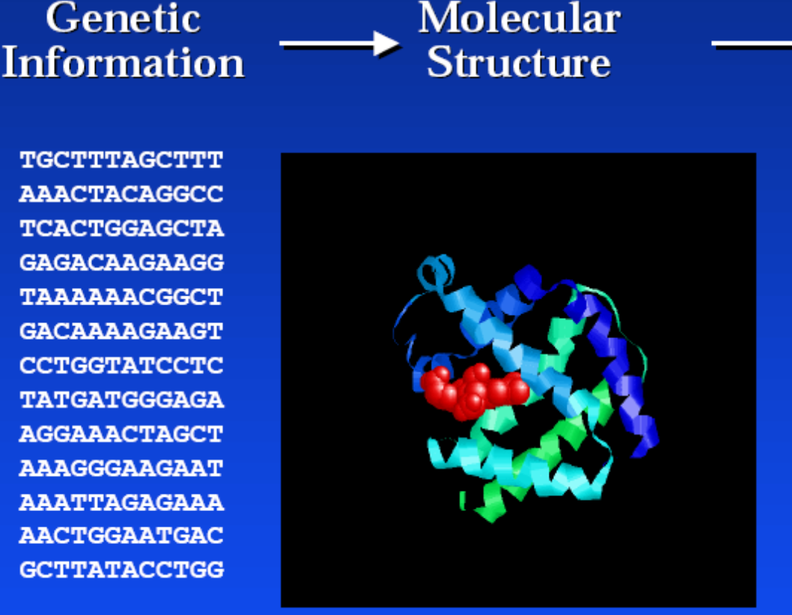
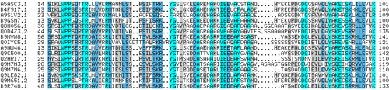
---------------------------------------------------------------------------------------------------
Input
Output
The sequences of different genes or proteins may be aligned side-by-side to measure their similarity.

Slide 4
With the growing amount of data, it long ago became impractical to analyze DNA sequences manually. Today, computer programs such as BLAST are used daily to search sequences from more than 260 000 organisms, containing over 190 billion nucleotides.
BLAST: Basic Local Alignment Search Tool
www.ncbi.nlm.nih.gov/blast
--an unknown sequence can be matched up to known sequences published in GenBank
Lists all sequences producing significant alignments
Gene identification
Organism genus/species
% identity alignment/match

Slide 5
Data Source of Bioinformatics

Slide 6
Computational biology Subfields
1- Computational biomodeling
Computational biomodeling is a field concerned with building computer models of biological systems. Computational biomodeling aims to develop and use visual simulations in order to assess the complexity of biological systems.
2- Computational genomics (Computational genetics) Computational genomics is a field within genomics which studies the genomes of cells and organisms. It is often referred to as Computational and Statistical Genetics. The Human Genome Project is one example of computational genomics
3- Computational neuroscience Computational neuroscience is the study of brain function in terms of the information processing properties of the structures that make up the nervous system.
4- Computational pharmacology is “the study of the effects of genomic data to find links between specific genotypes and diseases and then screening drug data
5- Computational evolutionary biology is using DNA data to evaluate the evolutionary change of a species over time, Taking the results of computational genomics in order to evaluate the evolution of genetic disorders within a species, and Build models of evolutionary systems in order predict what types of changes will occur in the future
6- Cancer computational to advance the understanding, diagnosis, treatment, cure, and prevention of cancer and related diseases.

Slide 7
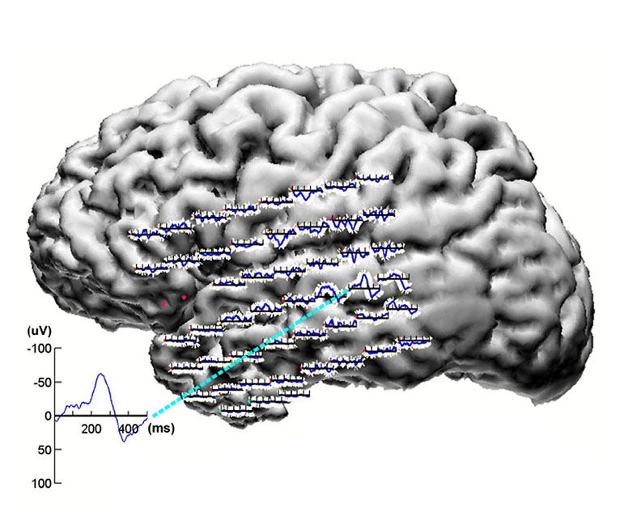
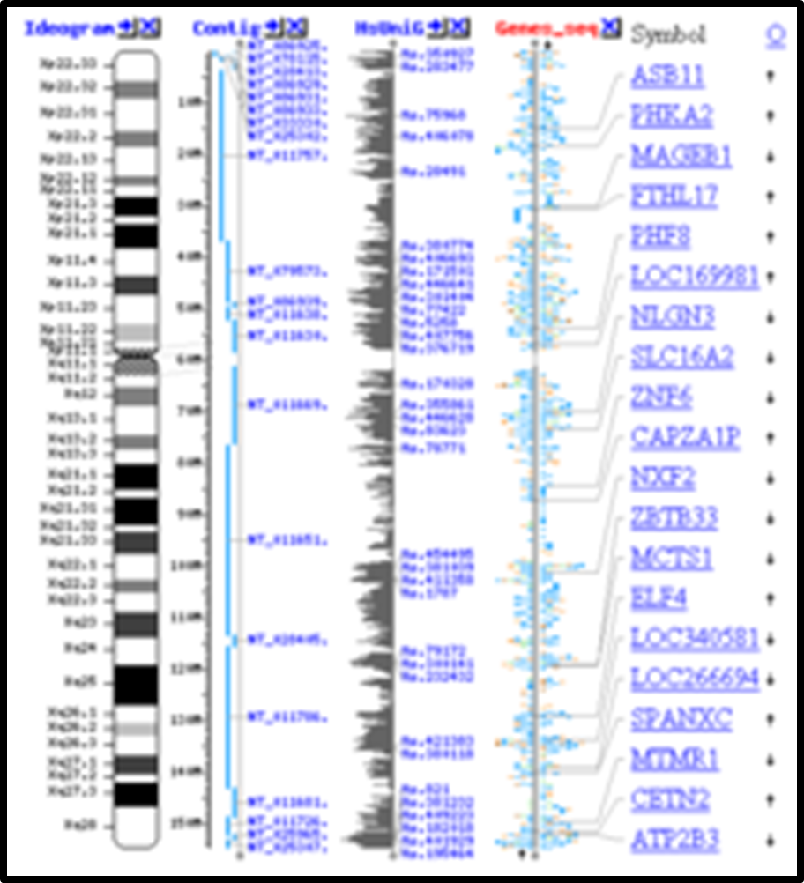
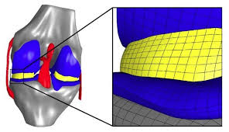
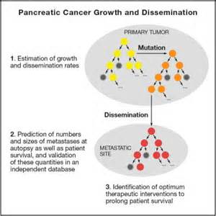
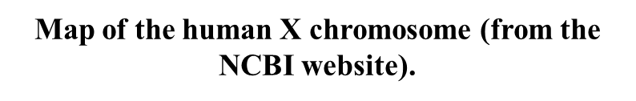
Output of computational biology
auditory information is processed and encoded in the human brain
Element model of the knee joint with representation of the cartilage

Slide 8
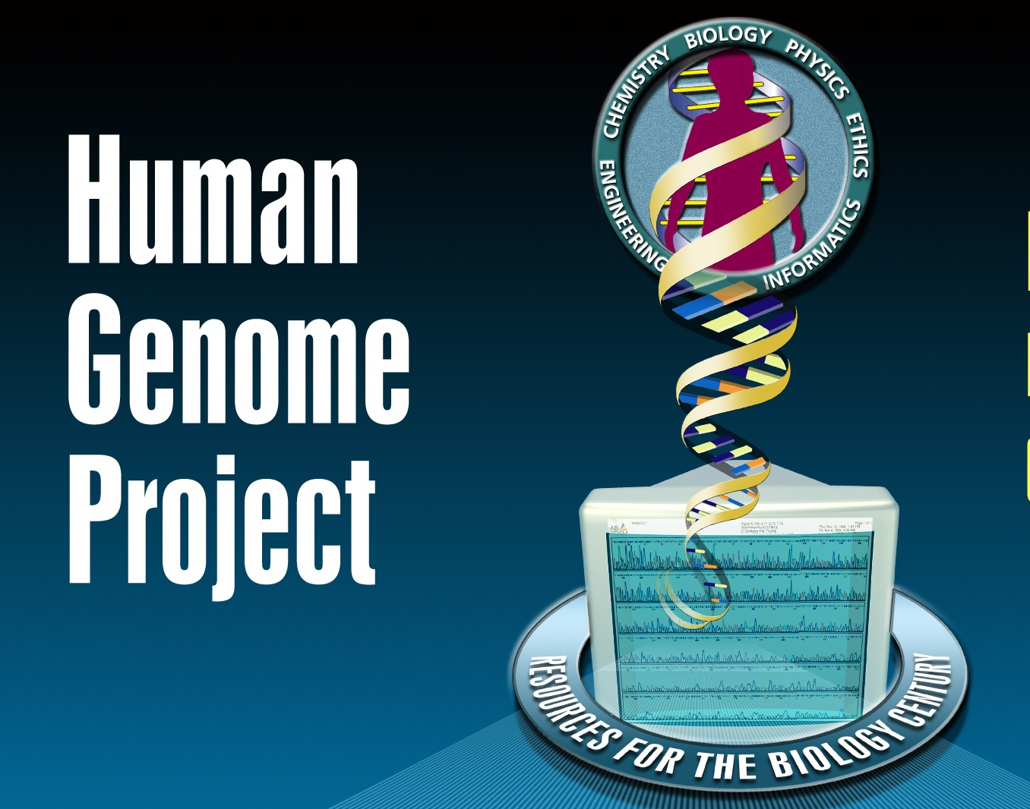
Bioinformatics achievement
Human Genome Project (HGP)
Assembly of the human genome is one of the greatest achievements of bioinformatics.

Slide 9
Human Genome Project (HGP)
The Human Genome Project (HGP) is an international scientific research project with the goal of determining the sequence of chemical base pairs which make up human DNA, and of identifying and mapping all of the genes of the human genome from both a physical and functional standpoint. It remains the world's largest collaborative biological project. The project was proposed and funded by the US government; planning started in 1984, the project got underway in 1990, and was declared complete in 2003.
The $3-billion project was formally founded in 1990 by the US Department of Energy and the National Institutes of Health, and was expected to take 15 years. In addition to the United States, the international consortium comprised geneticists in the United Kingdom, France, Australia, Japan and myriad other spontaneous relationships.
Due to widespread international cooperation and advances in the field of genomics (especially in sequence analysis), as well as major advances in computing technology, a 'rough draft' of the genome was finished in 2000 (announced jointly by U.S. President Bill Clinton and the British Prime Minister Tony Blair on June 26, 2000 )

Slide 10
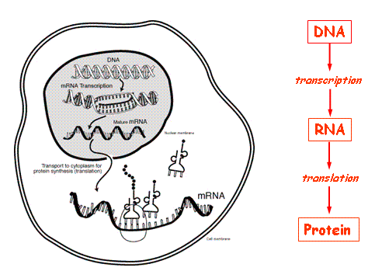
Central dogma
Data acquisition
DNA nucleotide
A = T
C = G
RNA nucleotide
A = U
C = G

Slide 11
Chain-termination methods (Sanger sequencing)
There are several different techniques for determining the nucleotide sequence of DNA segments
Sanger sequencing: developed by Frederick Sanger and colleagues in 1977
DNA sequencing may be used to determine the sequence of individual genes, larger genetic regions (i.e. clusters of genes or operons), full chromosomes or entire genomes.
Sequencing provides the order of individual nucleotides in DNA or RNA (commonly represented as A, C, G, T, and U) isolated from cells of organism.
Sanger sequencing is a method of DNA sequencing based on the selective incorporation of chain-terminating dideoxynucleotides by DNA polymerase during in vitro DNA replication.D
The reaction mixture contains DNA templet , DNA polymerase, dNTPs, ddNTPs ( ddATP, ddTTPs, ddCTP, ddGTP).
The alteration of the four dideoxynucleotides, corresponding to the four ordinary nucleotides, has the effect that when added by the polymerase to the growing chain, no further nucleotides can be added to the 3’ end afterwards and hence the strand is terminated.

Slide 12
Chain-termination methods (Sanger sequencing)
A gel solution containing the copied fragments may now be charged by a voltage so that the DNA fragments, which are slightly negative, start traveling towards the positive end of the gel.
The four different dideoxynucleotides are labeled with four different fluorochromes that emit four different colors of light when absorbing radiation of specific wavelengths. The dideoxynucleotides at the 3’ end may therefore be scanned with a laser and determined from the resulting image.
Furthermore, the nucleotides in each position in the original DNA segment may now also be determined given fragments of all possible lengths. For example, the nucleotide in position 7 in the original segment is determined by the color of the light emitted by the dideoxynucleotide at the 3’ end of fragments of length 7.

Slide 13
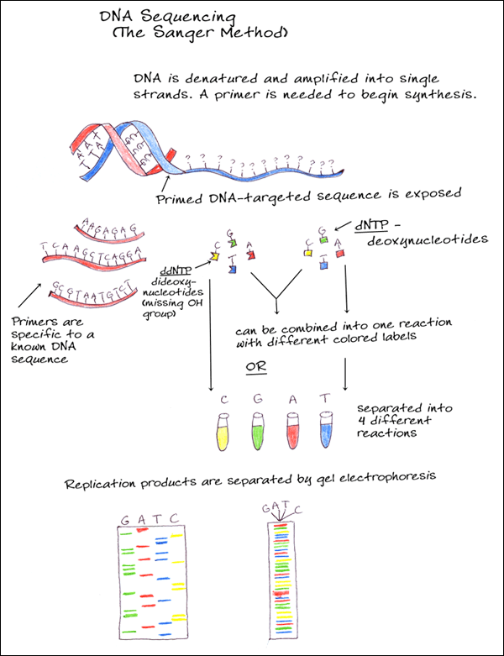
Chain-termination methods (Sanger sequencing)
http://www.youtube.com/watch?v=nudG0r9zL2M
http://www.youtube.com/watch?v=vK-HlMaitnE
http://www.youtube.com/watch?v=iTBTHmhNNbE

Slide 14
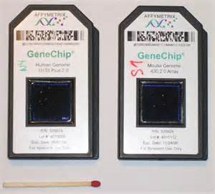
Microarray technology
The sample spot sizes are typically less than 200 microns in diameter usually contain thousands of spots.
Thousands of spotted samples known as probes (with known identity) are immobilized on a solid support (a microscope glass slides or silicon chips or nylon membrane). The spots can be DNA, cDNA, or oligonucleotides. These are used to determine complementary binding of the unknown sequences thus allowing parallel analysis for gene expression and gene discovery.
An experiment with a single DNA chip can provide information on thousands of genes simultaneously.

Slide 15
DNA Microarray Technology
first collect the messenger RNA molecules present in that cell.
then label each mRNA molecule by using a reverse transcriptase enzyme (RT) that generates a complementary cDNA to the mRNA.
During that process fluorescent nucleotides are attached to the cDNA. The tumor and the normal samples are labeled with different fluorescent dyes.
place the labeled cDNAs onto a DNA microarray slide. The labeled cDNAs that represent mRNAs in the cell will then hybridize – or bind – to their synthetic complementary DNAs attached on the microarray slide, leaving its fluorescent tag.
A researcher must then use a special scanner to measure the fluorescent intensity for each spot/areas on the microarray slide.

Slide 16
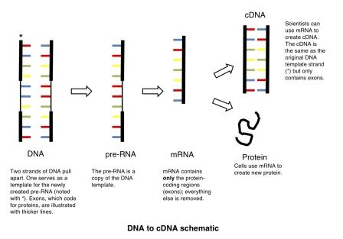

Slide 17
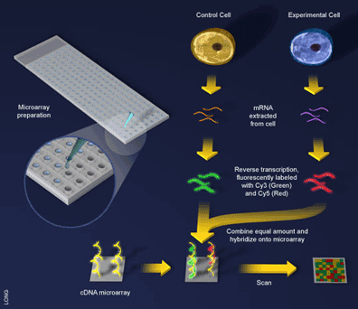
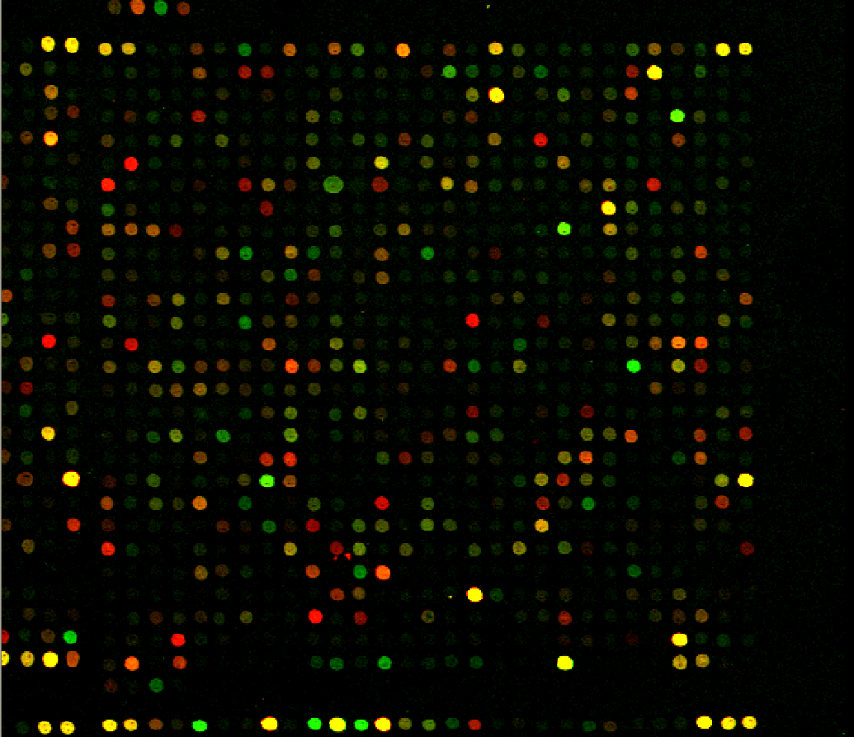
Gene(s) express in control cell
Gene(s) express in experimental cell
Mixed color express in both

Slide 18
http://www.youtube.com/watch?v=9U-9mlOzoZ8
http://www.youtube.com/watch?v=_6ZMEZK-alM
Applications of Microarrays
Gene Discovery: DNA Microarray technology helps in the identification of new genes, know about their functioning and expression levels under different conditions.
Gene expression profiling: In an mRNA or gene expression profiling experiment the expression levels of thousands of genes are simultaneously monitored to study the effects of certain treatments, diseases. For example, microarray-based gene expression profiling can be used to identify genes whose expression is changed in response to pathogens or other organisms by comparing gene expression in infected to that in uninfected cells or tissues.

