Slide 1
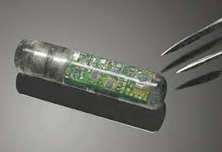
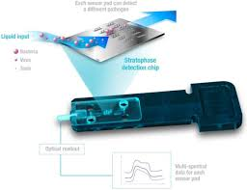
Biosensor & Biochip

Slide 2
Biosensor biosensor is an analytical device, used for the detection of an analyte, that combines a biological component with a physicochemical detector. the sensitive biological element (e.g. tissue, microorganisms, organelles, cell receptors, enzymes, antibodies, nucleic acids, etc.), a biologically derived material or biomimetic component that interacts (binds or recognizes) the analyte under study. The biologically sensitive elements can also be created by biological engineering

Slide 3
The biosensor system
A biosensor typically consists of a bio-recognition component, biotransducer component, and electronic system which include a signal amplifier, processor, and display.
The recognition component, often called a bioreceptor, uses biomolecules from organisms or receptors to interact with the analyte of interest.
This interaction is measured by the biotransducer which outputs a measurable signal proportional to the presence of the target analyte in the sample.

Slide 4
Biotransducer
دمج المواد البايولوجيه مع مجس ذو خصوصيه كيمياوية او كهربائية لتحيول الاشاره الصادره الى اشاره كهربائيه يمكن رويتها وتسجيلها.
Biotransducer
Biological components
Enzyme
Antibodies
Non biological component
Ion electrode
pH electrode
يتكون من

Slide 5

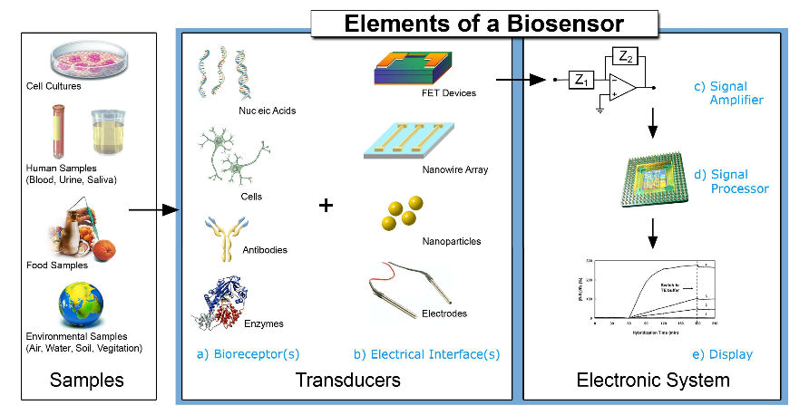

Slide 6
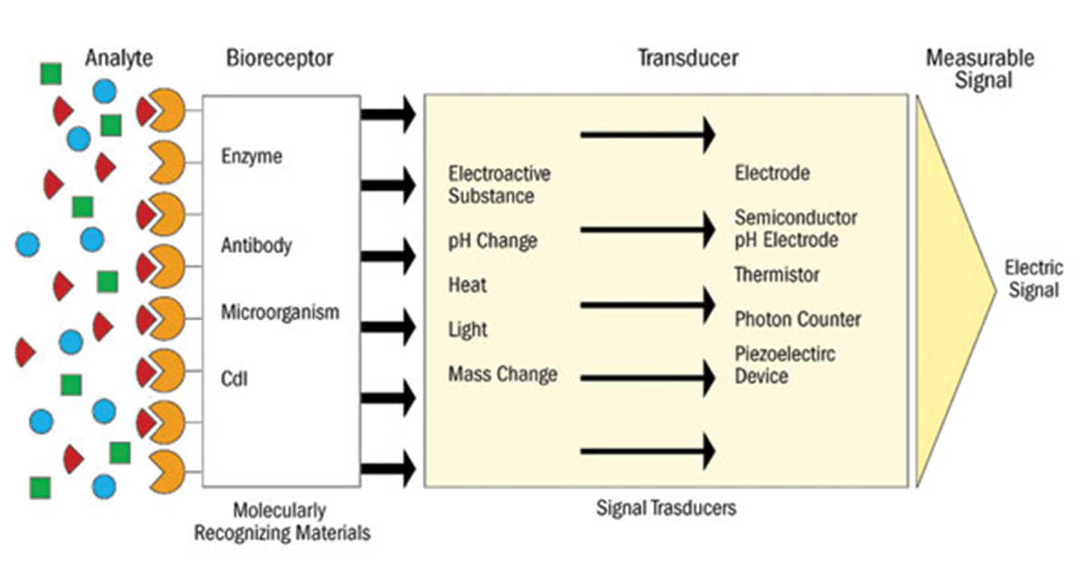
the bioreceptor is designed to interact with the specific analyte of interest to produce an effect measurable by the transducer

Slide 7
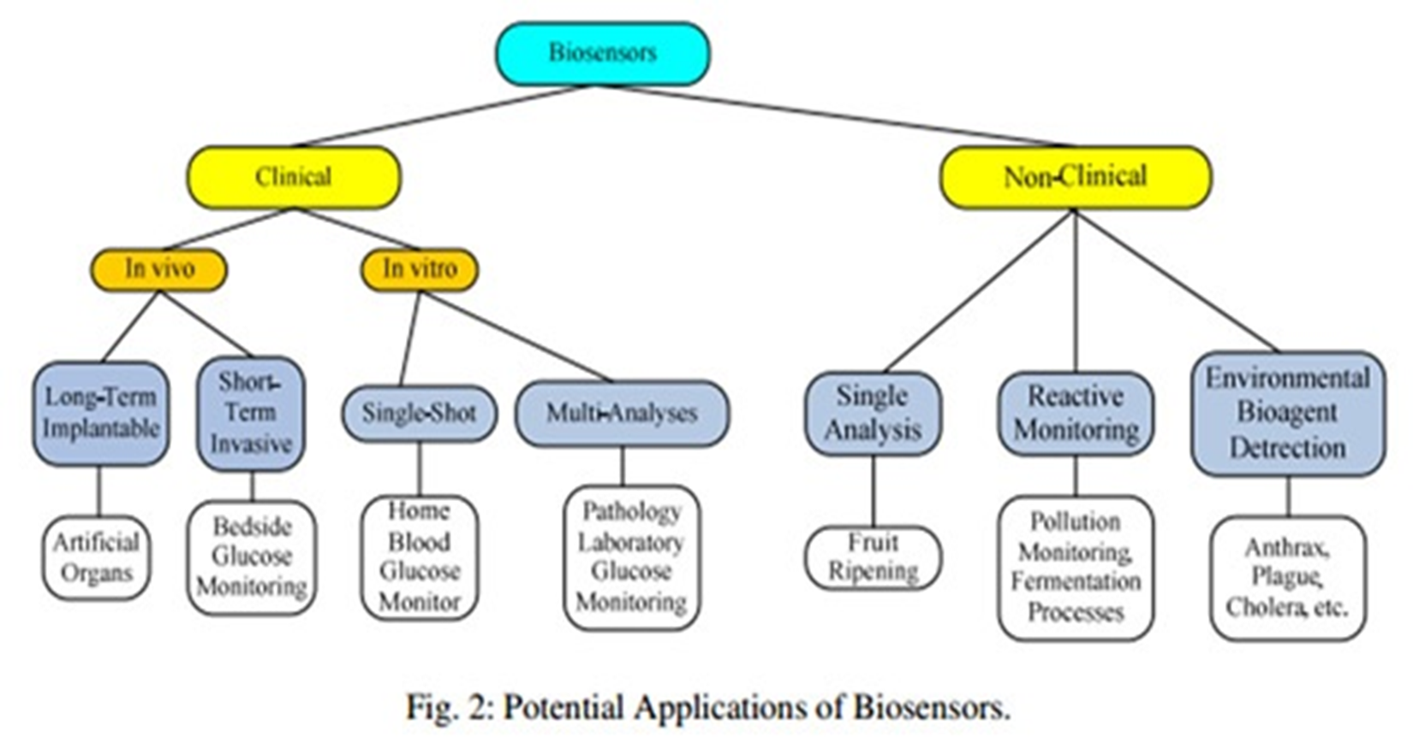

Slide 8
Types Bioreceptor
Antibody/antigen Interactions
An immunosensor utilizes the very specific binding affinity of antibodies for a specific compound or antigen. Binding events result in a physicochemical change that in combination with fluorescent molecules, enzymes, or radioisotopes, can generate a signal.
Enzymatic Interactions
The specific binding capabilities and catalytic activity of enzymes make them popular bioreceptors.
the enzyme converting the analyte into a product that is sensor-detectable.
detecting enzyme inhibition or activation by the analyte
Notably, since enzymes are not consumed in reactions, the biosensor can easily be used continuously.

Slide 9
Types Bioreceptor
Nucleic acid Interactions
Biosensors that employ nucleic acid interactions can be referred to as genosensors. The recognition process is based on the principle of complementary base pairing, adenine:thymine and cytosine:guanine in DNA. If the target nucleic acid sequence is known,complementary sequences can be synthesized, labeled, and then immobilized on the sensor.
Cells
Cells are often used in bioreceptors because they are sensitive to surrounding environment and they can respond to all kinds of stimulants. Cells tend to attach to the surface so they can be easily immobilized. They are commonly used to detect global parameter like stress condition, toxicity and organic derivatives. They can also be used to monitor the treatment effect of drugs .

Slide 10
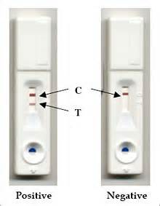
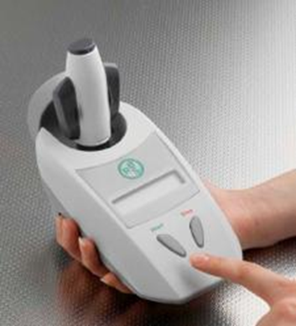
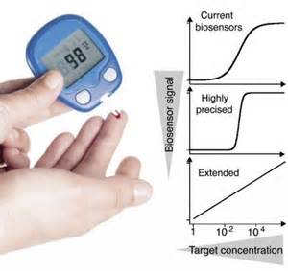
Example of biosensors
Glucose test
Pregnancy kit
Infectious disease biosensor
Monitors the glucose level in the blood.
Detects the hCG protein in urine

Slide 11
Advantages of Biosensor
Easy to use
Rapid analysis
Sensitive and specific
Less amount solution (analyte) required
Biosensor improves disease detection and diagnosis.

Slide 12
Biochips
DNA microarray
Biochip implant

Slide 13
What is a biochip implant?
Biochip implant system is actually a fairly simple device. Today’s, biochip implant is basically a small (micro) computer chip, inserted under the skin, for identification purposes.
The biochip implant system consists of two components; a transponder and a reader or scanner. The transponder is the actual biochip implant. The biochip system is a radio frequency identification (RFID) system, using low-frequency radio signals to communicate between the biochip and reader.

Slide 14

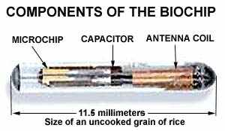
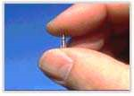
The transponder: The transponder is the actual biochip implant. It is a passive transponder, meaning it contains no battery or energy of it's own. In comparison, an active transponder would provide it’s own energy source, normally a small battery. Because the passive biochip contains no battery, or nothing to wear out, it has a very long life, up to 99 years, and no maintenance.
The biochip-transponder consists of four parts; computer microchip, antenna coil, capacitor and the glass capsule.

Slide 15
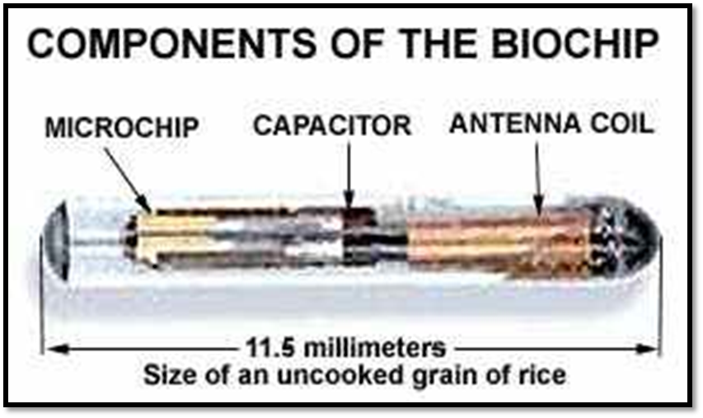
Biochip Implant System
Computer Microchip: The microchip stores a unique identification number from 10 to 15 digits long. The storage capacity of the current microchips is limited, capable of storing only a single ID number. AVID (American Veterinary Identification Devices), claims their chips, using a nnn-nnn-nnn format, has the capability of over 70 trillion unique numbers. The unique ID number is "etched" or encoded via a laser onto the surface of the microchip before assembly. Once the number is encoded it is impossible to alter. The microchip also contains the electronic circuit necessary to transmit the ID number to the "reader".

Slide 16
Antenna Coil: This is normally a simple, coil of copper wire around a ferrite or iron core. This tiny, primitive, radio antenna "receives and sends" signals from the reader or scanner.
Tuning Capacitor: The capacitor stores the small electrical charge which activates the transponder. This "activation" allows the transponder to send back the ID number encoded in the computer chip.
Glass Capsule: The glass capsule "houses" the microchip, antenna coil and capacitor. It is a small capsule, the smallest measuring 11 mm in length and 2 mm in diameter, about the size of an uncooked grain of rice. The capsule is made of biocompatible material.

Slide 17

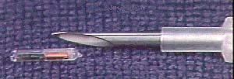
The biochip is inserted into the subject with a hypodermic syringe. Injection is safe and simple, comparable to common vaccines. the biochip is usually injected behind the neck between the shoulder blades.

Slide 18

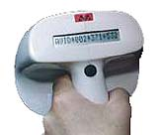
The reader: The reader consists of an "exciter" coil which creates an electromagnetic field that, via radio signals, provides the necessary energy to "excite" or "activate" the implanted biochip.
The reader also carries a receiving coil that receives the transmitted code or ID number sent back from the "activated" implanted biochip. This all takes place very fast, in milliseconds. The reader also contains the software and components to decode the received code and display the result in an LCD display.

Slide 19
How it works
The reader generates a low-power, electromagnetic field, in this case via radio signals, which "activates" the implanted biochip. This "activation" enables the biochip to send the ID code back to the reader via radio signals. The reader amplifies the received code, converts it to digital format, decodes and displays the ID number on the reader's LCD display. The reader must normally be between 2 and 12 inches near the biochip to communicate. The reader and biochip can communicate through most materials, except metal.

