Slide 1
BASIC OF BIOTECHNOLOGY OF FERMENTATION PROCESS AND PHARMACEUTICAL PROCESS.

Slide 2
INTRODUCTION
Fermentation refers to the process of chemical transformation of organic substrate using enzymes of microorganisms.It is an extracellular process resembling to anaerobic respiration to some extent but the anaerobic respiration is always intercellular process. Industries producing medicine,organic acids(butaric acid,latic acid,oxalic acid etc.),organic solvent,amino acids,enzymes are all based on application of certain microorganisms for fermentation based industries processes.

Slide 3
Requirement for fermentation process:-
Specific strain of microoganisms or its mutants capable of showing fermentation efficiently at a much faster rate.
Sutiable substrate for the microorganisms which can easily be fermented quickly
Proper environment for optical rate of fermentation.

Slide 4
TYPE OF FERMENTAION:- SOLID STATE FERMENTATION SUBMERGED FERMENTATION
ANAEROBIC FERMENTATION
AEROBIC FERMENTATION
IMMOBILIZED FERMENTATION

Slide 5
1)SOLID STATE FERMENTATION
In such fermentation microbial growth and product formatio occur at the surface of solid substrates.
Examples of such fermentation are mushroom cultivation,mold-ripened cheeses,startes cultures etc. This approch has been used for the production of extracellular enzymes, certain valuable chemical, fungual toxic, and fungal spores.
Traditional substrates are several agricultural products eg- rice,maize,soyabean etc.
The substrate provides a rich and complex source of nutrients which may or may not need to be supplemented.Such substrate selectively supports mycelial organisms, which can grow at high nutients concentartion and produce a variety of extracellular enzymes.

Slide 6
Acc to solid physical state, solid state fermentation are divided into the following two groups:-
i)Low mositure solid fermented without or with occasional/continous agitation
ii)Suspended solid fermented in packed columns through which liquid is circulated. The fungi used for solid state fermentation are usually obligate aerobes

Slide 7
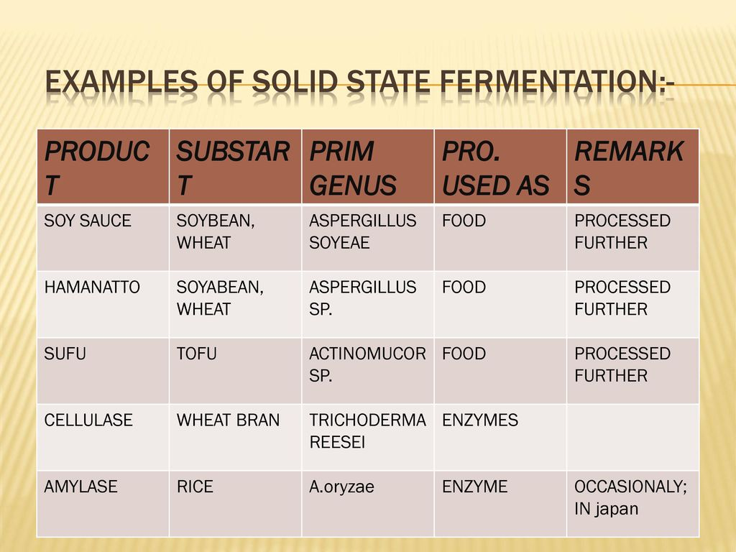

Slide 8
2)SUBMERGED FERMENTATION
BATCH culture is a closed culture system,which contain limited amount of nutrient medium.After inoculation the culture enter lag phase, during which there is increase in the size of the cell and not in their numb.
The culture then enters lag phase or expanential growth phase during which cell divided at max rate and their generation time reaches min.The increaseing in the nutrients and the accumulation of inhibitory end products in the medium.
If we collet the data of the increase in cell number at various intervals of time and plot this data in two ways. We find a characteristic growth curve.this typical growth is only obtained in a batch culture.

Slide 9
ii) Fed-batch culture-when a batch culture is subsequently fed with fresh nutrients medium without removeing the growing microbial culture, it is called fed-batch culture. Fed-batch culture allows to supplement the medium with such nutrients that are depleted or that may be needed for the terminal stage or the culture.
iii)Continuous culture-contrary to the batch culture where the exponential growth of micobial population is restricted only for few generations, it is often desirable to maintain prolonged exponential growth of microbial population in industrial processes.This condition is obtained by grwoing microbes in a continuous culture.

Slide 10
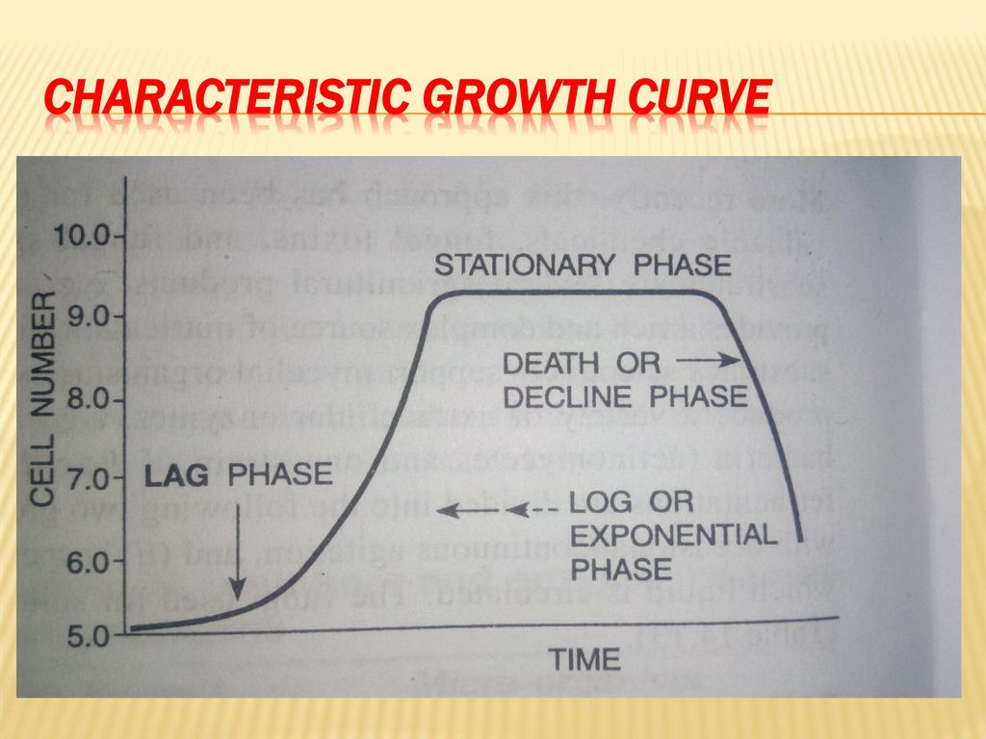

Slide 11
3)ANAEROBIC FERMENTATION
In anaerobic fermentaion a provision for aeration is usually not needed. But in some cases,aeration may be needed initally mixing of the inoculum in necessary.
One the fermentation begins,the gas produced in the process generates sufficient mixing. The air presents in the headspace of the fermenter should be replaced by carbon dioxide,hydrogen,ammonia gas or suitable mixture of these.
The fermentation usally librates carbon dioxide and hydrigen gas which are colleted and used for bubbling into freshly inoculated germenters. In case of acetogens and other gas utilizers bact, oxygen-freez sterile carbon dioxide or other gases are bubbled through the medium.Acetogens have been cultured in 400 fermenters by bubbling sterile carbon dioxide and 3Kg cells could be harvested in each run.

Slide 12
4)AEROBIC FERMENTATION
The main feature of aerobic fermentaion is the provision for adequate aeration; in some cases,the amount of air needed per hour is about 60 times the medium volume. Therefore, bioreactors used for aerobic fermentation have a provision for adequate supply of sterile air, which is genearlly sparged into the medium. IN medium, thes fermentaers may have a mechinism for stirring and mizing of the medium and cell. Aerobic fermenters may either of the
stirred-tank type in which mechinical motot-driven stirrerd are provided
Air-lift type in which no mechinical stirrers are used and the agitation is archieved by the air bubble generated by the air supply.

Slide 13
5)IMMOBILIZED CELL BIOREACTORS
BIOREACTORS OF THIS TYPE ARE BASED ON IMMOBLIZED CELLS. Cell immbolized is advantageous when
i)The enzyme of interst are intercellular
ii)Extracted enzymes are unstable.
iii)The cell do not have interering enzymes or such enzymes are easily inactivated or removed.
iv)The products are low molecular weightcompund released into the medium.

Slide 14
Cell immoblized may be achieved in one of the following ways
1)Cells may be directly bound with water insoluble carrier. 2)They can be cross-linked to bi- or multifunctional reagents.
3)Polymer matrices may be used for entrapping cells;such matrices are polymacylamide gell,polyglycol oligomers etc.

Slide 15
Cell immoblized has been used for commercial production of amino acid e.g-E.coli cells entrapped in polyacrylamide gel for theproduction of L-aspartic acid,L-alanine oroduction using a mixture of E-coli and pseudomonas dacunhae immoblized in k-Carrageenan, organic acid.

Slide 16
Application of fermentation
-METABOLITE PRODUCTION
ACETONE-BUTANOL
INDUSTRIAL ALCOHOL
-ANTIBIOTICS
INOCULUM
FERMENTER
-ENZYMES
FERMENTATION
ISOLATION & PURIFICATION

Slide 17
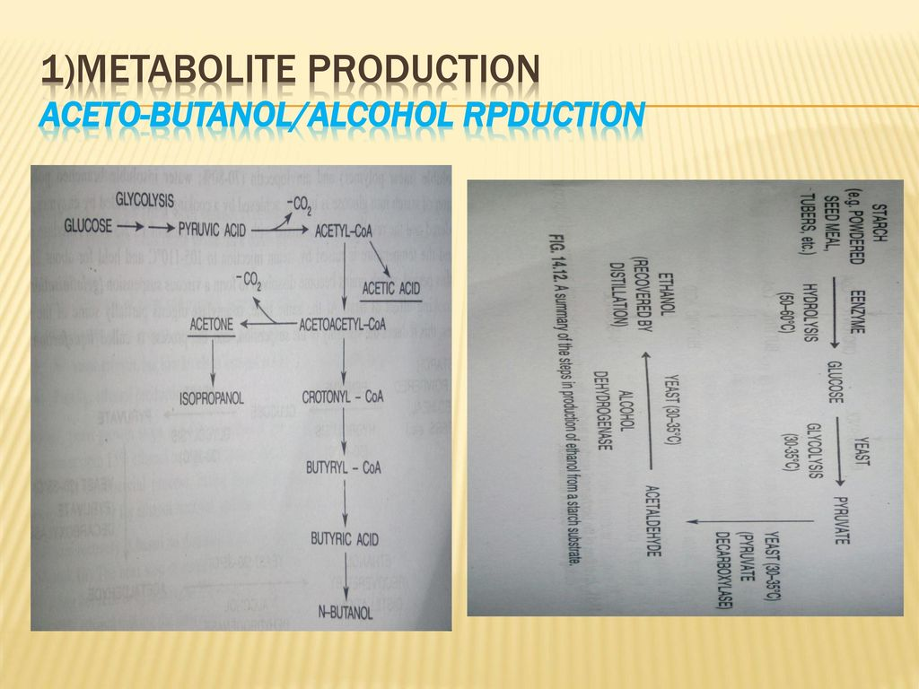

Slide 18
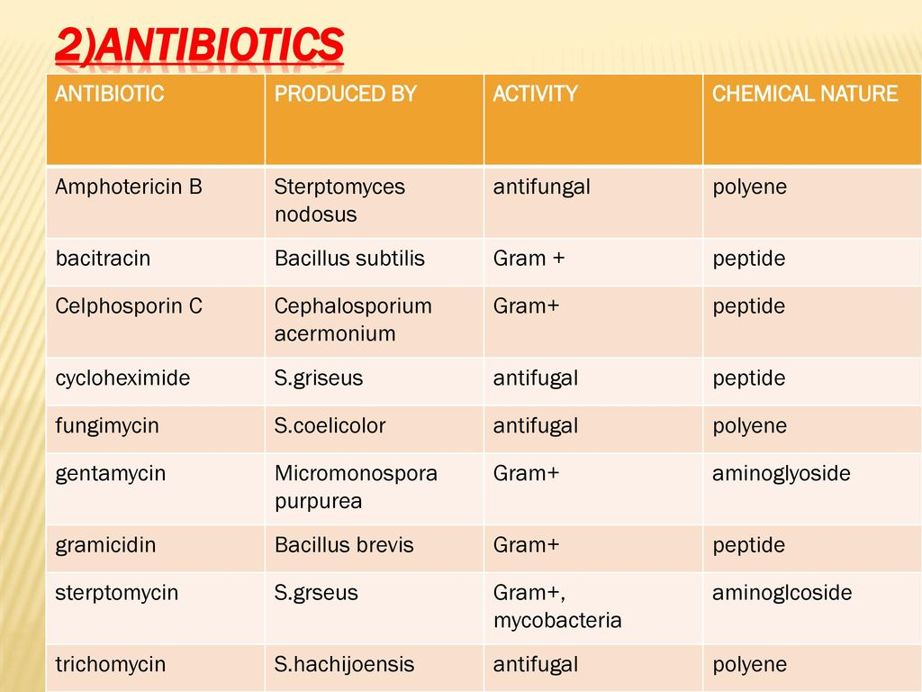

Slide 19
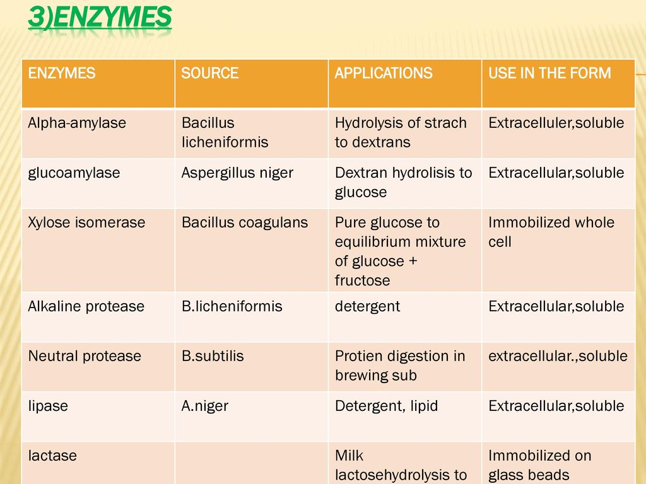

Slide 20
Some products formed by fermentation process
i)AMMINO ACID PRODUCTION-
a)Lysin
b)Glutamic acid
ii)ORGANIC ACIDS
a)Latic acid
b)Cetric acid
c)Acidic acid
iii)ANTIBIOTICS
a)Penicillin

Slide 21
Procedure-
A)Latic acid
C12H12O11 + H2O +LACTOSE =2C6H12O6 + ENZYMES === 2CH3CHOHCOOH
B)Acitic acid
*CARBOHYDRATES→ ALCOHOL
*ALCOHOL + ACETOBACTER→Acetic acid
C)Lysine
Diaminopimelic acid(DAP)+decarboxylase→Lysine

Slide 22
Pharmaceutical process

Slide 23
Introduction
Define as generation of useful products or services from plant cells, tissue,and often organs. Such cells, tissue nad organs are either continously maintained in vitro or they pass through a variable in vitro phase to enable regernation from them of complete plantlets which are ultimately transferred to the field.
Some of the objectives e.g-biochemical production required continuous in vitro culture of cells for product generation. In such and certain other caces e.g- rapid clonal multiplication, haploid production etc.
Or some objective achieved are-growth of plants for high yield production,large sacle propagation,high resestive against certain bact or fungal microbes and for biochemical production by plants

Slide 24
Applications of pharmaceutical process
1)BIOCHEMICAL PRODUCTION;-Plants are source of a large number of biochemical,which are metablicaly of both primary and secondary metabolism.But secondary metabolism are of much grater interest since they have impressive biological activites like antimicrobial,antibiotic,insexticidal,molluscicidal,hormonal properties and valuable pharmalogical and pharmaceutical activites
The primary metabolism processes; e.g photosynthesis,respiration,protien and lipids biosynthesis.

Slide 25
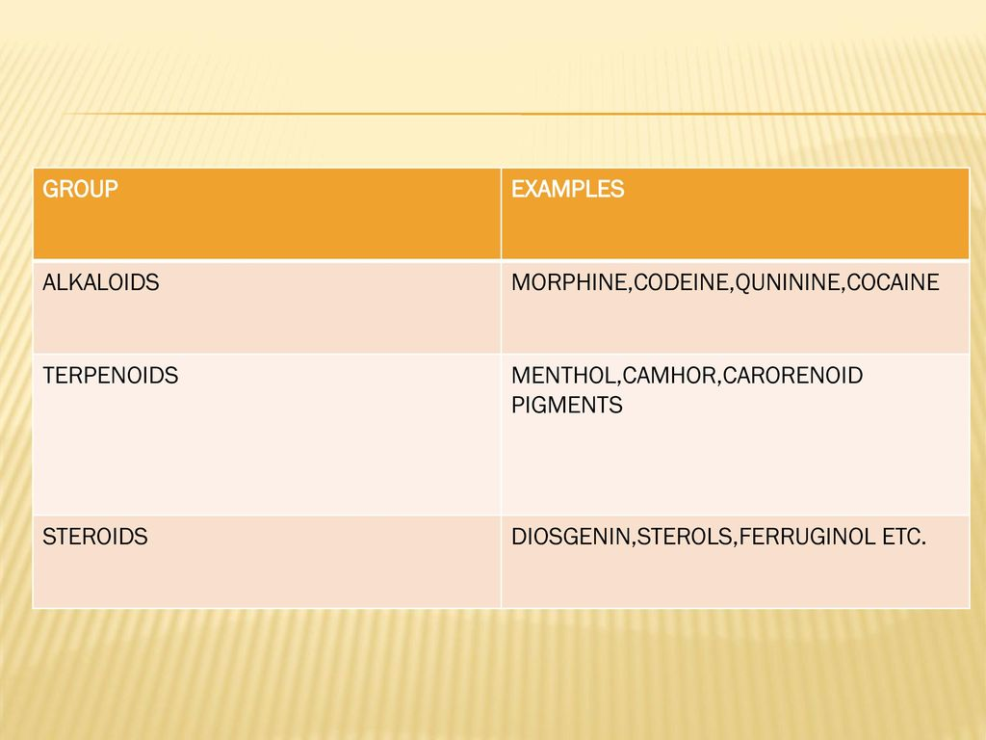

Slide 26
2)ENCHANCING BIOMASS YIELD
Virtually all high value biochemicals from cultured plant cell are secondary metabloites, which are usually produced in deifferentiated cells or organised tissue. Therefore most such biochemical are not produced by rapidly growing cell cultures and the culture conditions favouring growth suppress biochemical production.Production startegy consists two phases
i)growth phase for cell biomass accumulation
ii)production phase for biosynthesis and accumlation of the biochemical.

Slide 27
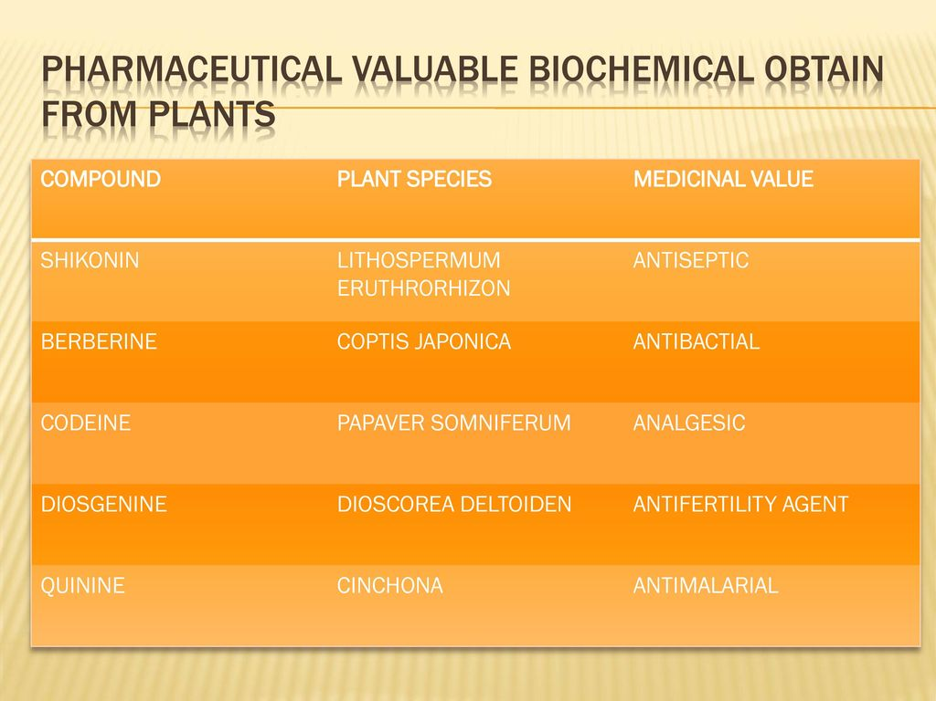

Slide 28
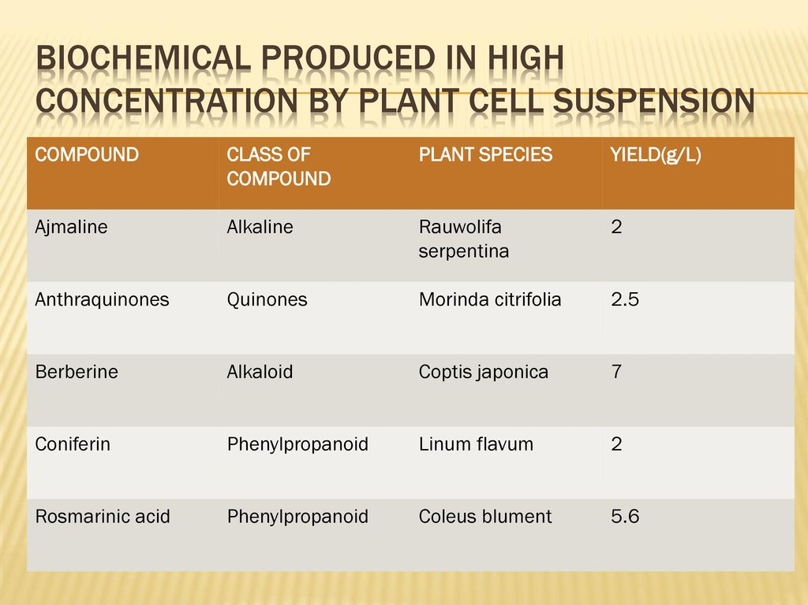

Slide 29
Thank you

