Slide 1
CONCEPT AND SCOPE OF BIOTECHNOLOGY

Slide 2
NTRODUCTION
Biotechnology = Bio (Life) + Technology
Biotechnology is technology based on biology
Biotechnology is "the application of biological organisms, system or processes to manufacturing and service industries"( British Biotechnologist).
Biotechnology is the use of living organisms and their components in agriculture, food and other industrial processes.
Biotechnology is "the application of scientific and engineering principles of the processing of materials by biological agents to provide goods and services''(Holt and Lilley,1982).
Biotechnology utilizes cellular and biomolecular processes to develop technologies and products that help improve our lives and the health.
The earliest biotechnologists were farmers who developed improved species of plants and animals by cross pollenization or cross breeding

Slide 3
CONCEPT
The origin of biotechnology is as old as human civilization. As a science it is little more than 100 years old.
Fermentation is the oldest biotechnological process discovered by the people by prolonged soaking of grains or by sorting juices of fruits or palms.
Other early processes practiced by man included leavening of bread, production of alcoholic beverages, production of vinegar, production of curd, etc.
Nowadays biotechnology has achieved greatest advancement in the filed of Recombinant DNA technology, PCR, Cell-culture and fusion, gene cloning, DNA fingerprinting, environmental engineering, Immunology etc.

Slide 4
Disciplines of Biotechnology

Slide 5
HISTORY
- 6000 B.C., Sumarians and Babylonians Knew the technique of preparing beer.
2500 B.C.,Aryans started preparing curd.
2000 B.C., Greeks were probably first to prepare cheese from milk ( cheese one of the first fermented food).
1822-1895 Louis Pasteur, "The father of Microbiology and father of Industrial Biotechnology'‘ discovered that yeast produced alcohol in wine and rod-shaped bacteria produced acetic acid, cause souring of wine.
1929, Alexander Fleming discovered antibiotic penicillin.
1973, First successful genetic engineering experiments were carried out in famous world laboratories.

Slide 6
Aims of Biotechnology
To produce dairy and pharmaceutical products.
To fight disease such as cancer.
To develop more resistant plants and animals.
To develop renewable energy.
Increase shelf life of products.

Slide 7
SCOPE OF BIOTECHNOLOGY
Besides being a branch of advance biological sciences, it has attracted many multinational companies including those are concerned with:
• The production of pharmaceutical products for the cure or control of many human diseases. These products include antibiotics, vaccines, life saving drugs and gene therapy.
• Improvement of clinical testing and diagnostic tools.
• Production of novel varieties of crop plants and animals.

Slide 8
• Production of wide range of food products, fertilizers, pesticides
• Waste treatment, bioremediation and energy production.
• Production of reagents including enzymes, DNA/RNA, etc.
• Biotechnology has also enhanced the sale of many biological products in the world market by improving their varieties and increasing their large scale production.
• These items include antibiotics (penicillins, tetracyclines etc.), amino acids, enzymes, vaccines, steroids, vitamins, insulin, human growth hormones, microbial pesticides, citric acid, improved variety seeds, etc. Continue….

Slide 9
BIOTECHNOLOGY INDUSTRY FACTS
- There are more than 370 drug products and vaccines currently in clinical trials targeting more than 200 diseases, including various cancers, Alzheimer’s disease, heart disease, diabetes, multiple sclerosis, AIDS and arthritis.
Consumers already are enjoying biotechnology foods such as papaya, soybeans and corn.
Environmental biotechnology products make it possible to clean up hazardous waste more efficiently by harnessing pollution- eating microbes without the use of caustic chemicals.
DNA fingerprinting, a biotech process, has dramatically improved criminal investigation and forensic medicine.

Slide 10
There are :-
1,466 biotechnology companies in the United States, of which 318 are publicly held.
The U.S. biotechnology industry employed 194,600 people as of Dec. 31, 2002; that's more than all the people employed by the toy and sporting goods industries.
Biotechnology is one of the most research intensive industries in the world. The U.S. biotech industry spent $20.5 billion on research and development in 2002.
The biotech industry is regulated by the U.S. Food and Drug Administration (FDA), the Environmental Protection Agency (EPA) and the Department of Agriculture (USDA). Continue….

Slide 12
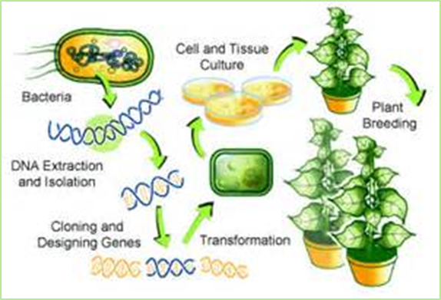
Plant Biotechnology
Genetically modified crops ("GM crops", or "biotech crops") are plants used in agriculture, the DNA of which has been modified using genetic engineering techniques. In most cases the aim is to introduce a new trait to the plant which does not occur naturally in the species.
Examples in *food crops include resistance to certain pests, diseases, stressful environmental conditions, resistance to chemical treatments (e.g. resistance to a herbicide), reduction of spoilage, or improving the nutrient profile of the crop. Examples in *non-food crops include production of pharmaceutical agents, biofuels, and other industrially useful goods.

Slide 13
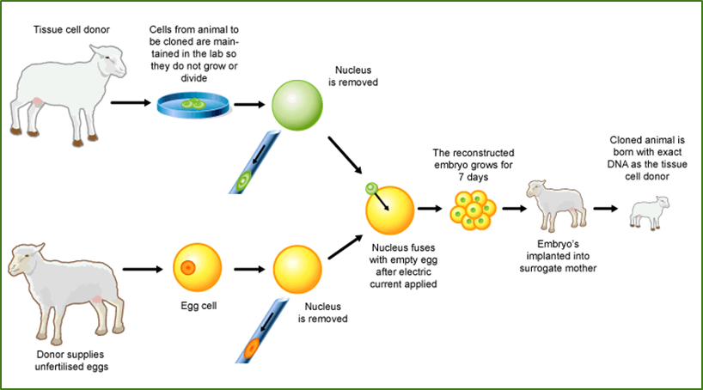
Animal biotechnology
Animal biotechnology include generation of transgenic animals with one or more genes introduced by human intervention using gene knockout technology to generate animals in which a specific gene has been inactivated, production of nearly identical animals by somatic cell nuclear transfer.
Research on genetic engineering has led to the development of a substantial variety of food and agricultural products as well as pharmaceutical and human health related products derived from several types of animals, including cows, sheep, goats, swine, fish, and insects
Example large number of genes encoding useful protein products—hormones, blood proteins, and others—has been introduced into domestic animals, leading to their expression in milk, eggs, or blood
Examples of human pharmaceutical proteins include
enzymes, clotting factors, albumin, and
antibodies.

Slide 14
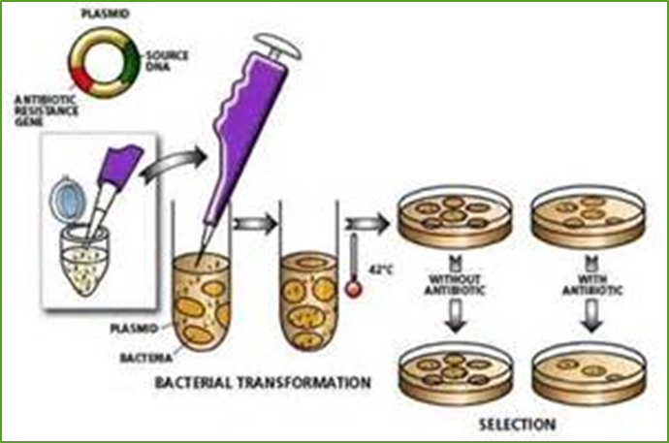
Microbial biotechnology
Use microbes or genetically modified microbes and use them in following application
Microbial biotechnology, enabled by genome studies, will lead to breakthroughs such as
improved vaccines and better disease-diagnostic tools, improved microbial agents for biological control of plant and animal pests, modifications of plant and animal pathogens for reduced virulence, and development of new industrial catalysts and fermentation organisms

Slide 15
Old Biotechnology refers to the process that based on the inherent capabilities of microorganisms or biological agents for carrying out the reaction that ultimately lead to product.
Example : use of microorganism in Cheese and wine production.
New Biotechnology refer to manipulation of genome or innate capabilities of organism for making it more desirable or to synthetic more desirable product.
Example : making plant more disease resistant ( Bt Cotton )
Bt gene is bacterial gene codes for insecticidal protein.
Production Human insulin in the bacteria .

Slide 18
CONCLUSION
Biotechnology is the production of interaction between biological science and modern technology.
During last two decades biotechnology has achieved greatest advancements in the fields of recombinant DNA technology, Polymerase chain reaction(PCR), gene cloning, DNA finger-printing etc.
Being a branch of advance biological sciences, it has also attracted many multinational companies.
Insulin production and production of growth hormones is one of the greatest blessing of Biotechnology.

Slide 19
REFERENCES
Gupta,P.K. “Elements of Biotechnology” ,First Edition (1999), Rastogi Publications,Meerut ,U.P.
Srivastava,H.N. “Plant Physiology, Biochemistry and Biotechnology”,Tenth Edition (2013), Pradeep Publication Jalandhar.
Purohit,S.S. “Biotechnology Fundamentals and Applications”, Third Edition (2004), Agrobios India.
SCHOOL OF STUDIES IN BOTANY JIWAJI UNIVERSITY,GWALIOR (M.P) CONCEPT AND SCOPE OF BIOTECHNOLOGY : Aarif Maqbool M.Sc 2nd Sem.

