Slide 1
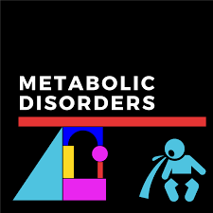
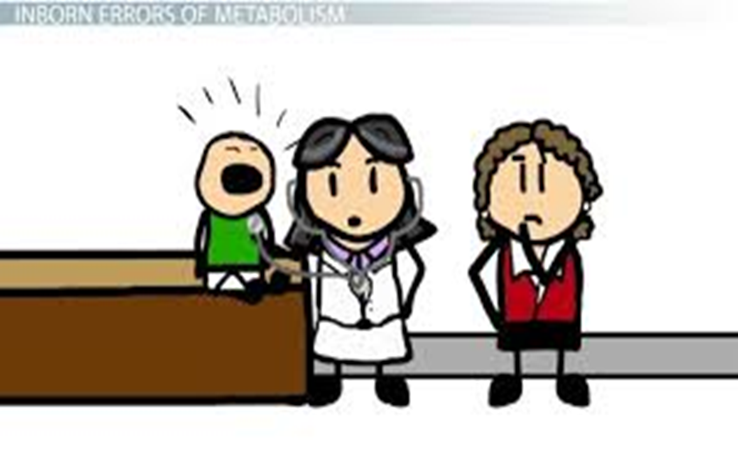

Slide 2
Inborn errors of metabolism
Inborn errors of metabolism (IEM) are a group of inherited metabolic disorders leading to enzymatic defects in the human metabolic pathways.
inborn errors means birth defects in newborn infants which passed down from family and affecting metabolism process;( Inborn errors of metabolism or inherited metabolic disorders).
IEM can appear at birth or later in life such as phenylketonuria, albinism, lactose intolerance, Gaucher disease, Fabry’s disease .
IEM refers a condition where in body’s metabolism is affected due to genetic disorders.

Slide 3
Inborn errors of metabolism

Slide 4
Inborn errors of metabolism cause
The cause of IEM is mutations in a gene that code for an enzyme leading to synthesis of defective enzyme activity or deficiency of an enzyme that affects the normal function of a metabolic pathway.
The main indication of IEM is an excess storage or accumulation of specific metabolites in tissues, organs and blood which further manifest to health diseases.
In last decades, several hundreds of different IEM have been identified. Most IEM are rare but some are life threatening. Although, most people do not know what inherited metabolic disorders are and may never have heard of them.

Slide 5
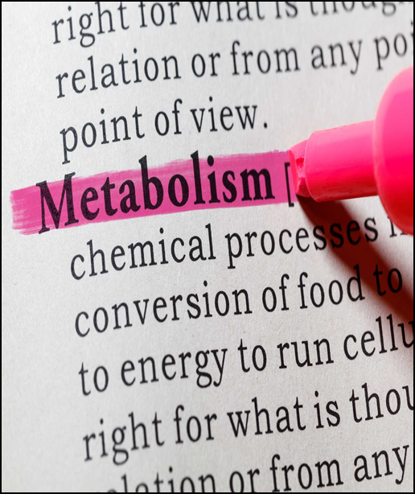
IEM consequences
Metabolism is basically energy production and consumption process that undergoes in a series of chemical reactions occurring within a cell.
Metabolic pathways are required for maintenance of the human body in healthy state.
All metabolic events are driven by enzymes that are catalytic proteins and their main function is to accelerate the rate of biochemical reactions, without being altered during that process.
Enzymes play a crucial role in the metabolism of food stuffs, such as proteins, fats, and carbohydrates. If an error in the normal metabolic process due to deficiency of an enzyme caused metabolic abnormalities.

Slide 6
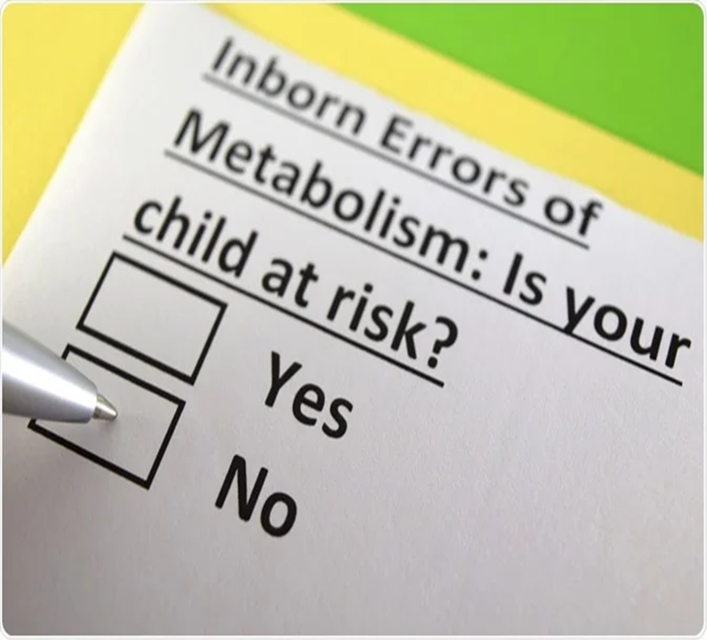
Types of inheritance
IEM are usually Autosomal recessive.
Some are x-linked recessive condition including:
A few inherited as Autosomal dominant trait hyperlipdemia

Slide 7
Autosomal recessive Inheritance

Slide 8
IBE
Metabolism: chemical or physical changes undergone by substances in a biological system.
Small molecule disease
Carbohydrate
Protein
Lipid
Nucleic Acids
Organelle disease
Lysosomes
Mitochondria
Peroxisomes
Cytoplasm

Slide 9
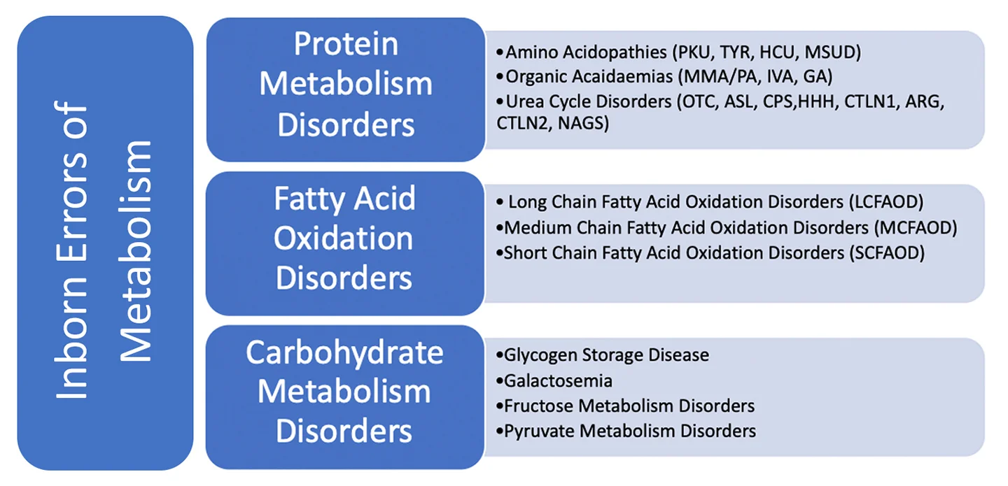

Slide 10
IBE symptoms
Diarrhea
Exercise intolerance
Familial myocardial infarct/ stroke
Muscle cramps/ spasticity
Peripheral neuropathy
Recurrent emesis
Symptoms of pancreatitis
Upward gaze paralysis

Slide 11
IBE and associated lab findings
Abnormal liver function tests…
↑ transaminase or hyper bilirubinemia
Hypoglycemia
Hypophosphatemia
Hypouricemia
↑ CSF protein
Ketosis
Metabolic acidosis
IBE and associated organ manifestations
CNS
Skin/ eye

Slide 12
The Type of Inborn Errors of Metabolism
Type 1: Silent Disorders
Type 2: Acute Metabolic Crises
Type 3: Neurological

Slide 13
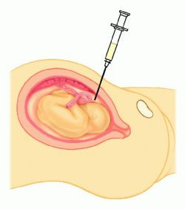
Prenatal tests
Amniocentesis
Best carried out at 15-16 weeks
Used for analysis of specific metabolites by gas chromatography with mass spectroscopy, tandem mass spectroscopy, etc
Used for detection genetic defects using DNA technology
Intended for diagnosis of some amino acid disorders, lysosomal storage disorders etc.

Slide 14
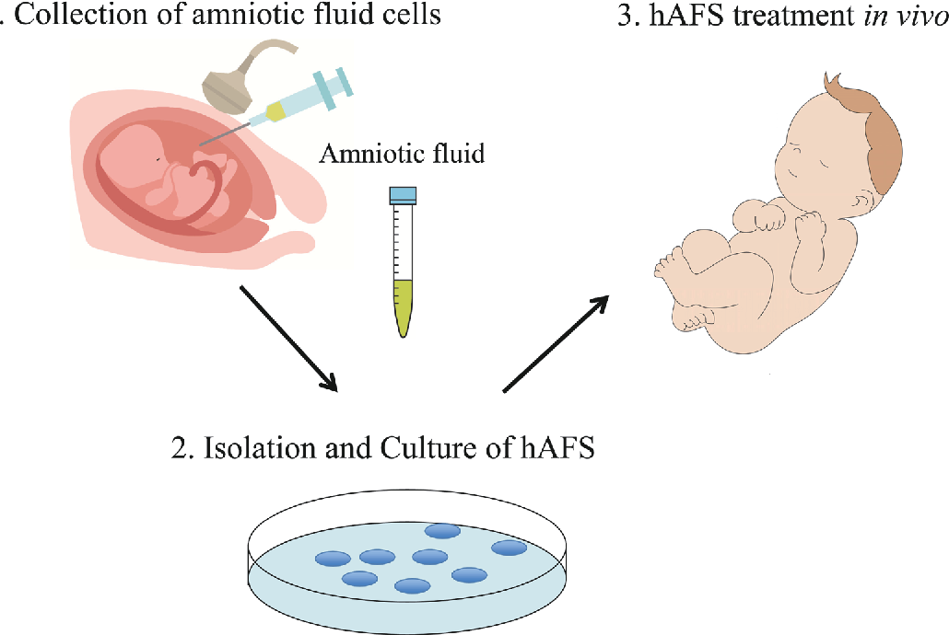
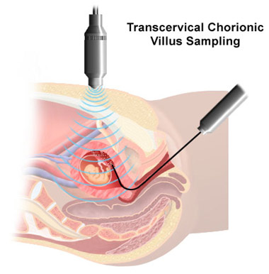
Prenatal tests
Cultured amniotic fluid cells
Used for measurement of specific enzyme activity using various enzyme assays
Used for the study of various metabolic pathways
Major disadvantage is the delay in waiting for sufficient number of cells to grow
Chorionic villus sampling (CVS)
Offers a greater advantage over amniocentesis
Samples are taken at around 11-week gestation
Used for determination of enzyme activity using various enzyme assays

Slide 15
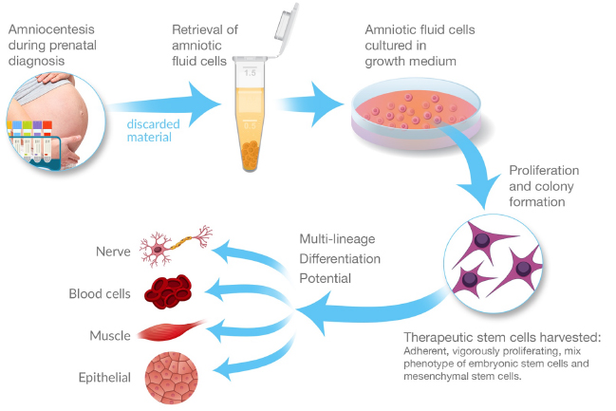

Slide 16
Prenatal tests
Foetal blood and Foetal tissue
Foetal blood is rarely used
Sample taken late in pregnancy
Used when there has been a failure in amniotic fluid analysis
Liver biopsies are used when enzyme deficiencies are not expressed in CVS
Very risky
Used for diagnosis of conditions where enzyme deficiency is expressed in the liver

Slide 17
Postnatal Tests
The investigation of IEM should begin with simple urine and blood analysis.
Screening tests:
Serum electrolytes (looking for evidence of acidosis), glucose & ammonia levels
Blood and urine amino acids for disorders of amino acid metabolism
Urine organic acids for disorders of organic acid metabolism, Acyl carnitine profile for disorders of fatty acid
Blood lactate and pyruvate for disorders of carbohydrate metabolism and mitochondrial disorders

Slide 18
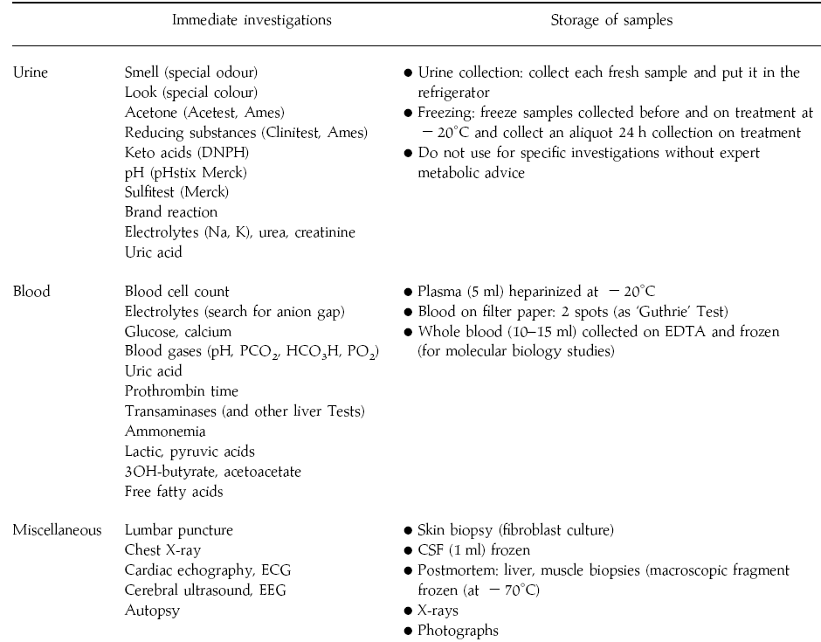
Notes:
18

Slide 20
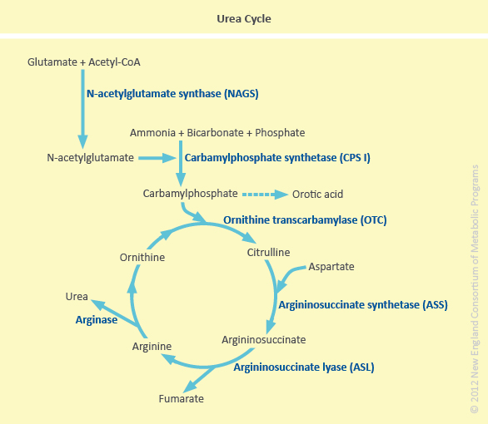

Slide 21
Urea cycle defects
This is an autosomal recessive inherited genetic disorder that affecting the urea cycle.
The liver is a vital organ which plays a promising role in detoxification of nitrogenous wastes by forming the compound urea through the urea cycle.
Urea is a major disposal byproduct of amino acids.
The disturbance in the normal urea cycle leads to accumulation of urea causing cellular toxicity.
The estimated incidence of urea cycle defects is about 1 in 8,000 live births and generally occurs in the first few days of life.

Slide 22
Cause
The urea cycle disorders (UCDs) are caused by defective or total absence of catalytic activity of the first five enzymes involved in the urea cycle.
Errors in this cycle, body unable to detoxify nitrogen content leads to abnormal accumulation of ammonia and other precursor metabolites.
These enzymes are:
• Carbamoyl phosphate synthetase I deficiency (CPS1)
• Ornithine trans carbamylase deficiency (OTC)
• Arginino-succinic acid synthetase deficiency (ASS1)
• Arginino-succinic acid lyase deficiency (ASL)
• Arginase deficiency (ARG)
+ Co factor

Slide 24
CPSI deficiency: Along with OTC deficiency, deficiency of CPSI is the most severe of the UCDs.
OTC deficiency: Absence of its activity in males.

Slide 25
Signs & symptoms
The typical initial symptoms of a child with hyperammonemia are non-specific:
failure to feed, loss of thermo-regulation with a low core temperature, and somnolence.
Symptoms progress from somnolence to lethargy and coma. Abnormal posturing and encephalopathy are often related to the degree of CNS swelling and pressure upon the brain stem.
About 50% of neonates with severe hyperammonemia have seizures.
Hyperventilation, secondary to cerebral edema, is a common early finding in a hyperammonemic attack, which causes a respiratory alkalosis.
Hypoventilation and respiratory arrest follow as pressure increases on the brain stem.

Slide 26
Diagnosis
A plasma ammonia concentration of 150 mmol /L or higher, associated with a normal anion gap and a normal serum glucose concentration, is a strong indication for the presence of a UCD.
Plasma quantitative amino acid analysis
Plasma concentration of arginine may be reduced in all urea cycle disorders, except ARG deficiency, in which it is elevated 5-7 fold.
Plasma concentration of citrulline helps discriminate between the proximal and distal UCD, as citrulline is the product of the proximal enzymes (OTC and CPSI) and a substrate for the distal enzymes (ASS, ASL, ARG).
Urinary orotic acid is measured to distinguish CPSI deficiency and NAGS deficiency from OTC deficiency.
A definitive diagnosis of (CPSI, OTC or NAGS) deficiencies depends on determination of enzyme activity from a liver biopsy specimen.
Molecular genetic testing are often sufficient for diagnostic confirmation, eliminating the risks of liver biopsy.

Slide 27
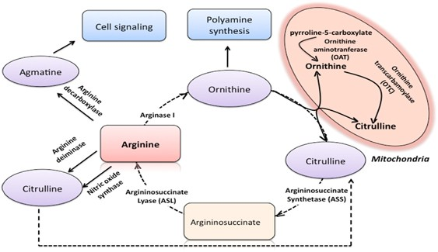

Slide 28
Hyper ammonemia 2
In OTC deficiency, an X-linked inherited and the most common urea cycle disorder, excess carbamoyl phosphate is converted into orotic acid.
This leads to an increased serum ammonia level, increased serum and urinary orotic acid levels and a decreased serum blood urea nitrogen level.
This also leads to an increased urinary orotic acid excretion, because the orotic acid is not being properly utilized and must be eliminated.
The hyper ammonemia depletes α-kT ……. decreasing (ATP) production.
Orotic aciduria is a cause of megaloblastic anemia

Slide 29
Orotic acid
Orotic acid is a heterocyclic compound and an acid; it is also known as pyrimidine carboxylic acid.
Historically it was believed to be part of the vitamin B complex and was called vitamin B₁₃, but it is now known that it is not a vitamin.
The compound is manufactured in the body via a mitochondrial enzyme, dihydroorotate dehydrogenase or a cytoplasmic enzyme of pyrimidine synthesis pathway.
It is sometimes used as a mineral carrier in some dietary supplements (to increase their bioavailability), most commonly for lithium orotate.

