Slide 1
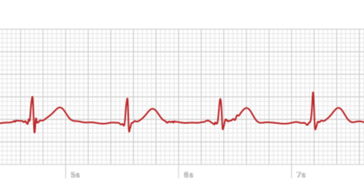
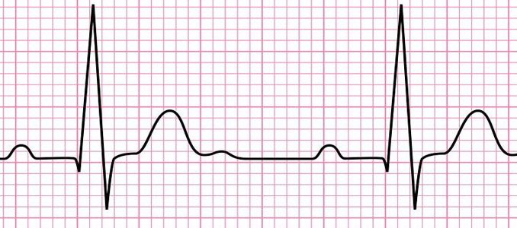
VT versus SVT with Aberrant conduction
Professor Dr.Mousa Qasim
24th th May 2020

Slide 2
Ventricular tachycardia is defined as three or more ventricular complexes in succession at a rate greater than 100 bpm. Patients presenting with ventricular tachycardia often present with a regular heart rate between 100 and 250 bpm (HR below = 146 bpm), in which the QRS morphology is constant and abnormally wide (greater than 0.12 seconds).

Slide 3
Frequently, these ECG's demonstrate AV dissociation in which the ventricular rate is greater than the atrial rate. P waves are frequently hidden within the broad ventricular complexes, although they can sometimes be identified as bumps or notches in the ventricular cycles. Although patients without heart disease may develop paroxysmal non-sustained ventricular tachycardia, chronic sustained VT is most commonly associated with coronary artery disease, dilated cardiomyopathy and prior myocardial infarction or severe heart disease.

Slide 4
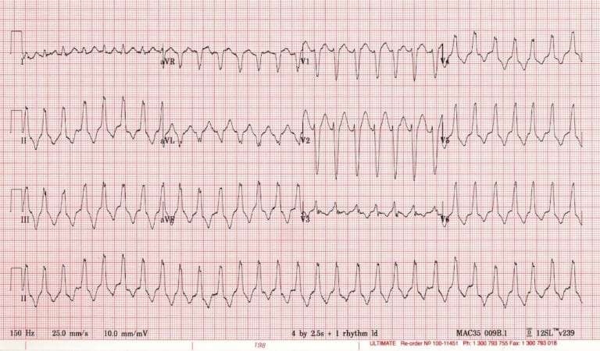
Check out this ECG – how do you interpret it?

Slide 5
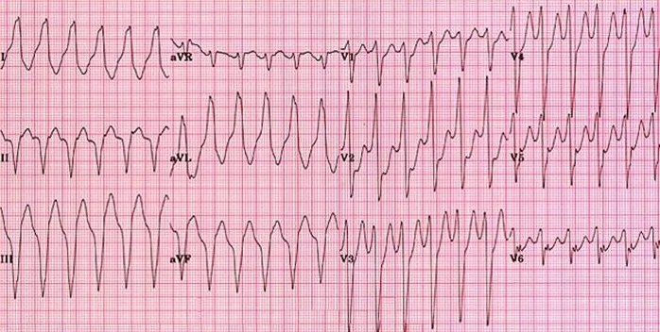

Slide 6
There are three main diagnostic possibilities:
1-Ventricular tachycardia (VT)
2-Supraventricular tachycardia (SVT) with aberrant conduction due to bundle branch block
3-SVT with aberrant conduction due to the Wolff-Parkinson-White syndrome

Slide 7
The most important distinction is whether the rhythm is ventricular (VT) or supraventricular (SVT with aberrancy), as this will significantly influence how you manage the patient. SVTs usually respond well to AV-nodal blocking drugs, whereas patients with VT may suffer precipitous haemodynamic deterioration if erroneously administered an AV-nodal blocking agent.
Unfortunately, the electrocardiographic differentiation of VT from SVT with aberrancy is not always possible

Slide 8
ECG features increasing the likelihood of VT
Electrocardiographic features that increase the likelihood of VT:
1-Absence of typical RBBB or LBBB morphology
2-Extreme axis deviation (“northwest axis”) — QRS is positive in aVR and negative in I + aVF.
3-Very broad complexes (>160ms)
4-AV dissociation (P and QRS complexes at different rates)

Slide 9
5-Capture beats — occur when the sinoatrial node transiently ‘captures’ the ventricles, in the midst of AV dissociation, to produce a QRS complex of normal duration.
6-Fusion beats — occur when a sinus and ventricular beat coincides to produce a hybrid complex.

Slide 11
7-Positive or negative concordance throughout the precordial (chest) leads, i.e. leads V1-6 show entirely positive (R) or entirely negative (QS) complexes, with no RS complexes seen.

Slide 12
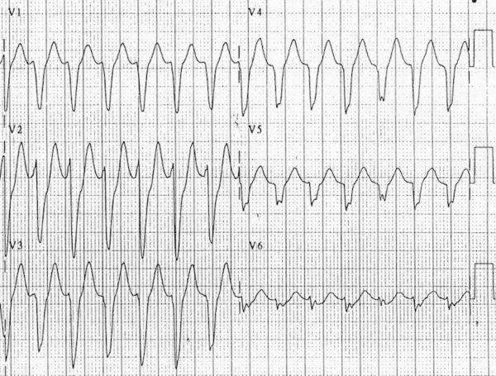
Negative concordance in VT

Slide 13
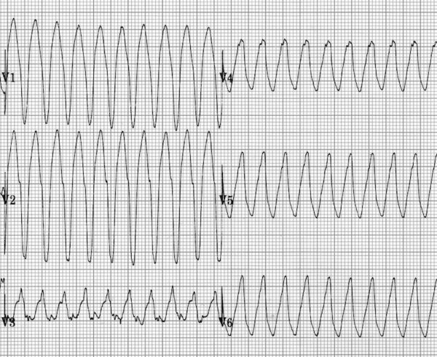
Positive concordance in VT

Slide 14
8-Brugada sign – The distance from the onset of the QRS complex to the nadir of the S-wave is > 100ms
9-Josephson sign – Notching near the nadir of the S-wave
10-RSR’ complexes with a taller left rabbit ear. This is the most specific finding in favour of VT. Note: This is in contrast to RBBB, where the right rabbit ear is taller.

Slide 15
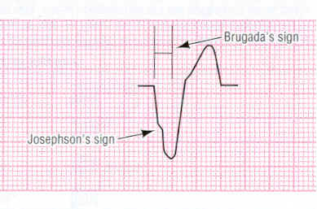

Slide 17
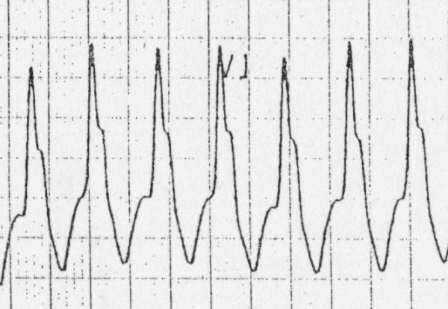
taller left rabbit ear V1/V2→ VT

Slide 18
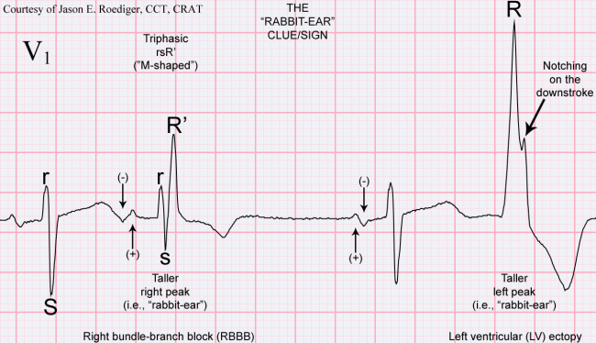

Slide 20
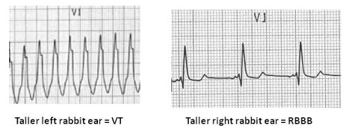

Slide 21
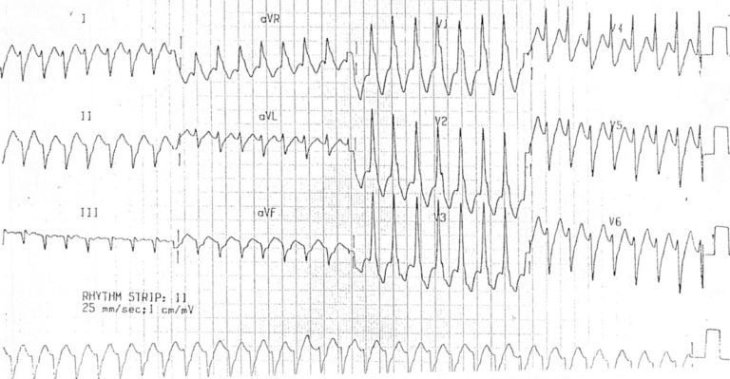
Monomorphic VT:
Extreme axis deviation / northwest axis is present
-150 degree; QRS positive in aVR, negative in I + aVF
There is a RBBB-like pattern in V1 with a taller left rabbit ear – this is very specific for VT.

Slide 22
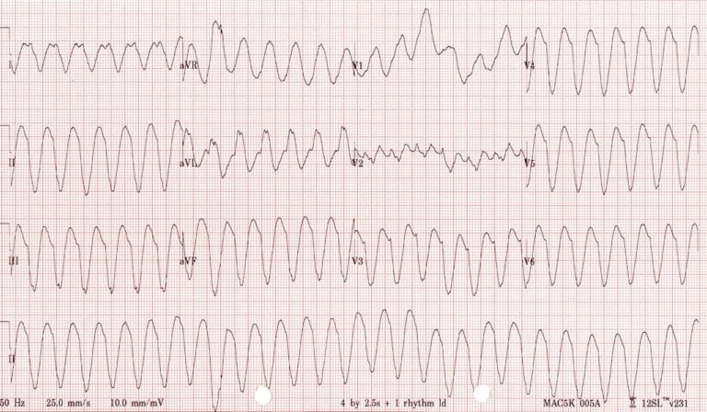
Monomorphic VT:
Classic monomorphic VT with uniform QRS complexes.
Indeterminate axis.
Very broad QRS (~200 ms).
Notching near the nadir of the S wave in lead III = Josephson’s sign.

Slide 23
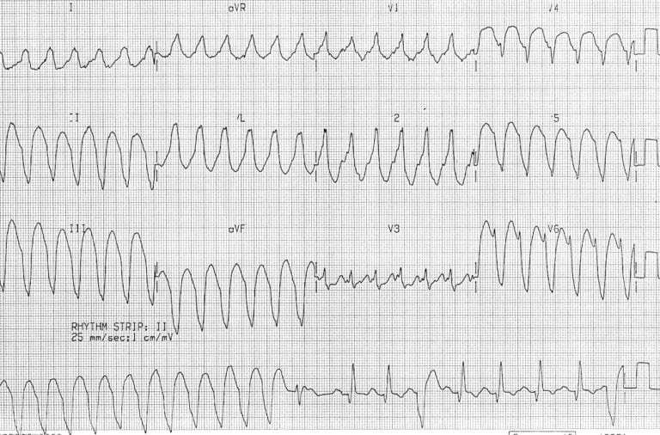
Monomorphic VT:
Very broad QRS complexes (~ 200 ms) with uniform morphology.
Fusion and capture beats are seen in the rhythm strip.
Brugada’s sign is present: the time from the onset of the QRS complex to nadir of S wave is > 100 ms (best seen in V6).

Slide 24
Additional factors associated with VT or SVT
The likelihood of VT is increased with:
Age > 35 (positive predictive value of 85%)
Structural heart disease
Ischaemic heart disease
Previous MI
Congestive heart failure
Cardiomyopathy
Family history of sudden cardiac death (suggesting conditions such as HOCM, congenital long QT syndrome, Brugada syndrome or arrhythmogenic right ventricular dysplasia that are associated with episodes of VT)

Slide 25
The likelihood of SVT with aberrancy is increased if:
-Previous ECGs show a bundle branch block pattern with identical morphology to the broad complex tachycardia.
-Previous ECGs show evidence of WPW (short PR < 120ms, broad QRS, delta wave).
-The patient has a history of paroxysmal tachycardias that have been successfully terminated with adenosine or vagal manoeuvres.

Slide 26
Advanced Tips for Diagnosing VT — The Brugada Criteria
For difficult cases, the Brugada algorithm can be used to distinguish between VT and SVT with aberrancy.
The algorithm is followed from top to bottom — if any of the criteria are satisfied then VT is diagnosed.

Slide 27
1. Absence of an RS complex in all precordial leads
This is essentially the same as having positive or negative concordance.
All precordial leads consist of either monophasic R or S waves
→ VT is diagnosed.
If there are any RS complexes present in V1-6
→ go to step 2.

Slide 28
2. RS interval > 100ms in one precordial lead
If RS complexes are present in V1-6 then the RS interval is measured. This is the time from the onset of the R wave to the nadir of the S wave.
If the RS interval is > 100 ms
→ VT.
If the RS interval is < 100 ms
→ go to step 3

Slide 29
3. AV dissociation
The ECG is scrutinised for hidden P waves; these are often superimposed on the QRS complexes and may be difficult to see.
P waves are present at a different rate to the QRS complexes
→ AV dissociation is present and VT is diagnosed.
No evidence of AV dissociation can be seen
→ go to step 4

Slide 30
4. Morphological Criteria for VT
Leads V1-2 and V6 are assessed for characteristic features of VT. There are two sets of morphological criteria depending on the appearance of the QRS complex in V1:
Dominant R wave in V1
→ see criteria for RBBB-like morphology
Dominant S wave in V1
→ see criteria for LBBB-like morphology

Slide 31
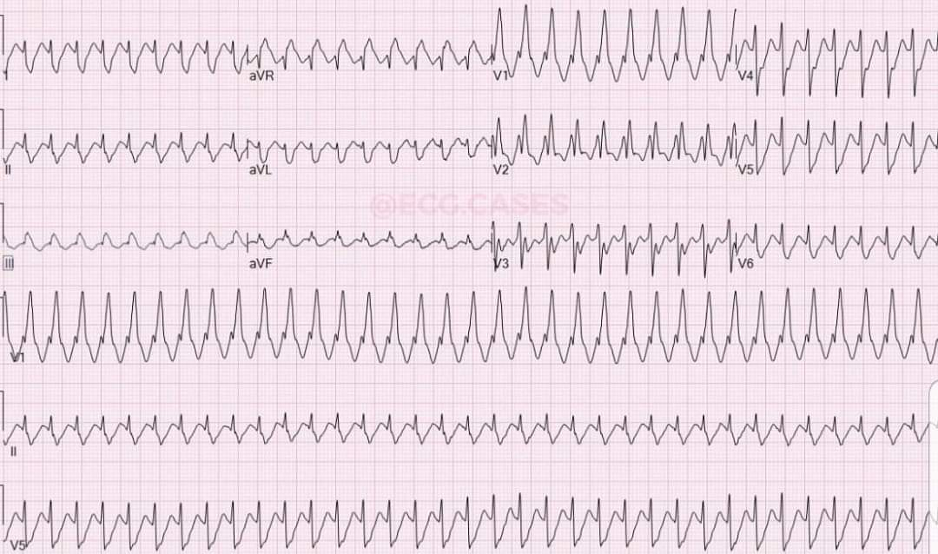
SVT with RBBB

Slide 32
SVT WITH LBBBB

Slide 33
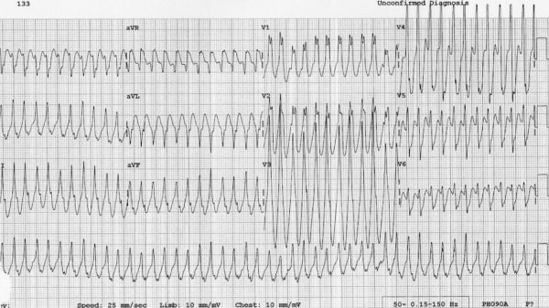
Antidromic atrioventricular re-entry tachycardia (AVRT) with WPW:
There is a regular, broad complex tachycardia at ~280 bpm; this would be very difficult to distinguish from VT.

Slide 34
THANK YOU
THANK YOU

