Slide 1
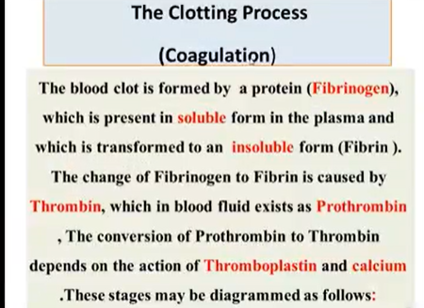

Slide 2
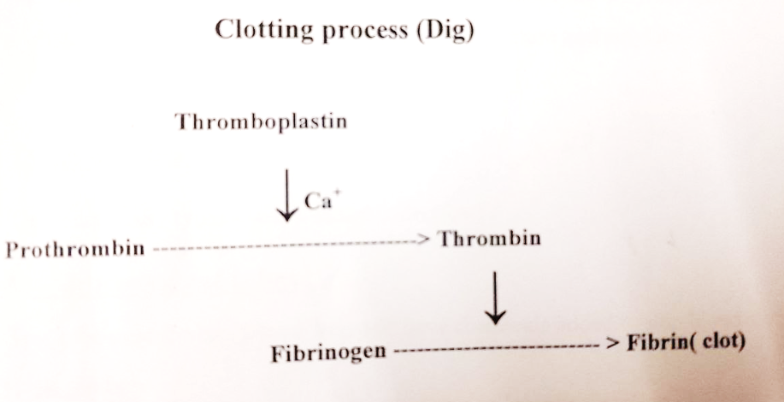

Slide 3
Anticoagulants
Is a substance that prevents coagulation (clotting) of blood. Anticoagulant drugs inhibit clot ormation by blocking the action of clotting factors or platelets.

Slide 4
