Slide 1
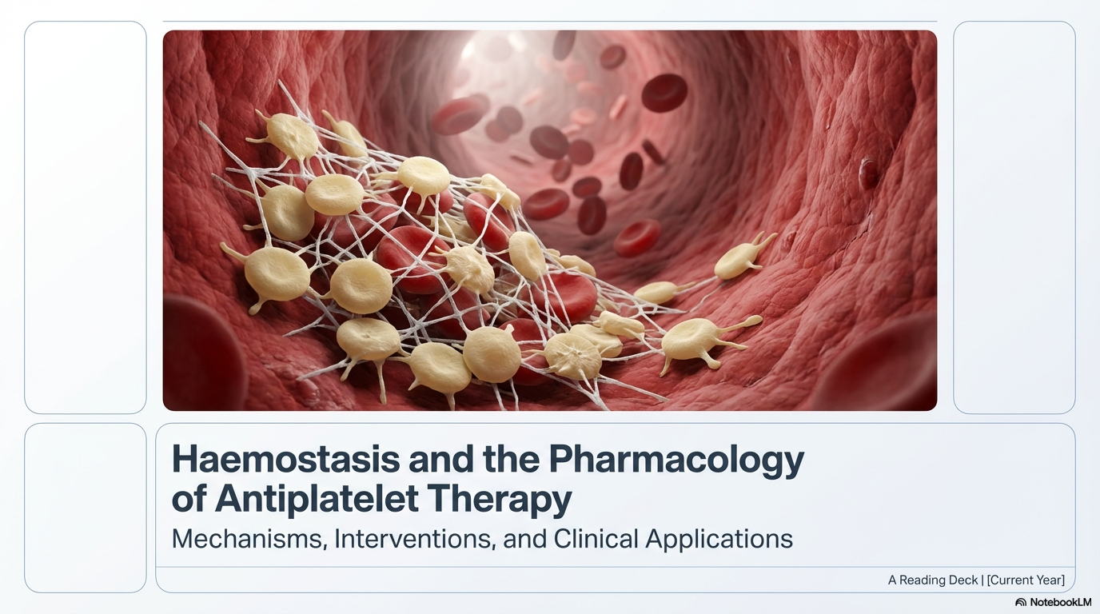

Slide 2
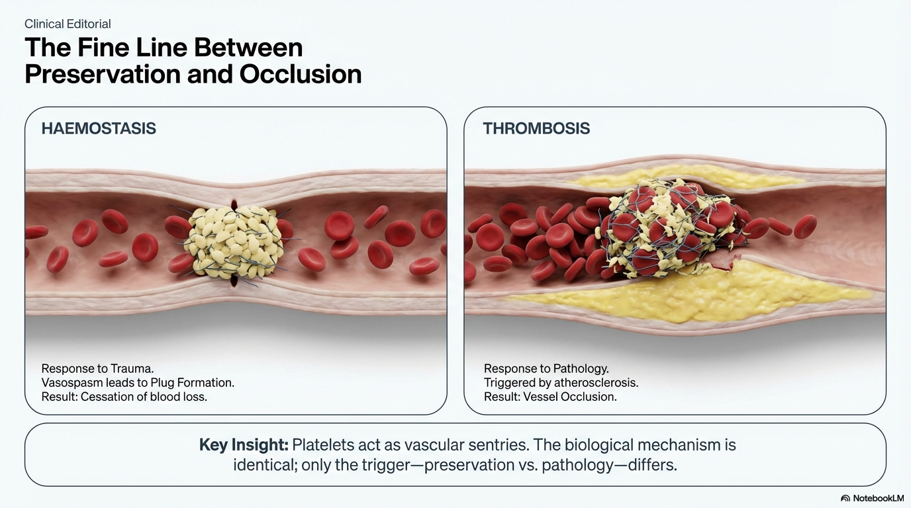

Slide 3
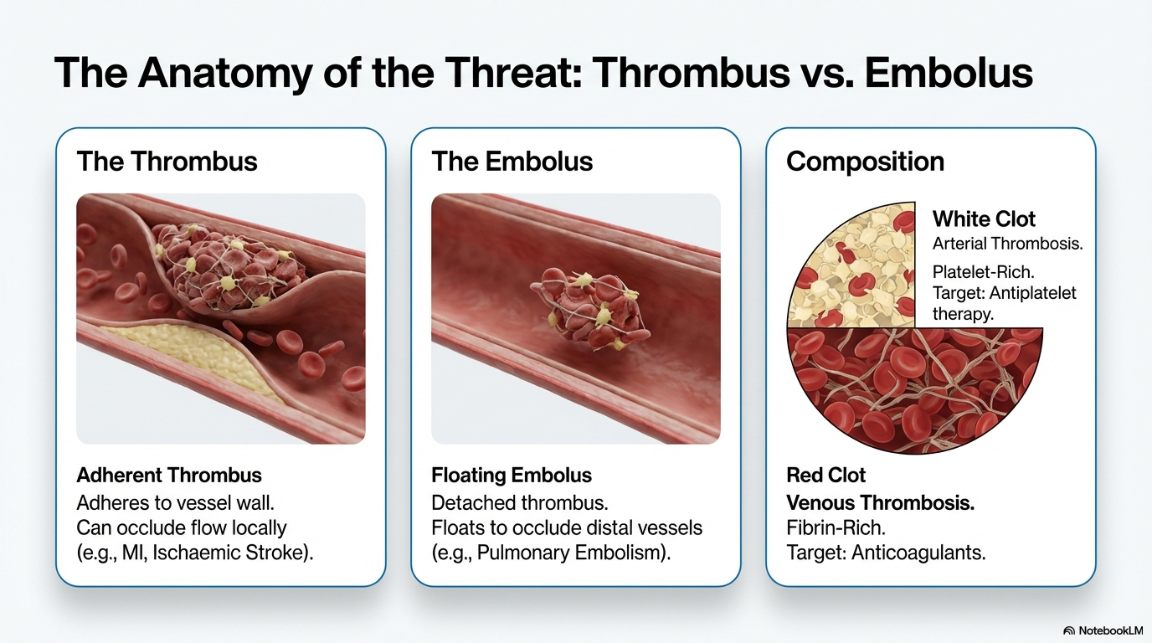

Slide 4
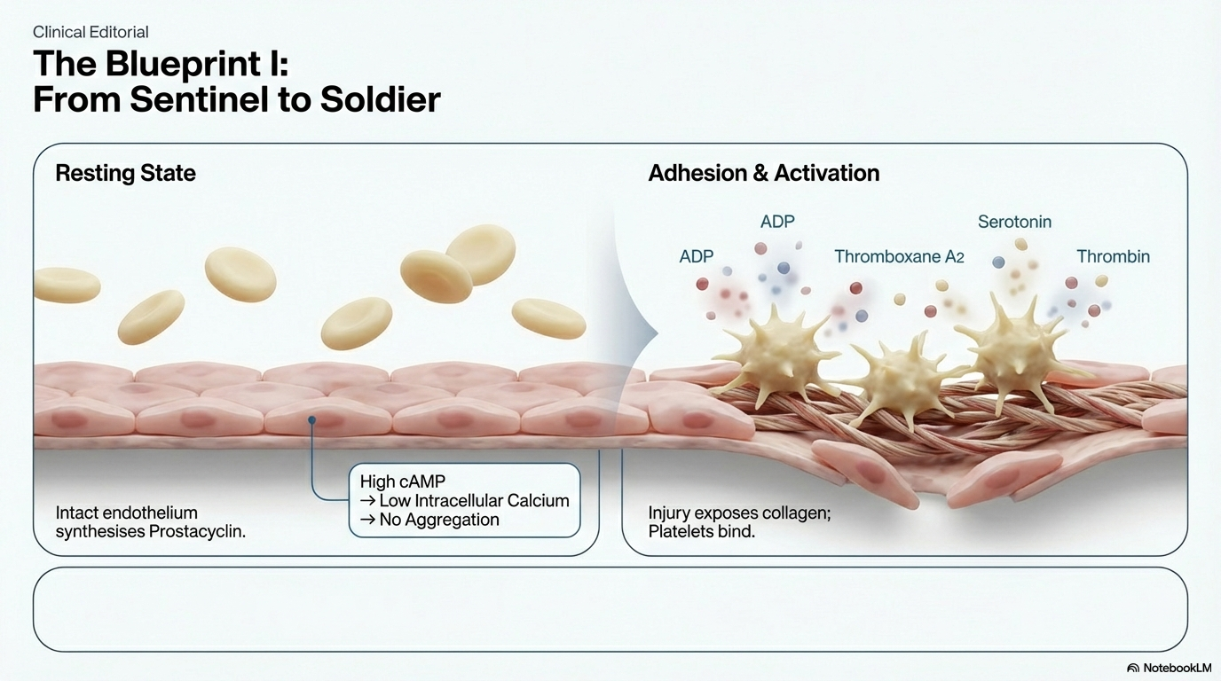

Slide 5
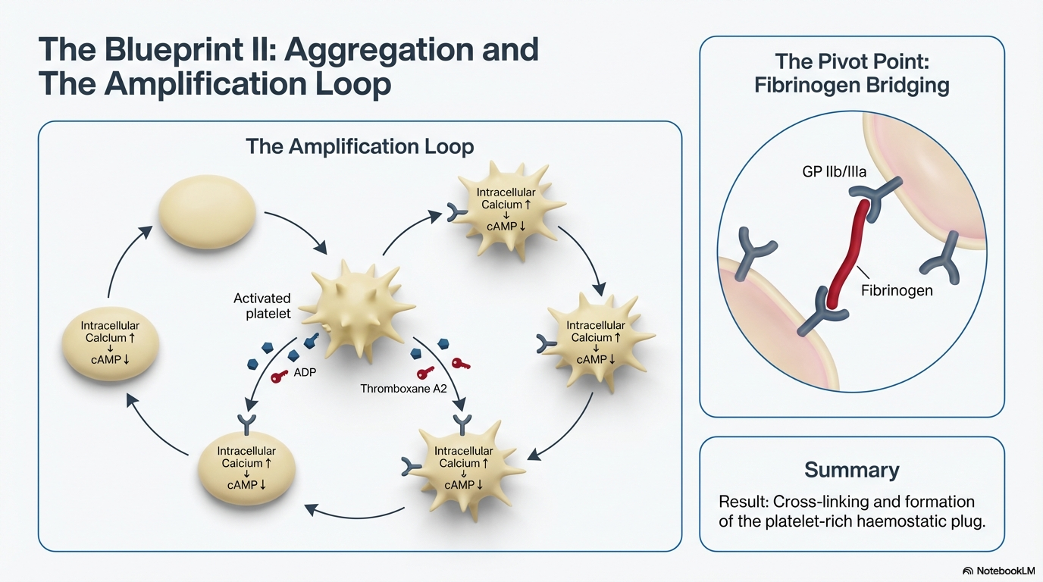

Slide 6
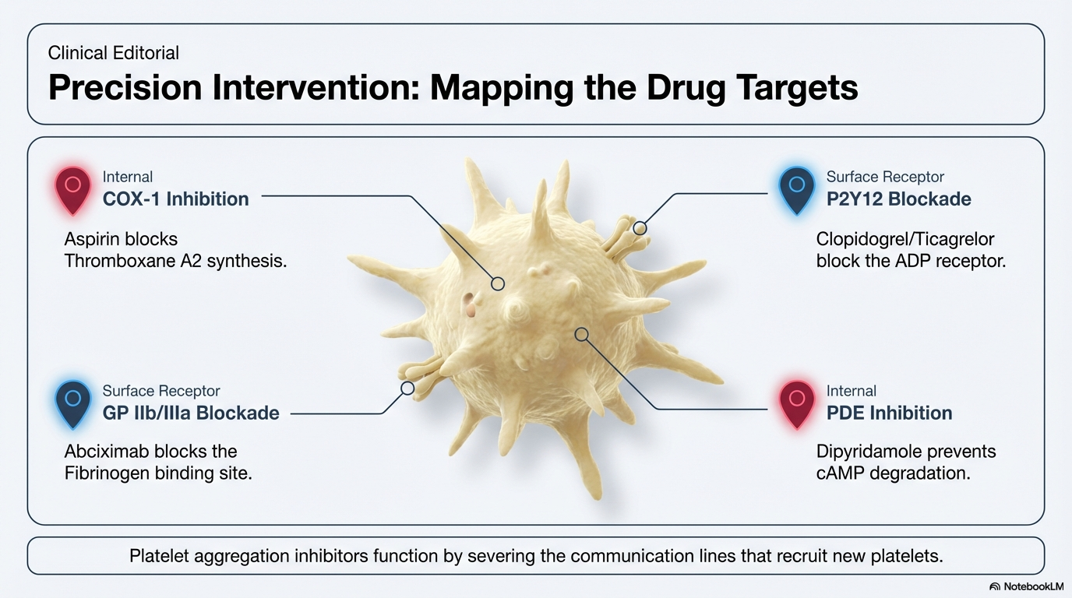

Slide 7
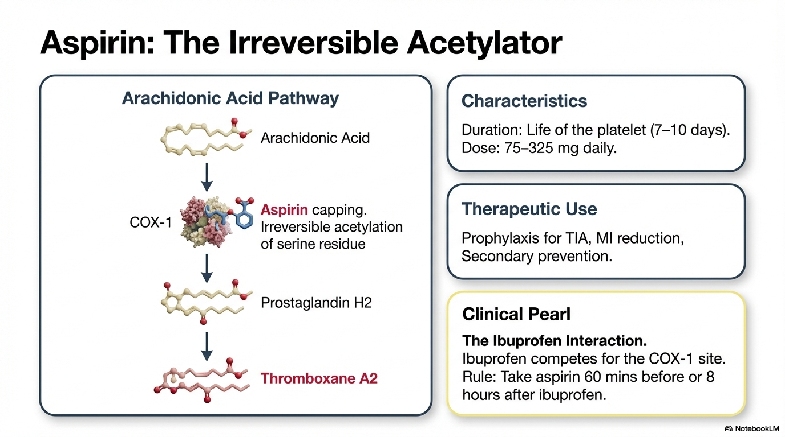

Slide 8
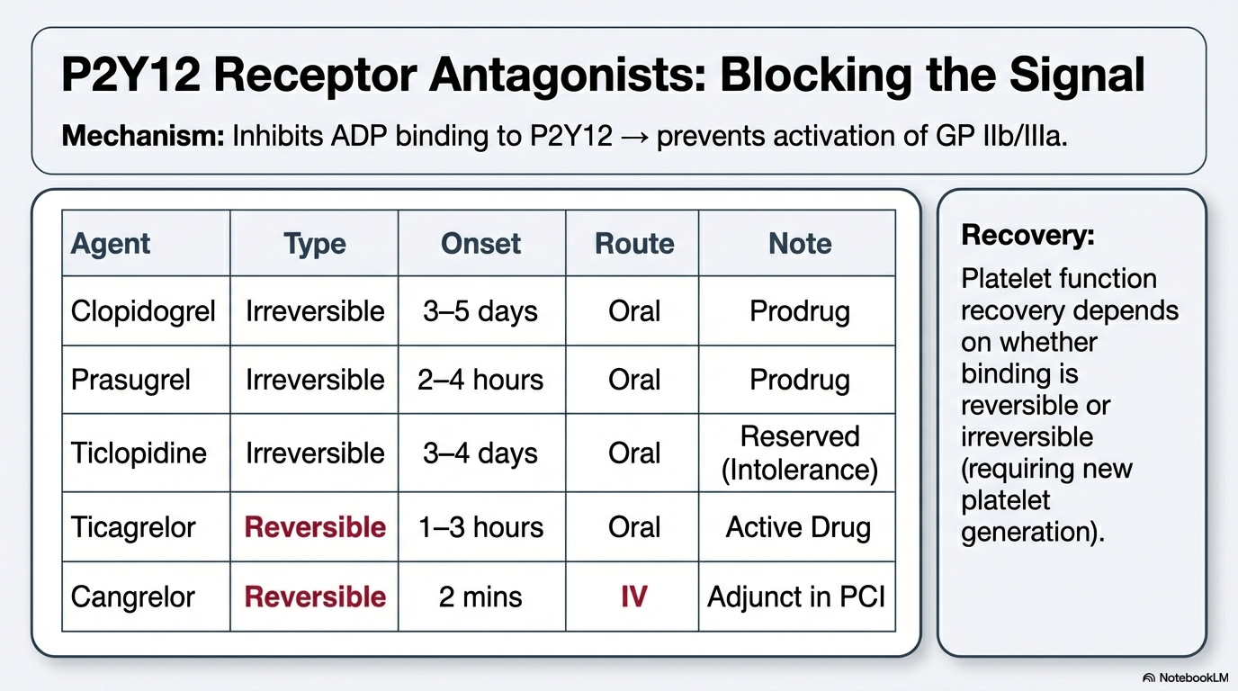

Slide 9
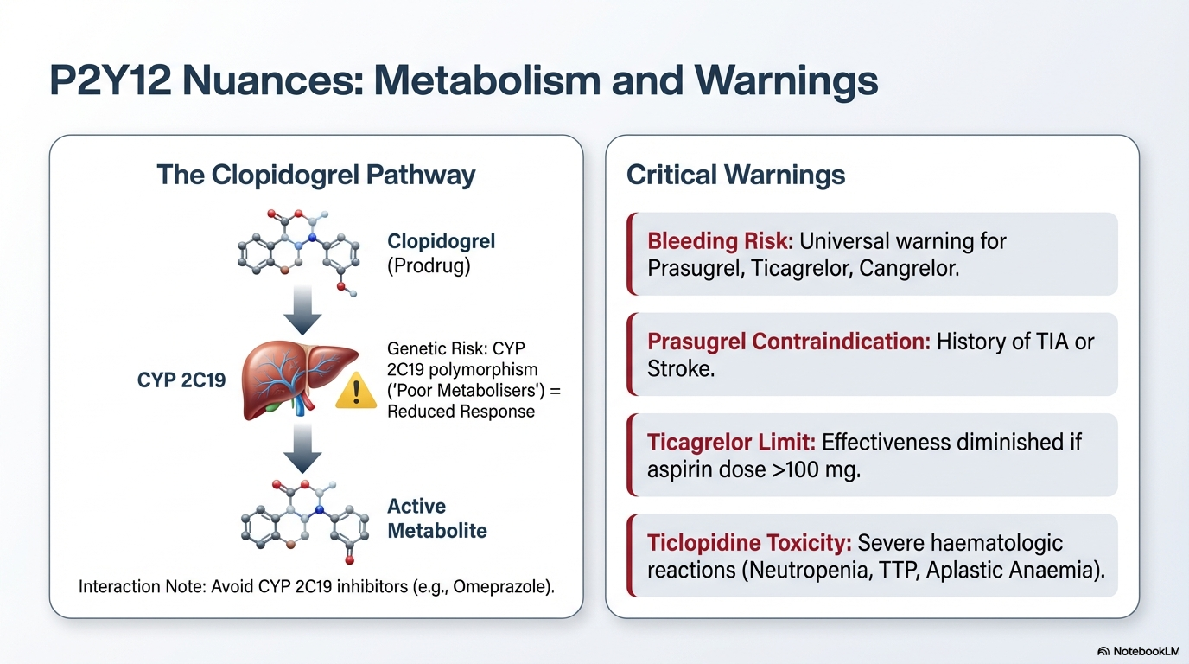

Slide 10
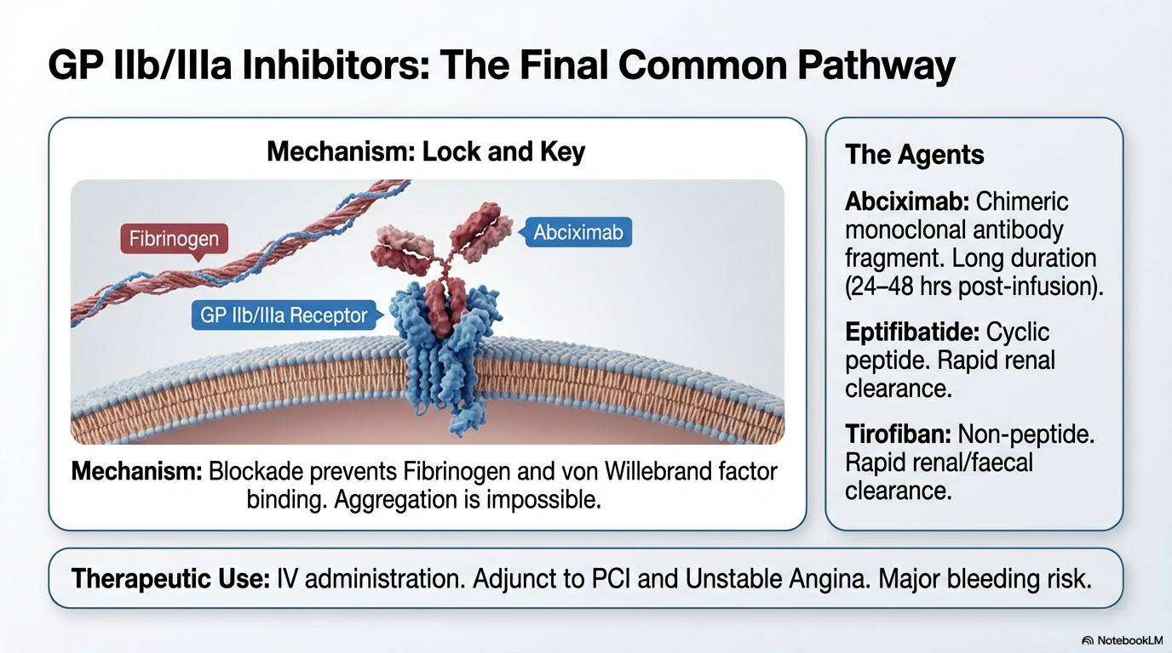

Slide 11
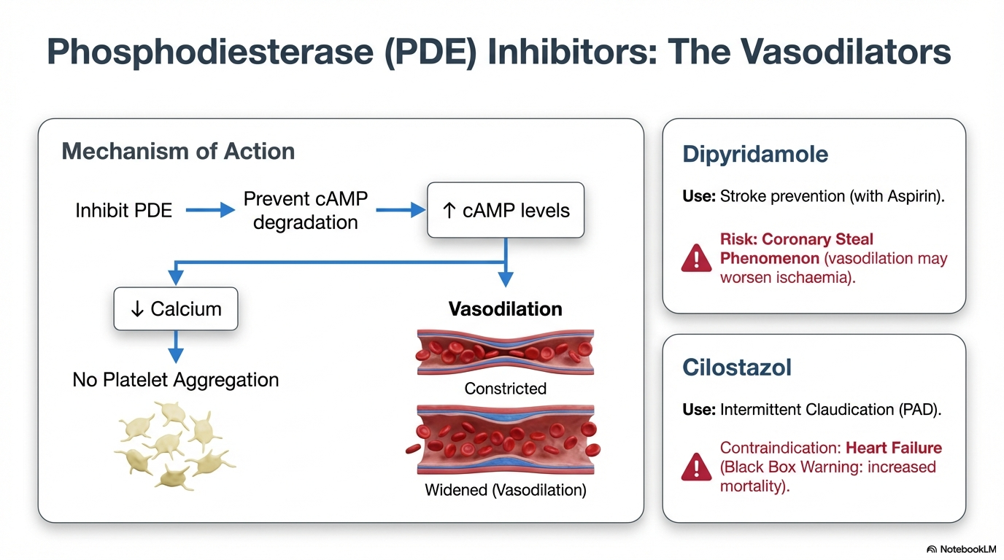

Slide 12
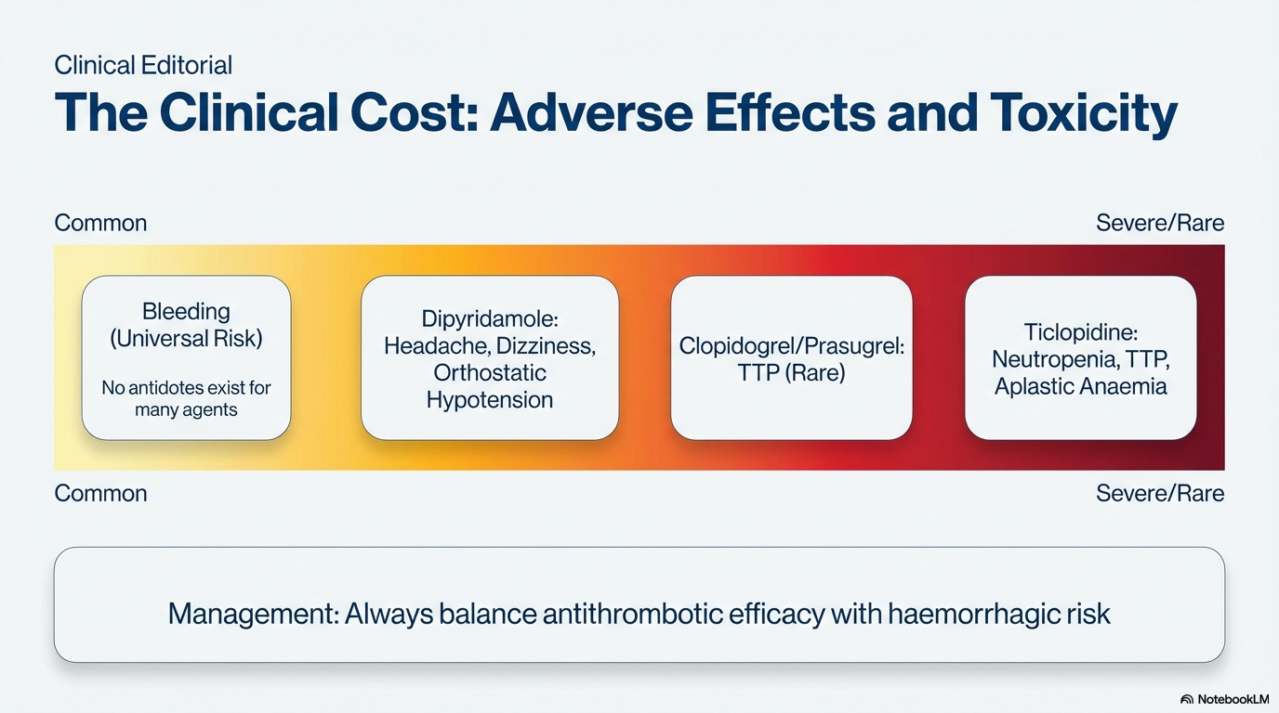

Slide 13
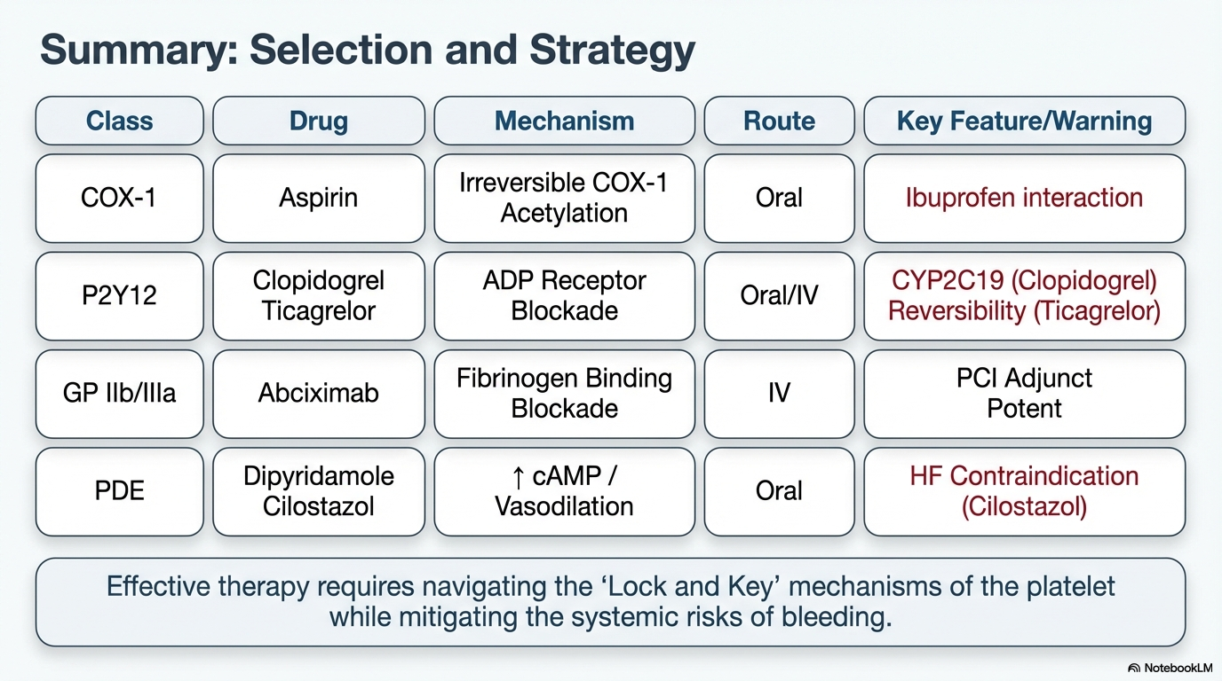

Slide 14
BLOOD COAGULATION

Slide 15
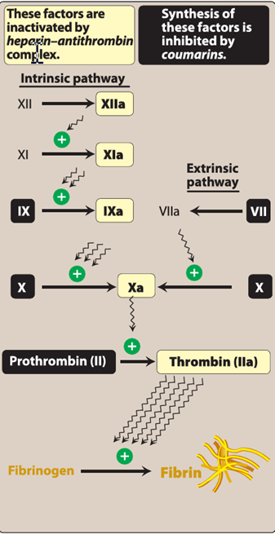

Slide 16
Inhibitors of coagulation
It is important that coagulation is restricted to the local site of vascular injury. Endogenously, protein C, protein S, antithrombin Ill, and tissue factor pathway inhibitor all inhibit coagulation factors. The mechanism of action of several anticoagulant agents, including heparin and heparin-related products, involves activation of these endogenous inhibitors (primarily antithrombin Ill).
d a title

Slide 17
Inhibitors of coagulation
It is important that coagulation is restricted to the local site of vascular injury. Endogenously, protein C, protein S, antithrombin Ill, and tissue factor pathway inhibitor all inhibit coagulation factors. The mechanism of action of several anticoagulant agents, including heparin and heparin-related products, involves activation of these endogenous inhibitors (primarily antithrombin Ill).
d a title

