Slide 1
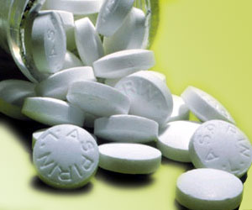

2021 - 2022
Preparation
of
Acetylsalicylic acid

Slide 2
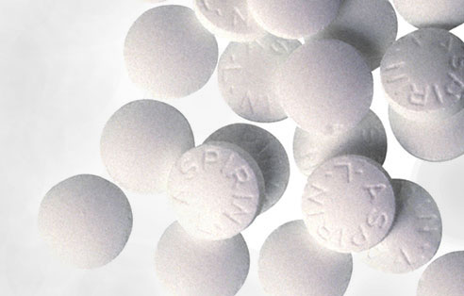
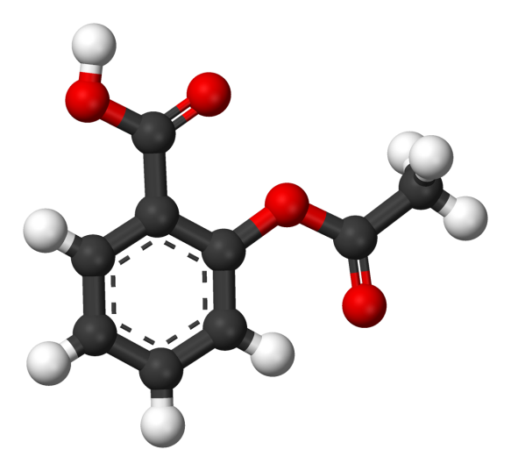
Properties of Acetylsalicylic acid, Aspirin,
1- Aspirin occurs as white crystals
or as a white crystalline powder.
2- It is slightly soluble in water
(1:300), soluble in alcohol (1 :5),
chloroform (1:17) & ether (1:15).
It dissolves easily in glycerin.
C₉H₈O₄
Molar mass 180.15 g/mol
Melting point 135 ºC
3- Practically all salts of aspirin (soluble in aqueous
media) , except those of aluminum and calcium
(insoluble in aqueous media), are unstable for phar-
maceutical use.
4- Aspirin gives No color with FeCl₃ solution.

Slide 3

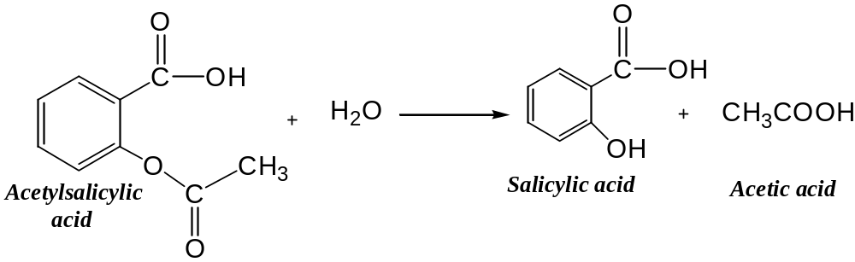

5- It's used as antipyretic, analgesic & antirheumatic
in tablets, suppositories, vials, …etc. dosage form.
6- Aspirin is stable in dry air, but in the presence of
moisture, it slowly hydrolyzes into acetic acid and
salicylic acid.
So old aspirin tablets may have a smell like vinegar as a result of the hydrolysis reaction that produces acetic acid ( Ethanoic acid ).

Slide 4
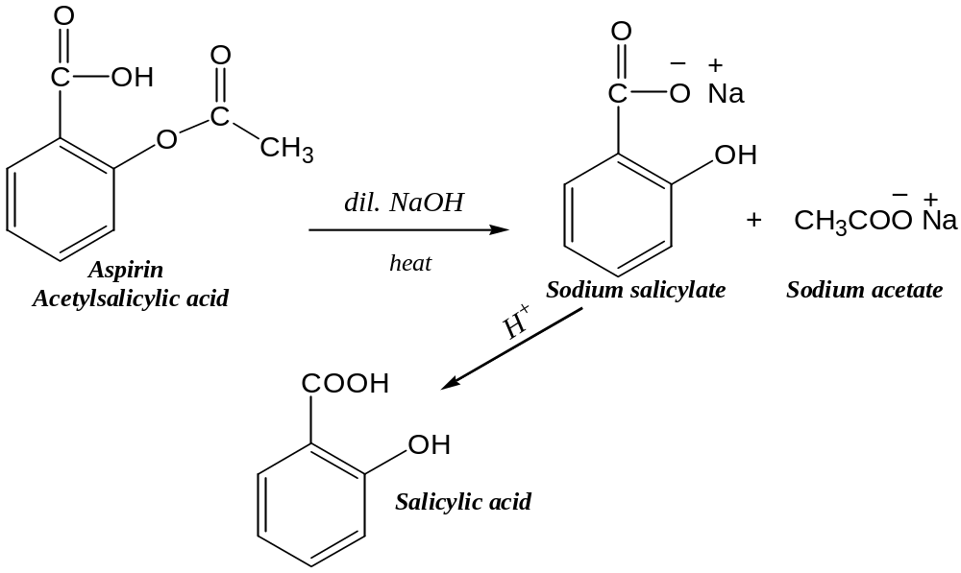
7- Salicylic acid will crystallize out when an aqueous
solution of aspirin and NaOH is boiled and then
acidified.
So , Aspirin decomposes in the presence of alkaline hydroxides & carbonates.

Slide 5
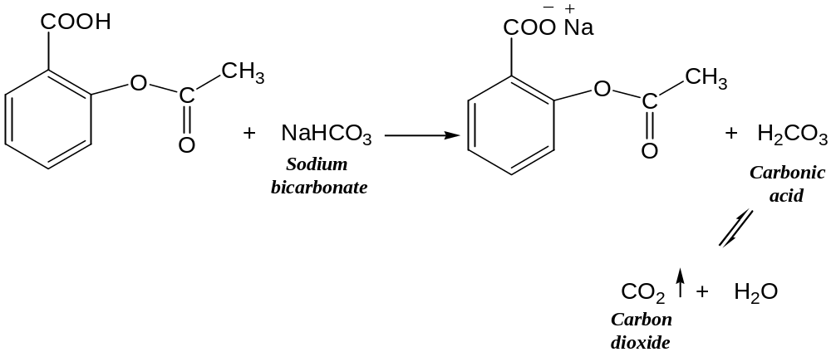
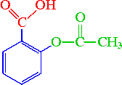
8- Aspirin itself is acidic enough to produce
effervescence with carbonates.
Acetylsalicylic acid:
Aspirin contains three groups:
Carboxylic acid functional group
(R-COOH)
Ester functional group (R-O-CO-R')
Aromatic group (benzene ring)

Slide 6
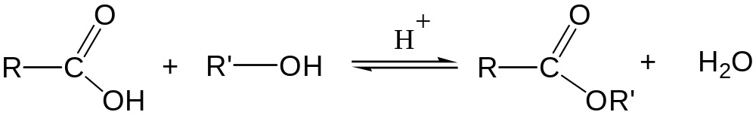
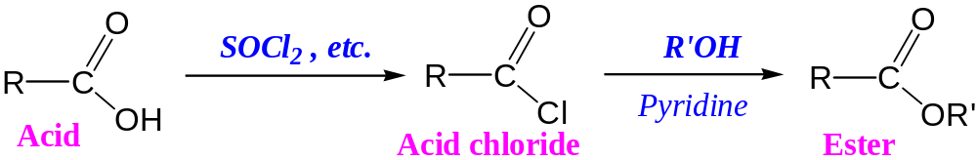
Preparation of ester:
1- Direct esterification procedure:
The interaction between a carboxylic acid & an alcohol is: (a) Reversible. (b) Proceeds very slowly.
2- Esterification using acid chlorides:
Acid chlorides reacts readily with primary & secondary alcohols to give esters in very good yields.

Slide 7
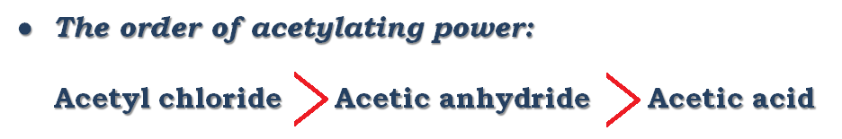
The reaction is fast but it's not safe and it produces HCl gas so pyridine should be used as a base to pick up a proton (H⁺) and gives pyridinium chloride.
Pyridine is teratogenic and air pollutant.
3- Esterification using acid anhydrides:
Esterification can be carried out with acid anhydrides in the presence of a suitable catalyst either an acidic catalyst such as sulphuric acid, or a basic catalyst.

Slide 8
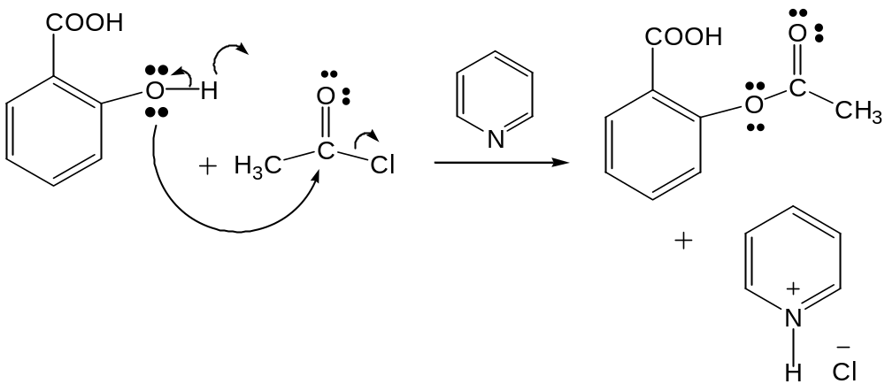
Preparation of acetyl salicylic acid:
Method 2:
Preparation of aspirin by using acetyl chloride with salicylic acid
Acetyl chloride is an acyl chloride, is very reactive it reacts vigorously with Salicylic acid to form aspirin.

Slide 9
Method 3:
Preparation of aspirin by the reaction of S.A. and
acetic anhydride :
Acetic anhydride, Ac₂O, is an acid anhydride which
is used chiefly to make esters that cannot be made
by direct esterification with acetic acid.
Acetic anhydride is cheap , readily available, easily
handled and not forming corrosive HCl gas , with
moderate reactivity , the acetylating reaction is
moderate but safer than that of acid chloride.

Slide 10
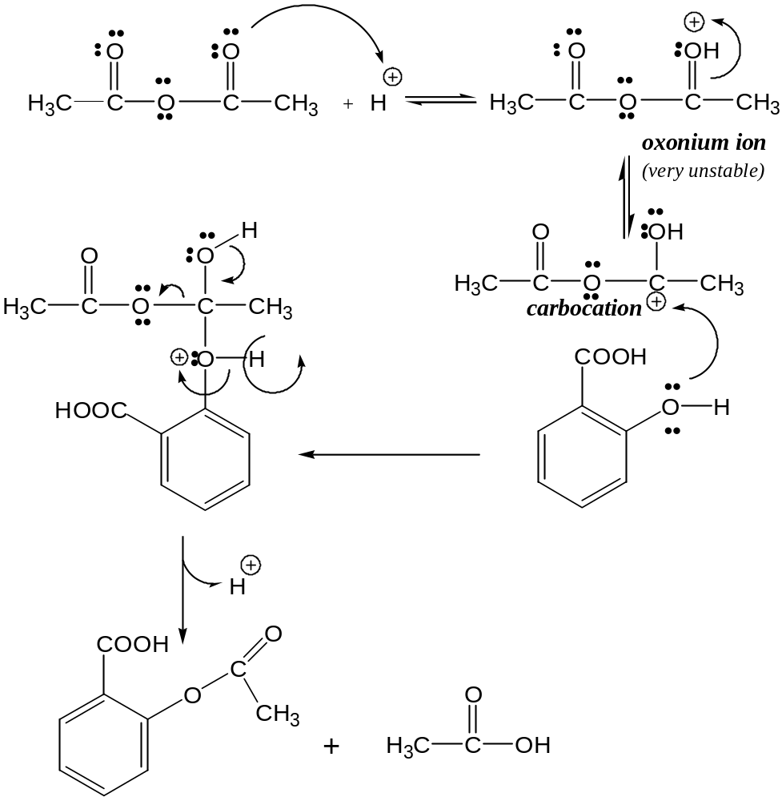
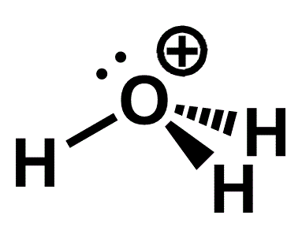
Mechanism I:
Oxonium ion is any oxygen cation with 3 bonds, The simplest oxonium ion is Hydronium ion.

Slide 11
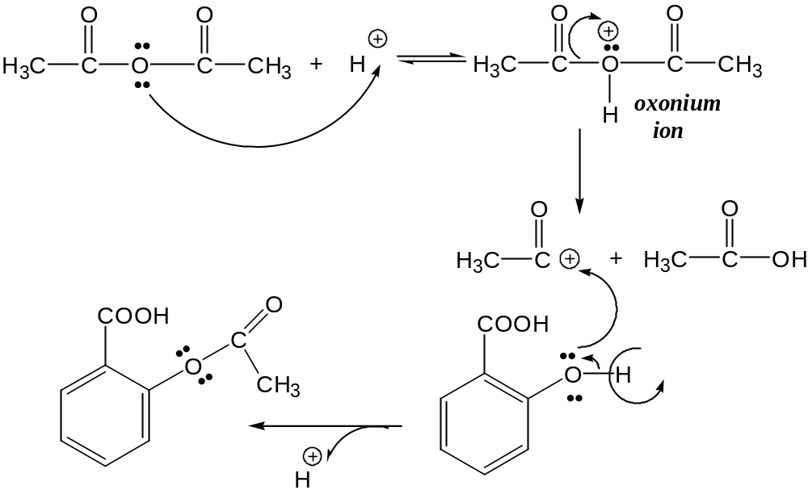
Mechanism II:

Slide 12
Name of Experiment: Esterification using acid anhydride.
Aim of experiment: Preparation of Aspirin.
Procedure:
1) Put 2.5 gm of S.A in a dry conical flask*.
2) Add 5 ml of acetic anhydride**.
3) Shake well.
4) Add 3-5 drops conc. H₂SO₄ ***.
5) Warm on water bath to (50-60) ºC for about
(10-15) min****.
6) Stirring, cooling (ppt. of aspirin ) then add
75 ml D.W.***** .
7) Filtration, wash the ppt. with cold D.W. and
collect the product (aspirin).

Slide 13

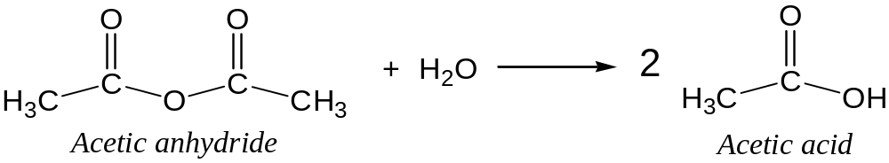
Notes:
* The conical flask should be dried well since the presence of moisture could hydrolyze acetic anhydride to acetic acid .

Slide 14

** The 1st step in this esterification is to create
a suspension of Salicylic acid (solid at r.t. ) in an
excess of Acetic anhydride (
liquid at r.t.).
So, Acetic anhydride serves as both a reactant and
a solvent.
*** A catalyst is required for this reaction.
Conc. H₂SO₄ , donates a proton which binds to the reaction complex.
As a catalyst, H⁺ is regenerated, not consumed by the end of the reaction.

Slide 15
**** As the reaction proceeds , the solid S.A.
disappears and the Acetylsalicylic acid product remains dissolved in the hot solution.
Once all solid has disappeared (all the S.A. has been consumed) the reaction is completed.
Avoid very high temperature or prolonged heating period since the synthesized acetylsalicylic acid may decompose.

Slide 16
***** At this point the excess unreacted
Acetic anhydride must be hydrolyzed (split apart by
the addition of water ) to acetic acid.
Acetic anhydride is very reactive toward water,
so the hydrolysis must be done slowly, water should
be added drop-wisely.
More water is then added and the flask is placed in
an ice bath to lower the solubility and precipitate
the prepared aspirin.
The collected ASA is then recrystallized by using mixed solvents to further purify the product.

Slide 17


Percent yield :
It serves to measure the effectiveness of a synthetic procedure.
To calculate the percent yield of
a reaction:
1- Write a balanced equation for the reaction.
2- Finding the limiting reagent.
3- Determination of the theoretical yield.
4- Determination of the actual yield.
5- Calculation of the percent yield.

Slide 18

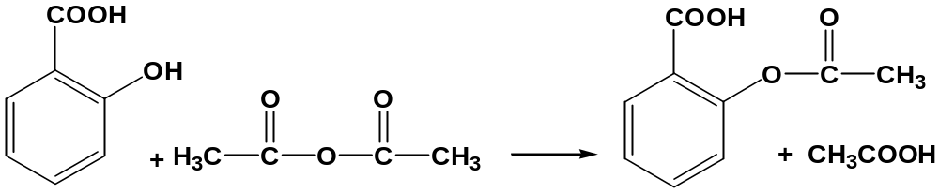
In our experiment today
1 mole
S.A.
1 mole
Acetic anhydride
1 mole
Aspirin
- We used acetic anhydride in excess so salicylic acid
is the limiting reagent.
- Use salicylic acid to calculate the theoretical yield.

Slide 19
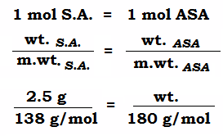

Wt . = 3.25 g of the ASA theoretically
The wt. of ASA synthesized in the experiment = 2.7 g
''for example''
Wt. = 2.7 g of the ASA
Actual

