Slide 1
Nonsteroidal Anti-inflammatory Drugs Toxicity

Slide 2
Nonsteroidal anti-inflammatory drugs (NSAIDs) comprise a class of xenobiotics with analgesic, antipyretic, and anti-inflammatory properties.
These desirable clinical effects account for the extensive list of approved clinical uses, including the treatment of pain, inflammation, and fever, as well as the management of connective tissue, immunologic, and rheumatologic diseases

Slide 3
Ibuprofen, naproxen, and ketoprofen are currently the only nonprescription NSAIDs in the United States.
NSAIDs are also contained in cough and cold preparations and in prescription combination drugs (eg, ibuprofen with hydrocodone).
NSAIDs are considered among the most commonly used and prescribed medications in the world

Slide 4
Pharmacology
They all share the ability to inhibit prostaglandin (PG) synthesis.
PG synthesis begins with the activation of phospholipases A2 that cleave phospholipids in the cell membrane to form arachidonic acid (AA).
AA is metabolized by COX, to form many eicosanoids, including PGs and the prostanoids, prostacyclin (PGI 2) and thromboxane (TXA 2)

Slide 5
AA can also be metabolized by lipoxygenase (LOX) to form many different leukotrienes (LTs) that are involved in creating a pro-inflammatory environment

Slide 6
The COX enzyme responsible for PG production exists in two isoforms termed COX-1 and COX-2.
COX-1 is constitutively expressed by virtually all cells throughout the body but is the only isoform found within platelets.
COX-2 is rapidly induced (within 1 to 3 hours) in inflammatory tissue by laminar shear (or mechanical) forces and cytokines, producing PGs involved in the inflammatory response.
COX-2 is also upregulated by several cytokines, growth factors, and tumor promoters involved with cellular differentiation and mitogenesis, suggesting a role in cancer development.

Slide 7
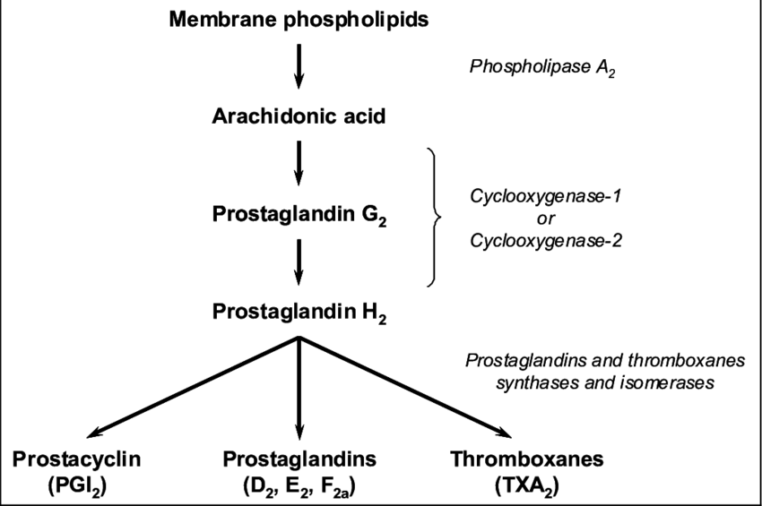

Slide 8
Pathophysiology
GI toxicity is the most common adverse effect from NSAID use.
Normally, the COX-1 enzyme expressed in the gastric epithelial cells leads to the production of PGs (PGE 2 and PGI 2), which are responsible for maintaining GI mucosal integrity by increasing mucous production and decreasing acid production.

Slide 10
NSAIDs inhibit the production of these cytoprotective PGs and platelet aggregator TXA2 besides have a direct cytotoxic effect, increasing the risk of gastric and duodenal ulcers, perforations, and hemorrhage.
Selective COX-2 inhibitors to decrease the incidence of significant GI toxicity compared with some nonselective NSAIDs, a benefit that is lost in patients concomitantly taking warfarin or low-dose aspirin

Slide 11
Locally, the kidney produces homeostatic PGs largely via COX-1, including PGI2, PGE2, and PGD2, which cause renal vasodilation and maintain renal blood flow and function.
Patients with volume contraction (dehydration) or poor cardiac output (congestive heart failure) have elevated concentrations of renal vasoconstrictor substances from stimulation of both the renin–angiotensin–aldosterone axis and the sympathetic nervous system.
In these patients, NSAIDs inhibit the synthesis of the compensatory vasodilatory PGs, resulting in unopposed renal vasoconstriction and causing decreased renal blood flow and glomerular filtration rate (GFR)

Slide 12
Normal platelet function depends partly on endothelial-derived PGI2, which blocks platelet activation and causes vasodilation, allowing blood to flow freely within vessels.
At the site of vascular injury, platelets are activated by binding to collagen-bound von Willebrand factor and synthesize and release TXA2, a potent platelet stimulator and vasoconstrictor.
The antiplatelet activity of NSAIDs stems from their ability to inhibit COX-1 which is necessary for platelet-stimulating TXA2 synthesis

Slide 13
Inhibiting the anti-aggregator PGI2 may counter the antiplatelet effect, creating a pro-thrombotic environment.
This is the predominant theory of how selective COX-2 inhibitors increase the risk of adverse cardiovascular events .

Slide 14
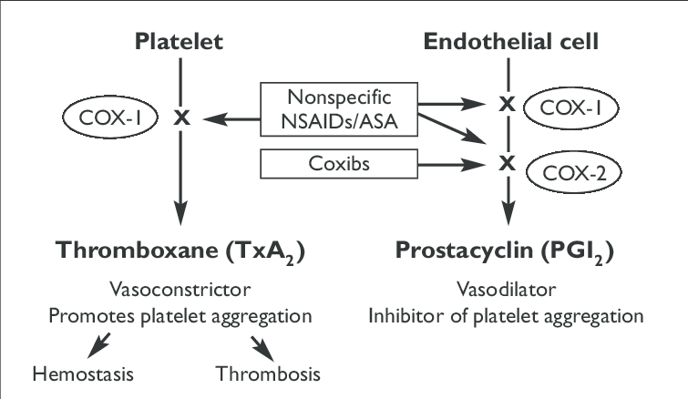

Slide 15
Cardiovascular Risk
Atherosclerosis is a dynamic process of thrombus formation and inflammation involving numerous tissue factors and inflammatory mediators.
Given the ability to inhibit synthesis of pro-inflammatory PGs, selective COX-2 inhibitors would be expected to be antithrombotic; however, their ability to inhibit endothelial-derived PGI2 combined with their relative inability to inhibit platelet-activating TXA 2 (a predominantly COX-1 effect) may shift the balance toward thrombus formation

Slide 16
Clinical Manifestations of Toxicity
Initial clinical manifestations are usually mild and predominantly include GI symptoms such as nausea, vomiting, abdominal pain, or neurologic symptoms such as drowsiness, headache, tinnitus, blurred vision, diplopia, and dizziness.
More moderate and severe findings are rare and include coma, seizures, central nervous system (CNS) depression, metabolic acidosis, hypotension, hypothermia, rhabdomyolysis, electrolyte imbalances, cardiac dysrhythmias, and acute oliguric renal failure.
Massive NSAID ingestions may lead to multisystem organ failure and death

Slide 17
Renal and Electrolyte Effects
NSAIDs may have deleterious effects of renal function include
sodium retention and edema,
hyperkalemia(NSAIDs lower renin secretion by the kidney, which is normally mediated, in part, by locally produced prostaglandins , and they impair angiotensin II-induced aldosterone release. The ensuing fall in aldosterone secretion will reduce urinary potassium excretion, which will tend to raise the plasma potassium concentration)
acute renal failure
membranous nephropathy
nephrotic syndrome, interstitial nephritis
both acute and chronic renal papillary necrosis

Slide 18
General risk factors for NSAID-induced renal dysfunction include
congestive heart failure
volume depletion
diabetes mellitus
underlying renal disease
systemic lupus erythematosus
cirrhosis
diuretic therapy
advanced age.

Slide 19
Acute tubulointerstitial nephritis (ATIN) is one of the more common forms of NSAID-induced renal impairment, and it may occur with short-term therapeutic dosing. Many cases of ATIN probably go undiagnosed because clinical symptoms usually do not appear until significant renal impairment occurs

Slide 20
Gastrointestinal Effects
Numerous studies have reported an increased risk in serious, adverse GI effects with therapeutic use of NSAIDs. The relative risk of developing gastroduodenal perforation, ulcer, or hemorrhage during chronic NSAID therapy.
Acute NSAID overdoses are reported to cause bloody emesis, fecal occult blood, ; and severe, life-threatening GI hemorrhage. NSAID-induced hepatotoxicity is an idiosyncratic reaction primarily causing hepatocellular injury

Slide 21
Hematologic Effects
As a class, NSAIDs are frequently implicated as a cause of thrombocytopenia and are reported to have caused adverse effects on most other cell lines and function, including agranulocytosis, aplastic anemia, hemolytic anemia, methemoglobinemia, neutropenia, and pancytopenia

Slide 22
The ability of a particular type of NSAID to inhibit platelet aggregation and affect bleeding time depends on the dose and half-life because NSAIDs reversibly inhibit COX.
One dose of ibuprofen prolongs the bleeding time within 2 hours and persists for up to 12 hours; however, this increase in bleeding time usually remains within the upper limit of normal range

Slide 23
Diagnostic Testing
Laboratory measurements, including complete blood count, serum electrolytes, blood urea nitrogen, and creatinine should be obtained for all symptomatic patients, patients with intentional ingestion, ibuprofen ingestion of greater than 400 mg/kg in a child, or ibuprofen ingestion of greater than 6 g in an adult

Slide 24
Management
Management of a patient with an NSAID overdose is largely supportive and guided by the clinical signs and symptoms.
Most asymptomatic patients with intentional overdose and those with normal vital signs require observation for 4 to 6 hours and a serum acetaminophen concentration before being medically cleared

Slide 25
GI decontamination with activated charcoal (AC) should be considered for an asymptomatic patient with the potential for a large ingestion, symptomatic patients, and children with a history of ibuprofen ingestion greater than 400 mg/kg.
Serum concentrations of ibuprofen have been demonstrated to increase after the time of emergency department arrival, so gastric lavage for massive overdose followed by AC should be considered.

Slide 26
Patients with seizures, which are characteristic of mefenamic acid overdose, should be treated with IV benzodiazepines
To help prevent the development of ulcers, concomitant use of misoprostol (a PGE₁ analog), an H₂ -blocker, or a proton pump inhibitor (PPI) is often used; however, PPIs may be superior for both preventing and healing gastroduodenal ulcers resulting from chronic NSAID therapy

Slide 27
CNS depression:
Patients usually compensate the metabolic acidosis with a high respiratory rate. During intubation and ventilation it is paramount not to exacerbate the metabolic acidosis (risk of death) therefore pre-intubation a bolus of sodium bicarbonate 1-2 mmol/kg followed by hyperventilation and further boluses of sodium bicarbonate is best practice.
Seizures: IV benzodiazepines.
Check the patient is not in a dysrhythmia
Can be managed with benzodiazepines (varying doses in the textbooks, easy method is 0.1mg/kg IV for lorazepam (max 4mg) / midazolam (max 10mg) / diazepam (max 10mg). Or…
Lorazepam 0.1mg/kg max 4mg
Diazepam 0.15mg/kg max 10mg
Midazolam 0.2mg/kg max 10mg

