Slide 1
General Microbiology
-Microscope Examination
-Smear Preparation

Slide 2
Microscope
Microscope is an optical instrument that magnifies images of objects invisible to the naked eye by means of lens system.
Types of microscope :-
A- Light microscope.

Slide 4
Light microscope consists of:
1- Base
2- Arm
3-Stage
4-Stage clip
5-Condenser lens
6-Light source
7- Coarse & fine adjustment
8- Ocular or eye piece lens (10X)
9- Objective lenses
a- scanning lens (4X) b- low power lens (10X)
c- High power lens (40X) d- oil immersion lens (100X)

Slide 5
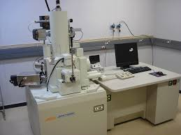
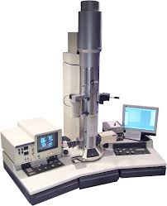
SEM TEM
B- Electron microscope
B- Electron
SEM

Slide 6
Bright field Light microscope component

Slide 7
How can you measure total magnification power
40 X 10 (ocular lens) = 400.
Why we use oil with oil immersion lens?
To prevent shattering of light rays, as light rays refracted when passing from media with high density (glass slide) to media with low density (air) and as the used oil had a refraction index equal to that of glass slide, we can reduce this refraction and obtain a full spectrum of light reached to lens.

Slide 8
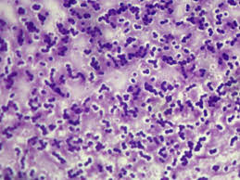
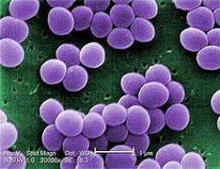
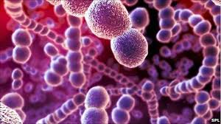
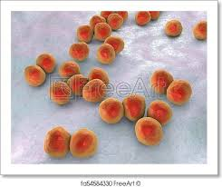
What are the morphological characteristics that can be seen by microscope to identify the bacteria?
1- Shape
a- cocci (spherical)

Slide 9
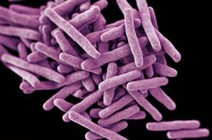
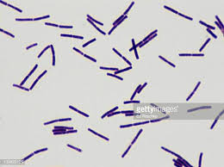
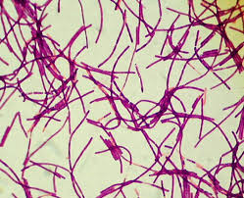
b- bacilli (rod -like)

Slide 10
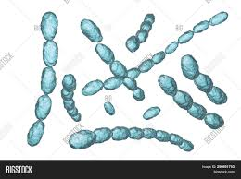
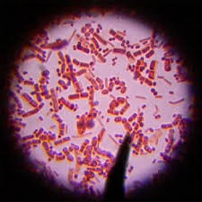
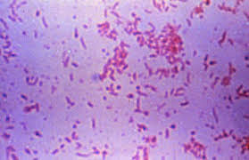
c- coccobacilli (between cocci & bacilli)

Slide 11
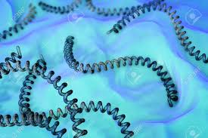
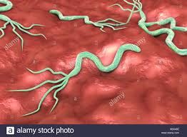
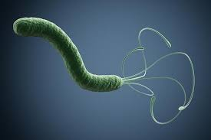
d- spiral ( curved rod)

Slide 12
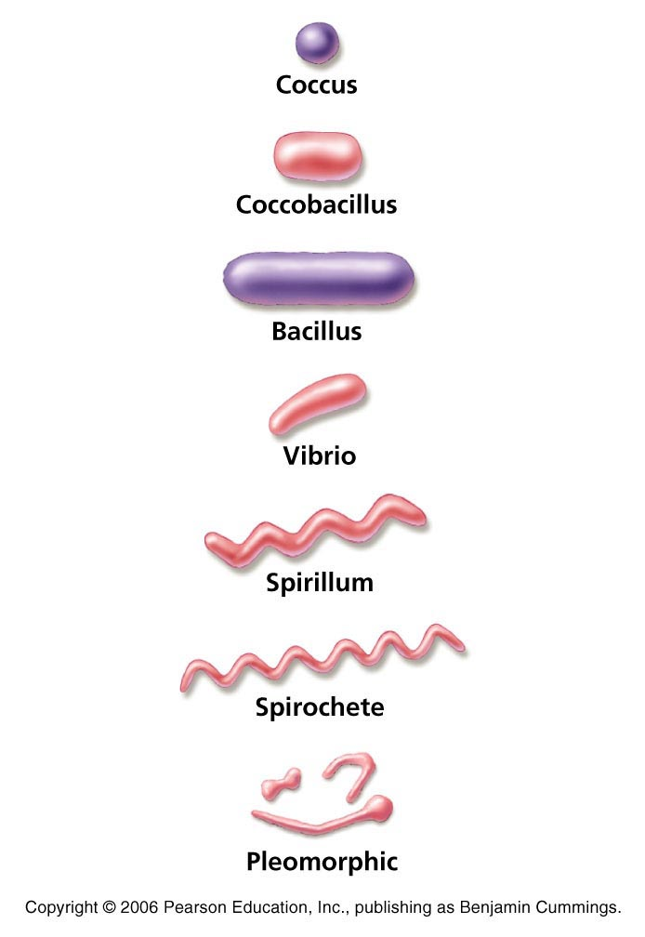
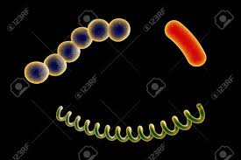

Slide 13
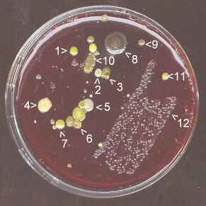
2- Size ; small or large (Macroscopically)

Slide 14
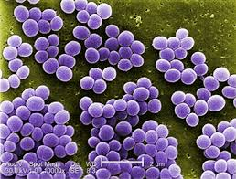
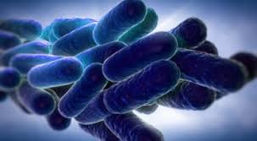
3- cell arrangements :
a- single
b- pairs (diplococci or diplobacilli).
c- chains (arranged in series: Streptococcus)
d- cluster ( grape like arrangement like Staphylococcus)

Slide 16
Bacteriology
Second Lab.
-Laboratory tools, instruments & equipment's
-Bacterial Staining:
Simple Stain, Gram Stain, Acid Fast Stain

Slide 17
Laboratory tools, instruments & equipment's
- Loop : use for transfer of bacterial cells from medium to another.
- Slide: use for examination . placed on microscope stage.
- Cover - slips : placed on the slid.
- Test tube: use to place the broth , solid, or semi-solid medium for stabbing or place as slant for bacterial culturing .

Slide 18
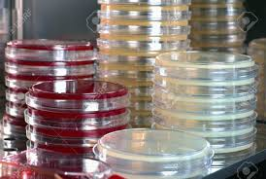
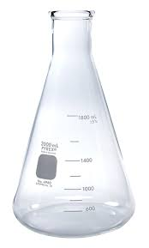
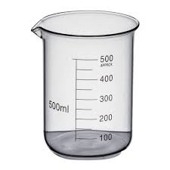
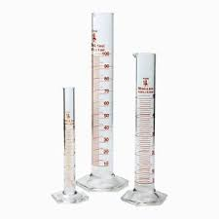
-Petri-dish: (Petri-plate) It is used for placing the solid medium in it.
-Flask: used for placing cultured or uncultured broth in it.
-Beaker : used for graduating the fluid volume.
-Cylinder: (graduated cylinder) used for graduating the volume of liquid.

Slide 19
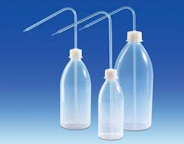
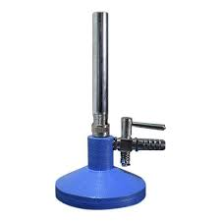
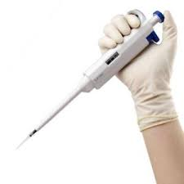
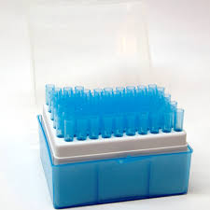
-Washing bottle : used to be filled with liquids (especially distilled water).
-Burner: may be gaseous or alcoholic, used for sterilization of loops ,needles and other metal tools.
-Micropipette: used to transfer or measure small volumes of liquids accurately.

Slide 20
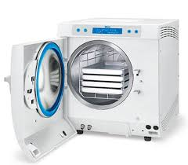
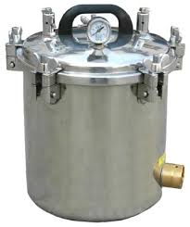
- Autoclave : equipped with high temperature, pressure and steam to sterilize the culture media and some of metal tool and glass water.
* Temperature = 121 c
* Pressure = 1 atm (15 pound/ inch 2)
* Time =10-30 min .
- 10 min for media with sugar
- 15 min for uncultured media
30 min for cultured media & contaminated tools & glass water.

Slide 21
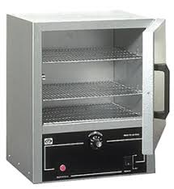
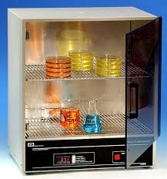
- Oven : the sterilization type is dry heat sterilization.
Temp. = 180 °C
Time = one hour and a half
-Incubator: for the availability of suitable temperature for growth of microorganism by place the culture media in it.
- Refrigerator : used to place the sterilized media & broth.

Slide 22
Preparation of smear
What you need to prepare a smear ?
. 1- Broth or solid medium .
2- Bacteriological loop.
3- Clean glass slide.
4- Bunsen burner.
Smear: a specimen for microscopic study is prepared by spreading the material across the glass slide.
Culture: propagation of microorganism in a growth media.
Growth media : an artificial media contains basic requirements needed for microorganisms' growth .

Slide 23
Forms of media : there are two main forms of growth media;
1- Liquid or called (broth): usually put in test tubes.
2- Solid or called (agar): usually put in a Petri-dishes.
Specimens:
Blood
Stool
Urine
Pus
Sputum
Cerebrospinal fluid (C.S.F)
Pleural fluid or peritoneal fluid.
Any discharge
Broth or agar culture

Slide 24
How do you prepare a smear?
A- from fluid material
1- Sterilize the loop in Bunsen flame & let it to cool.
2- Shake the specimen container (broth tube). Take a loopful of the specimen and spread it on the center of a clean slide to form a somewhat thick film of (1-2) in diameter.
Then re sterilize the loop.
3- Allow the film to dry by air.
Avoid heating to avoid shrinkage and missing of
Clear form.
4- The film is fixed on the slide by passing it (3-4)
times through the bunsin flame allow the slide to cool before staining .

Slide 25
B- from solid material
1- Sterilize the loop in bunsin flame & let it to cool.
2- Place a loopful of clean water (tap water) on
the center of a clean slide.
3- Re sterilize the loop, then transfer a small portion of the colony to the drop of water & spread the mixture evenly on the slide to form a thin film of (1-2) cm in diameter.
4- Dry & fix.

Slide 26
Aim of Fixation:
1- Kill the microorganism.
2- Make the microorganism stuck to the surface of the slide.
3- Make the microorganism more permeable to the stain.
4- Prevent the microorganism from going autolytic changes.

Slide 27
Staining of bacteria
Staining : are employed in bacteriology for making organisms visible .
Dyes (aniline) can be divided into three groups: * Basic as Crystal violet & methylene blue.
* Acidic as Nigrosine.
* Neutral stains as Giemsa.

Slide 28
Stains can be divided into :-
* Simple stain
*Differential stain
*Special stain

Slide 29
A-Simple Stain: using one stain only so bacteria appear in one color.
Used to get the following information:
1- Size of micro – organism.
2- Shape: could be one of the following
* spherical (cocci)
* rods (bacilli)
* Pleomorphic (coccobacilli)
* Spiral (spirillum)
3- Grouping or called arrangement: ( single, pairs, chain, and cluster)

Slide 30
Method of simple staining :
1- flood the slide with crystal violet or carbol fuchsine or methylene blue for 1 min.
2- Wash off the stain in slowly running tap water.
3- Allow the slide to dry in air or place it between two sheets of filter paper (called blotting the slide).
4- Examine under oil immersion, see the shape & arrangement of the bacteria.
5- Draw in your book what you have seen.

Slide 31
B-Differential Stain
Using two or more types of dyes successively to differentiate between the bacteria according to their response to the dyes.
Examples to these stains:
* Gram stain
* Acid-fast stain (Zeihl-Neelsen stain)

Slide 32
1- Gram Stain
It is one of the most important methods widely used in bacteriology, using 2 dyes in sequence each of different color, so that bacteria fall into two different categories:
A-Those that retain the first dye (crystal violet) throughout the staining procedure are known as (Gram positive).
B- Those that lose the first dye (CV) after washing with decolorizing solution and stained with the second dye (Diluted carbol fuchsin) are known as (Gram negative)

Slide 33
Gram Stain Method
1- Prepare the bacterial smear.
2- Flood the slide with crystal violet, leave for 1-2 minutes, wash with tap water.
3- Apply Gram iodine (Lugol´s iodine), leave for one minute, then wash with tap water.
4- Apply 95% ethyl alcohol (as decolorizer), leave for 20-30 seconds, wash with tap water.
5- Apply diluted carbol-fuchsin (the counter stain) leave for 1 minute, then wash with tap water.
6- Blot, dry in air and examine with oil immersion lens.

Slide 34
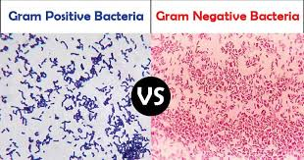
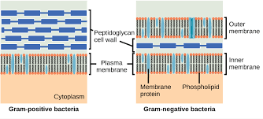

Slide 35
2- Acid–Fast stain (Ziehl- Neelsen stain)
Used to identify acid-Fast organisms such as Mycobacteria which contain large amount of lipid substances within their cell walls called mycolic acids; these acids resist staining by ordinary methods like Gram stain.
The Z–N is used in direct examination for specimens of bacilli bacteria with high lipid and fat content like Mycobacterium and Actinomyces. Acid-fast bacilli will be bright red after staining.

Slide 36
Method of Acid-fast stain
1- prepare a bacterial smear.
2- flood the slide with concentrated carbol-fuchsin (C.C.F), heat until steaming for 5 mins (avoid boiling and drying of stain).
3- cool the slide then wash with tap water.
4- dip the slide in 3% Acid –alcohol(HCL) for 20 -30 sec.
5- wash with tap water.

Slide 37
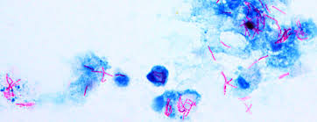
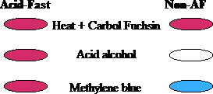
6- flood the slide with counter stain (Methylene blue) and leave for 1 min.
7- wash with tap water.
8- blot and dry on air.
9- examine under oil immersion lens.

