Slide 1
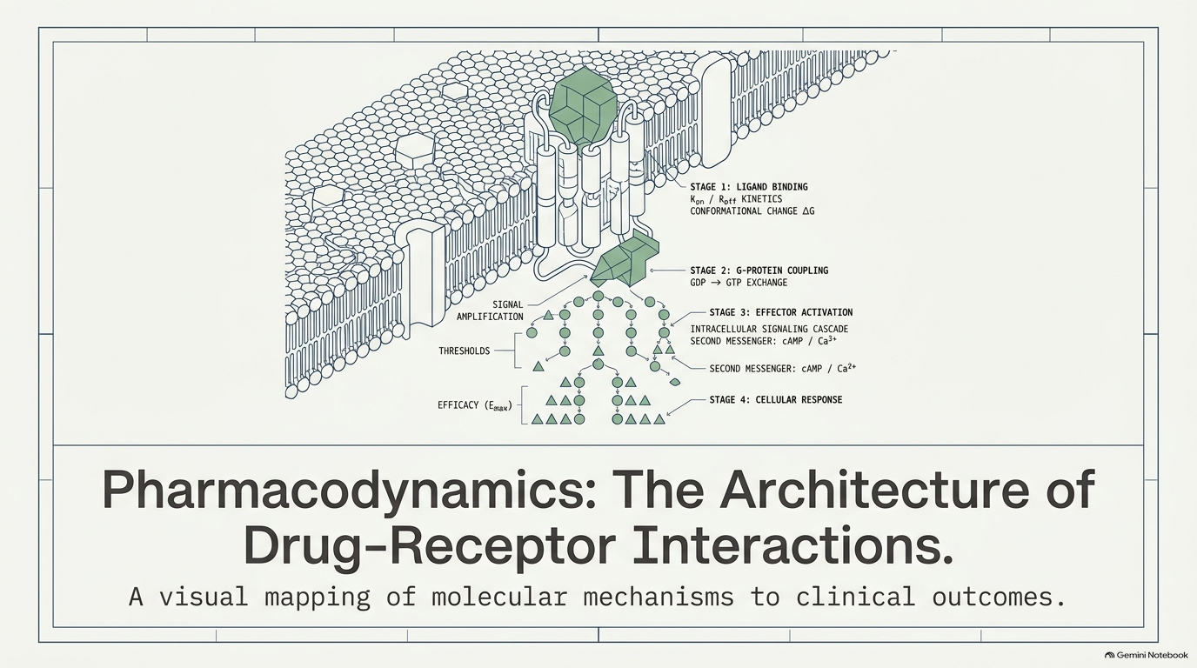

Slide 2
Drug–Receptor Interactions and
Pharmacodynamics
Pharmacodynamics describes the actions of a drug on the body and the influence of drug concentrations on the magnitude of the response.
Most drugs exert their effects, both beneficial and harmful, by interacting with receptors (that is, specialized target macromolecules) present on the cell surface or within the cell.
The drug–receptor complex initiates alterations in biochemical and/or molecular activity of a cell by a process called signal transduction.

Slide 3
Signal Transduction:
Drugs act as signals, and receptors act as signal detectors.
A drug is termed an "agonist' if it binds to a site on a receptor protein and activates it to initiate a series of reactions that ultimately result in a specific intracellular response.
"Second messenger'' or effector molecules are part of the cascade of events that translates agonist binding into a cellular response.

Slide 4
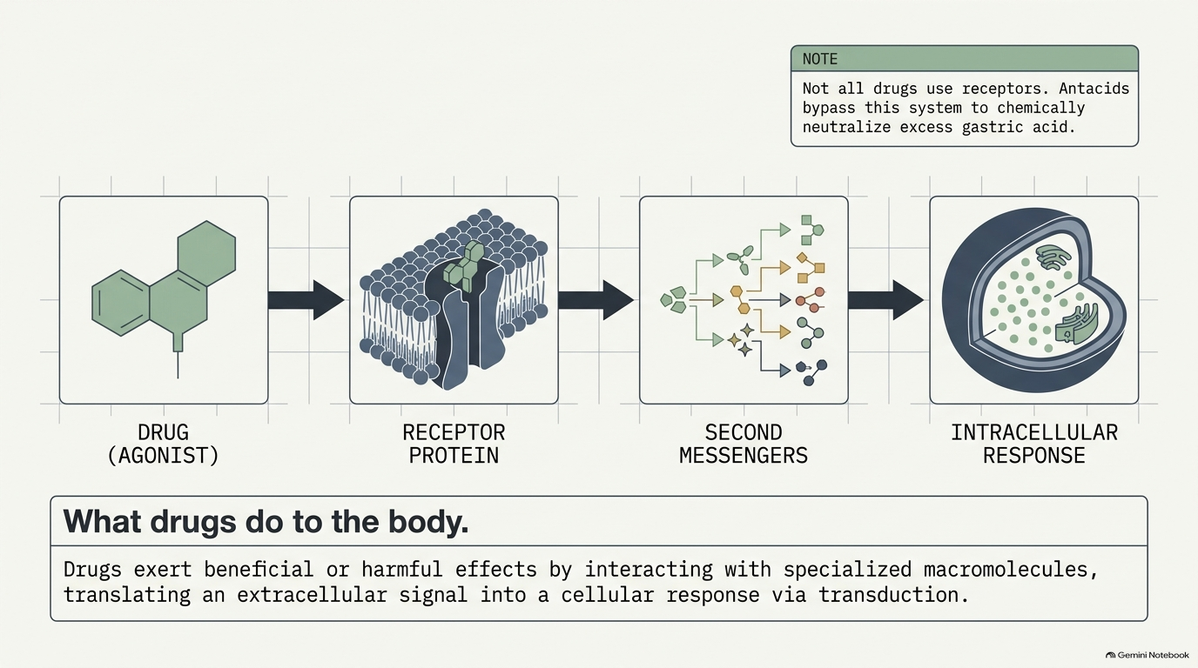

Slide 5
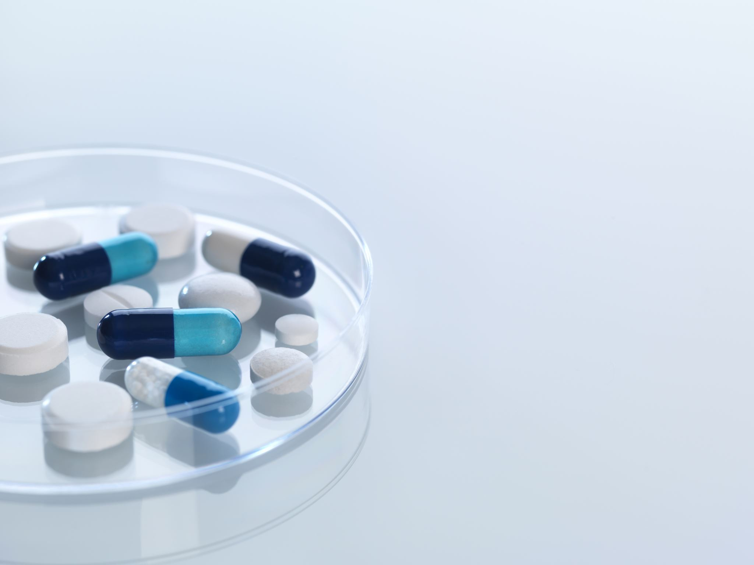
A. The drug-receptor complex
Cells have many different types of receptors, each of which is specific for a particular agonist and produces a unique response. Cardiac cell membranes, for example, contain β-adrenergic receptors that bind and respond to epinephrine or norepinephrine. Cardiac cells also contain muscarinic receptors that bind and respond to acetylcholine.
These two receptor populations dynamically interact to control the heart's vital functions. The magnitude of the cellular response is proportional to the number of drug-receptor complexes.

Slide 6
This concept is conceptually similar to the formation of complexes between enzyme and substrate and shares many common features, such as specificity of the receptor for a given agonist.
Although much of this chapter centers on the interaction of drugs with specific receptors, it is important to know that not all drugs exert effects by interacting with a receptor. Antacids, for instance, chemically neutralize excess gastric acid, thereby reducing stomach upset.

Slide 7
B. Receptor states
Receptors exist in at least two states, inactive (R) and active (R*), that are in reversible equilibrium with one another, usually favoring the inactive state. Binding of agonists causes the equilibrium to shift from R to R* to produce a biologic effect.
Antagonists are drugs that bind to the receptor but do not increase the fraction of R*, instead stabilizing the fraction of R. Some drugs (partial agonists) shift the equilibrium from R to R*, but the fraction of R* is less than that caused by an agonist.
The magnitude of biological effect is directly related to the fraction of R*.
In summary, agonists, antagonists, and partial agonists are examples of molecules or ligands that bind to the activation site on the receptor and can affect the fraction of R*.

Slide 8
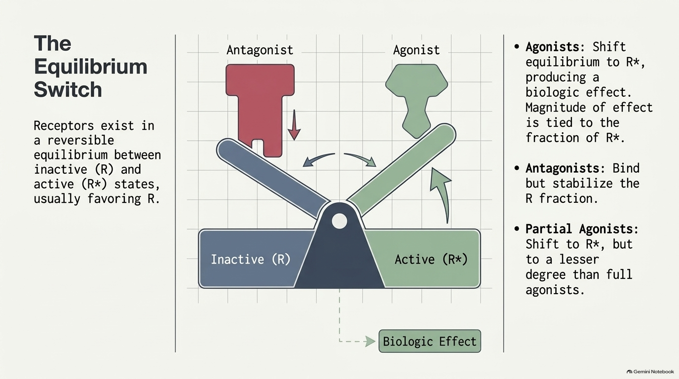

Slide 9
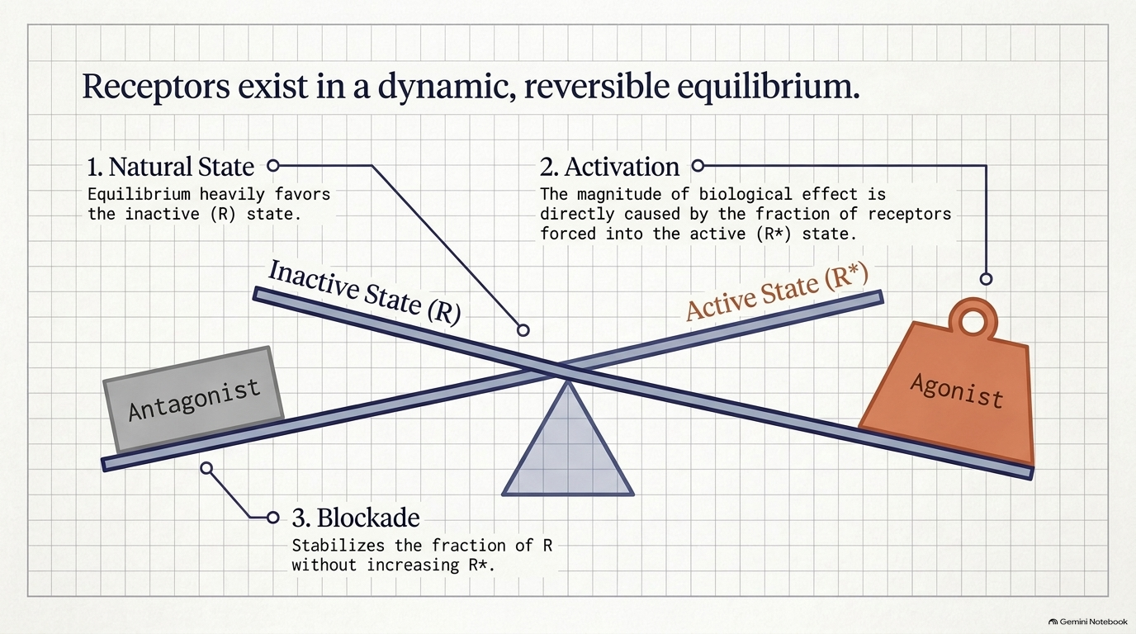

Slide 10
C. Major receptor families
A receptor is defined as any biologic molecule to which a drug binds and produces a measurable response.
Thus, enzymes, nucleic acids, and structural proteins can act as receptors for drugs or endogenous agonists.
However, the richest sources of receptors are membrane bound proteins that transduce extracellular signals into intracellular responses.

Slide 11
These receptors may be divided into four families:
1) ligand-gated ion channels
2) G protein-coupled receptors
3) enzyme-linked receptors.
4) intracellular receptors.

Slide 12
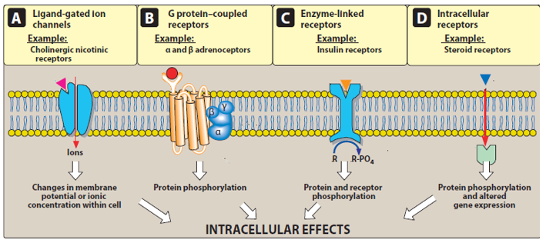
Generally, hydrophilic ligands interact with receptors that are found on the cell surface. In contrast, hydrophobic ligands enter cells through the lipid bilayers of the cell membrane to interact with receptors found inside cells.
Transmembrane signaling mechanisms.

Slide 13
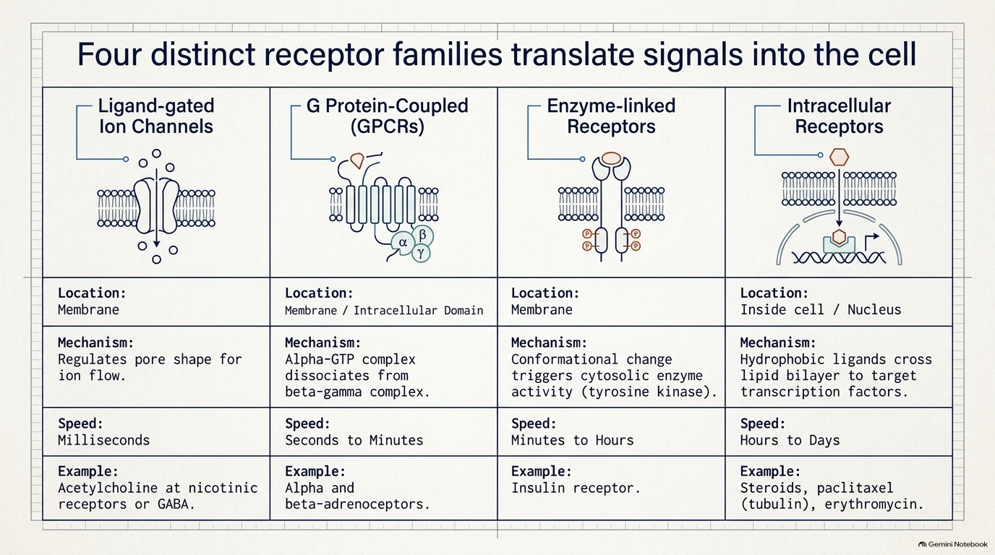

Slide 14
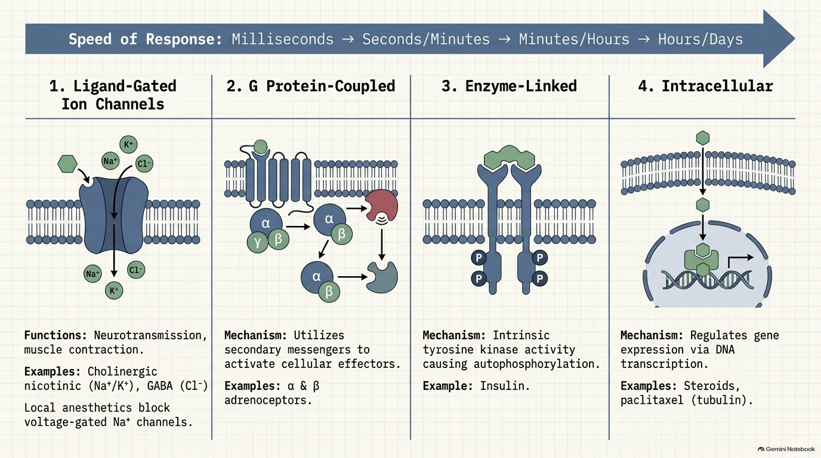

Slide 15
The extracellular portion of ligand-gated ion channels usually contains the ligand binding site. This site regulates the shape of the pore through which ions can flow across cell membranes.
The channel is usually closed until the receptor is activated by an agonist, which opens the channel briefly for a few milliseconds.
1.Transmembrane ligand-gated ion channels:
Depending on the ion conducted through these channels, these receptors mediate diverse functions, including neurotransmission, and cardiac or muscle contraction. For example, stimulation of the nicotinic receptor by acetylcholine results in sodium influx and potassium outflux, generating an action potential in a neuron or contraction in skeletal muscle. On the other hand, agonist stimulation of the γ-aminobutyric acid (GABA) receptor increases chloride influx and hyperpolarization of neurons.

Slide 16
Voltage-gated ion channels may also possess ligand-binding sites that can regulate channel function.
For example, local anesthetics bind to the voltage-gated sodium channel, inhibiting sodium influx and decreasing neuronal conduction.

Slide 17
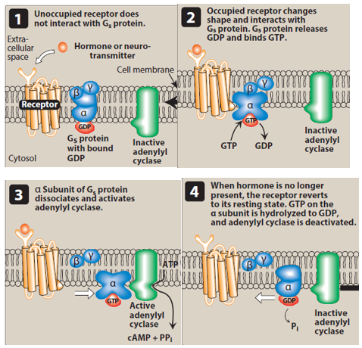
The recognition of chemical signals by G protein–coupled membrane receptors affects the activity of adenylyl cyclase.

Slide 18
2. Transmembrane G protein–coupled receptors:
The extracellular domain of this receptor contains the ligand-binding area, and the intracellular domain interacts (when activated) with a G protein or effector molecule.
There are many kinds of G proteins (for example, Gs, Gi, and Gq), but they all are composed of three protein subunits. The α subunit binds guanosine triphosphate (GTP), and the β and γ subunits anchor the G protein in the cell membrane.

Slide 19
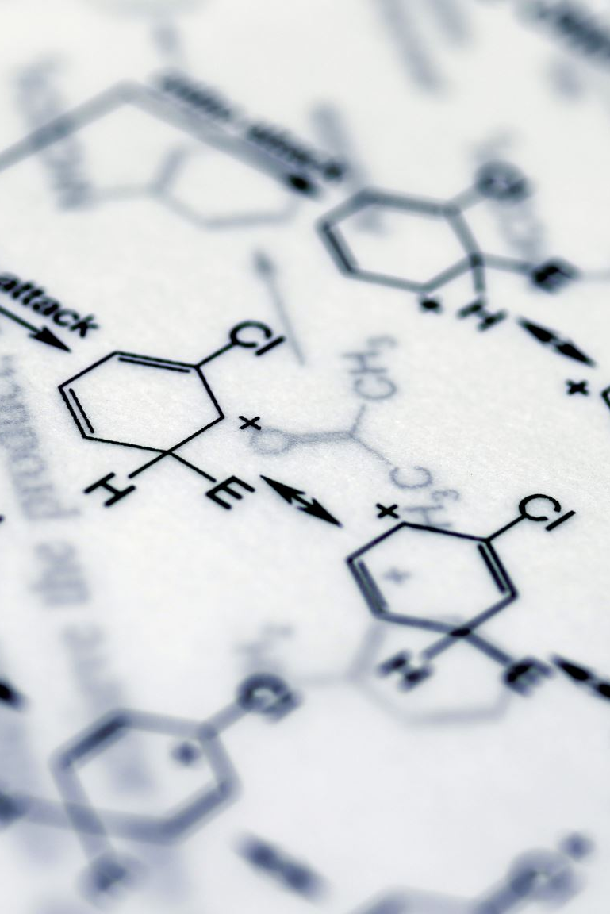
Binding of an agonist to the receptor increases GTP binding to the α subunit, causing dissociation of the α-GTP complex from the βγ complex.
These two complexes can then interact with other cellular effectors, usually an enzyme, a protein, or an ion channel, that are responsible for further actions within the cell. These responses usually last several second to minutes.
Sometimes, the activated effectors produce second messengers that further activate other effectors in the cell, causing a signal cascade effect.

Slide 20
A common effector, activated by Gs and inhibited by Gi, is adenylyl cyclase, which produces the second messenger cyclic adenosine monophosphate (cAMP).
Gq activates phospholipase C, generating two other second messengers: inositol 1,4,5-trisphosphate (IP3) and diacylglycerol (DAG).
DAG and cAMP activate different protein kinases within the cell, leading to a myriad of physiological effects.
IP3 regulates intracellular free calcium concentrations, as well as some protein kinases.

Slide 21
3. Enzyme-linked receptors:
This family of receptors consists of a protein that may form dimers or multisubunit complexes. When activated, these receptors undergo conformational changes resulting in increased cytosolic enzyme activity, depending on their structure and function (Figure 6).
This response lasts on the order of minutes to hours. The most common enzyme-linked receptors (epidermal growth factor, platelet-derived growth factor, atrial natriuretic peptide, insulin, and others) possess tyrosine kinase activity as part of their structure.

Slide 22
The activated receptor phosphorylates tyrosine residues on itself and then other specific proteins. Phosphorylation can substantially modify the structure of the target protein, thereby acting as a molecular switch.
For example, when the peptide hormone insulin binds to two of its receptor subunits, their intrinsic tyrosine kinase activity causes autophosphorylation of the receptor itself. In turn, the phosphorylated receptor phosphorylates other peptides or proteins that subsequently activate other important cellular signals. This cascade of activations results in a multiplication of the initial signal, much like that with G protein–coupled receptors.

Slide 23
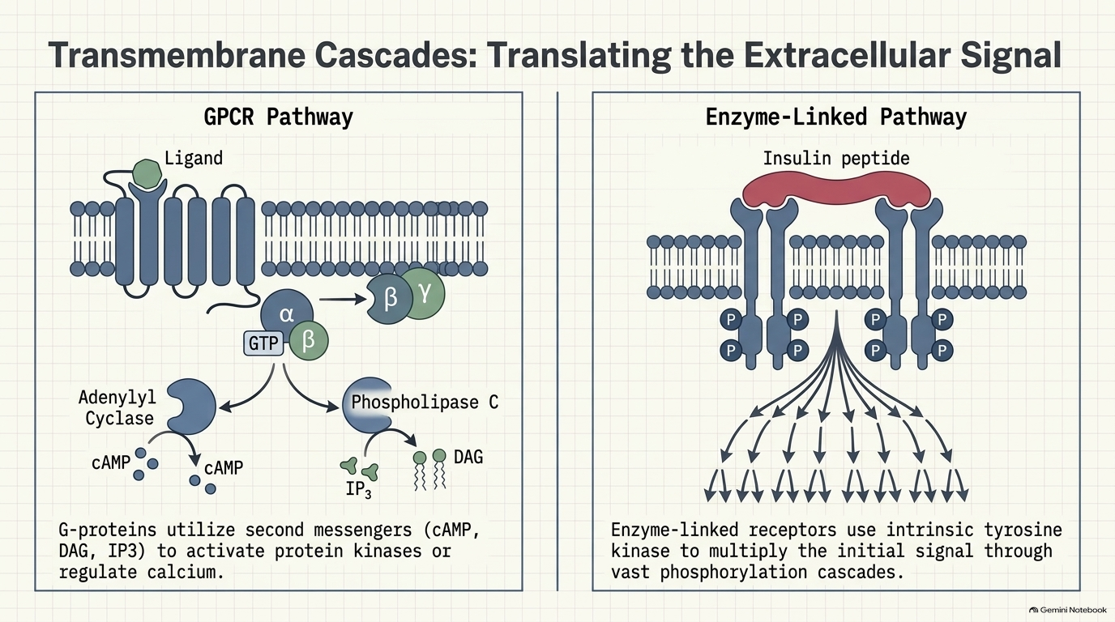

Slide 24
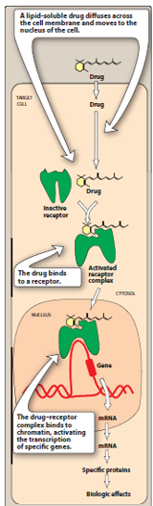
4. Intracellular receptors:
The fourth family of receptors differs considerably from the other three in that the receptor is entirely intracellular, and, therefore, the ligand must diffuse into the cell to interact with the receptor.
In order to move across the target cell membrane, the ligand must have sufficient lipid solubility. The primary targets of these ligand– receptor complexes are transcription factors in the cell nucleus.

Slide 25
Binding of the ligand with its receptor generally activates the receptor via dissociation from a variety of binding proteins.
The activated ligand–receptor complex then translocates to the nucleus, where it often dimerizes before binding to transcription factors that regulate gene expression. The activation or inactivation of these factors causes the transcription of DNA into RNA and translation of RNA into an array of proteins.
The time course of activation and response of these receptors is on the order of hours to days. For example, steroid hormones exert their action on target cells via intracellular receptors.
Other targets of intracellular ligands are structural proteins, enzymes, RNA, and ribosomes. For example, tubulin is the target of antineoplastic agents such as paclitaxel, the enzyme dihydrofolate reductase is the target of antimicrobials such as trimethoprim, and the 50S subunit of the bacterial ribosome is the target of macrolide antibiotics such as erythromycin.

Slide 26
D. Characteristics of signal transduction
Signal transduction has two important features:
1) the ability to amplify small signals and
2) mechanisms to protect the cell from excessive stimulation.

Slide 27
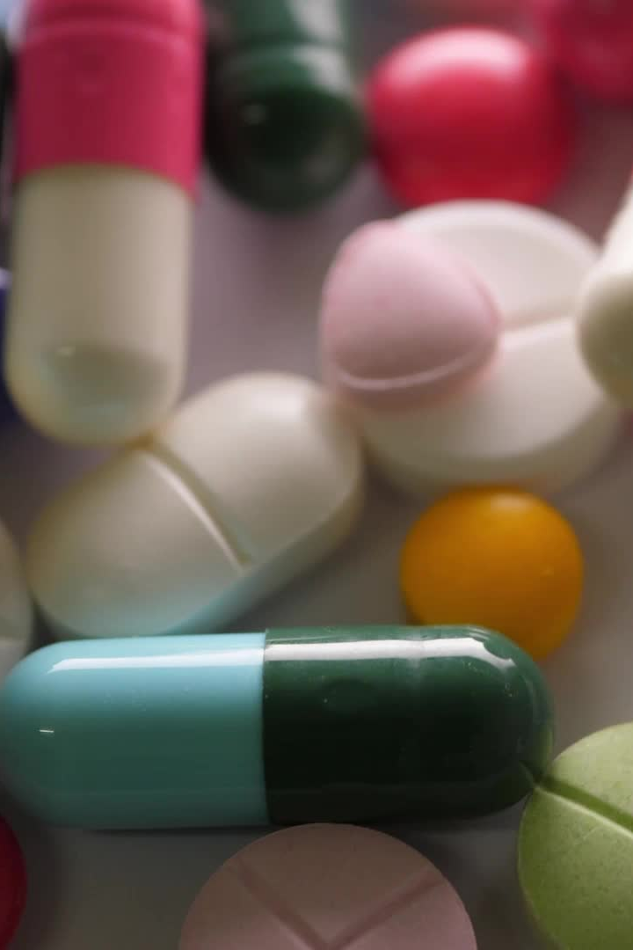
1. Signal amplification:
A characteristic of G protein-linked and enzyme-linked receptors is the ability to amplify signal intensity and duration via the signal cascade effect.
Additionally, activated G proteins persist for a longer duration than does the original agonist-receptor complex.
The binding of albuterol, for example, may only exist for a few milliseconds, but the subsequent activated G proteins may last for hundreds of milliseconds.
Further prolongation and amplification of the initial signal are mediated by the interaction between G proteins and their respective intracellular targets.

Slide 28
Because of this amplification, only a fraction of the total receptors for a specific ligand may need to be occupied to elicit a maximal response. Systems that exhibit this behavior are said to have spare receptors.
About 99% of insulin receptors are "spare” providing an immense functional reserve that ensures that adequate amounts of glucose enter the cell.
On the other hand, only about 5% to 10% of the total B-adrenoceptors in the heart are spare. Therefore, little functional reserve exists in the failing heart, because most receptors must be occupied to obtain maximum contractility.

Slide 29
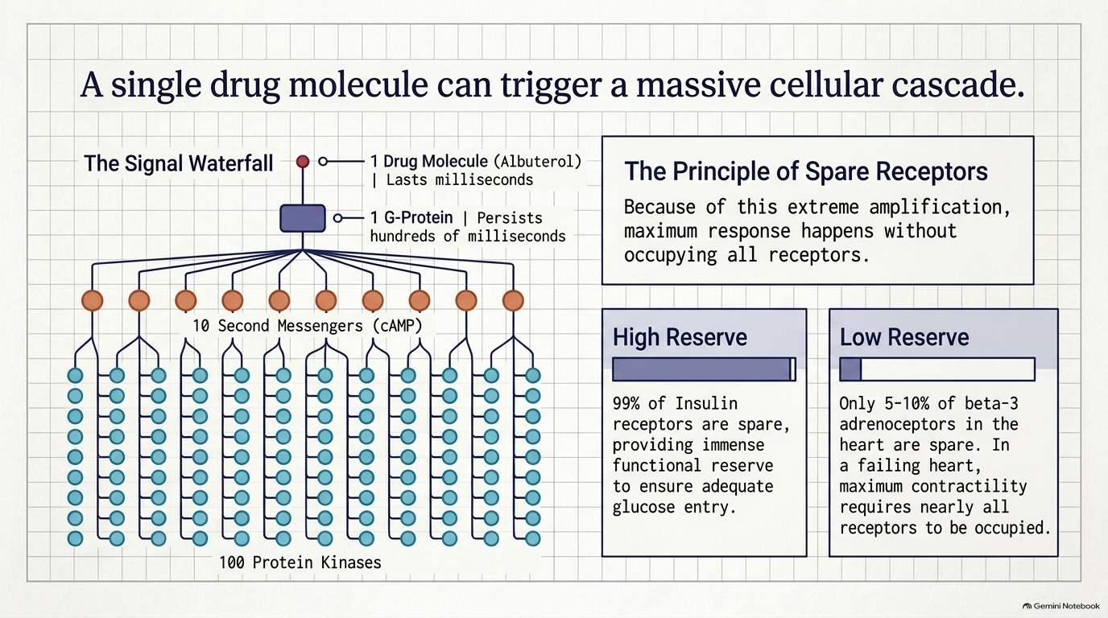

Slide 30
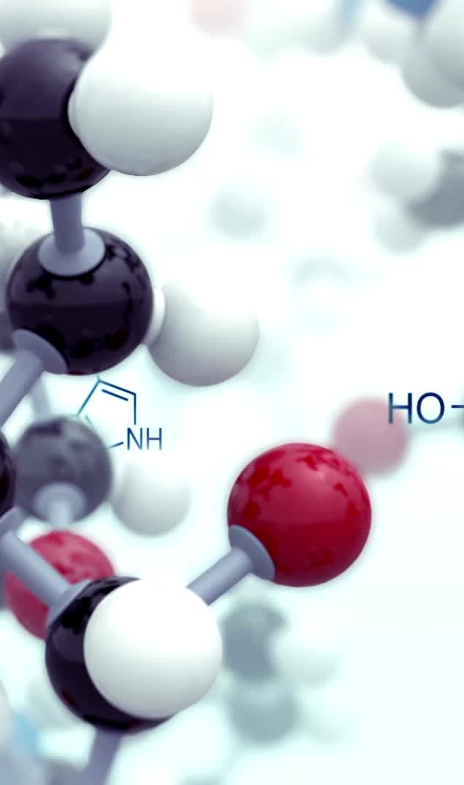
2. Desensitization and down-regulation of receptors:
Repeated or continuous administration of an agonist or antagonist often leads to changes in the responsiveness of the receptor.
The receptor may become desensitized due to too much agonist stimulation (Figure 2.6), resulting in a diminished response. This phenomenon, called tachyphylaxis, is often due to phosphorylation that renders receptors unresponsive to the agonist. In addition, receptors may be internalized within the cell, making them unavailable for further agonist interaction (down-regulation).

Slide 31

Some receptors, particularly ion channels, require a finite time following stimulation before they can be activated again. During this recovery phase, unresponsive receptors are said to be "refractory”.
" Repeated exposure of a receptor to an antagonist, on the other hand, results in up-regulation of receptors, in which receptor reserves are inserted into the membrane, increasing the number of receptors available.
Up-regulation of receptors can make cells more sensitive to agonists and/or more resistant to effects of the antagonist.

Slide 32
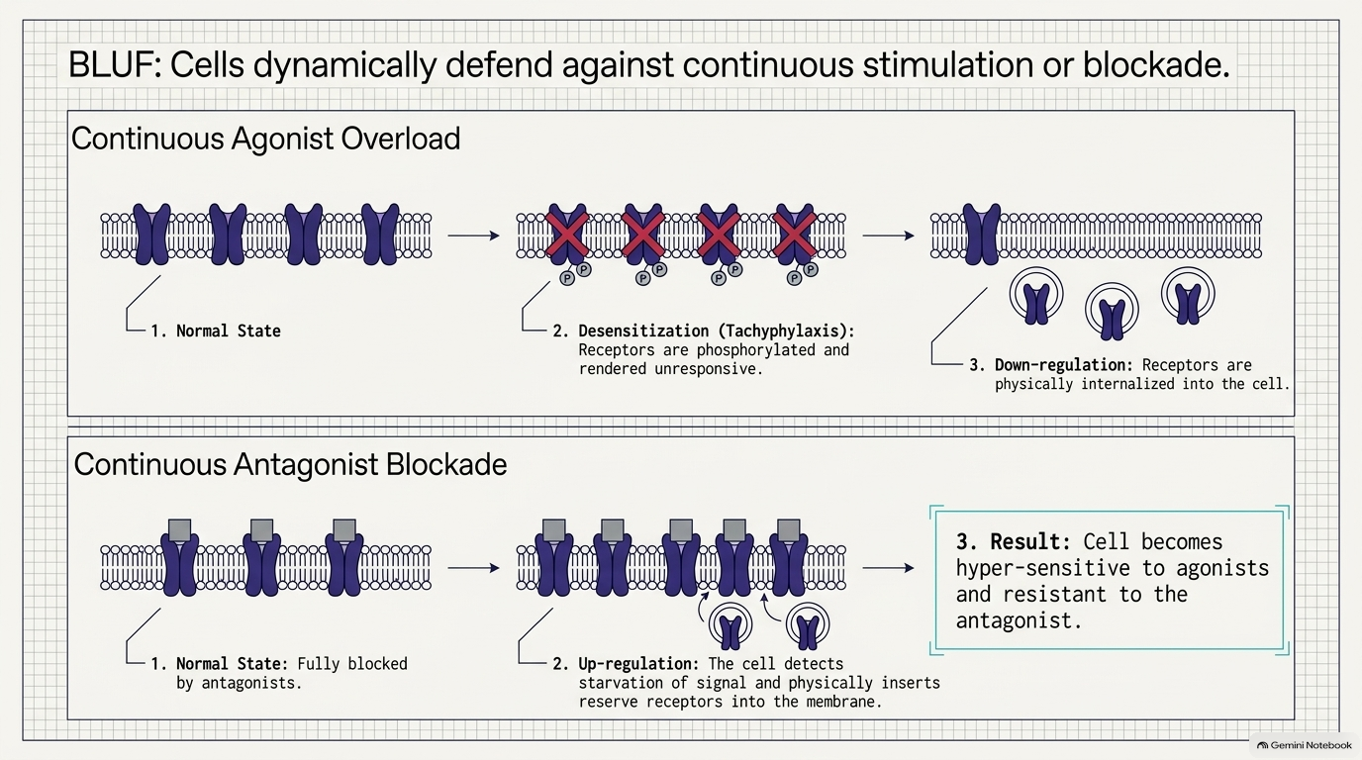

Slide 33
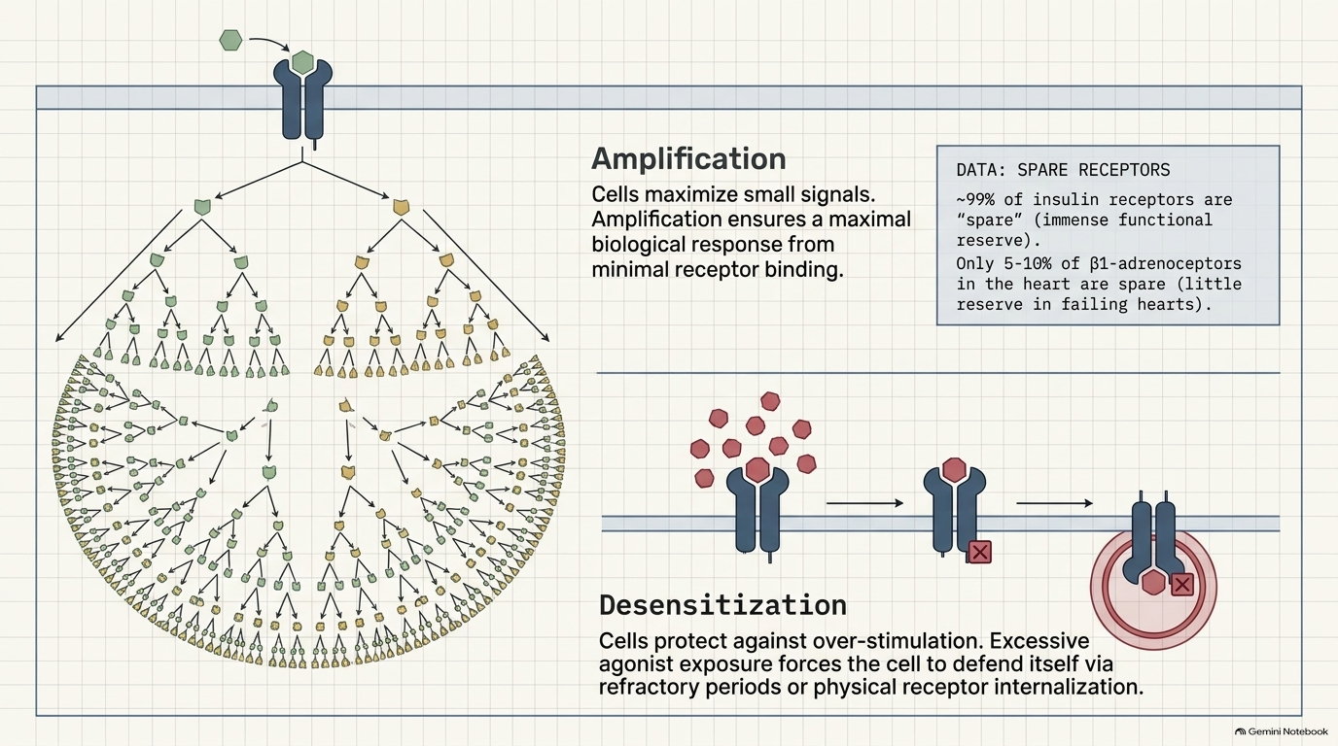

Slide 34
Dose-Response Relationship:
Agonist drugs mimic the action of the endogenous ligand for the receptor (for example, isoproterenol mimics norepinephrine on B1 receptors of the heart).
The magnitude of the drug effect depends on receptor sensitivity to the drug and the drug concentration at the receptor site, which, in turn, is determined by both the dose of drug administered and by the drug's pharmacokinetic profile, such as rate of absorption, distribution, metabolism, and elimination.

Slide 35
A. Graded dose-response relationship
As the concentration of a drug increases, its pharmacologic effect also gradually increases until all the receptors are occupied (the maximum effect).
Plotting the magnitude of response against increasing doses of a drug produces a graded dose-response curve.
Two important drug characteristics, potency and efficacy, can be determined by graded dose response curves.

Slide 36
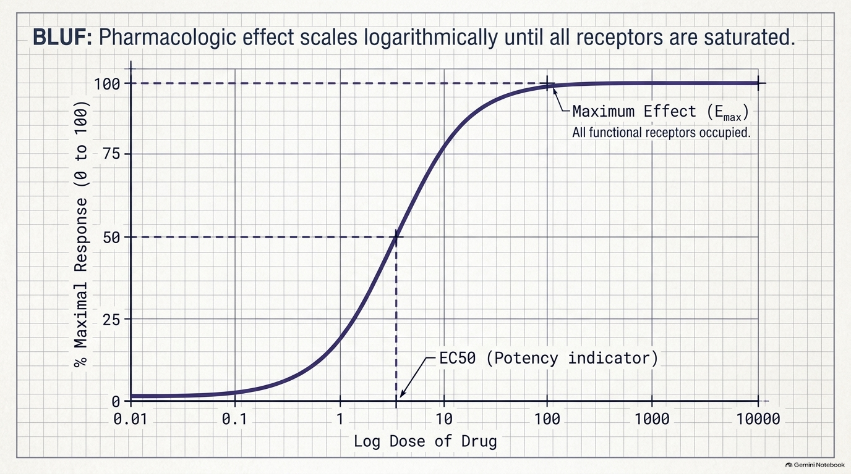

Slide 37
1. Potency:
Potency is a measure of the amount of drug necessary to produce an effect. The concentration of drug producing 50% of the maximum effect (EC50) is often used to determine potency.
In below figure, The EC50 for Drugs A and B indicate that Drug A is more potent than Drug B, because a lesser amount of Drug A is needed to obtain 50% effect. Therapeutic preparations of drugs reflect their potency. For example, candesartan and irbesartan are angiotensin receptor blockers used to treat hypertension.

Slide 38
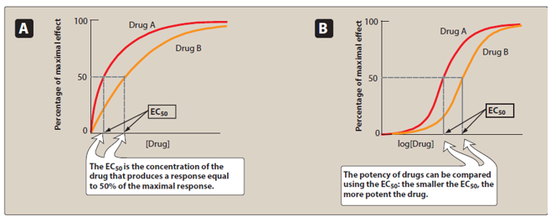
The therapeutic dose range for candesartan is 4 to 32 mg, as compared to 75 to 300 mg for irbesartan. Therefore, candesartan is more potent than irbesartan (it has a lower EC50 value).
Since the range of drug concentrations that cause from 1% to 99% of maximal response usually spans several orders of magnitude, semilogarithmic plots are used to graph the complete range of doses. the curves become sigmoidal in shape, which simplifies the interpretation of the dose-response curve.
The effect of dose on the magnitude of pharmacologic response. Panel A is a linear graph. Panel B is a semilogarithmic plot of the same data. EC50 = drug dose causing 50% of maximal response.

Slide 39
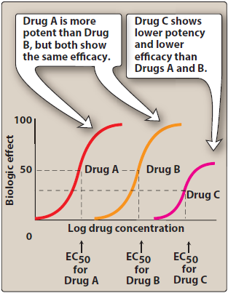

Slide 40
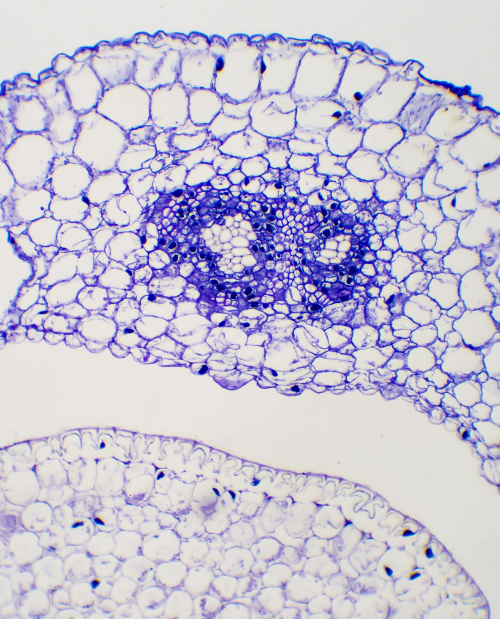
2. Efficacy:
Efficacy is the magnitude of response a drug causes when it interacts with a receptor. Efficacy is dependent on the number of drug receptor complexes formed and the intrinsic activity of the drug (its ability to activate the receptor and cause a cellular response). Maximal efficacy of a drug (Emax) assumes that the drug occupies all receptors, and no increase in response is observed in response to higher concentrations of drug.
The maximal response differs between full and partial agonists, even when the drug occupies 100% of the receptors. Similarly, even though an antagonist occupies 100% of the receptor sites, no Efficacy is a more clinically useful characteristic than potency, since a drug with greater efficacy is more therapeutically beneficial than one that is more potent.

Slide 41
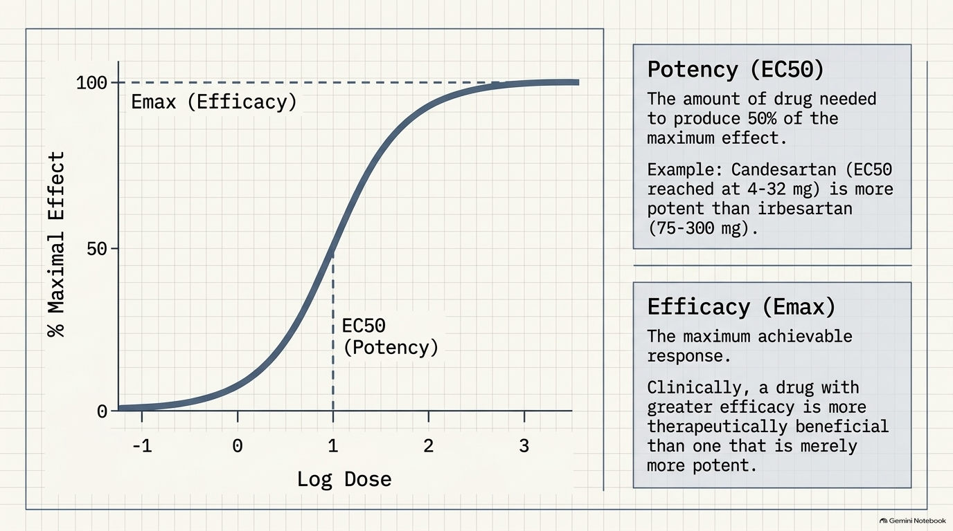

Slide 42
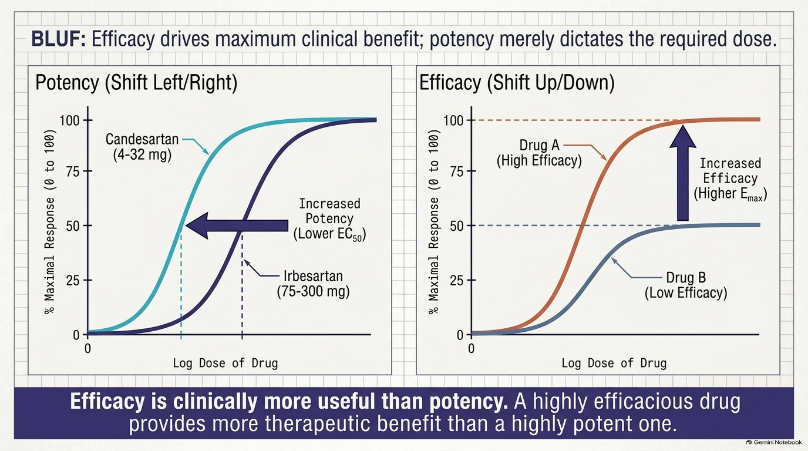

Slide 43

Intrinsic Activity:
As mentioned above, an agonist binds to a receptor and produces a biologic response based on the concentration of the agonist and the fraction of activated receptors.
The intrinsic activity of a drug determines its ability to fully or partially activate the receptors. Drugs may be categorized according to their intrinsic activity and resulting Emax values.

Slide 44
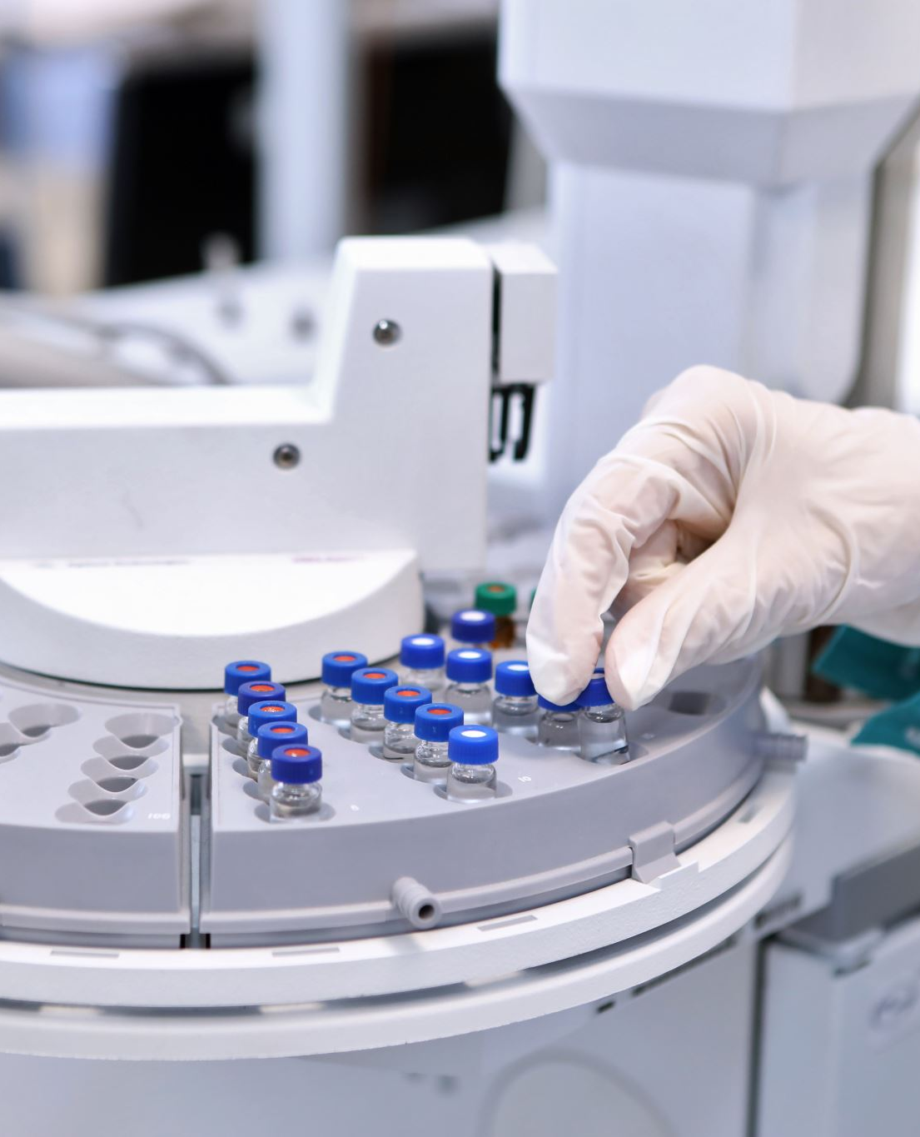
A. Full agonists
If a drug binds to a receptor and produces a maximal biologic response that mimics the response to the endogenous ligand, it is a full agonist. Full agonists bind to a receptor, stabilizing the receptor in its active state and are said to have an intrinsic activity of one.
All full agonists for a receptor population should produce the same Emax. For example, phenylephrine is a full agonist at α1-adrenoceptors, because it produces the same Emax as does the endogenous ligand, norepinephrine.
Upon binding to α1-adrenoceptors on vascular smooth muscle, phenylephrine stabilizes the receptor in its active state. This leads to the mobilization of intracellular Ca²⁺, causing interaction of actin and myosin filaments and shortening of the muscle cells. The diameter of the arteriole decreases, causing an increase in resistance to blood flow through the vessel and an increase in blood pressure.

Slide 45
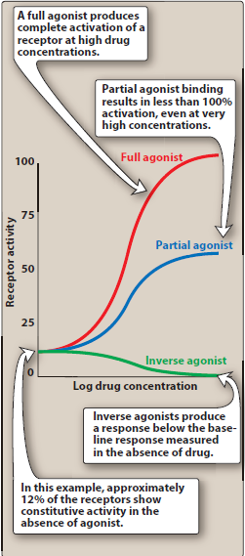
As this brief description illustrates, an agonist may have many measurable effects, including actions on intracellular molecules, cells, tissues, and intact organisms. All of these actions are attributable to interaction of the drug with the receptor. For full agonists, the dose–response curves for receptor binding and each of the biological responses should be comparable.

Slide 46
B. Partial agonists
Partial agonists have intrinsic activities greater than zero but less than one. Even if all the receptors are occupied, partial agonists cannot produce the same Emax as a full agonist.
However, a partial agonist may have an affinity that is greater than, less than, or equivalent to that of a full agonist. When a receptor is exposed to both a partial agonist and a full agonist, the partial agonist may act as an antagonist of the full agonist.

Slide 47
Consider what would happen to the Emax of a receptor saturated with an agonist in the presence of increasing concentrations of a partial agonist.
As the number of receptors occupied by the partial agonist increases, the Emax would decrease until it reached the Emax of the partial agonist. This potential of partial agonists to act as both an agonist and antagonist may be therapeutically utilized.
For example, aripiprazole, an atypical antipsychotic, is a partial agonist at selected dopamine receptors.

Slide 48
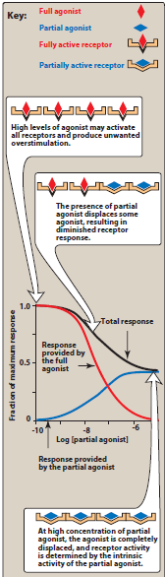
Dopaminergic pathways that are overactive tend to be inhibited by aripiprazole, whereas pathways that are underactive are stimulated.
This might explain the ability of aripiprazole to improve symptoms of schizophrenia, with a small risk of causing extrapyramidal adverse effects.

Slide 49
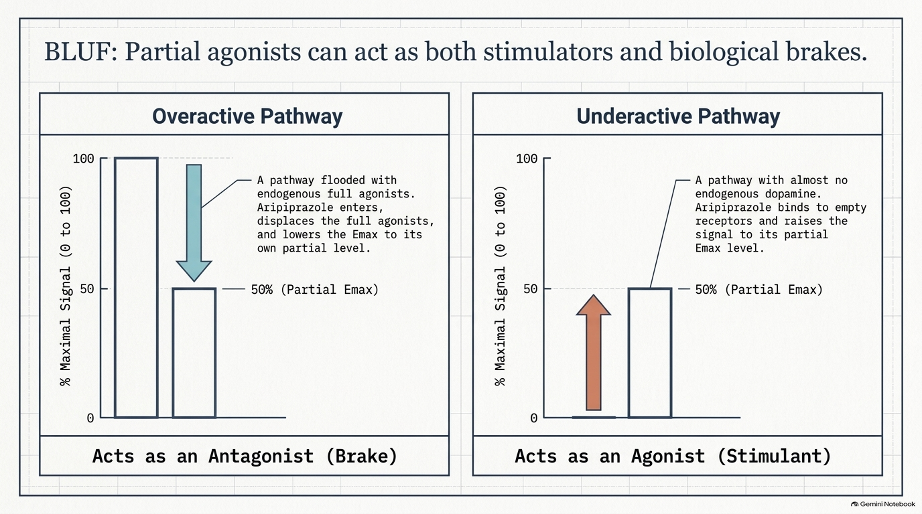

Slide 50
C. Inverse agonists
Typically, unbound receptors are inactive and require interaction with an agonist to assume an active conformation. However, some receptors show a spontaneous conversion from R to R* in the absence of an agonist (constitutive activation). Inverse agonists, unlike full agonists, stabilize the inactive R form and cause R* to convert to R.
This decreases the number of activated receptors to below that observed in the absence of drug. Thus, inverse agonists have an intrinsic activity less than zero, reverse the activity of receptors, and exert the opposite pharmacological effect of agonists.

Slide 51
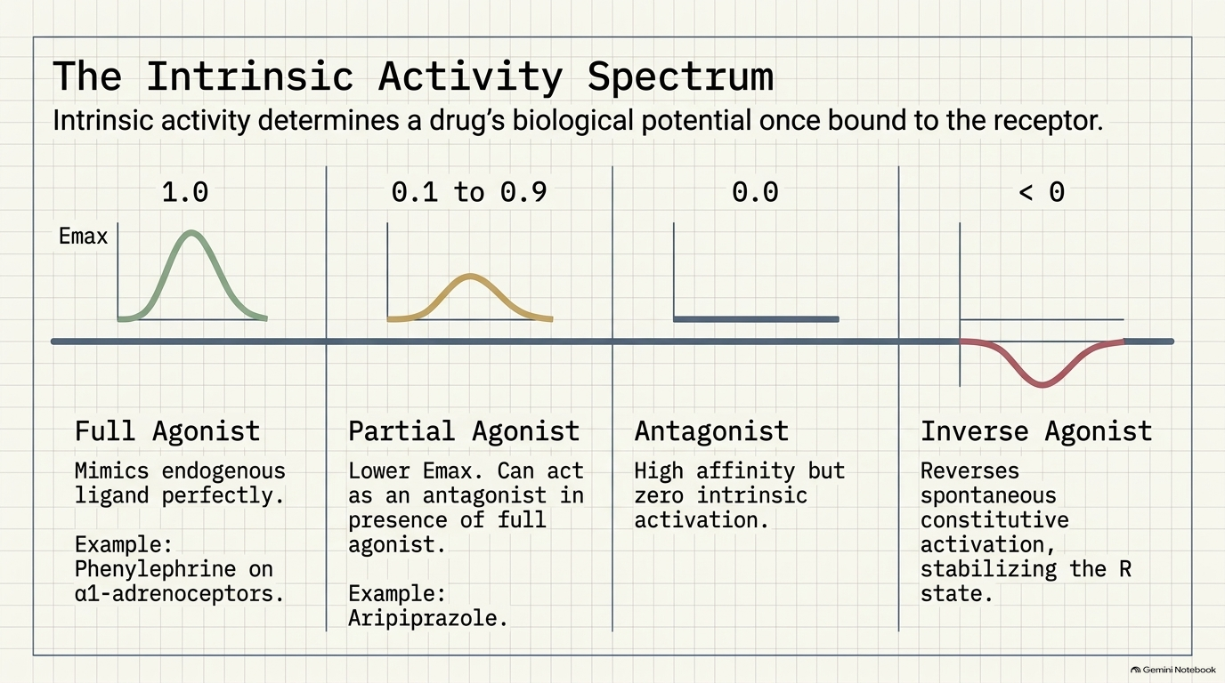

Slide 52
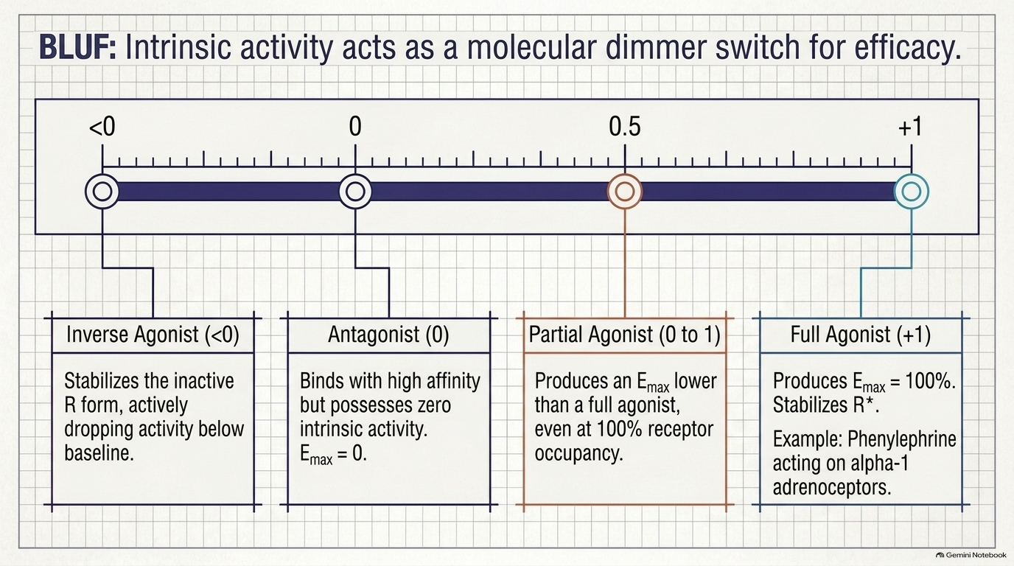

Slide 53
D. Antagonists
Antagonists bind to a receptor with high affinity but possess zero intrinsic activity.
An antagonist has no effect on biological function in the absence of an agonist but can decrease the effect of an agonist when present. Antagonism may occur either by blocking the drug's ability to bind to the receptor or by blocking its ability to activate the receptor.

Slide 54
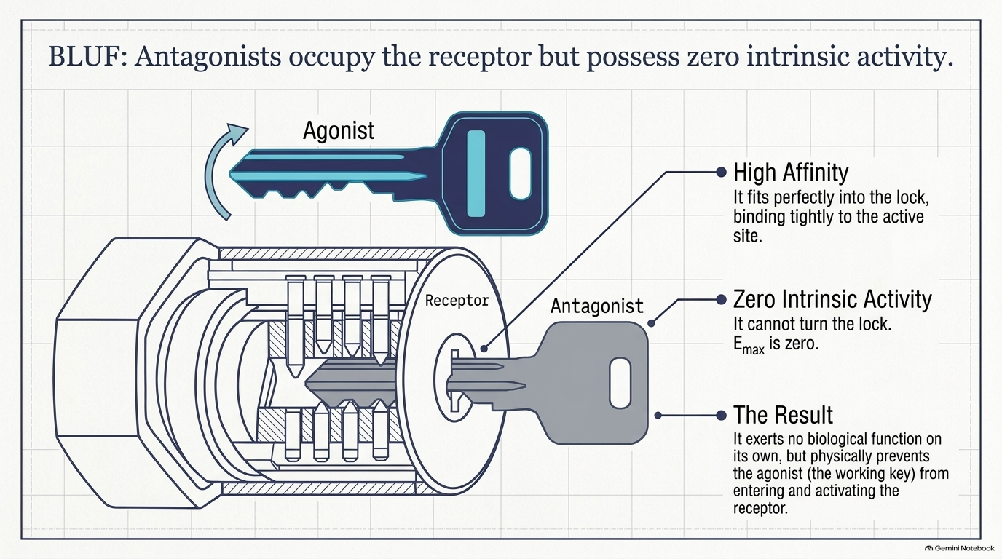

Slide 55
1. Competitive antagonists:
If the antagonist binds to the same site on the receptor as the agonist in a reversible manner, it is "competitive’’ A competitive antagonist interferes with an agonist binding to its receptor and maintains the receptor in its inactive state. For example, the antihypertensive drug terazosin competes with the endogenous ligand norepinephrine at α1-adrenoceptors, thus decreasing vascular smooth muscle tone and reducing blood pressure.
However, increasing the concentration of agonist relative to antagonist can overcome this inhibition. Thus, competitive antagonists characteristically shift the agonist dose-response curve to the right (increased EC50) without affecting Emax.

Slide 56
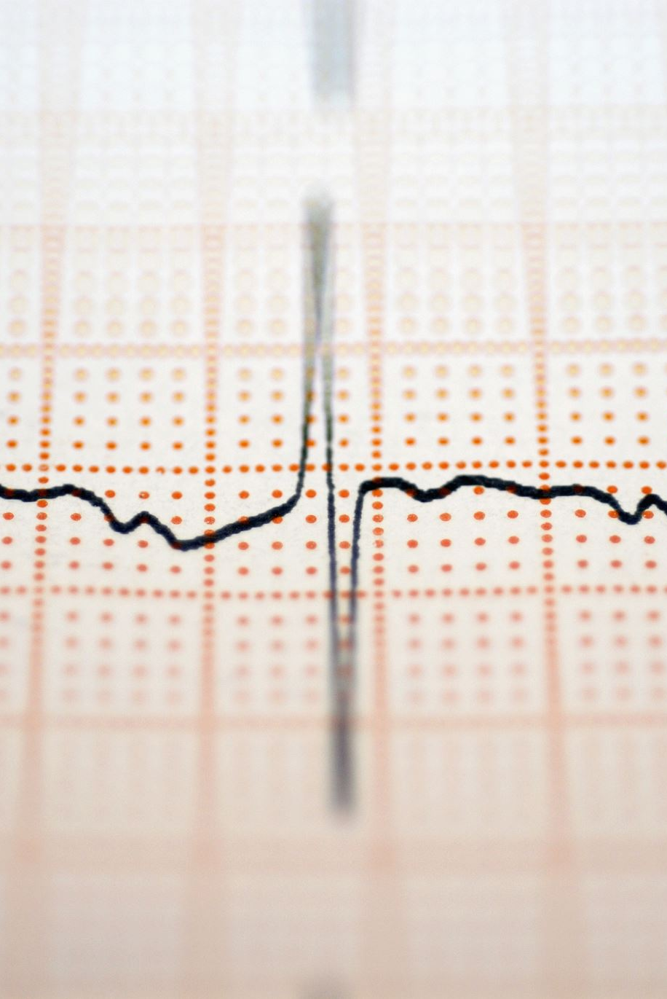
2. Irreversible antagonists:
Irreversible antagonists bind covalently to the active site of the receptor, thereby permanently reducing the number of receptors available to the agonist.
An irreversible antagonist causes a downward shift of the Emax. with no shift of EC50 values. In contrast to competitive antagonists, addition of more agonist does not overcome the effect of irreversible antagonists.
Thus, irreversible antagonists and allosteric antagonists are both considered noncompetitive antagonists. A fundamental difference between competitive and noncompetitive antagonists is that competitive antagonists reduce agonist potency (increase EC₅₀) and noncompetitive antagonists reduce agonist efficacy (decrease Emax).

Slide 57
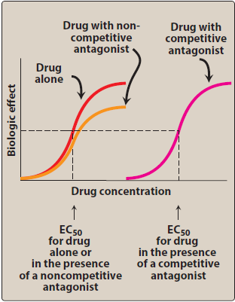

Slide 58
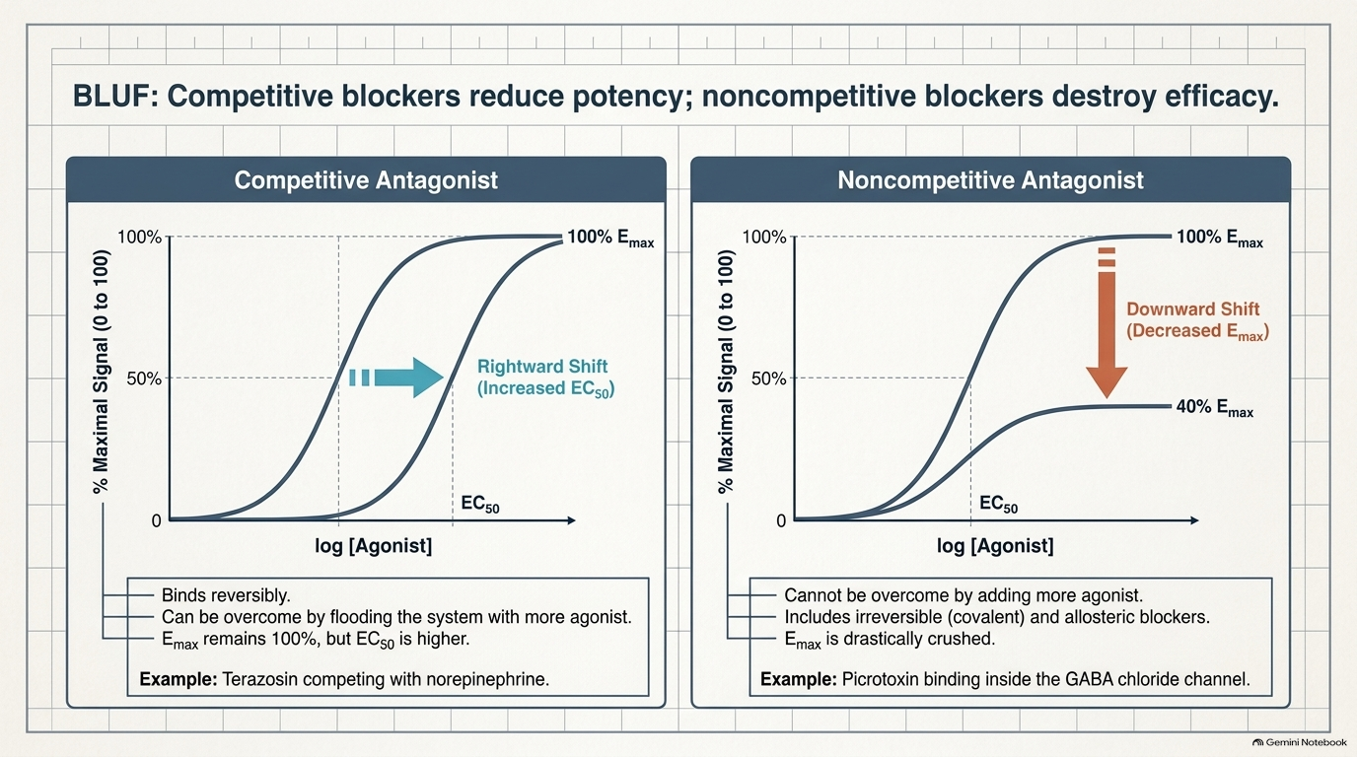

Slide 59
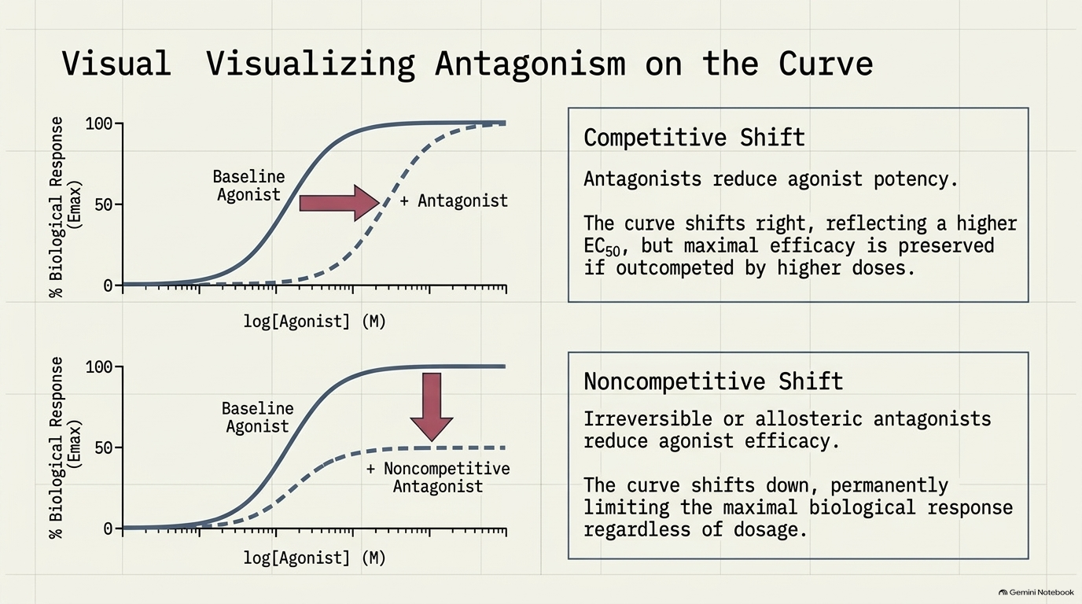

Slide 60
3. Allosteric antagonists:
An allosteric antagonist binds to a site (allosteric site) other than the agonist-binding site and prevents receptor activation by the agonist. This type of antagonist also causes a downward shift of the E_{max} of an agonist, with no change in the EC₅₀ value. An example of an allosteric antagonist is picrotoxin, which binds to the inside of the GABA-controlled chloride channel.
When picrotoxin binds inside the channel, no chloride can pass through the channel, even when GABA fully occupies the receptor.

Slide 61
4. Functional antagonism:
An antagonist may act at a completely separate receptor, initiating effects that are functionally opposite those of the agonist. A classic example is the functional antagonism by epinephrine to histamine-induced bronchoconstriction.
Histamine binds to H1 histamine receptors on bronchial smooth muscle, causing bronchoconstriction of the bronchial tree. Epinephrine is an agonist at β2-adrenoceptors on bronchial smooth muscle, which causes the muscles to relax. This functional antagonism is also known as "physiologic antagonism."

Slide 62
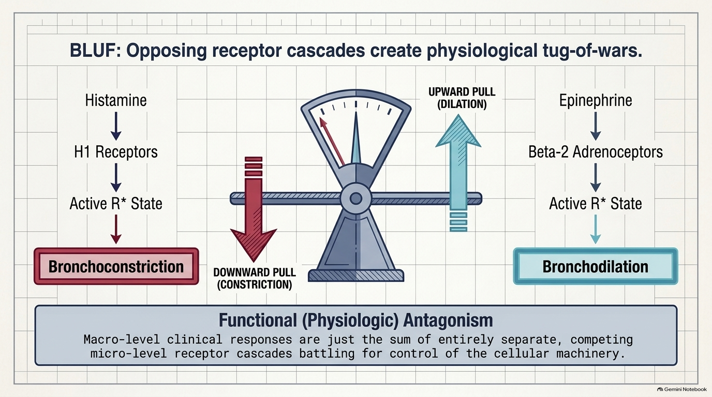

Slide 63
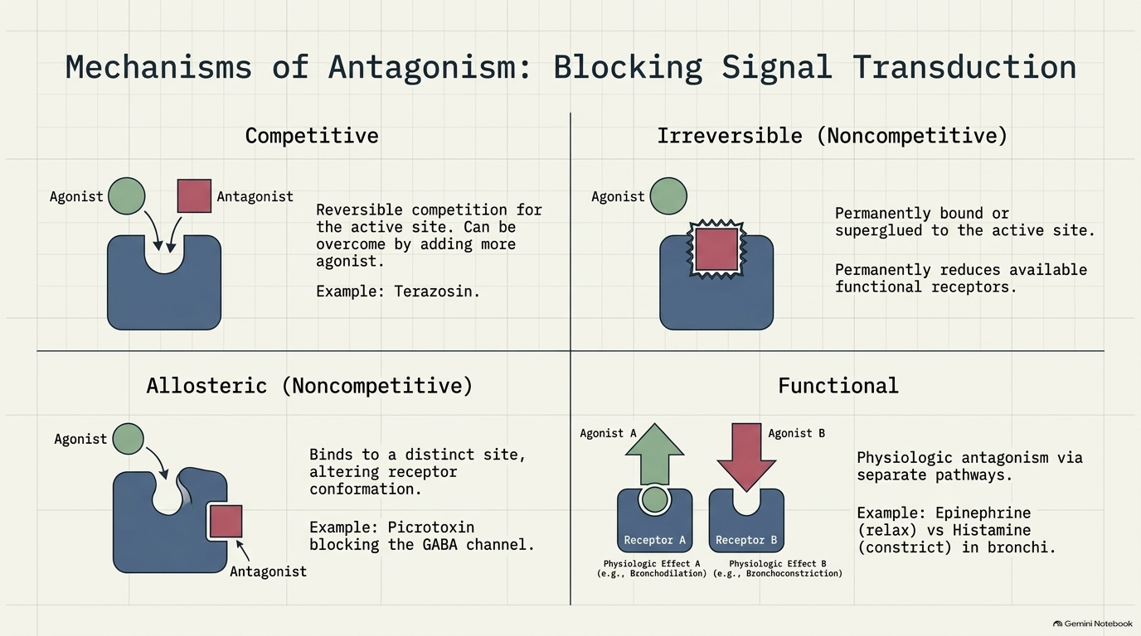

Slide 64
Quantal Dose-Response Curve:
Another important dose-response relationship is that between the dose of the drug and the proportion of a population of patients that responds to it. These responses are known as quantal responses, because, for any individual, either the effect occurs or it does not.
Graded responses can be transformed to quantal responses by designating a predetermined level of the graded response as the point at which a response occurs or not. For example, a quantal dose response relationship can be determined in a population for the antihypertensive drug atenolol. A positive response is defined as a fall of at least 5 mm Hg in diastolic blood pressure.
Quantal dose-response curves are useful for determining doses to which most of the population responds. They have similar shapes as log dose-response curves, and the ED₅₀ is the drug dose that causes a therapeutic response in half of the population.

Slide 65
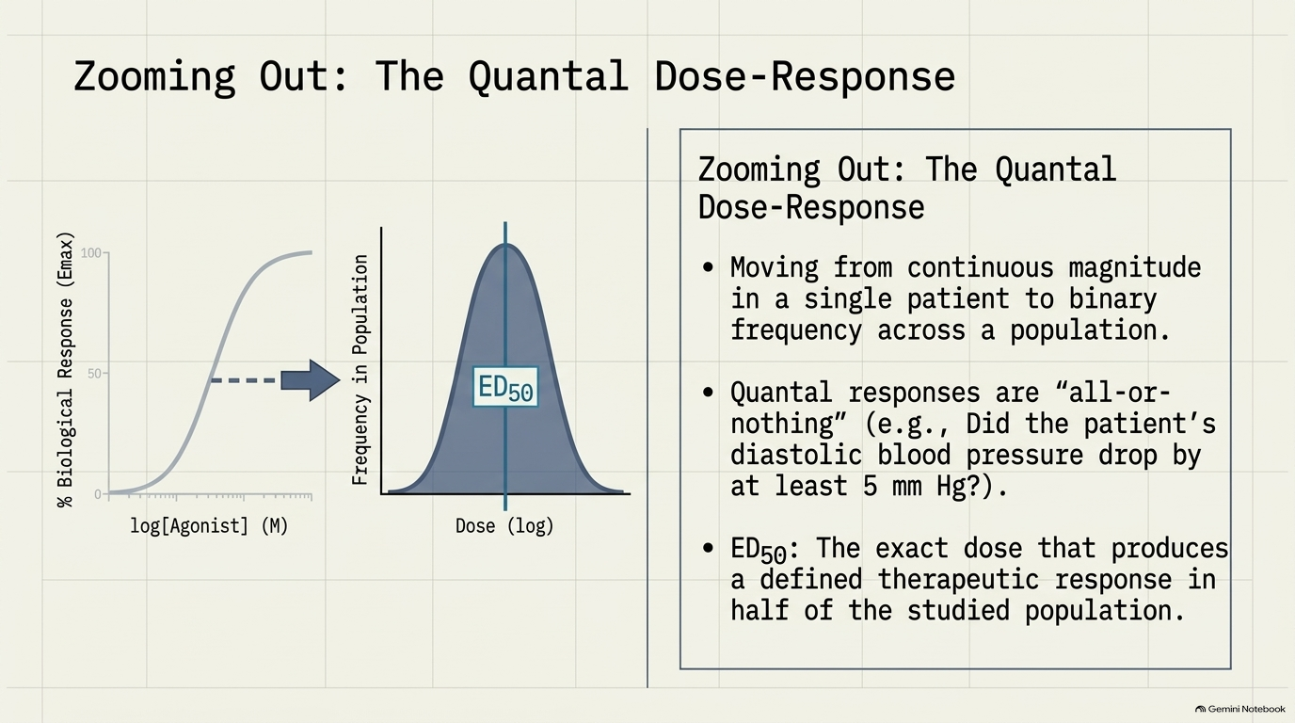

Slide 66
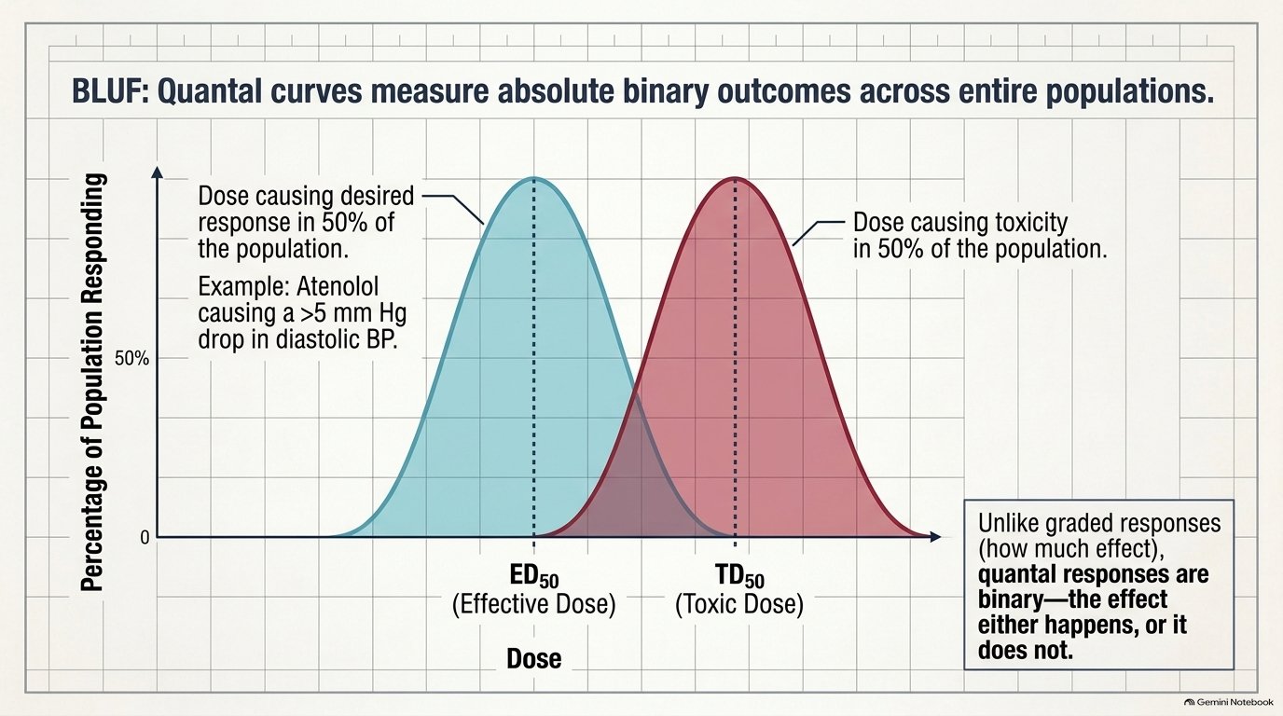

Slide 67

A. Therapeutic index
The therapeutic index (TI) of a drug is the ratio of the dose that produces toxicity in half the population (TD50) to the dose that produces a clinically desired or effective response (ED50) in half the population:
The Tl is a measure of a drug's safety, because a larger value indicates a wide margin between doses that are effective and doses that are toxic.

Slide 68
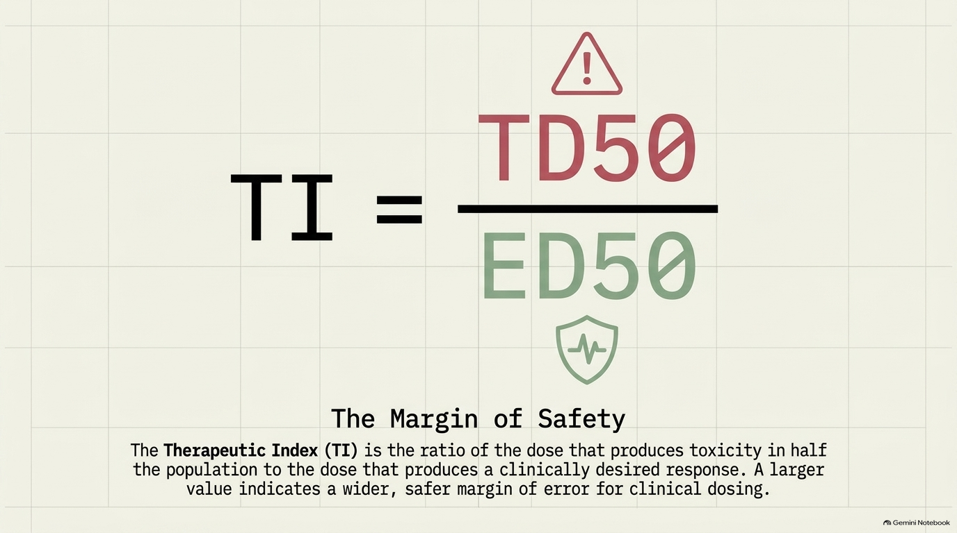

Slide 69
B. Clinical usefulness of the therapeutic Index
The Tl of a drug is determined using drug trials and accumulated clinical experience. These usually reveal a range of effective doses and a different (sometimes overlapping) range of toxic doses.
Although high Tl values are required for most drugs, some drugs with low therapeutic indices are routinely used to treat serious diseases. In these cases, the risk of experiencing adverse effects is not as great as the risk of leaving the disease untreated. The responses to warfarin, an oral anticoagulant with a low TI, and penicillin, an antimicrobial drug with a large Tl.

Slide 70
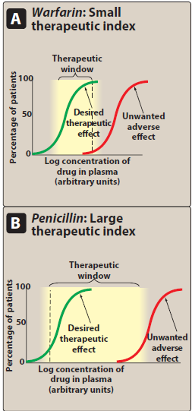

Slide 71
1. Warfarin (example of a drug with a small therapeutic index): As the dose of warfarin is increased, a greater fraction of the patients responds (for this drug, the desired response is a two- to threefold increase in the international normalized ratio [INR]) until, eventually, all patients respond.
However, at higher doses of warfarin, anticoagulation resulting in hemorrhage occurs in a small percent of patients.
Agents with a low Tl (that is, drugs for which dose is critically important) are those drugs for which bioavailability critically alters the therapeutic effects.

Slide 72
2. Penicillin (example of a drug with a large therapeutic index):
For drugs such as penicillin, it is safe and common to give doses in excess of that which is minimally required to achieve a desired response without the risk of adverse effects. In this case, bioavailability does not critically alter the therapeutic or clinical effects.

Slide 73
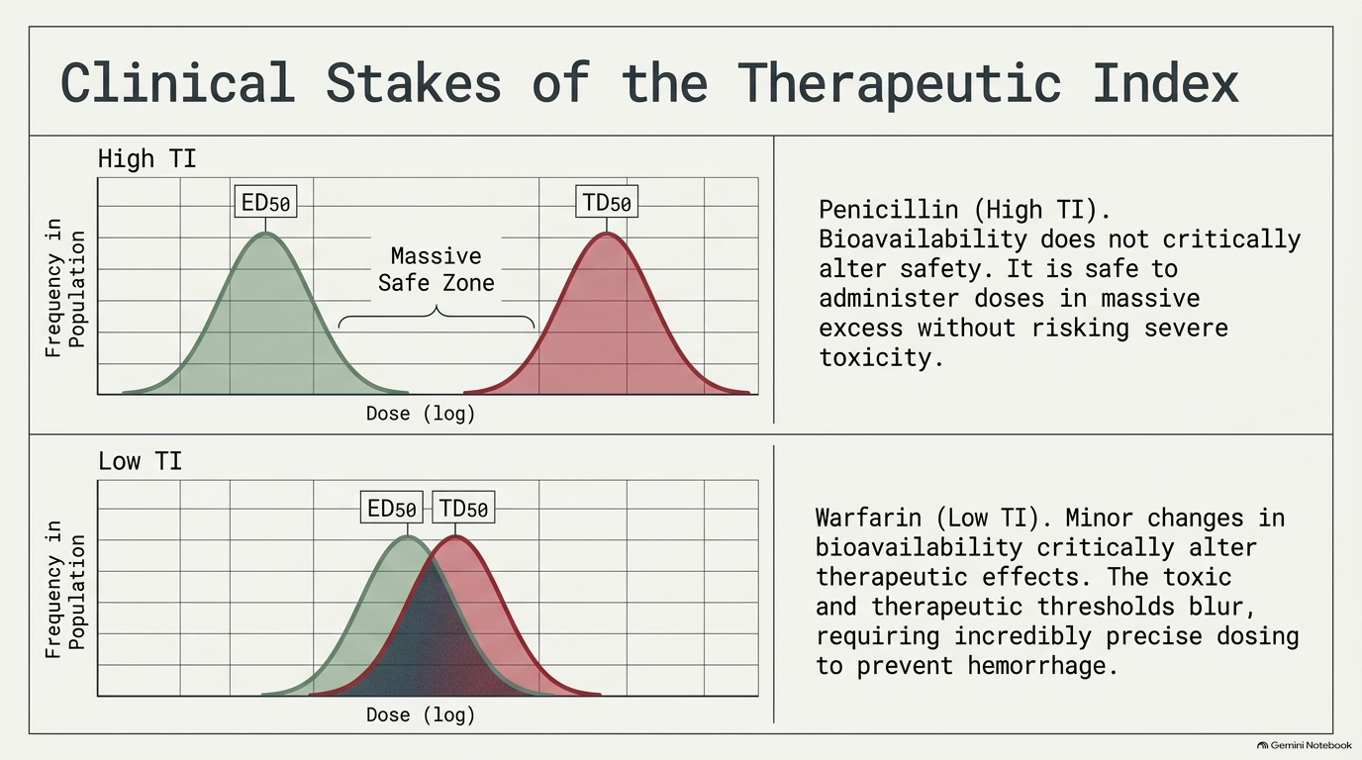

Slide 74
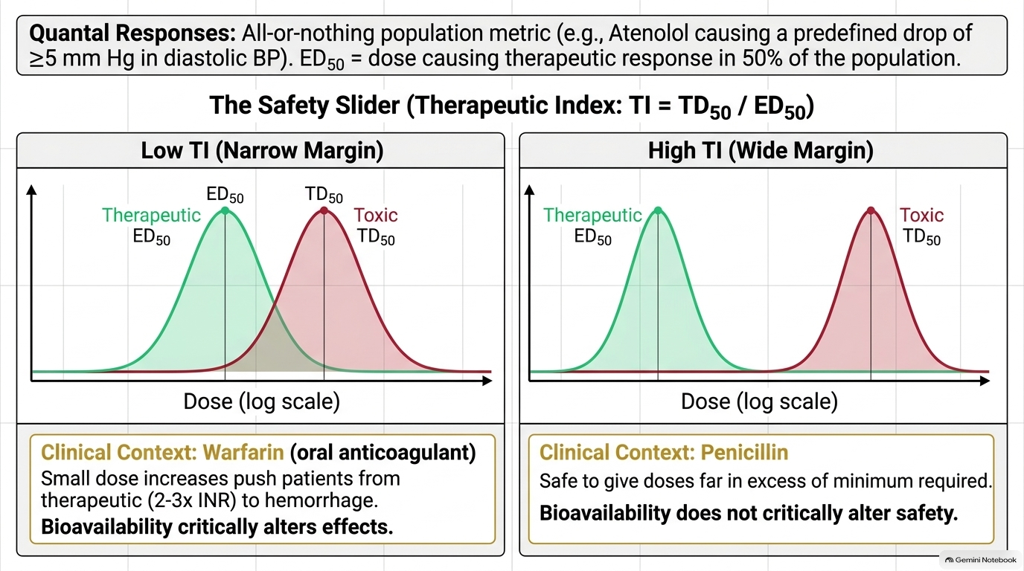

Slide 75
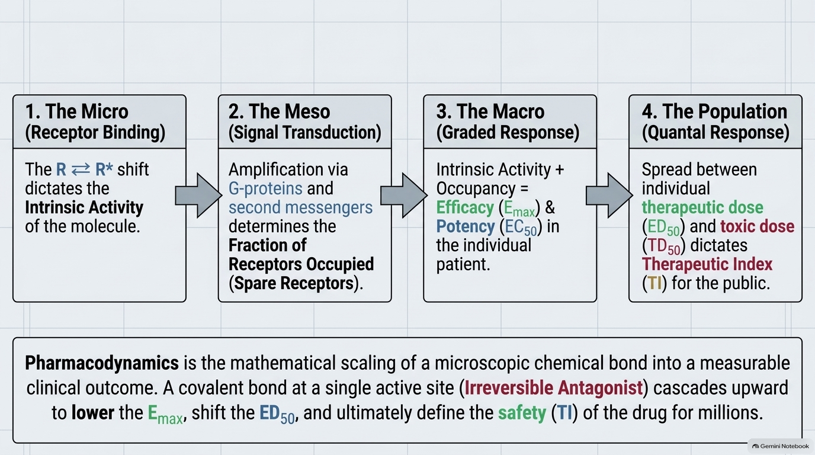

Slide 76
The therapeutic index (TI) of a drug is the ratio of:
TD50/ED50
Emax/EC50
Emax/ TD50

Slide 77


