Slide 1
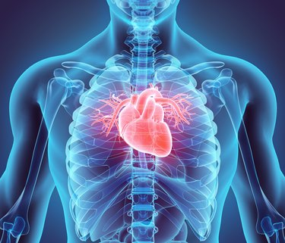
The Cardiovascular system
Physiology of the Heart

Slide 2
Conducting System of the Heart
The heart generates its own electrical impulses and beats independently of nervous or hormonal control (autorhythmicity). Parts of conducting system:
Sinoatrial (SA) node Small groups of specialized cells in the myocardium initiate and conduct impulses causing coordinate and synchronized contraction of the heart muscle. located in the posterior wall of right atrium (at the junction of the superior vena cava with the right atrium).
Atrioventricular (AV) node located in the right posterior portion of interaterial septum
Bundle of His: located in the interventricular septum and divided into two branches right and left.
Purkinje fibers: begin within the apex of the heart and extend through the walls of the ventricles.
This system has ability to stimulate cardiac contraction without any innervations.

Slide 3
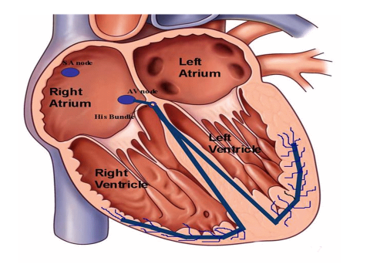

Slide 4
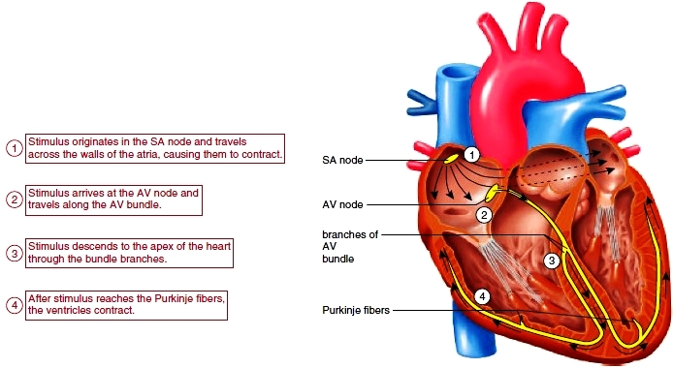

Slide 5
Action potential: electrical stimulation created by a sequence of ion fluxes through specialized channels in the membrane (sarcolemma) of cardiomyocytes that leads to cardiac contraction.
Electricity and Action potential of the cardiac muscle
Myocardial fibers have a resting membrane potential of approximately (-90) mV.
At resting membrane potential the Na⁺ channel Ca⁺⁺ channel are closed. While some leakage of K⁺ through K⁺ channel..
Notes:
Sarcolemma غلاف الليف العضلي

Slide 6
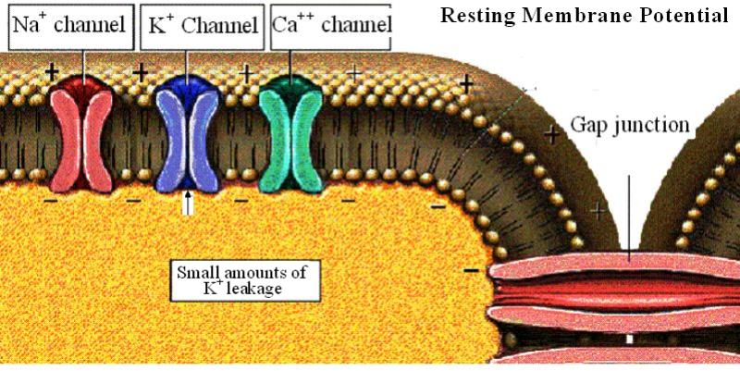

Slide 7
The action potential in the stimulated cardiac myocyte is divided into 5 phases:
Phase 0 :
Rapid depolarization: occurs due to rapid Na⁺ influx, so the inner membrane gradually becomes less negative, and when the membrane potential becomes (- 70)mV (reaches the threshold for initiating action potential), more Na+ ions influxes lead to produce the rapidly rising phase of action potential depolarization. The membrane potential reaches to the +30 mV.

Slide 8
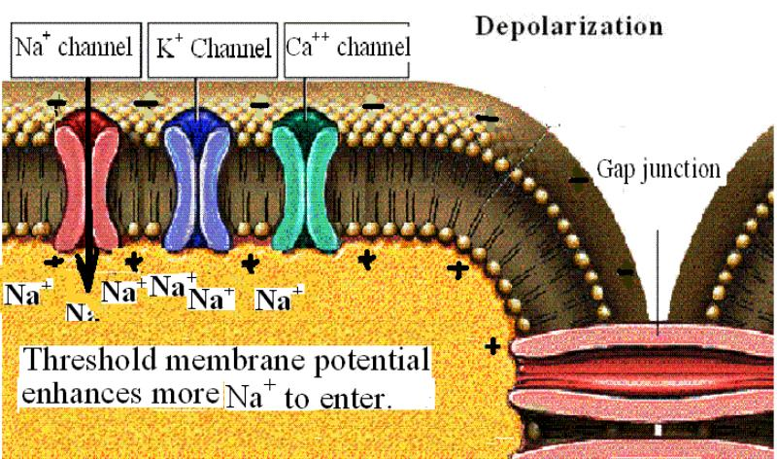

Slide 9
Phase 1: initial rapid repolarization. It is a short phase. The membrane potential in this phase reaches to (-10) mV. This phase occurs due to closure of Na⁺ channel and opening of K⁺ channel.
Phase 2: plateau. It occurs due to slow influx of Ca^{++.}
Phase 3: repolarization. during this phase complete repolarization and the membrane reaches to approximately resting value.
Phase 4: resting potential. The membrane potential is maintained at (-90)mV.

Slide 10
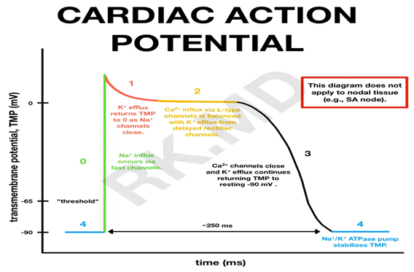
Action potential causes the release Ca++ into cytoplasm (from sarcoplasm) which causes the muscle contraction.
All heart cells are electrically joint one to another by intercalated disc (gap junction), so one cardiac muscle generate action potential it just spread to the other.

Slide 11
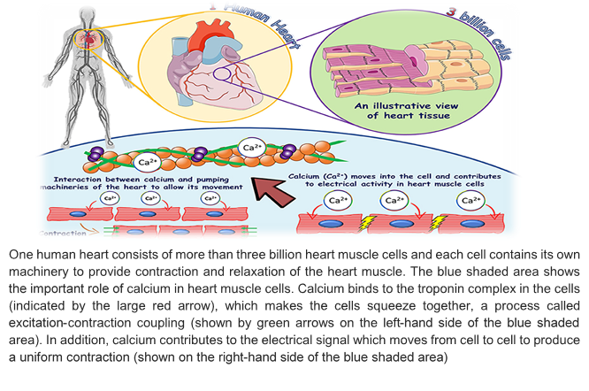

Slide 12
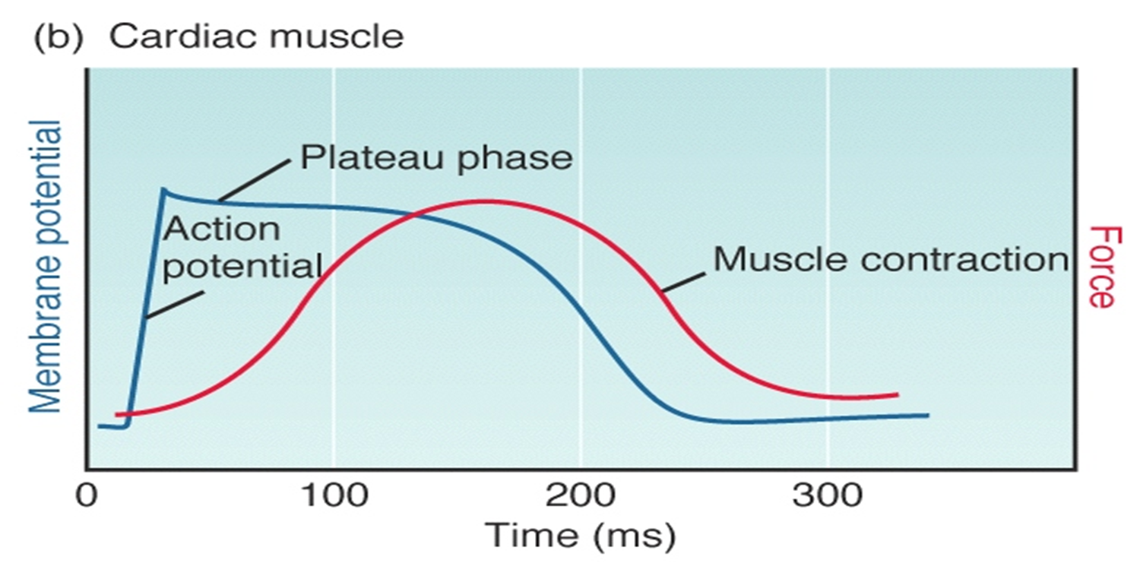
Duration of action potential:
is about 250 msec. at a heart rate 75 beats/ minute. The duration of action potential decrease when heart rate increases.

Slide 13
Electrical potential in the pacemaker
The resting membrane potential in SA node is only (-55) mV to (-60) mV.
The threshold level is (-40) mV.
Ca⁺⁺ ions enter cell at threshold level.
Rapid depolarization up to (+ 5) mV followed by rapid repolarization.

Slide 14
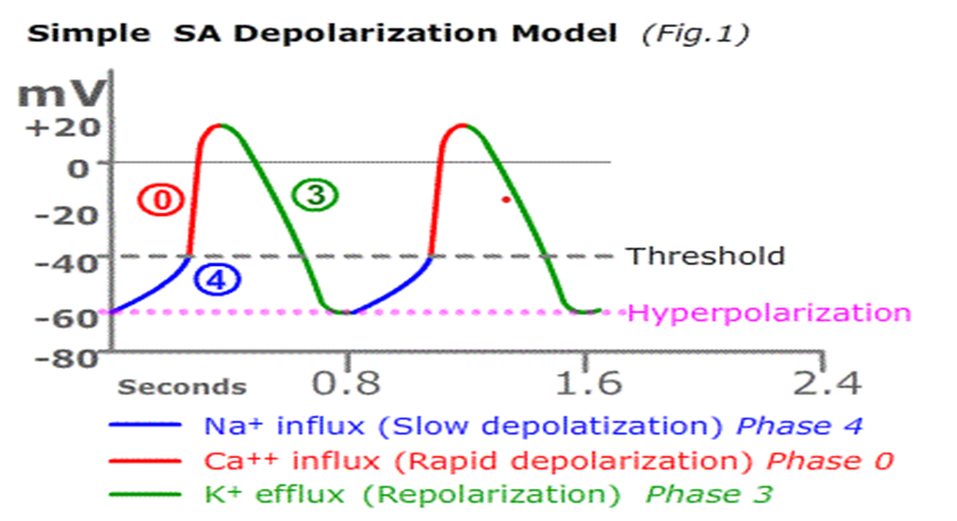
Electrical potential of paecemaker

Slide 15
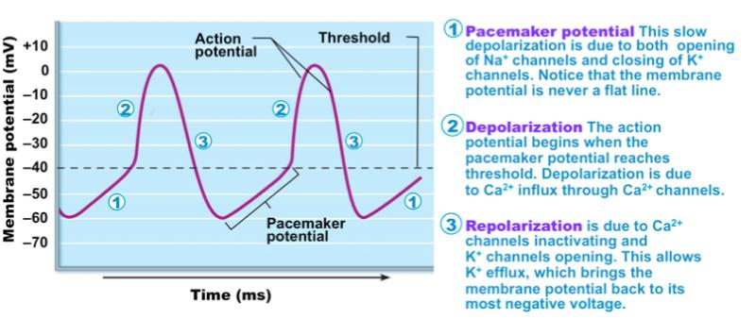

Slide 16
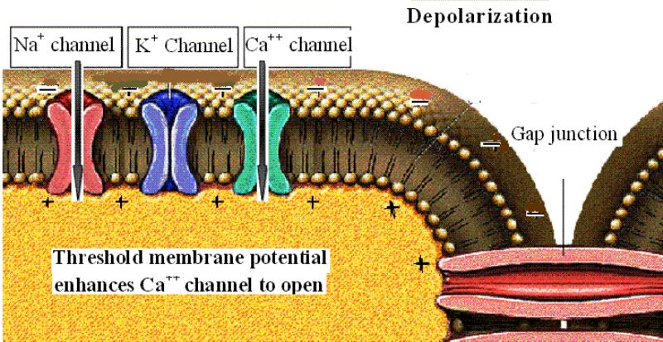
Threshold of paecemaker cells

Slide 17
Cardiac cycle
It is the inclusive period of time from the start of one heartbeat to the initiation of the next.
In each cardiac cycle, there are alternate contractions and relaxation of all chambers.
Each contraction is called systole and each relaxation is called diastole.
The events at single cardiac cycle:
Atrial systole: contraction of both atria (left and right) simultaneously leads to move blood (20%) from atria to the ventricles (from right atrium to the right ventricle through tricuspid valve. And from left atrium to the left ventricle through mitral valve).
Atrial diastole:
Ventricular systole: In this period, the tricuspid and mitral valves are closed, and the blood forced into the blood vessels through semilunar valves (from left ventricle to the pulmonary artery. And from left ventricle to the aorta).
Ventricular diastole: most of blood (80%) flows passively from relaxing atria into the ventricles through the open aterioventricle valves.
Cardiac cycle
It is the inclusive period of time from the start of one heartbeat to the initiation of the next.
In each cardiac cycle, there are alternate contractions and relaxation of all chambers.
Each contraction is called systole and each relaxation is called diastole.

Slide 18
The events at single cardiac cycle:
Atrial systole: contraction of both atria (left and right) simultaneously leads to move blood (20%) from atria to the ventricles (from right atrium to the right ventricle through tricuspid valve. And from left atrium to the left ventricle through mitral valve).
Atrial diastole:
Ventricular systole: In this period, the tricuspid and mitral valves are closed, and the blood forced into the blood vessels through semilunar valves (from right ventricle to the pulmonary artery. And from left ventricle to the aorta).
Ventricular diastole: most of blood (80%) flows passively from relaxing atria into the ventricles through the open aterioventricle valves.

Slide 19
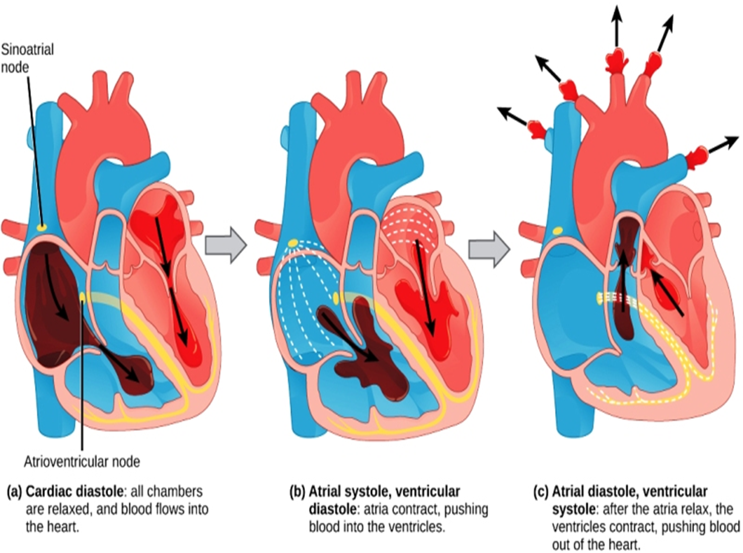

Slide 21
Heart Sounds
Lab Sound:
Is fairly loud is due to ventricles contraction and closure of tricuspid and mitral valves (atrioventricular valves).
Dup Sound: Made by closure of pulmonary and aortic valves. When ventricles relax.

Slide 25
Normal Electrocardiogram (ECG or EKG)
It refers to the record of the potential fluctuation during the cardiac cycle. Due to sequential spread of the excitation in the:
Atria
Interventricular septum.
Ventricular wall
Repolarization of the myocardium
These events appear in the ECG as a series of positive and negative waves (P, Q, R, S, and T).

Slide 26
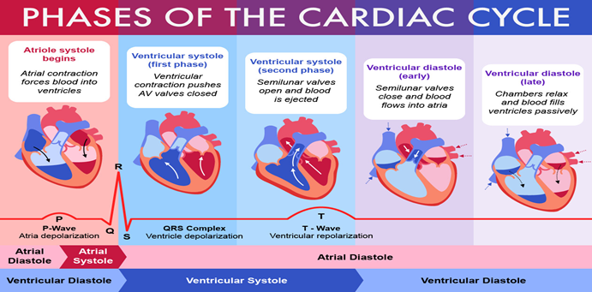

Slide 27
Waves of ECG
P wave: atrial depolarization
QRS complex wave: ventricular depolarization
T wave: ventricular repolarization.

Slide 29
Intervals and segments
P-R interval:
it measured from the onset of P wave to the onset QRS complex.
It measures the AV conduction time. Its duration varies from 0.12- 0.2sec.
QT interval:
it is the time from the start of the QRS complex to the end of T wave.
It indicates total systolic time of ventricle (ventricular depolarization and repolarization).
PQ segment:
ST segment:
it is an isoelectric period between the end of QRS and beginning of T wave.
Its duration is about 0.32 sec.

Slide 31
Clinical application of ECG:
It is important in the diagnosis, prognosis, and planning
treatment of the cardiac disorders e.g.:
Cardiac arrhythmias
Myocardial infarction
Cardiac hypertrophy
Changes in the ionic composition of the heart.

Slide 33
Cardiac Output
It means the amount of blood ejected by each ventricle per minute.
Stroke volume:
is the amount of blood ejected by each ventricle per beat
Cardiac output = stroke volume x heart rate
Factors affecting cardiac output:
Ventricular End Diastolic Volume (VEDV)(preload)
Venous return:
*position of the body
*skeletal muscle pump
*respiratory pump
Strength of myocardial contraction
Blood volume

Slide 34
