Slide 1
Electromagnetic Waves
Prof. Dr. Samir Al-ani

Slide 2
Electromagnetic Waves
Section 1 slides 3- 31
What are electromagnetic waves?
Section 2 slides 32-59
The Electromagnetic Spectrum
Section 3 slides 60-69
Radio Communication

Slide 3
What are electromagnetic waves?
How electromagnetic waves are formed
How electric charges produce electromagnetic waves
Properties of electromagnetic waves

Slide 4
Electromagnetic Waves…
Do not need matter to transfer energy.

Slide 5
Electromagnetic Waves…
Do not need matter to transfer energy.
Are made by vibrating electric charges and can travel through space by transferring energy between vibrating electric and magnetic fields.

Slide 6
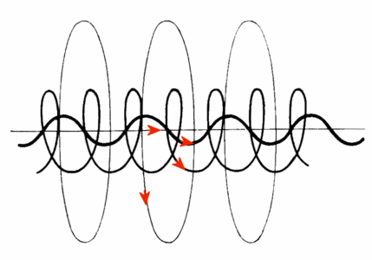
How do moving charges create magnetic fields?
Any moving electric charge is surrounded by an electric field and a magnetic field.

Slide 7
What happens when electric and magnetic fields change?
A changing magnetic field creates a changing electric field.

Slide 8
What happens when electric and magnetic fields change?
A changing magnetic field creates a changing electric field.
One example of this is a transformer which transfers electric energy from one circuit to another circuit.

Slide 9
What happens when electric and magnetic fields change?
A changing magnetic field creates a changing electric field.
One example of this is a transformer which transfers electric energy from one circuit to another circuit.
In the main coil changing electric current produces a changing magnetic field
Which then creates a changing electric field in another coil producing an electric current
The reverse is also true.

Slide 10
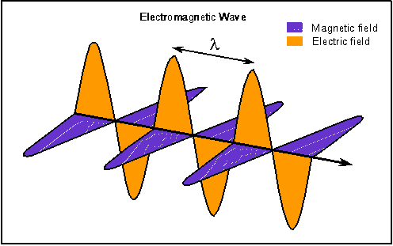
This page was copied from Nick Strobel's Astronomy Notes. Go to his site at www.astronomynotes.com for the updated and corrected version.

Slide 11
Making Electromagnetic Waves
When an electric charge vibrates, the electric field around it changes creating a changing magnetic field.

Slide 12
Making Electromagnetic Waves
The magnetic and electric fields create each other again and again.

Slide 13
Making Electromagnetic Waves
An EM wave travels in all directions. The figure only shows a wave traveling in one direction.

Slide 14
Making Electromagnetic Waves
The electric and magnetic fields vibrate at right angles to the direction the wave travels so it is a transverse wave.

Slide 15
Properties of EM Waves
All matter contains charged particles that are always moving; therefore, all objects emit EM waves.

Slide 16
Properties of EM Waves
All matter contains charged particles that are always moving; therefore, all objects emit EM waves.
The wavelengths become shorter as the temperature of the material increases.

Slide 17
Properties of EM Waves
All matter contains charged particles that are always moving; therefore, all objects emit EM waves.
The wavelengths become shorter as the temperature of the material increases.
EM waves carry radiant energy.

Slide 18
What is the speed of EM waves?
All EM waves travel 300,000 km/sec in space. (speed of light-nature’s limit!)

Slide 19
What is the speed of EM waves?
All EM waves travel 300,000 km/sec in space. (speed of light-nature’s limit!)
EM waves usually travel slowest in solids and fastest in gases.
Material | Speed (km/s)
Vacuum | 300,000
Air | <300,000
Water | 226,000
Glass | 200,000
Diamond | 124,000

Slide 20
What is the wavelength & frequency of an EM wave?
Wavelength= distance from crest to crest.

Slide 21
What is the wavelength & frequency of an EM wave?
Wavelength= distance from crest to crest.
Frequency= number of wavelengths that pass a given point in 1 s.

Slide 22
What is the wavelength & frequency of an EM wave?
Wavelength= distance from crest to crest.
Frequency= number of wavelengths that pass a given point in 1 s.
As frequency increases, wavelength becomes….

Slide 23
What is the wavelength & frequency of an EM wave?
Wavelength= distance from crest to crest.
Frequency= number of wavelengths that pass a given point in 1 s.
As frequency increases, wavelength becomes smaller.

Slide 24
Can a wave be a particle?
In 1887, Heinrich Hertz discovered that shining light on a metal caused electrons to be ejected.

Slide 25
Can a wave be a particle?
In 1887, Heinrich Hertz discovered that shining light on a metal caused electrons to be ejected.
Whether or not electrons were ejected depended upon frequency not the amplitude of the light! Remember energy depends on amplitude.

Slide 26
Can a wave be a particle?
Years later, Albert Einstein explained Hertz’s discovery: EM waves can behave as a particle called a photon whose energy depends on the frequency of the waves.

Slide 27
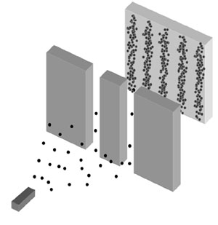
Can a particle be a wave?
Electrons fired at two slits actually form an interference pattern similar to patterns made by waves

Slide 28
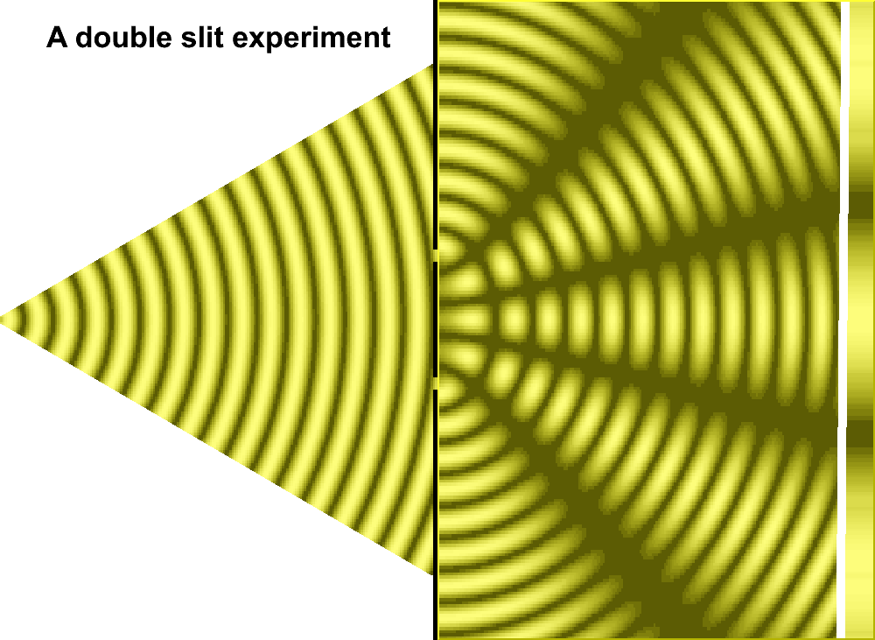
Can a particle be a wave?
Electrons fired at two slits actually form an interference pattern similar to patterns made by waves

Slide 29
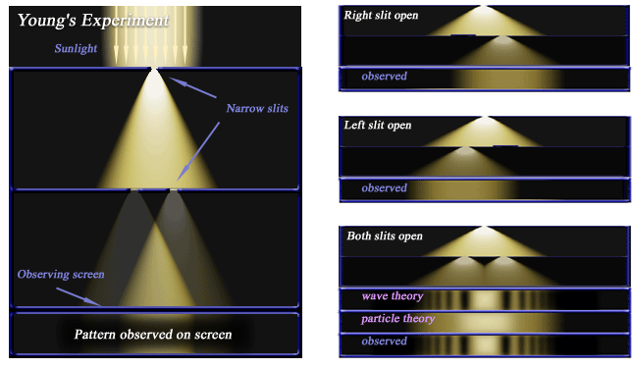
What did Young’s experiment show?

Slide 30
Electromagnetic Waves
How they are formed
Kind of wave
Sometimes behave as

Slide 31
Electromagnetic Waves
How they are formed
Waves made by vibrating electric charges that can travel through space where there is no matter
Kind of wave
Transverse with alternating electric and magnetic fields
Sometimes behave as
Waves or as
Particles (photons)

Slide 32
Electromagnetic Waves
Section 2 The Electromagnetic Spectrum

Slide 33
The whole range of EM wave…
Frequencies is called the electromagnetic spectrum.

Slide 34
The whole range of EM wave…
Frequencies is called the electromagnetic spectrum.
Different parts interact with matter in different ways.

Slide 35
The whole range of EM wave…
Frequencies is called the electromagnetic spectrum.
Different parts interact with matter in different ways.
The ones humans can see are called visible light, a small part of the whole spectrum.

Slide 36
As wavelength decreases, frequency increases…

Slide 37
Devices detect other frequencies:
Antennae of a radio detects radio waves.

Slide 38
Devices detect other frequencies:
Antennae of a radio detects radio waves.
Radio waves are low frequency EM waves with wavelengths longer than 1mm.

Slide 39
Devices detect other frequencies:
Antennae of a radio detects radio waves.
Radio waves are low frequency EM waves with wavelengths longer than 1mm.
These waves must be turned into sound waves by a radio before you can hear them.

Slide 40
What are microwaves?
Microwaves are radio waves with wavelengths less than 30 cm and higher frequency & shorter wavelength.

Slide 41
What are microwaves?
Microwaves are radio waves with wavelengths less than 30 cm and higher frequency & shorter wavelength.
Cell phones and satellites use microwaves between 1 cm & 20 cm for communication.

Slide 42
What are microwaves?
Microwaves are radio waves with wavelengths less than 30 cm and higher frequency & shorter wavelength.
Cell phones and satellites use microwaves between 1 cm & 20 cm for communication.
In microwave ovens, a vibrating electric field causes water molecules to rotate billions of times per second causing friction, creating TE which heats the food.

Slide 43
How does radar work?
Radio Detecting And Ranging or radar is used to find position and speed of objects by bouncing radio waves off the object.

Slide 44
What is magnetic resonance imaging?
MRI was developed in the 1980s to use radio waves to diagnose illnesses with a strong magnet and a radio wave emitter and a receiver. Protons in H atoms of the body act like magnets lining up with the field. This releases energy which the receiver detects and creates a map of the body’s tissues.

Slide 45
Infrared Waves
EM with wavelengths between 1mm & 750 billionths of a meter.
Used daily in remote controls, to read CD-ROMs
Every objects gives off infrared waves; hotter objects give off more than cooler ones. Satellites can ID types of plants growing in a region with infrared detectors

Slide 46
Visible Light
Range of EM humans can see from 750 billionths to 00 billionths of a meter.
You see different wavelengths as colors.
Blue has shortest
Red is the longest
Light looks white if all colors are present

Slide 47
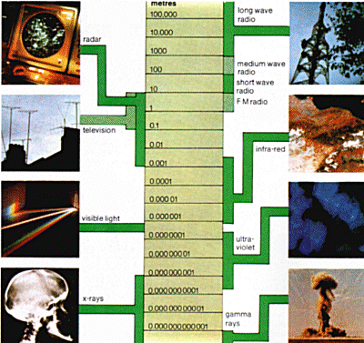
A range of frequencies
In order of increasing frequency and decreasing wavelength, the EM spectrum consists of: very long wave radio, used for communication with submarines; long, medium and short wave radio (used for AM broadcasting); FM radio, television and radar; infra-red (heat) radiation, which is recorded in the Earth photographs taken by survey satellites; visible light; ultraviolet light, which, while invisible, stimulates fluorescence in some materials; x rays & gamma rays used in medicine and released in radioactive decay

Slide 48
Ultraviolet Waves
EM waves with wavelengths from about 400 billionths to 10 billionths of a meter.
Have enough energy to enter skin cells
Longer wavelengths – UVA
Shorter wavelengths – UVB rays
Both can cause skin cancer

Slide 49
Can UV radiation be useful?
Helps body make vitamin D for healthy bones and teeth
Used to sterilize medical supplies & equip
Detectives use fluorescent powder (absorbs UV & glows) to find fingerprints

Slide 50
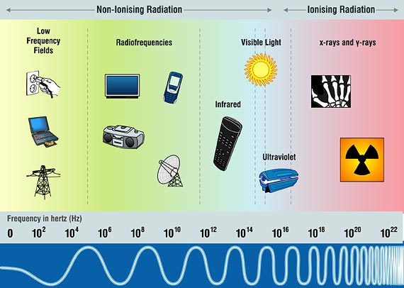

Slide 51
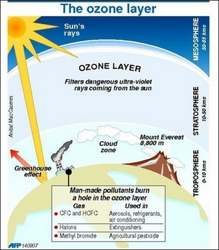
What is the ozone layer?
20-50 km above earth
Molecule of 3 O atoms
Absorbs Sun’s harmful UV rays
Ozone layer decreasing due to CFCs in AC, refrigerators, & cleaning fluids

Slide 52
What could happen to humans…
And other life on Earth if the ozone layer is destroyed?

Slide 53
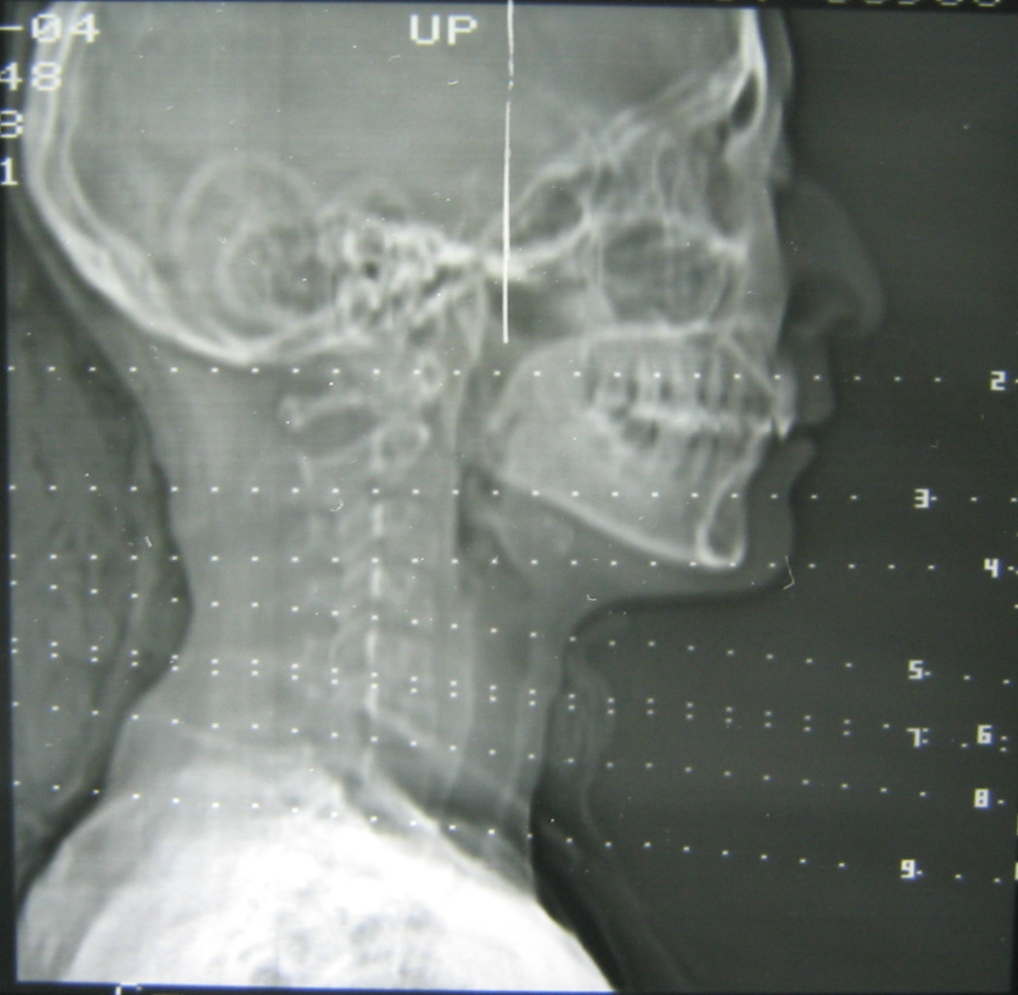
X Rays and Gamma Rays
EM waves with shortest wavelength & highest frequency
High Energy- go through skin & muscle
High level exposure causes cancer

Slide 54
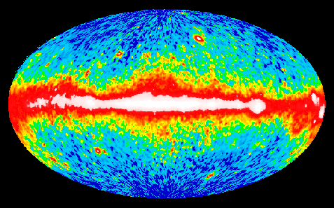
X Rays and Gamma Rays
EM with wavelengths shorter than 10 trillionths of a meter.
Highest energy, can travel through several centimeters of lead.
Both can be used in radiation therapy to kill diseased cells.
The composite image shows the all sky gamma ray background.

Slide 55
Identify which statement is not true:
A. Gamma rays are low frequency waves.
B. X rays are high-energy waves.
C. Gamma rays are used to treat diseases.

Slide 56
Why do you think MRIs cause ...
Less harm than X rays?

Slide 57
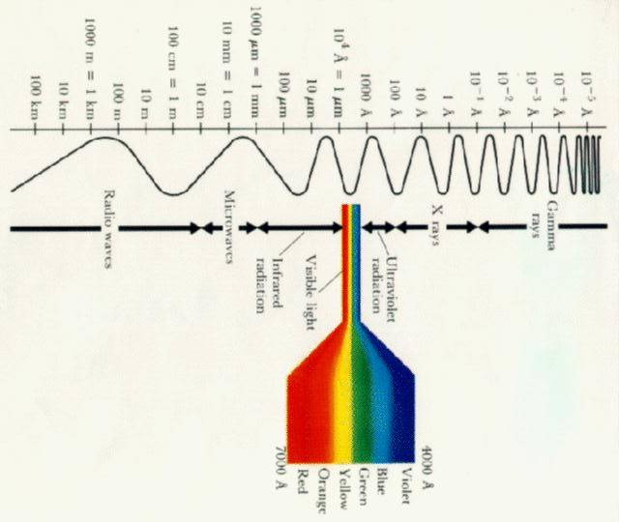
F
Fill in the boxes with the waves of the EM spectrum.

Slide 59
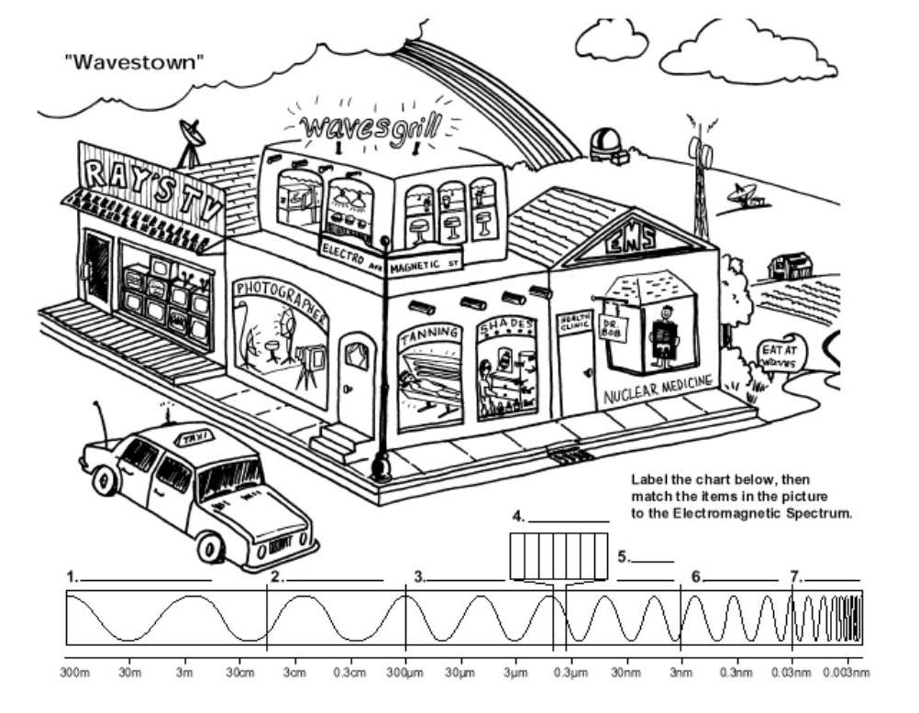

Slide 60
Electromagnetic Waves
Chp. 12 Section 3 Radio Communication

Slide 61
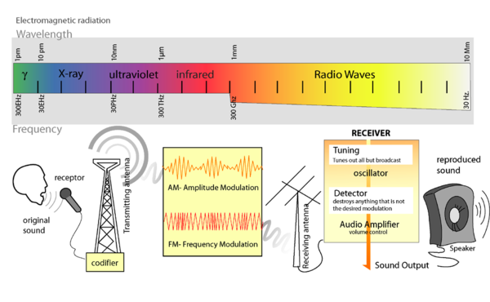
Radio Transmission
Radio stations change sound to EM waves & then your radio receiver changes the EM waves back to sound waves again.

Slide 62
How does a radio receive different stations?
Each station broadcasts at a certain frequency which you tune in by choosing their frequency.
Carrier wave- the frequency of the EM wave that a station uses
Microphones convert sound waves to a changing electric current or electronic signal containing the words & music.

Slide 63
How does a radio receive different stations?
Microphones convert sound waves to a changing electric current or electronic signal containing the words & music.
The modified carrier wave vibrates electrons in the station’s antennae creating a radio wave that travels out in all directions at the speed of light to your radio antennae.

Slide 64
How does a radio receive different stations?
The modified carrier wave vibrates electrons in the station’s antennae creating a radio wave that travels out in all directions at the speed of light to your radio antennae.
The vibrating electrons produce a changing electric current which your radio separates the carrier wave from the signal to make the speakers vibrate creating sound waves….

Slide 65
What is AM radio?
In AM amplitude changes but frequency does not. AM frequencies range from 540,000 Hz to 1,6000,000 Hz usually listed in kHz.

Slide 66
What is FM radio?
In FM radio stations transmit broadcast information by changing the frequency of the carrier wave. The strength of FM waves is always the same and is in megahertz. Mega=million

Slide 67
Television
Uses radio waves to send electronic signals in a carrier wave.
Sound is sent by FM; color and brightness is sent at the same time by AM signals.

Slide 68
What is a cathode-ray tube?
Many TVs and computer monitors display images on a CRT, a sealed vacuum tube in which beams of electrons are produced.
Color TV produces 3 electron beams inside the CRT which strike the inside of the screen that is covered with more than 100,000 rectangular spots.

Slide 69
What is a cathode-ray tube?
There are 3 types of spots, red, green and blue. The electron beams move back and forth across the screen.
The signal from the TV station controls how bright each spot is. Three spots together can form any color.
You see a full color image on the TV.

Slide 70
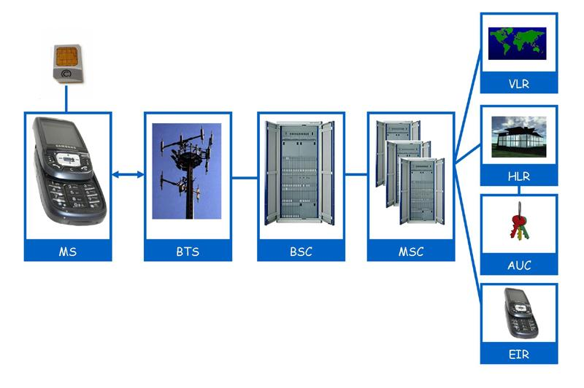
Telephones
Sound waves→ microphone→ electric signal→ radio waves→ transmitted to and from microwave tower → receiver→ electric signal → speaker→ sound wave
Mobile Phone BTS Base Transceiver Station BSC Base Station Controller MSC Mobile services Switching Centre VLR Visitor Location Register HLR Home Location Register

Slide 71
How do cordless phones work?
Cell phones and cordless telephones are transceivers, device that transmits one signal & receives another radio signal from a base unit.
You can talk and listen at the same time because the two signals are at different frequencies.

Slide 72
How do pagers work?
A pager is a small radio receiver with a phone number. A caller leaves a message at a terminal with a call-back number.
At the terminal, the message is turned into an electronic signal transmitted by radio waves.
Newer pagers can send and receive messages.

Slide 73
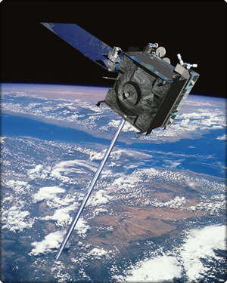
Communications Satellites
Thousands of satellites orbit Earth. A radio or TV station sends microwave signals to the satellite which amplifies the signal and sends it back to a different place on Earth. Satellite uses dif freq to send & receive.

Slide 74
Global Positioning System
GPS is a system of 24 satellites, ground monitoring stations and portable receivers that determine your exact location on Earth. GPS receiver measures the time it takes for radio waves to travel from 4 different satellites to the receiver. The system is owned and operated by the US Dept of Defense, but the microwaves can be used by anyone.

