Slide 1
Communications Systems
The topics within this unit are:
Characteristics of communication systems.
Examples of communication systems.
Transmitting and receiving in communication systems.
Other information processes in communication systems.
Issues related to communication systems.

Slide 2
TOPICS MENU
Click on the topic of your choice
Characteristics of Communication Systems
Examples of Communication Systems
Transmitting and Receiving
Other Information Processes
Issues Related To Communication Systems

Slide 3
Communications Terms
Communications Glossary
Communications Networking Glossary
Glossary of Networking terms at Clock.org

Slide 4
Characteristics of Communication Systems
  Protocols
  Handshaking
  Speed of Transmission
  Error Checking
  Communication Settings

Slide 5
Characteristics of Communication Systems
More Information
must be a Sender and Receiver
A protocol is a set of rules which governs the transfer of data between computers. Protocols allow communication between computers and networks.
Handshaking is used to establish which protocols to use. Handshaking controls the flow of data between computers
protocols will determine the speed of transmission, error checking method, size of bytes, and whether synchronous or asynchronous
Examples of protocols are: token ring, CSMA/CD, X.25, TCP/IP

Slide 6
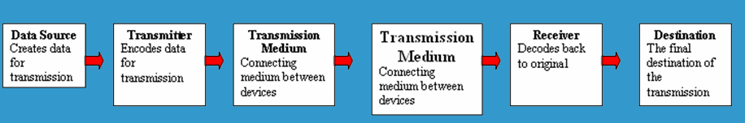
5 Basic Components
Every communication system has 5 basic requirements
Data Source (where the data originates)
Transmitter (device used to transmit data)
Transmission Medium (cables or non cable)
Receiver (device used to receive data)
Destination (where the data will be placed)

Slide 7
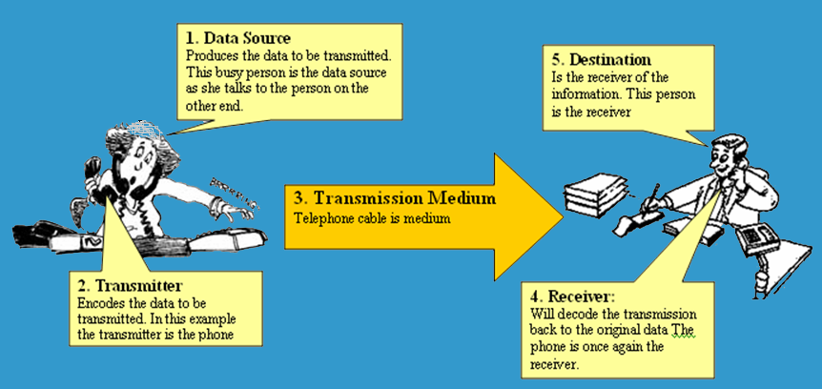
5 Basic Components

Slide 8
Transmission Media Speed
Bandwidth:The amount of data which can be transmitted on a medium over a fixed amount of time (second). It is measured on Bits per Second or Baud
Bits per Second (bps): A measure of transmission speed. The number of bits (0 0r 1) which can be transmitted in a second (more)
Baud Rate: Is a measure of how fast a change of state occurs (i.e. a change from 0 to 1) (more)

Slide 9
Packets
Transmissions are broken up into smaller units or data transmissions called packets
Example
A data file is divided into packets.
It does not matter what the transmission is. It could be Word
document, a PowerPoint or an MP3. Imagine this Green box
is a file for transfer
This file has now been broken into four packets
PACKET
PACKET
PACKET
PACKET

Slide 10
Packets and OSI
After the file is divided into packets extra information is required to make sure it all goes back together correctly. The OSI model helps to look after this.
The OSI model also provides much more information which is included with each package.

Slide 11
OSI 7 Layer Model
Originally Created by Bob Baker
Modified 2006
Graham Betts
More Information on OSI
OSI “Open System Interconnection”
OSI is not a protocol but a list of protocols divided between 7 layers with each layer having a different set of functions.
Each packet is layered/packaged with protocols from each of the layers as it is processed.
The process of layering the protocols around each package is called encapsulation. The final encapsulated data packet is called a frame.

Slide 12
Open Systems Interconnection
Originally Created by Bob Baker
Modified 2006
Graham Betts
OSI Reference model
  Layer 7 application
  Layer 6 presentation
  Layer 5 session
  Layer 4 transport
  Layer 3 network
  Layer 2 data link
  Layer 1 physical
Sender
Receiver
File
File
File
Each file
is divided
into
packets
Each Packet
will
then be
Encapsulated
with
PROTOCOLS
The protocols
Will be added
systematically
Layer
By layer
The encapsulated
Packet is called
a frame
The received
frame is then
unpacked
in the
opposite order
Transmission Medium

Slide 13
Services Performed at Each Layer
Originally Created by Bob Baker
Modified 2006
Graham Betts
  Layer 7 application
  Layer 6 presentation
  Layer 5 session
  Layer 4 transport
  Layer 3 network
  Layer 2 data link
  Layer 1 physical
  Identification, authentication
  Format conversion
  Set-up coordinate conversation
  Ensures error-free transfer
  Routing of data through network
  Error control and synchronisation
  Placing signals on the carrier

Slide 14
Examples of protocols
Originally Created by Bob Baker
Modified 2006
Graham Betts
More on Protocols
  Layer 7 application
  Layer 6 presentation
  Layer 5 session
  Layer 4 transport
  Layer 3 network
  Layer 2 data link
  Layer 1 physical
  E-mail, Web browser, Directory
  POP, SMTP, FTP, HTTP, DNS
  Sockets
  TCP
  IP
  PPP, Ethernet, Token ring
  100baseT

Slide 15
Encapsulation
Originally Created by Bob Baker
Modified 2006
Graham Betts
Device 1
Device 2
Application
data
Application
Presentation
H6
data
T6
Presentation
Session
H5
data
T5
Session
Transport
H4
data
T4
(Packet)
Transport
Network
H3
data
T3
(packet)
Network
Data Link
H2
data
T2
Data Link
Physical
H1
data
T1
Physical
carrier
FRAME
FRAME
FRAME
FRAME
A typical frame
Preamble
Destination
Address
Source
Address
Data
Padding
CRC

Slide 16
Error Checking Methods
More on internet
Parity bit check
Check sum
* data transmitted in blocks, each block added to give a total – checksum
* used in X Modem protocol
Cycle redundancy check

Slide 17
HSC Topic 3.3
Examples of Communication Systems

Slide 18
Examples of Communication Systems
- E-mail
- Voice Mail - Fax
- Smart Phone - Instant Messaging
- Telecommuting - Video-conferencing
- Groupware - Telephony
- E-Commerce - The Internet
Bulletin board system - The Web
- Global positioning system

Slide 19
HSC Topic 3.4
Transmitting and Receiving in Communication Systems
Communication concepts
(transmission of data, protocols and handshaking, networks, LANs and WANs,Topologies, Network Access Methods)
Network Hardware
(NICs, Servers, Routers and Switches, Bridges and gateways, Hubs, Transmission media
Network Software
NOSs, Network Operating System Tasks, Logon and Logoff Procedures, Intranets and Extranets

Slide 20
Communication Concepts
Any transmission May be:
analog or digital
Serial or parallel

Slide 21
Serial Transmission
Data is transmitted, on a single channel, one bit at a time one after another
- Much faster than parallel because of way bits processed (e.g. USB and SATA drives)
Sender transmitted
Receiver received
1
0
0
1
1
0
0
1

Slide 22
Parallel Transmission
each bit has it’s own piece of wire along which it travels
- often used to send data to a printer
1
0
0
1
Receiver received
Sender transmitted
1
0
0
1
All bits are sent simultaneously

Slide 23
Why Not use Parallel Instead of serial?
Due to inconsistencies on channels data arrives at different times
Because of the way it is transmitted packet switching cannot be used
The above two points makes parallel slower than serial and requires higher bandwidth.
Parallel transmissions are rarely used anymore

Slide 24
Synchronous Vs AsynchronousTransmissions
Synchronous Transmission
all data sent at once and no packet switching
Asynchronous Transmission
Uses stop/ start bits
most common type of serial data transfer
Allows packet switching
Allows sharing of bandwidth (i.e. talk on phone while another person is using internet)

Slide 25
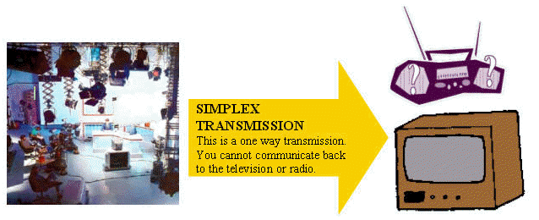
Transmission Direction
- simplex: One direction only

Slide 26
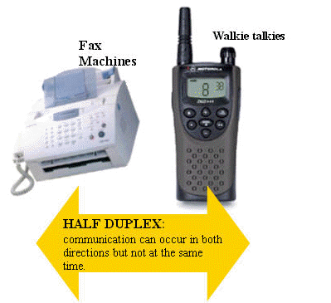
Half Duplex Transmission
half duplex: Both directions but only one direction at a time

Slide 27
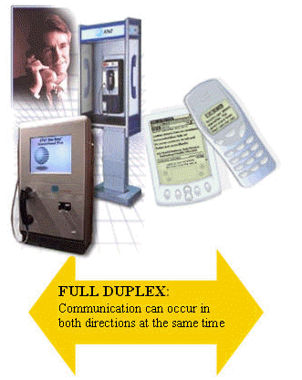
Full Duplex Transmission
full duplex: send and receive both directions at once

Slide 28
3 Common Protocols
Ethernet (Ethernet Network)
Carrier Sense Multiple Access/Collision Detection (CSMA/CD)
TCP/IP

Slide 29
Ethernet
Developed at Xerox in 1976.
First protocol approved as an industry standard protocol 1983
LAN protocol used on bus and star
Most popular LAN protocol
Inexpensive

Slide 30
Carrier Sense Multiple Access/Collision Detection (CSMA/CD)
Used on bus networks to avoid data collisions.

Slide 31
TCP/IP
Developed in 1973 for use on the ARPANET which was a defense force research network.
Adopted in 1983 as the Internet standard. all hosts on the Internet are required to use TCP/IP.
- Allows transfer of data using packet switching

Slide 32
LANs Vs WANs
LAN is “local Area network” which is a network confined to a small geographic area which is a building or a group of buildings.
WAN is “wide area network” which is a network spread over a large geographic area. The largest WAN is the internet.

Slide 33
Examples of LANS
3 different types of LANS are:
  Ring
  Bus
  Star

Slide 34
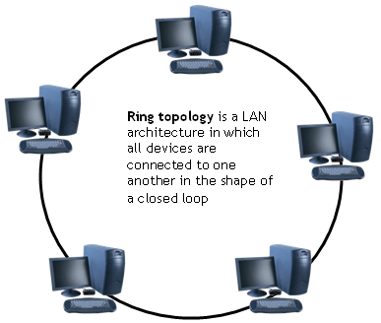
Ring
Uses an empty data packet called a token and a special protocol called “token ring”. Packets travel around the ring in a clockwise direction. Clients require an empty token to transmit data.
Advantages
- no collisions because all data travels in same direction.
Disadvantages
- fails if an individual node in the network fails

Slide 35
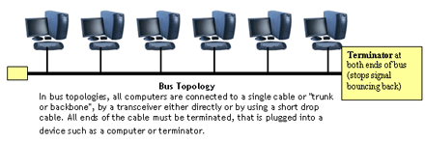
BUS TOPOLOGY
A bus is a form of Ethernet. Nodes linked by a cable known as the bus. Bus transmits in both directions and uses CSMA/CD protocol
Advantages - Easy to set up and maintain failure of one node does not affect network | Disadvantages Higher rate of data collision than with a bus network fails if there is any damage to the bus
Notes:
Easy to add extra computers . If computer goes down it doesn’t affect rest of network

Slide 36
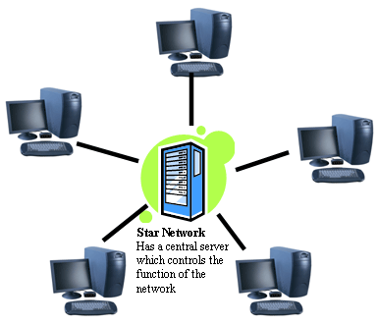
Star
All data is sent from one client to another through the server.
Advantages
- If one client fails no other clients are affected.
Disadvantages
- If central file server fails the network fails.
Notes:
If central host goes doewn affects rest of network

Slide 37
Network Hardware

Slide 38
What is a Network?
A network is a number of computers and peripheral devices connected together so as to be able to communicate (i.e. transfer data)
Each device in a network is called a node.
Terminals are data entry points which can also display.

Slide 39
NETWORKS: categorized by size
LAN – a network that connects computers in a limited
geographical area.
MAN – a backbone that connects LANs in a metropolitan
area such as a city and handles the bulk of communications
activity across that region.
WAN – covers a large geographical area such as a city or
country. Communication channels include telephone lines,
Microwave, satellites, etc.
Notes:
LAN local area network

Slide 40
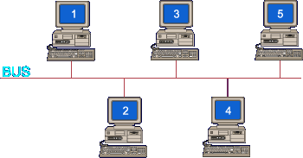
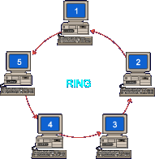
NETWORK TOPOLOGIES (categorizing by shape)
Notes:
Contention occurs on star and bus networks.

Slide 41
Bridge
Large networks can be separated into two or more smaller networks using a bridge. This is done to increase speed and efficiency. This type of network is called a segmented LAN and has largely been superseded by the use of switches which can transfer data straight to a computer and thus avoid bottleneck jams which bridges were designed to fix.
Bridge
Notes:
Devives that connect local area networks
If a BUS or ring then a Gateway needs to be used

Slide 42
Gateway
Often used to connect a LAN with a WAN. Gateways join two or
More different networks together.
Gateway

Slide 43
Internet, Intranet, Extranet
Internet
public/international network which is used to access information, e-shopping, e-banking, email
Intranet
private network (LAN or WAN) used to share resources in secure environment
uses web pages (HTML to view) and TCP/IP protocols (to make connection)
Extranet
intranet that has been extended to include access to or from selected external organizations such as customers, but not general public.
Note: Connections via leased lines, or network interconnections.

Slide 44
Transmission Media
More on internet
twisted pair – telephone cable
coaxial cable –Thick black cable used for higher bandwidth communications than twisted pair (i.e. Optus cable)
fibre optic – data transferred through pulses of light. Extremely fast.
Non cable methods such as satelite, microwave, wireless and bluetooth

Slide 45
Network Hardware
More on Internet
SERVERS: Help to manage the network and the resources of that network. On larger networks servers commonly have specialised tasks such as: File Servers: stores and manages files, Print Servers: manages printers and print jobs, Mail Server: Manages email, Web Server: manages web access.
Routers: connects multiple networks and are protocol independent. can be used in place of a switch or bridge.
Switches: smart hubs which transmit packets to the destination port only
Hubs: like double adapters /power boards in the home except instead of plugging in extension cords we are plugging in computers to allow them to communicate.

Slide 46
Some Network Administration Tasks
- adding/removing users
- assigning users to printers
- giving users file access rights
- installation of software and sharing with users
- client installation and protocol assignment
- logon and logoff procedures
- network based applications

Slide 47
Other Information Processes in Communication Systems
Collecting: phone as collection device with voice mail, EFTPOS terminal as a collection device for electronic banking
processing: sending of attachments with e-mail, encoding and decoding methods, including: analog data to analog signal, digital data to analog signal, digital data to digital signal, analog data to digital signal, client-server architecture: the client controls the user interface and the application logic server controls access to the database

Slide 48
Collecting
Collecting: The following are collection devices: ATMs for internet banking, EFTPOS for stores, microphone and video camera for video conferencing. Data can be analog or digital

Slide 49
Processing
Processing: Is the manipulation or changing the data into a more useable format. The processing may include changing the appearance of the data, the file type or storage options.

Slide 50
Displaying
Displaying: How the information is made available for the user to see

Slide 51
Issues related to Communication Systems
Messaging Systems (social context, Danger of Misinterpretation, Power Relationships, Privacy and confidentiality, power relationships, electronic junk mail, information overload)
Internet (Internet trading, taxation, employment, nature of business, trade barriers, censorship, child protection, internet banking, security, changing nature of work, branch closures and job losses, radio and video)
Telecommuting (work from home), blurring between work and home, more stress, advantagesand disadvantages)

Slide 52
Issues relating to messaging systems
‘netiquette’ is etiquette/ manners on net
Many people rely on messaging systems more than spoken or face to face communication.
written word only recipient miss out on (e.g. body language and voice inflection)
privacy (employers have right to read e-mail at work)
Spam is overloading mailboxes
Work/ information overload from ever growing number of emails

Slide 53
Issues relating to internet trading
employment ramifications
Effect on trade barriers and taxation laws
Phishing and security

Slide 54
Issues relating to internet banking
branch closures and job losses
decreasing number of bank branches
job losses
changing nature of work
security of banking details

Slide 55
Physical boundaries
telecommuting is working from home
virtual organisations
national trade barriers

Slide 56
Acknowledgements
Slides 11-15 were originally created by Bob Baker and have been modified by Graham Betts
A number of slides have been adapted from a slide show by Loretta Kocovska around 2001 especially the illustrations on slides 18,39,40, 41, 42 and 43

