Slide 1
Compilers
مدرس المادة
ا.م. نادية محمد عبدالمجيد

Slide 2
The Phases of a Compiler
The compilation process is a sequence of various phases. Each phase takes input from its previous stage, has its own representation of source program, and feeds its output to the next phase of the compiler. Let us understand the phases of a compiler.
Analyzer Lexical مرحلة التحليل اللفظي
Analyzer Syntax مرحلة التحليل القواعدي
Analyzer Semantic مرحلة التحليل المعنوي
Intermediate Code Generator مرحلة توليد الشفرات الوسيطه
Optimizer Code مرحلة تحسين الشفرات
Code Generator مرحلة انتاج الشفرات

Slide 3
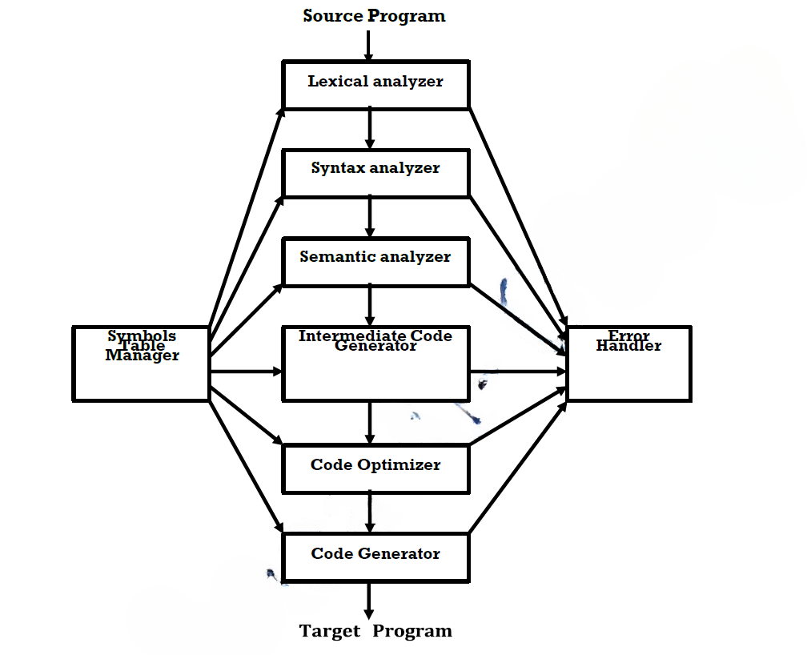
In each phase we need variables that can be obtained from a table called Symbol Table manager, and in each phase some errors may be generated so we must have a program used to handle these errors , this program called Error Handler.
في كل مرحلة نحتاج معلومات من مدير جدول الرموز.
كل مرحلة ممكن تنتج أخطاء، لذلك نستخدم برنامج خاص للتعامل معها يُسمى معالج الأخطاء

Slide 4
Lexical Analyzer :- Is the initial part of reading and analyzing the program text (source program); The text is read (character by character) and divided into tokens, each of which corresponds to a symbol in the programming language, e.g., a variable name, keyword or number.
المحلل اللفظي:أول جزء من المترجم، يقرأ النص المصدري (حرفاً بحرف) ويقسّمه إلى توكِنز (Tokens).
Syntax analyzer :- The next phase is called the syntax analysis
or parsing. It takes the token produced by lexical analysis as input and generates a parse tree (or syntax tree) that reflects the structure of the program. This phase is often called parsing.
المحلل القواعدي :يأخذ التوكِنز وينشئ شجرة الاعراب (Parse Tree) التي توضّح البنية النحوية للبرنامج.

Slide 5
Semantic Analysis:- Semantic analysis checks whether the parse tree constructed follows the rules of language. Also is known as Type checking which main function is to analyze the syntax tree to determine if the program violates certain consistency requirements, such as, if a variable is used but not declared, assignment of values is between compatible data types, and adding string to an integer.
المحلل الدلالي: يتحقق إن كانت الشجرة تتبع قواعد اللغة فمثلاً:
يتأكد أن المتغيّر مُصرَّح عنه قبل استخدامه.
يتأكد أن أنواع البيانات متوافقة (لا تستطيع ان تجمع نص + عدد مثلاً)
مدى المصفوفه العرف غير مطابق للمستخدم.
القسمه على صفر .
ملاحظه 1 الى هنا مشابه لمرحلة front end
ملاحظه 2 البرنامج الطالع من مرحلة Semantic Analyzer يجب ان يكون برنامج خالي من الأخطاء اللفظيه والقواعديه والمعنويه.

Slide 6
Intermediate Code Generator :- After syntax and semantic analysis, It is in between the high-level language and the machine language. This intermediate code should be generated in such a way that it makes it easier to be translated into the target machine code. This phase bridges the analysis and synthesis phases of translation.
مولّد الشيفرة الوسيطة: يحوّل البرنامج لشيفرة وسيطة بين اللغة عالية المستوى ولغة الآلة.
Code Optimization phase :- The code optimization phase attempts to improve the intermediate code which results that the output runs faster and takes less space. Optimization can be assumed as something that removes unnecessary code lines, and arranges the sequence of statements in order to speed up the program execution without wasting resources (CPU, memory).
مُحسّن الشيفرة: يحسّن الكود الوسيط ليصير أسرع وأصغر (يحذف تعليمات زائدة، يرتب التعليمات لتسريع التنفيذ)

Slide 7
Code Generator :- the final phase of complier is the generation of target code, which represents the output of the code generator in the machine language.
مولّد الشيفرة: آخر مرحلة، يولّد الشيفرة الهدف (Machine Code).
Symbol Table :- It is a data-structure maintained throughout all the phases of a compiler.
All the identifiers’ names along with their types are stored here. The symbol table makes it easier for the compiler to quickly search the identifier record and retrieve it.
جدول الرموز:هو قاعدة بيانات يخزن أسماء المتغيرات، أنواعها، وعناوينها وكل ما يحتاجه المترجم خلال مراحل تنفيذ مراحله.
Error Handler :- each phase can produce errors. however, after detecting an error, a phase must deal with that error, so that the compilation can proceed.
So dealing with that error is done by a program known as error handler which is software used to handle any error that may be produced from any phase and it is needed in all phases of the compliers.
معالج الأخطاء :يتعامل مع الأخطاء في كل مرحلة ويمنع توقف المترجم مباشرة.

Slide 8
Note :- Each phase of the complier has two inputs and two outputs; for example:- for the first phase (Lexical Analyzer) the first input to it is the source program while the second input is some variables that may be needed in that phase; while the first output is the errors that may be generated in it and will be manipulated by the Error Handler program, and the second output from it will represent the input for the next compiler phase (Syntax).
ملاحظه:كل مرحلة من مراحل المترجم تحتاج الى مدخلين ومخرجين.

Slide 9
Lexical Analysis:- A Review
Lexical analysis is the first phase of a compiler.
هو المرحلة الأولى من المترجم.
It takes the modified source code from language preprocessors that are written in the form of sentences. The lexical analyzer breaks these syntaxes into a series of tokens, by removing any whitespace or comments in the source code.
يأخذ الكود المصدري المعدّل (بعد المعالج المسبق) ويحوّله إلى توكِنز و يزيل الفراغات والتعليقات في الكود
In programming language, keywords, constants, identifiers, strings, numbers, operators and punctuations symbols can be considered as tokens.

Slide 10
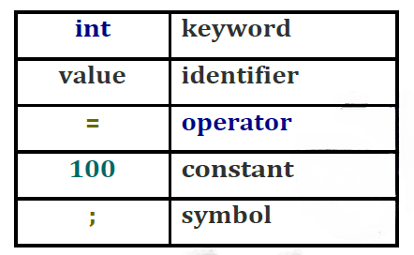
For example, in C++ language, the variable declaration line
int value = 100;
Contains the tokens
The lexical analyzer also follows rule priority where a reserved word, e.g., a keyword, of a language is given priority over user input. That is, if the lexical analyzer finds a lexeme that matches with any existing reserved word, it should generate an error.
إذا وجد المحلل اللفظي keywordمستعملة كمتغيّر → يُصدر خطأ.

Slide 11
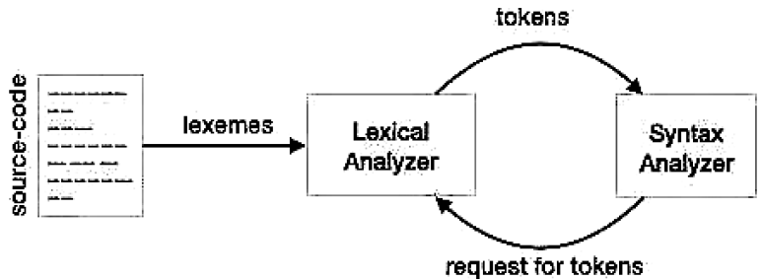
If the lexical analyzer finds a token invalid, it generates an error.
The lexical analyzer works closely with the syntax analyzer. It reads character streams from the source code, checks for legal tokens, and passes the data to the syntax analyzer when it demands.
إذا صادف توكِن غير صالح → يُصدر خطأ.

Slide 12
Specifications of Tokens
Let us understand how the language theory undertakes the following terms:
Alphabets :any finite set of symbols {0,1} is a set of binary alphabets, {0,1,2,3,4,5,6,7,8,9,a,b,c,d,e,f} is a set of hexadecimal alphabets, {a-z, a-z} is a set of english language alphabets.
الأبجديات: أي مجموعة محدودة من الرموز
Strings : any finite sequence of alphabets is called a string. length of the string is the total number of occurrence of alphabets, e.g., the length of the string tutorials point is 14 and is denoted by |tutorialspoint| =14.
A string having no alphabets, i.e. a string of zero length is known as an empty string and is denoted by ε (epsilon).
السلاسل : سلسلة أي تسلسل من الرموز ويمثل طول السلسلة عدد الرموز اما سلسلة فارغة (بدون رموز) فتمثل ابسيلون ε.

Slide 13
Specifications of Tokens
Language: A language is considered as a finite set of strings over some finite set of alphabets. Computer languages are considered as finite sets, and mathematically set operations can be performed on them. Finite languages can be described by means of regular expressions.
اللغة : مجموعة من السلاسل المتكوّنة من أبجدية محدودة فلغات الكمبيوتر تعتبر مجموعات منتهية. ومن الممكن وصفها باستخدام التعابير المنتظمة.
The various operations on languages are:
Union of two languages L and M is written as
L U M = {s | s is in L or s is in M}
Concatenation of two languages L and M is written as
LM = {st | s is in L and t is in M}
The Kleene Closure of a language L is written as
L* = Zero or more occurrence of language L

Slide 14
Specifications of Tokens
Grammars : a grammar is a set of formal rules for constructing correct sentences in any language; such sentences are called grammatical sentences.
القواعد :القاعدة هي مجموعة من القوانين الرسمية (Formal Rules) لبناء جُمل صحيحة في أي لغة. الجُمل الناتجة تُسمى جُمل نحوية.
Concatenation:
We define the Concatenation of two symbols U and V by:-
UV= { X | X= uv, u is in U and v is in V }
Note that:- UV ≠ VU
U (VW) = (UV) W
Example ①:-
Let Σ = {0,1} and U= {000,111} and V= {101,010}
→ UV= {000101, 000010, 111101, 111010}
→ VU= {101000, 101111, 010000, 010111}
∴UV ≠ VU

Slide 15
Example ②:-
Let Σ = {a,b,c,d} ; U= {abd , bcd} ; V= {bcd , cab} and W= {da , bd} To prove the following:- U (VW) = (UV) W
First, take the left side;
U (VW) ={abd , bcd} {bcdda, bcdbd, cabda, cabbd}
= { abdbcdda, abdbcdbd, abdcabda, abdcabbd, bcdbcdda, bcdbcdbd, bcdcabda, bcdcabbd }
Second, take the right side;
(UV) W = { abdbcd, abdcab, bcdbcd, bcdcab} {da , bd}
= { abdbcdda, abdcabda, bcdbcdda, bcdcabda, abdbcdbd, abdcabbd, bcdbcdbd, bcdcabbd }
∴ U (VW) = (UV) W

Slide 16
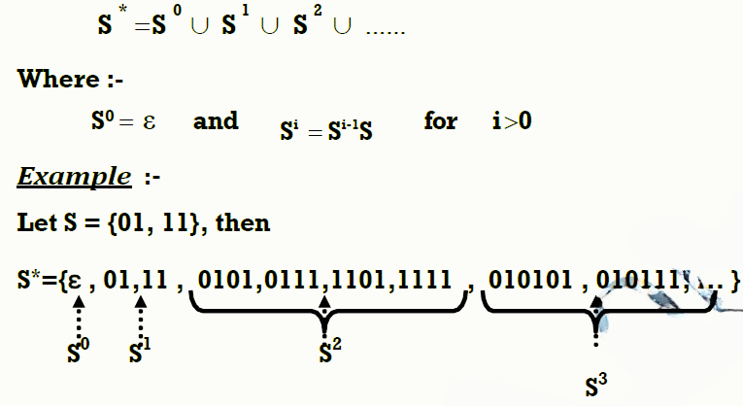
Closure or Star Operation :-
This operation defines on a set S, a derived set S*, having as members the empty word and all words formed by concatenating a finite number of words in S, as shown below:-

Slide 17
Thanks For Listening!

