Slide 2
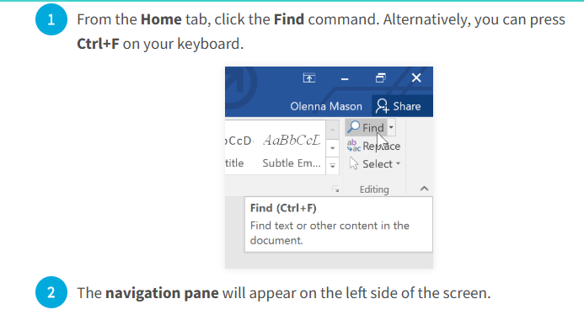
Find and replace text
Find and Replace helps you to find words or formats in a document and can let you replace all instances of a word or format.
The Find feature in Microsoft Word 2016 allows users to quickly locate specific words, phrases, or formatting within a document.
1. To find text

Slide 3
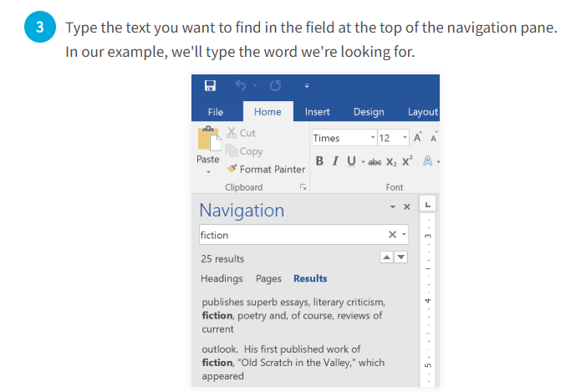

Slide 4
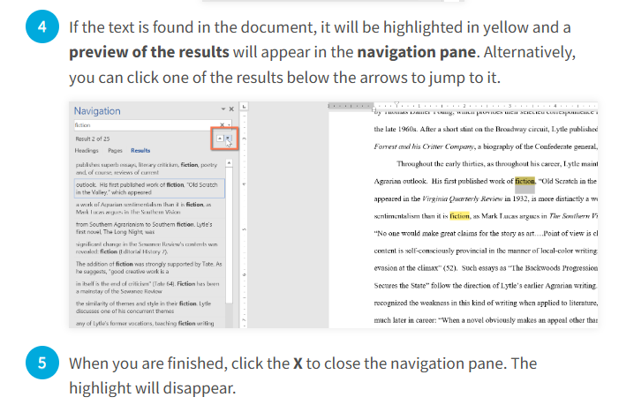

Slide 5
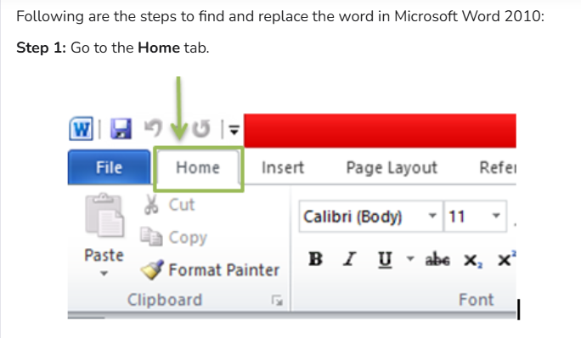
2. To Replace Text
The Replace feature in Microsoft Word 2016 allows users to find specific words or phrases in a document and replace them with new text automatically. This is useful for correcting mistakes, updating terms, or making bulk edits.

Slide 6
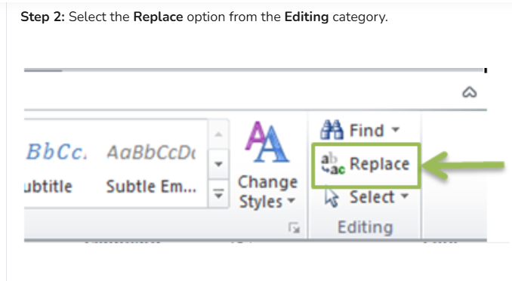

Slide 7
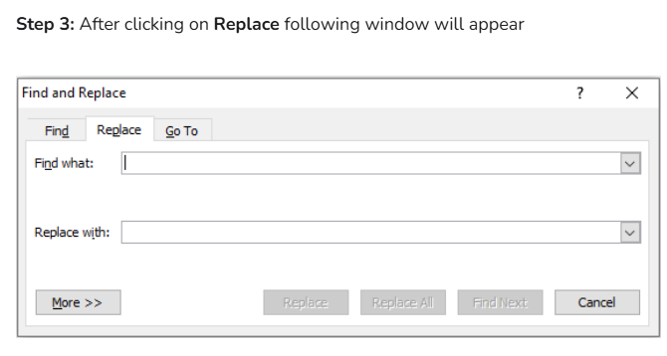

Slide 8
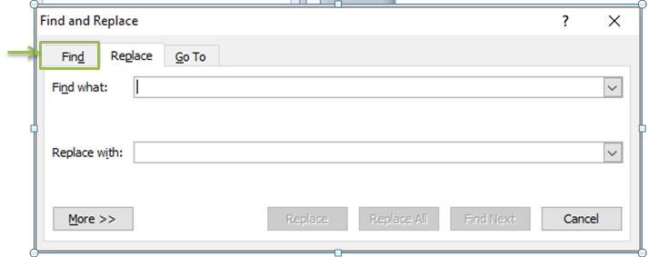
Step 4: Click on the Find Tab

Slide 9
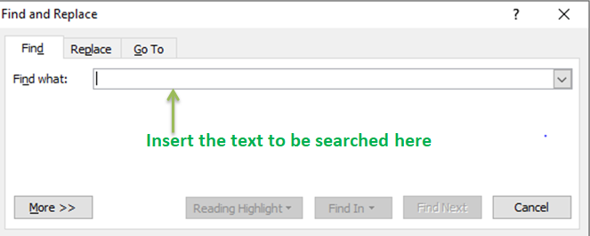
And enter the word or phrase to be searched and click on Find Next. Select Find Next until you come to the word you want to update.

Slide 10
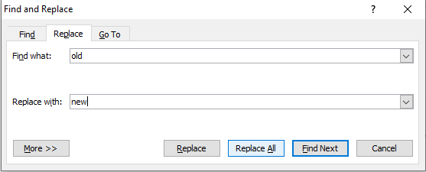
Step 5: Select Replace. To find and replace the text. To update all instances at once, choose Replace All.
Step 6: To Exit from Find and Replace, click on the Cancel button or the close button available in the upper right corner.

