Slide 1
Microsoft Word 2016

Slide 6
Difference between Save and Save As Method
Aspect | Save | save As
Function | Updates the existing file | Creates a copy and allows saving with a new name/location
Overwriting | Overwrites the current file with changes | Does not overwrite the original file but allows modifying it
Keyboard Shortcut | Ctrl + S (Windows), Command + S (Mac) | Ctrl + Shift + S (Windows), Command + Shift + S (Mac)
Purpose | Used to update and retain changes to the current file | Used to create a duplicate or save a modified version of the file
Dialog Box | Generally does not open a dialog box | Often opens a dialog box to specify new name/location
Use Case | Suitable for routine updates and modifications | Useful when creating different versions or backups of a file

Slide 11
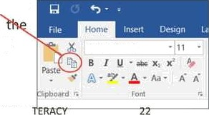
Copy and Paste Text
To copy and paste text:
Copying text creates a duplicate of the text.
1. Sélect the text you wish to cepy
2. Click the Copy command on the Heme tab or right click selected text and click Copy.

Slide 12
Copy and Paste Text (Cont.)
3. Place the insertion point where you wish the text to appear.
Click the Paste command on the Home tab or right click and click paste.
Then the copied text will appear.

Slide 13
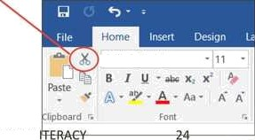
Cut and Paste Text
1. Select the text you wish to cut.
2. Click the Cut command on the Home tab or right click the sëlected text and select cut.

Slide 14
Cut and Paste Text (Cont.)
3. Place your insertion point where you wish the text to appear.
4. Click the Paste command on the Home tab or right click and select paste and the text will appear.

Slide 18
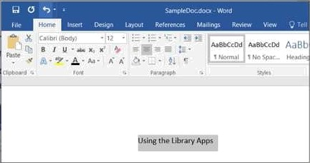
How to Change Font
Word 2016 provides a variety of other fonts you can use to customize text and titles.
1. Select the text you wish to change.

Slide 19
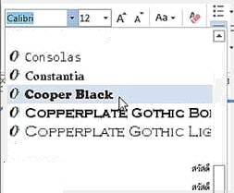
How to Change Font(Cont.)
2. On the Home tab cIfck the drop-down arrow next to
the Font box. A menu of font sfyles will appear.
5. Move the mouse over the list of font styles, then select the font you would like to use
4. The font will change
in the document.

Slide 20
Changing Font Size
1. Select the text you wish to change.

Slide 21
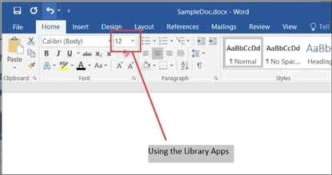
Changing Font Size (Cont.)
2. SeIE'ct the desired font size formatting option
Font size drop-down arrow: On the Home tab, click the Font
size drop-down arrow. A menu of font sizes will appear.
When you move the mouse over the various font sizes, a live preview of the font size will appear in the document.

Slide 22
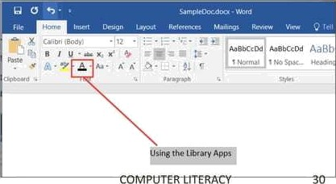
Font Color
Select the text you wish to change.
On the Home tab, click the Font Color drop-down arrow. The Font Color menu appears
Move the mouse over the various font colors. A live preview of the color wlll appear in the document.
3.

Slide 23
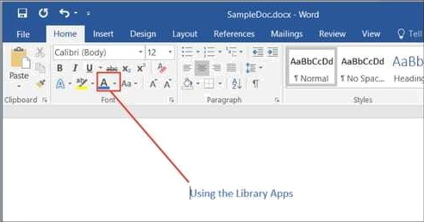
Font Color (Cont.)
4. Select the font color you wish to use. The font color will change in the document.

Slide 24
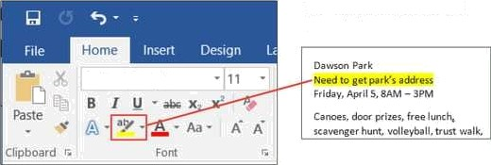
Highlight Text
Highlighting text can be useful when marking
important text in your document.
1. Select the text you wish to highlight.
t
2. From the Home tab, click the Text HighlightRF Color drop-down arrow.
3. Select the desired
highlight color.
Calibri tBody)

Slide 25
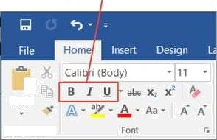
Bold, Italic, and Underline
Select the text you wish to change.
On the Home tab click the Bold (B), Italic (/), or Underline ( ) command in the Font group.
Pane
Clipboard r.
3. The seiE'cted text will be modified in thE' document.

Slide 27
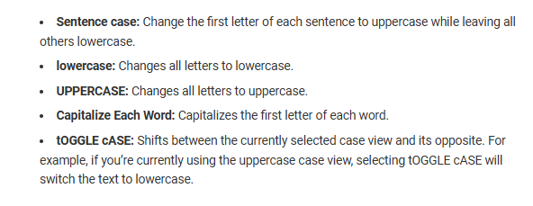
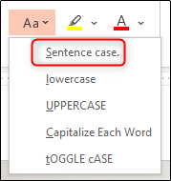
Change Case

Slide 28
Add an effect to text
Text Effects and Typography.
1. Select the text that you want to add an effect to.
2. On the Home tab, in the Font group, select Text Effects and Typography.
3. Select the effect that you want.
For more choices, point to Outline, Shadow, Reflection, or Glow, and then select the effect that you want to add.

Slide 29
Remove an effect from text
1. Select the text that you want to remove an effect from.
2. On the Home tab, in the Font group, click Clear All Formatting.

Slide 35
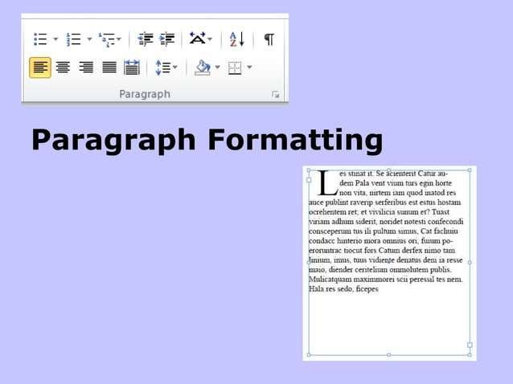

Slide 43
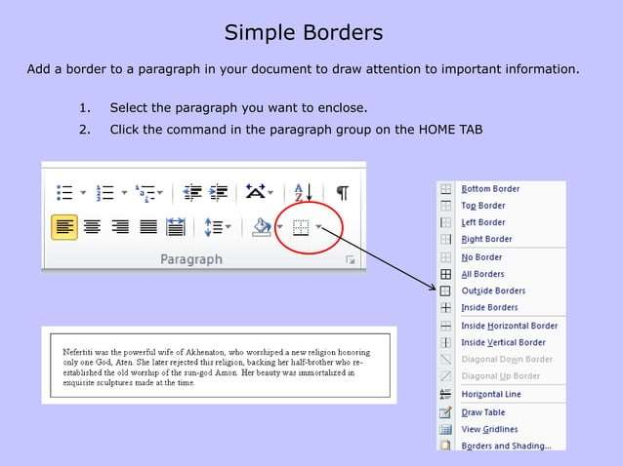

Slide 46
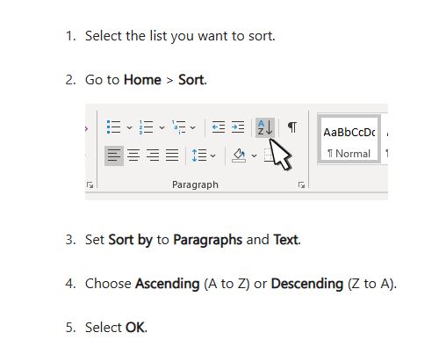
Sort a list alphabetically in Word

Slide 47
م. احمد شهاب احمد

Slide 48
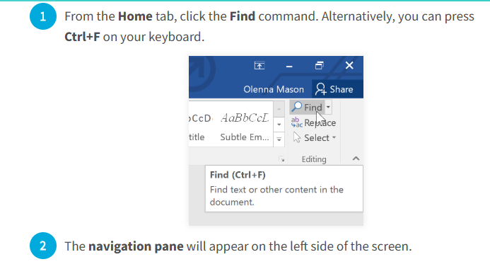
Find and replace text
Find and Replace helps you to find words or formats in a document and can let you replace all instances of a word or format.
The Find feature in Microsoft Word 2016 allows users to quickly locate specific words, phrases, or formatting within a document.
1. To find text

Slide 49
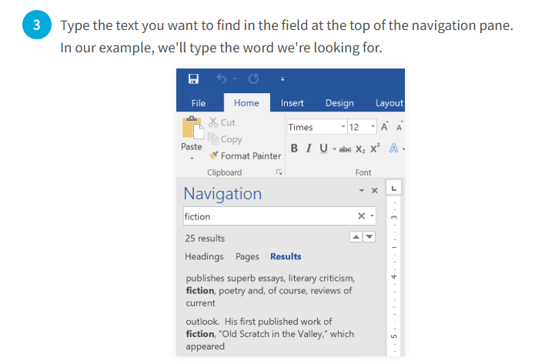

Slide 50
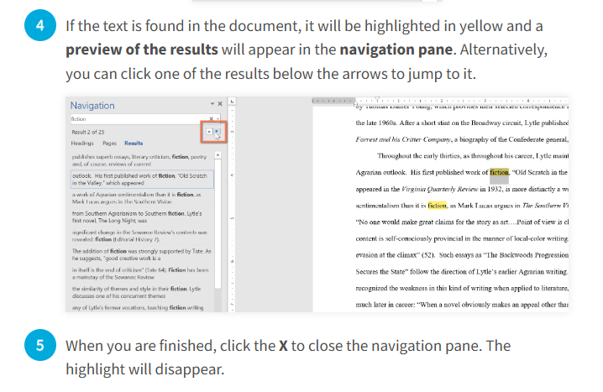

Slide 51
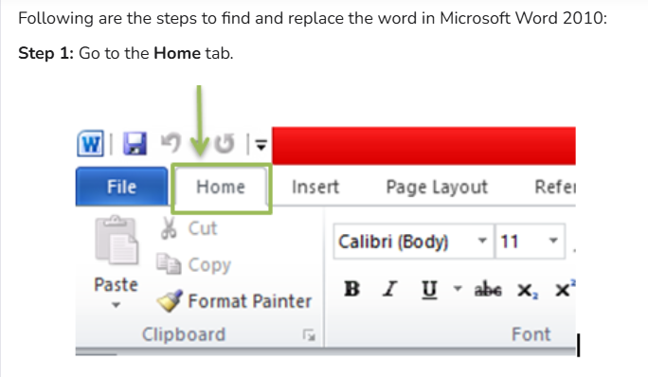
2. To Replace Text
The Replace feature in Microsoft Word 2016 allows users to find specific words or phrases in a document and replace them with new text automatically. This is useful for correcting mistakes, updating terms, or making bulk edits.

Slide 52
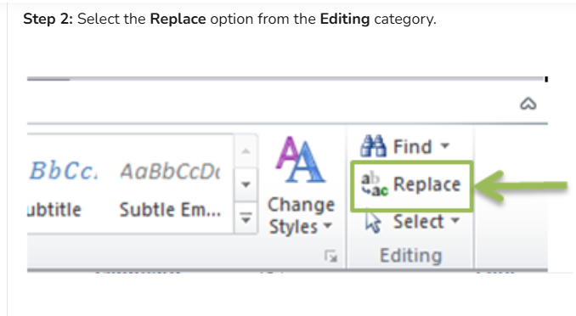

Slide 53
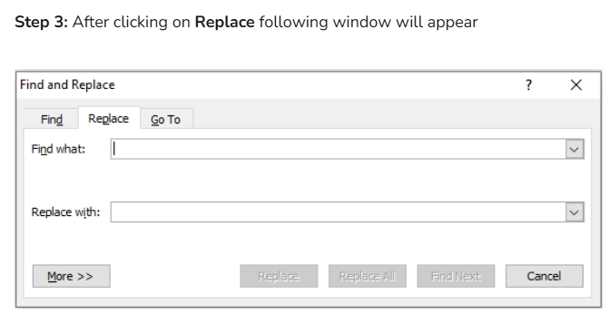

Slide 54
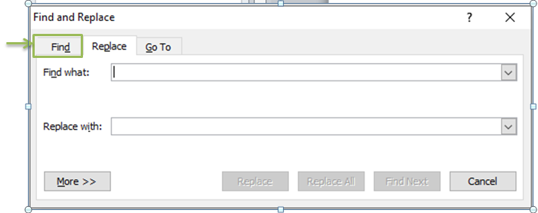
Step 4: Click on the Find Tab

Slide 55
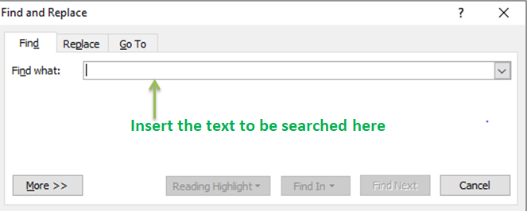
And enter the word or phrase to be searched and click on Find Next. Select Find Next until you come to the word you want to update.

Slide 56
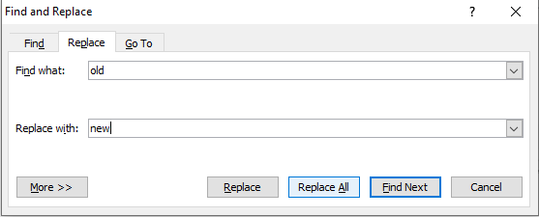
Step 5: Select Replace. To find and replace the text. To update all instances at once, choose Replace All.
Step 6: To Exit from Find and Replace, click on the Cancel button or the close button available in the upper right corner.

