Slide 1
Bioseparation
Assistant Professor Dr. Ahmed Aljanaby محاضرة 3

Slide 2
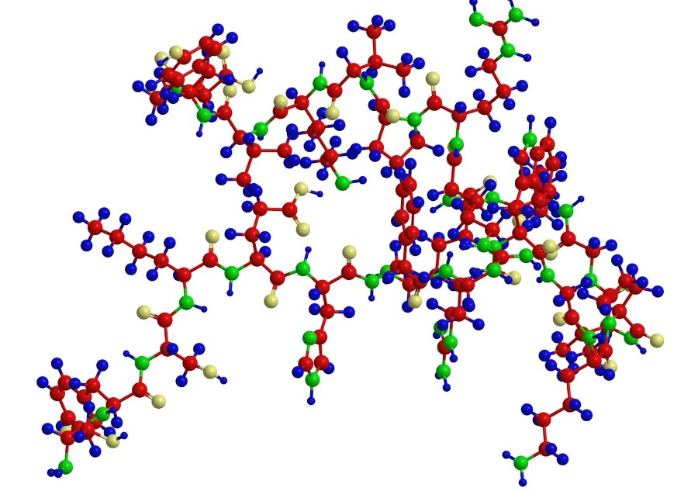
Purification of Proteins
Proteins are polymers composed of hundreds or even thousands of amino acids linked by peptide bonds.
Proteins fall into three basic classes according to shape and solubility:
1. Fibrous Protein – Collagen
2. Globular Protein – Myoglobin
3. Membrane Proteins – Bacteriorhodopsin
Notes:
Boundary الحدود

Slide 3
1. Fibrous Protein
• Regular linear structures
• Play structural roles in the cell (matrix formation)
• Often water Insoluble
Notes:
Clamping لقط
Currents التيارات
Rupturing تمزيق
Disintegration التفكك
Pores مسامات

Slide 4
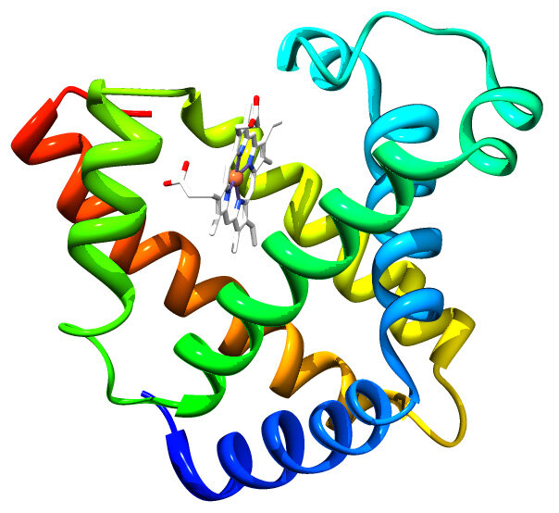
2. Globular Protein
• Roughly spherical in shape
• Often water soluble
• Hydrophobic amino acid side chains present in the interior of the molecule while hydrophilic side chains are outside exposed to the solution

Slide 5
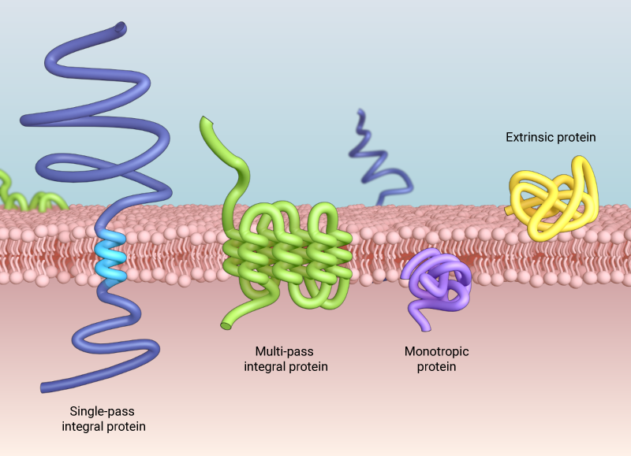
3. Membrane Protein
• Hydrophobic amino acid side chains present outside
• Play role in the cellular transport
• Often water insoluble but soluble in detergents
Notes:
Shear قص
Orifice فتحة
expansion upon discharge التوسع عند الفتحة

Slide 6
Organisation of Proteins
• Primary Structure
• Stabilized by peptide bonds only. E.g.: Each chain of insulin
• Secondary Structure
• α–helix, β-sheet, β-bends, motifs etc.
• Stabilized by covalent (peptide, disulfide) & non-covalent interactions (H-bonding, electrostatic forces, Hydrophobic interactions and Van der wall forces).
• Tertiary Structure
• More complex form of primary structure
• Stabilized by covalent & non-covalent interactions
• Quaternary Structure
• Consist of two or more polypeptides linked to each other by covalent and non-covalent interactions.
Notes:
Validated تم التحقق من ملائمتها

Slide 7
Purification of Proteins
Why we need to purify proteins?
• To identify structure and funtion of the protein of interest.
• To study protein regulation and protein-protein interactions.
• To produce antibodies
• Proteins(enzymes) are used in assays
• Perform structural analysis by X-ray crystallography
Where do we get proteins ?
• Whole organisms
• Organs or tissues
• Embryos
• Tissue culture cells
• Proteins from expression systems ➢Genes cloned into a vector, inserted into a living organism which makes the protein
Notes:
Bead mill مطحنة الحب
Beating الضرب
agitating مهيجة
Collide تصطدم

Slide 8
Steps of Protein Purification
• Step 1. Solubilization of protein
A. Homogenization
B. Centrifugation
C. Filtration
• Step 2. Stabilization of proteins
• Step 3. Isolation of proteins
• Note: Some biological materials themselves constitute a clear or nearly clear protein solution suitable for direct application to chromatography columns after centrifugation or filtration.

Slide 9
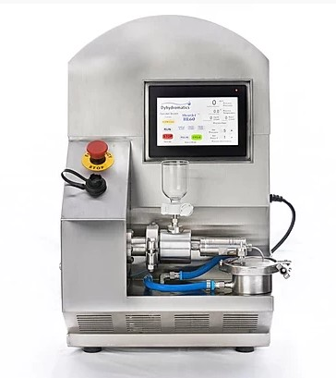
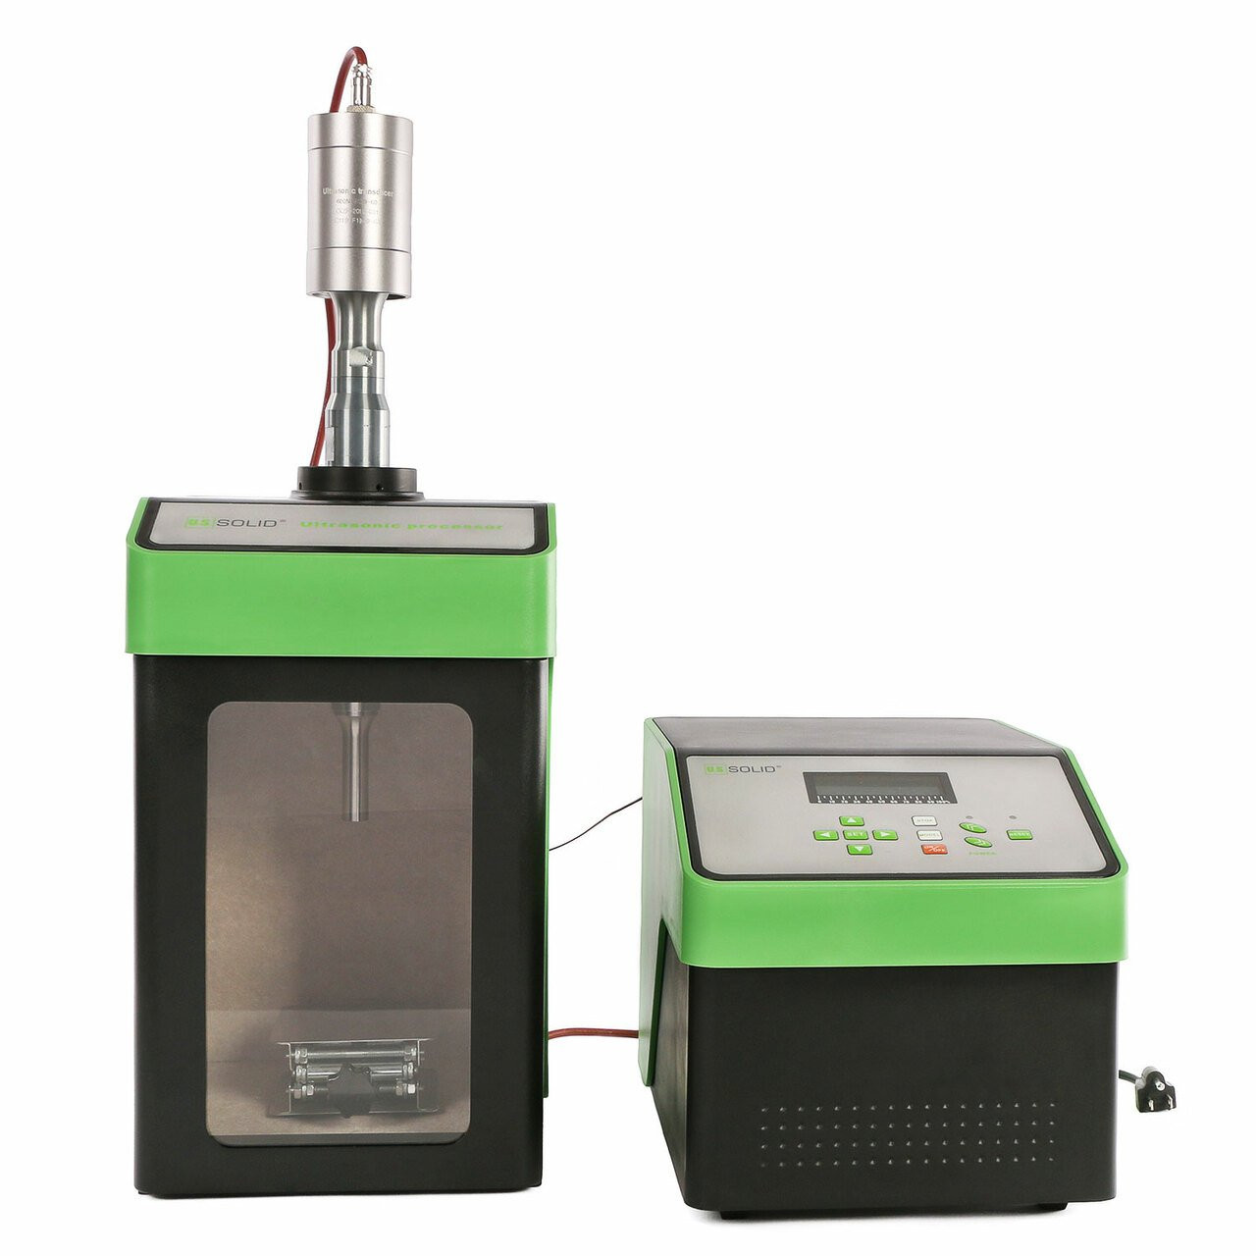
Homogenization
• On the laboratory scale:
✓ Sonication
✓ Enzymatic or chemical cleavage of the cells
✓ Freeze-thawing
• For larger scale:
✓ High pressure homogenization
✓ Bead milling
High-Pressure Homogenizer
Ultrasonic Homogenizer
Notes:
cavitation
التجويف

Slide 10
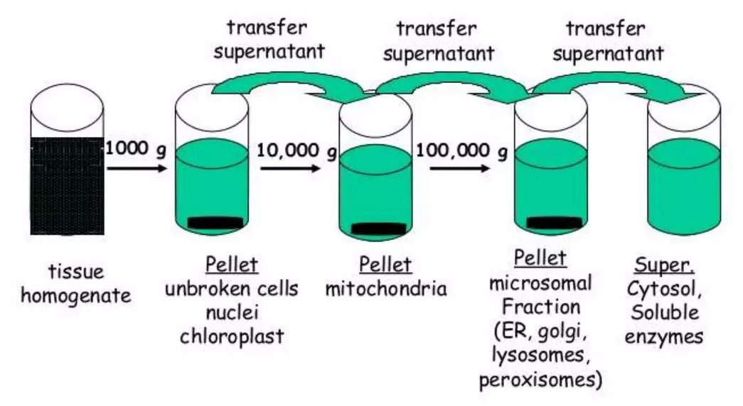
Centrifugation
• Centrifugation is done to isolate the proteins that are components of the membrane or subcellular assembly (For e.g: mitochondrial protein) • Cell lysate is centrifuged at a speed that removes only the cell components denser than the desired organelle.
Notes:
Consuming تستهلك
Collapse ينهار

Slide 11
Stabilization of Proteins
• Care must be taken to preserve protein structure and function after it is removed from its natural environment where it was stable.
• pH – To prevent denaturation or loss of function, proteins are placed in buffered solutions at or near their native pH.
• Temperature – Protein purification is normally carried at low temperature ~ 0°C. while some proteins are thermally stable at high temperatures.
• Inhibition of proteases
• Retardation of microbes that can destroy proteins
➢ Sodium azide is often used.
Notes:
Propagates ينتشر

Slide 12
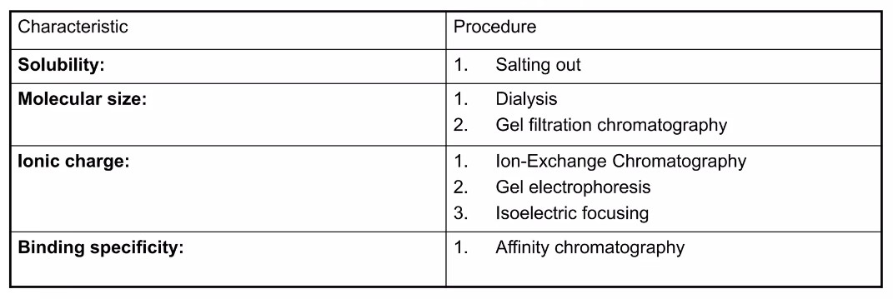
Step 3 – Isolation of Proteins
Method of isolation of proteins differs from one protein to other.
• Proteins can be isolated on the basis of following properties:
Notes:
Permeable قابل للنفاذ منه
swells up تتضخم
subsequently bursts تنفجر لاحقا
Fragile قابل للكسر
Periplasmic المحيط بالبلازما

Slide 13
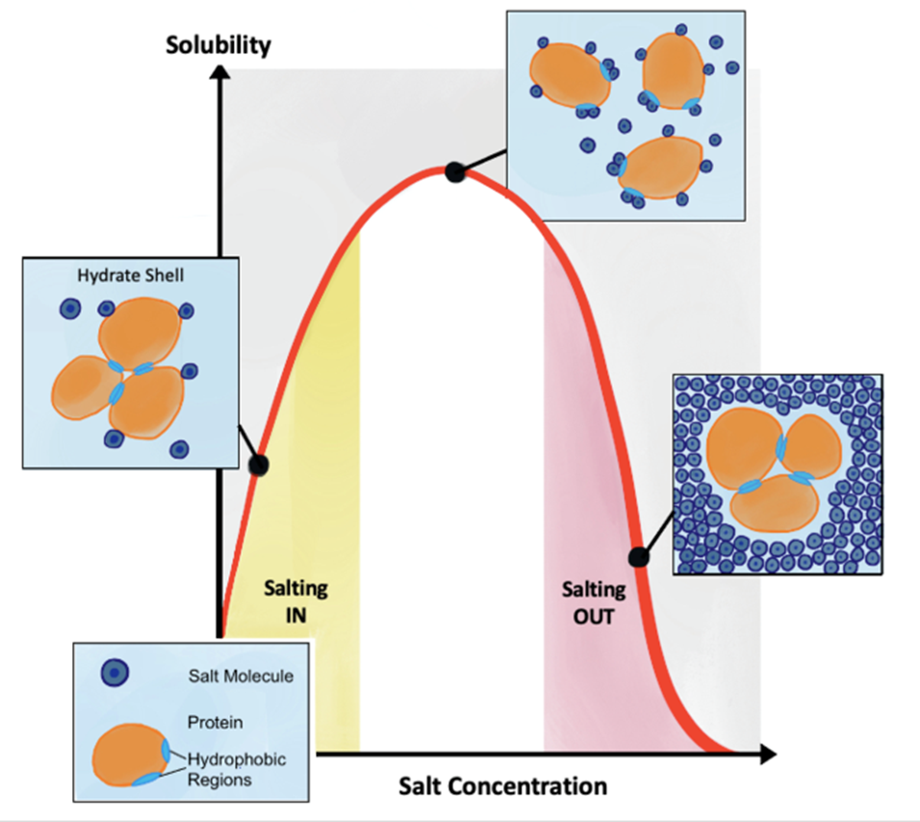
Solubility
• Salting-In: Most globular proteins tend to become increasingly soluble as the ionic strength is raised due to the addition of salt. This phenomenon is known as salting- in of proteins.
• Salting-out: As the salt concentration increases, this lead to diminishment of electrostatic attraction between protein molecules by the presence of abundant salt ions. This phenomenon is known as salting-out of proteins.
• The salt concentration at which protein precipitates differs from one protein to another.
• Salting out is one of the most commonly used protein purification procedures.
• Ammonium sulfate is the most commonly used reagent - High solubility (3.9 M in water at 0 ºC) - High ionic strength solution can be made (up to 23.5 in water at 0 ºC)
The principle of salting-in and salting-out techniques, based on increasing salt concentration.
Notes:
Rupture تمزق

Slide 14
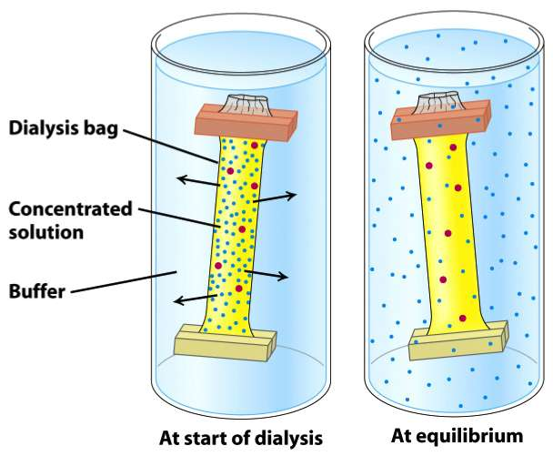
Molecular Size
Dialysis
• Proteins can be separated from small molecules such as salt by dialysis through a semipermeable membrane such as cellulose membrane with pores.
• Protein mixture is placed inside the dialysis bag which is then submerged in buffer solution.
• Molecules having dimensions significantly greater than the pore diameter are retained inside the dialysis bag.
• Smaller molecules and ions capable of passing through the pores of the membrane diffuse down their concentration gradient and emerge in the solution outside the bag.

Slide 15
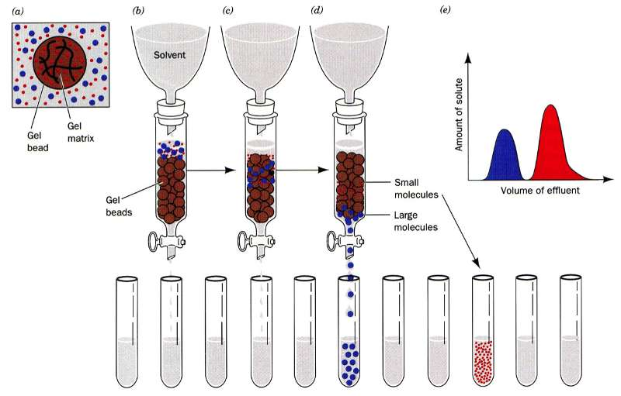
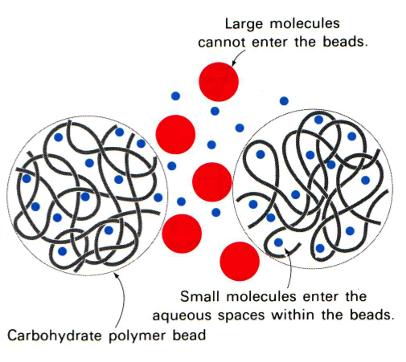
Molecular Size
Gel-filtration Chromatography
• Also Known as molecular exclusion chromatography.
• Stationary Phase: Porous beads. Eg: Sephadex, Sepharose etc
• Mobile Phase: Buffer Eg: Tetrahydrofuran, Choloform, Dimethyl formamide

Slide 16
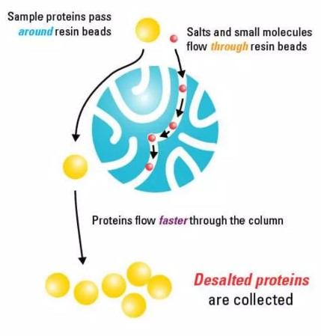
The beads are made of an insoluble but highly hydrated polymer such as dextran or agarose or polyacrylamide.
• Sample is applied at the top of the column consisting of porous beads in the buffer.
• Small molecules of the sample can enter these beads but large ones cannot.
• Small molecules are distributed inside the beads and between them whereas large molecules are located only in the solution between the beads.
• Large molecules flow more rapidly through this column while small molecules take a longer, tortuous path, will exit last.

Slide 17
Ionic Charge
Ion-exchange chromatography
•Stationary phase: Ion-exchangers
• Mobile phase: Buffers of variable concentrations
• Principle: Ion-exchange chromatography relies on the attraction between oppositely charged ion-exchangers and analyte (protein sample).
• Ion-exchangers: Carboxymethyl (CM) group (cation-exchanger) Diethylaminoethyl (DEAE) group (anion-exchanger)

