Slide 1
Bioseparation
Assistant Professor Dr. Ahmed Aljanaby محاضرة 2

Slide 2
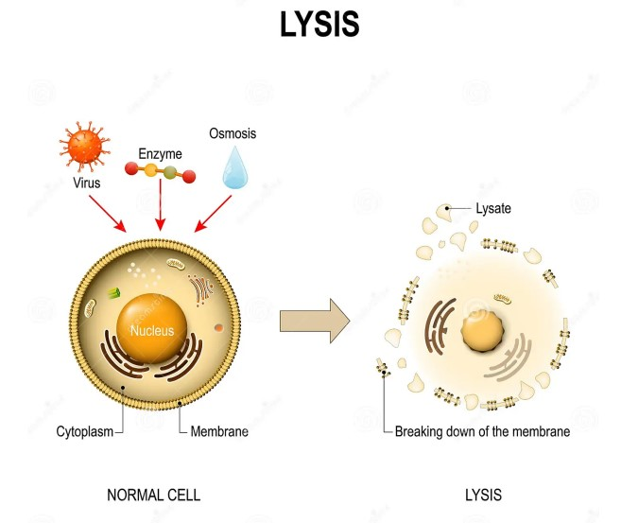
Cell lysis
Cell lysis or cellular disruption
is a method in which the outer boundary or cell membrane is broken down or destroyed in order to release inter-cellular materials such as DNA, RNA, protein or organelles from a cell.
Cell lysis is an important unit operation for molecular diagnostics of pathogens, immunoassays for point of care diagnostics, down streaming processes such as protein purification for studying protein function and structure, cancer diagnostics, drug screening, mRNA transcriptome determination and analysis of the composition of specific proteins, lipids, and nucleic acids individually or as complexes.
Notes:
Boundary الحدود

Slide 3
Bioseparation
Based on the application, cell lysis can be classified as complete or partial.
Partial cell lysis is performed in techniques such as patch clamping, which is used for drug testing and studying intracellular ionic currents.
In this technique, a glass micropipette is inserted into the cell, rupturing the cell membrane partially.
Complete cell lysis is the full disintegration of cell membrane for analyzing DNA, RNA and subcellular components
Notes:
Clamping لقط
Currents التيارات
Rupturing تمزيق
Disintegration التفكك
Pores مسامات

Slide 4
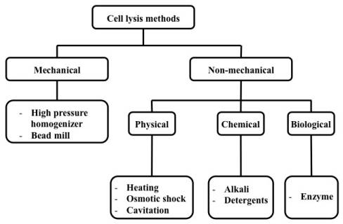
Classification of Cell Lysis Methods
A number of methods have been established to lyse cells in the macro and micro scale and these methods can be categorized mainly as mechanical and non-mechanical techniques.

Slide 5
Mechanical Lysis
In mechanical lysis, cell membrane is physically broken down by using shear force. This method is the most popular and is available commercially because of a combination of high throughput and higher lysing efficiency.
High Pressure Homogenizer (HPH) is one of the most widely used equipment for large scale microbial disruption. In this method, cells in media are forced through an orifice valve using high pressure. Disruption of the membrane occurs due to high shear force at the orifice when the cell is subjected to compression while entering the orifice and expansion upon discharge
However, generation of heat is a problem in this method. Cooling systems can be used to minimize the heat generated. researchers reported the degradation of some enzymes during homogenization due to the high pressure.
A combination of lysis methods, for example chemical treatment along with homogenization, has shown better results.
Notes:
Shear قص
Orifice فتحة
expansion upon discharge التوسع عند الفتحة

Slide 6
Example of a high pressure homogenizer system
Notes:
Validated تم التحقق من ملائمتها

Slide 7
Mechanical Lysis
Bead mill, also known as bead beating method, is a widely used laboratory scale mechanical cell lysis method.
The cells are disrupted by agitating tiny beads made of glass, steel or ceramic which are mixed along with the cell suspension at high speeds. The beads collide with the cells breaking open the cell membrane and releasing the intracellular components by shear force.
This process is influenced by many parameters such as bead diameter and density, cell concentration and speed of agitator.
Smaller beads with a range of 0.25–0.5 mm are more effective and recommended for lysis. Using this technique, several kinds of cells can be lysed for example yeast and bacteria.
Cell membrane can become totally disintegrated by this method confirming that the intracellular molecules are released. Thus, the efficiency of this method of lysing cells is very high.
Notes:
Bead mill مطحنة الحب
Beating الضرب
agitating مهيجة
Collide تصطدم

Slide 8
Complete disintegration produces small cell debris and thereby separation and purification of sample becomes harder.
In addition, heat generation occurs in this process due to the collision between beads and cells. This elevated heat may degrade proteins and RNA.
However, problems such as heating of sample volume, degradation of cellular products, cell debris and higher cost limit the use of this method.

Slide 9
Non-Mechanical Lysis
Non-mechanical lysis can be categorized into three main groups, namely physical, chemical and biological, where each group is further classified based on the specific techniques and methods used for lysis.
Physical disruption is a non-contact method which utilize external force to rupture the cell membrane. The different forces include heat, pressure and sound energy.
They can be classified as:
1- thermal lysis
2- cavitation
3- osmotic shock.
Notes:
cavitation
التجويف

Slide 10
Non-Mechanical Lysis
Thermal Lysis
Cell lysis can be conducted by repeated freezing and thawing cycles. This causes formation of ice on the cell membrane which helps in breaking down the cell membrane. This method is time consuming and cannot be used for extracting cellular components sensitive to temperature.
However, heating for a long period may damage the DNA. This method is expensive and so it is not widely used for macroscale industrial applications.
Cavitation is a technique which is used for the formation and subsequent rupture of cavities or bubbles. These cavities can be formed by reducing the local pressure which can be done by increasing the velocity, ultrasonic vibration, etc. Subsequently, reduction of pressure causes the collapse of the cavity or bubble.
Notes:
Consuming تستهلك
Collapse ينهار

Slide 11
Non-Mechanical Lysis
During the collapse of a bubble, a large amount of mechanical energy is released in the form of a shockwave that propagates through the media. Since this shock wave has high energy, it has been used to disintegrate the cell membrane. Ultrasonic and hydrodynamic methods have been used for generating cavitation used to disrupt cells.
This technique also produces very small cell debris which might be a problem for subsequent processes. In addition, large amount of heat is generated which needs to be dissipated. Enzymes that come out from cell after Ultrasonic Cavitation have also been reported to be degraded
Notes:
Propagates ينتشر

Slide 12
Non-Mechanical Lysis
Osmotic Shock
When the concentration of salt surrounding a cell is suddenly changed such that there is a concentration difference between the inside and outside of the cell, the cell membrane becomes permeable to water due to osmosis.
If the concentration of salt is lower in the surrounding solution, water enters the cell and the cell swells up and subsequently bursts. This technique is suitable for mammalian cell due to the fragile structure of membrane; however, periplasmic proteins may be released in the case of gram-negative bacteria
Chemical Cell Disruption
Chemical lysis methods use lysis buffers to disrupt the cell membrane.
Lysis buffers break the cell membrane by changing the pH.
Notes:
Permeable قابل للنفاذ منه
swells up تتضخم
subsequently bursts تنفجر لاحقا
Fragile قابل للكسر
Periplasmic المحيط بالبلازما

Slide 13
Non-Mechanical Lysis
Detergents can also be added to cell lysis buffers to solubilize the membrane proteins and to rupture the cell membrane to release its contents.
Chemical lysis can be classified as alkaline lysis and detergent lysis.
In alkaline lysis, OH⁻ ions are the main component used for lysing cell membrane. The lysis buffer consists of sodium hydroxide and sodium dodecyl sulphate (SDS).
The OH⁻ ion reacts with the cell membrane and breaks the fatty acid-glycerol ester bonds and subsequently makes the cell membrane permeable and the SDS solubilizes the proteins and the membrane.
The pH range of 11.5–12.5 is preferable for cell lysis. Although this method is suitable for all kinds of cells, this process is very slow and takes about 6 to 12 h. This method is mostly used for isolating plasmid DNA from bacteria
Notes:
Rupture تمزق

Slide 14
Non-Mechanical Lysis
Detergent Lysis
Detergents also called surfactants have an ability to disrupt the hydrophobic-hydrophilic interactions. Since the cell membrane is a bi-lipid layer made of both hydrophobic and hydrophilic molecules, detergents can be used to disintegrate them.
Detergents are capable of disrupting the lipid–lipid, lipid–protein and protein-protein interactions. Based on their charge carrying capacity, they can be divided into cationic, anionic and non-ionic detergents.
Detergents are most widely used for lysing mammalian cells.
For lysing bacterial cells, first the cell wall has to be broken down in order to access the cell membrane. Detergents are often used along with lysozymes for lysing bacteria (e.g., yeast).

Slide 15
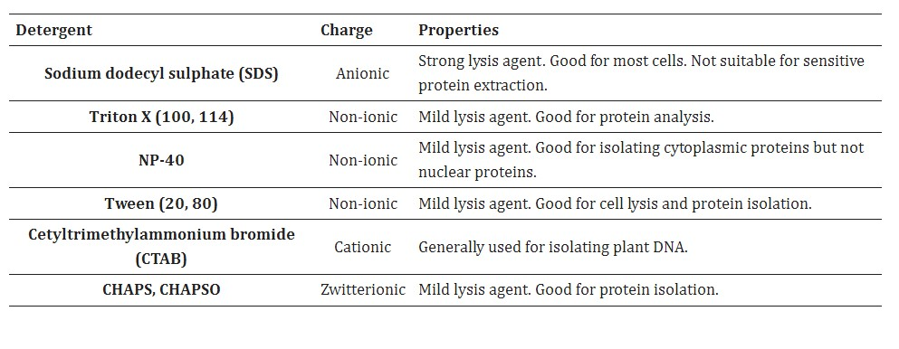
Non-Mechanical Lysis
Ionic detergent such as SDS is widely used for lysing cells because of its high affinity to bind to proteins and denature them quickly. It is used in gel electrophoresis and western blotting techniques. The hydrophilic part of an anionic detergent is mostly a sulphate or carboxylic group whereas for cationic detergent it is ammonium group.

Slide 16
Non-Mechanical Lysis
Enzymatic lysis is a biological cell lysis method in which enzymes such as lysozyme, lysostaphin, zymolase, cellulose, protease or glycanase are used. Most of these enzymes are available commercially and can be used for large scale lysis.
One advantage of enzymatic lysis is its specificity. For example, lysozymes are used for bacterial cell lysis whereas chitinase can be used for yeast cell lysis and pectinases are used for plant cell lysis.

