Slide 1
علم الطحالب العملي
المختبر الاول
المرحلة الثانية

Slide 2
Algae
The algae: it is a collective term for all those chlorophyll-bearing organisms, stoneworts, seaweeds and the like collectively known as the algae.
All are chlorophyll-bearing plants with a plant body showing no differentiation into true tissue. It never form true roots, stems and leaves and thus called a thallus.
The presence of algae in the environment
1- 1. Aquatic habitats
2. Terretrial habitats :(algae grow well in moist & well aerated soils )

Slide 3
Aquatic habitats:
Forms of algae which occur as floating or submerged in water bodies.
A- Benthic algae
(Benthic algae that grows on clay) 1- Epipelic
      To thesand) (Benthic algae that grows attached 2- Eoizamic
3- Epiphytic (Benthic algae that grow attached to plants and other algae)
4- Epizoic (Benthic algae that grows on the bodies of some animals)
5- Epilithic (Benthic algae that grows attached to rocks)
6- Endozoic (Algae that inside the bodies of some animals
7- Endophytic (Algae growing inside the plant)
B-Phytoplanktons :are free-floating (Volvox, Scenedesmus.)

Slide 4
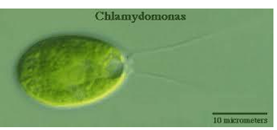
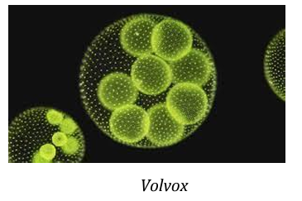
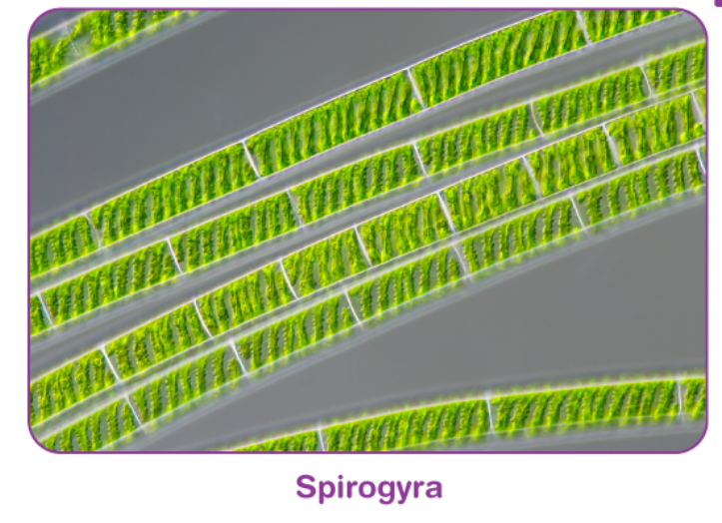
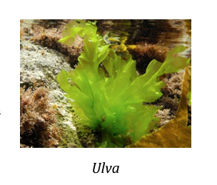
Shapes of algae
1- unicellular
2- Multicellular form
3- Filamentous form
4- Siphoneous form
5- paranchymatous form

Slide 5
Shapes of plastides in algae
        ex Chlamydomonas 1- cup shape
      ex Elodea 2- Discoid
      ex Zygnema 3- Stellate
  ex Ulothrix 4- Band
  ex Sprogyria 5- Spirall
  ex Cladophora 6- Reticulate

Slide 6
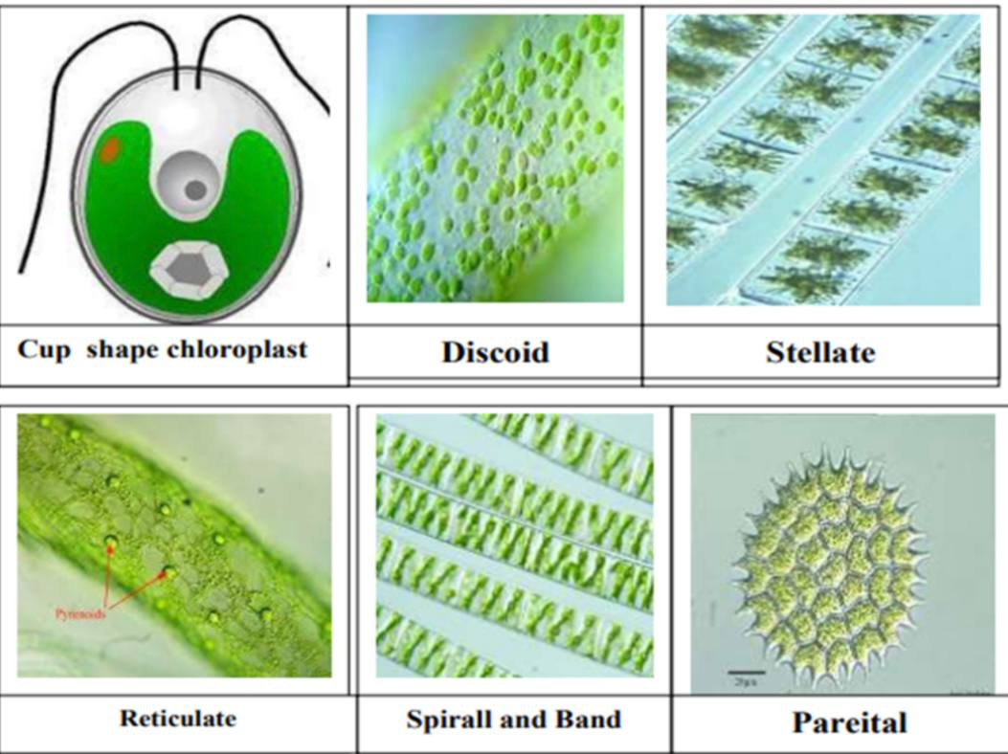

Slide 7
Classification of Algal
a) Pigment of the cell.
b) Chemical nature of stored food material.
c) Kind, number and relative length of the flagella on the motile cell.
d) Chemical composition of cell wall.
shape of chloroplast(e
e) Presence or absence of nucleus in the cell.

Slide 8
Benefits of Algae
They are the base of the aquatic food chain – photosynthetic organisms
Algae and algae extracts are used in many food and medical industries, including:
Used in the production of dietary supplements for humans
Baby food
Important food for many people, such as astronauts
Beauty products and cosmetics
Biofuels
Poultry and bird feed
Fish feed
Production of vitamins, medicines, and antibiotics, as well as in medical nanotechnology applications, most notably as drug delivery systems
Production of fertilizers and agricultural growth enhancers
Production of pesticides and harmful insect repellents

Slide 9
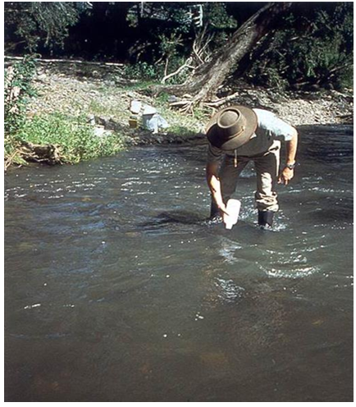
Collection of algae samples
Collecting samples directly from a stream or river:
Macroalgae and the attached microalgae can be collected by hand or with a knife,
including part or all of the substrate (rock, plant, wood etc.) if possible.
by simply scooping a jar through the water

Slide 10
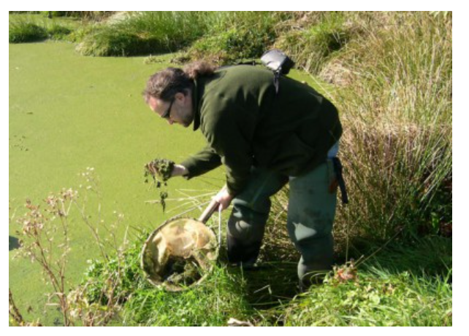
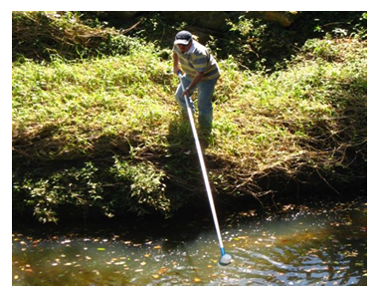
Microscopic floating algae (the phytoplankton) can be collected with a mesh net (e.g. with 25-30 m pores)

Slide 11
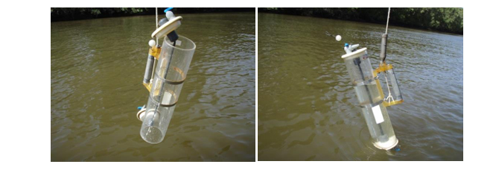
Collecting samples from depth water
Collecting samples using a depth sampler Samples can be collected at discrete depths using a sampler such as a Van Dorn sampler (Figure 4)

Slide 12
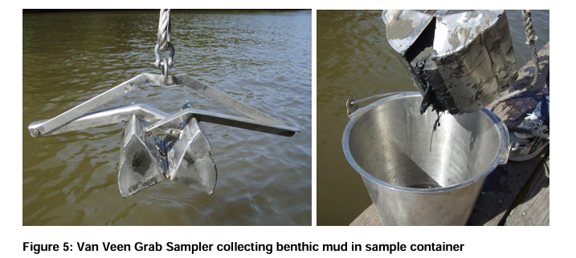
Collecting samples from bottom of lakes
Collecting samples from deep water Benthic algae samples in deep water sites using a benthic sampler such as a Eckman grab sampler.

