Slide 1
Division: Chlorophyta
Class: Chlorophyceae
1- Order: Ulotricales
Family: Ulotricaceae
Genus: Ulothrix
2- order: Cladophorales
Family: Cladophoraceae
Genus: Cladophora
3- order: Zygnematales
Family: Zygnemataceae
Genus: Zygnema , Genus: Spirogyra
4- Order: Oedogoniales
Family: Oedogoniaceae
Genus: Oedogonium

Slide 2
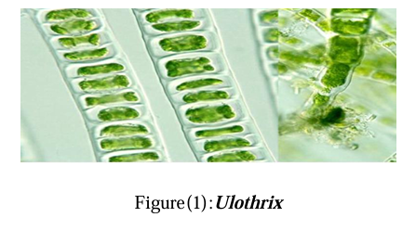
Order: Ulotricales
Genus: Ulothrix
filamentous alga (un-branched)
epiphytic alga installed itself on aquatic plants or objects through hold fast structure in the thread base
girdle shape chloroplast

Slide 3
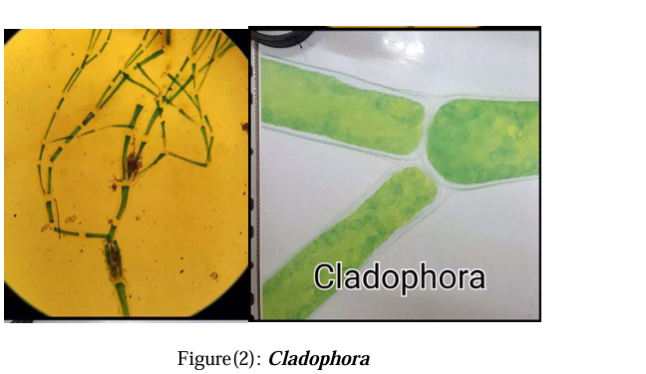
Order: cladophorales
Genus: Cladophora
Branched filamentous alga (true-branching)
Multinucleate cells having reticulate-shape chloroplast

Slide 4
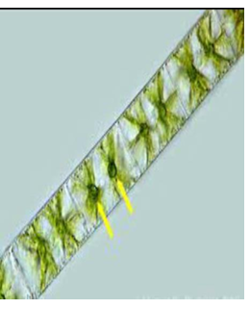
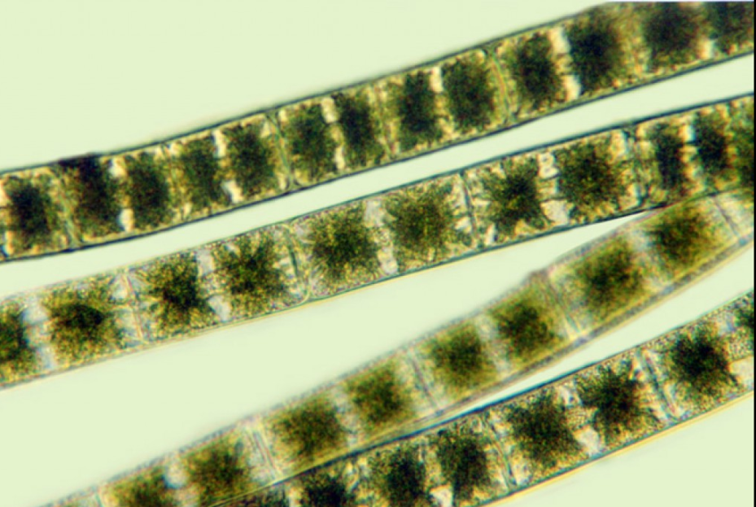
Family: zygnemataceae
Genus: Zygnema
filamentous un-branched algae
charecterized with double stellate chloroplast

Slide 5
Spirogyra
an unbranched filamentous .
Chloroplasts are ribbon-shaped and arranged spirally.
Chloroplast contains many pyrenoids.
reproduce sexually by two type of conjugation:
a-scalariform conjugation: take place between two parallel adjacent
algal filaments. male gametes are transferred to adjacent thread by
(conjugation canal) to fertilize ovum and forming zygote.
b-lateral conjugation: take place between two adjacent cells within
the same filament

Slide 6
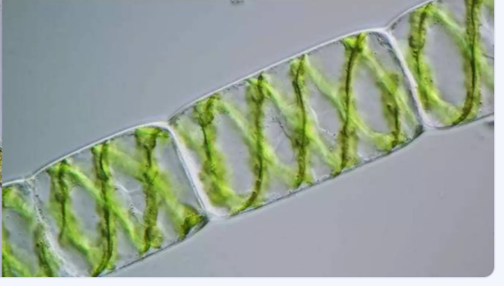
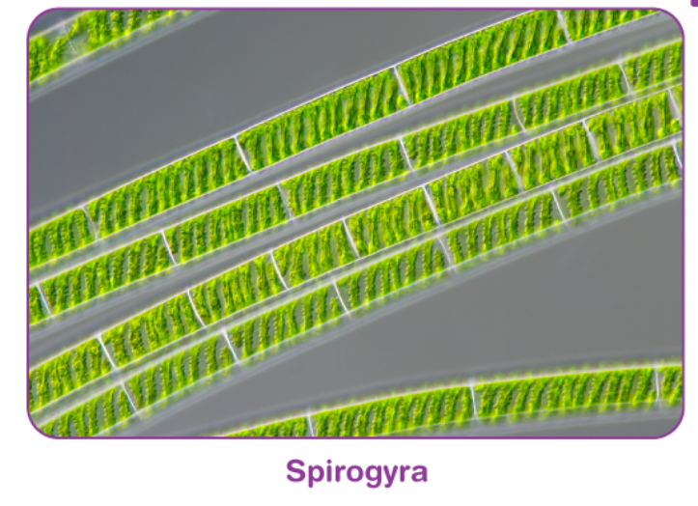

Slide 7
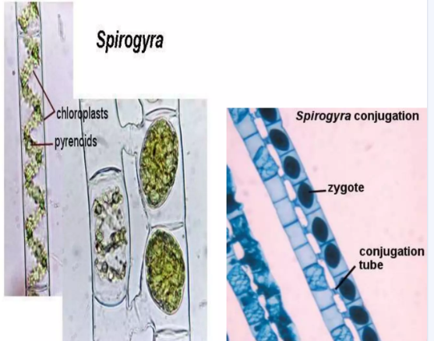
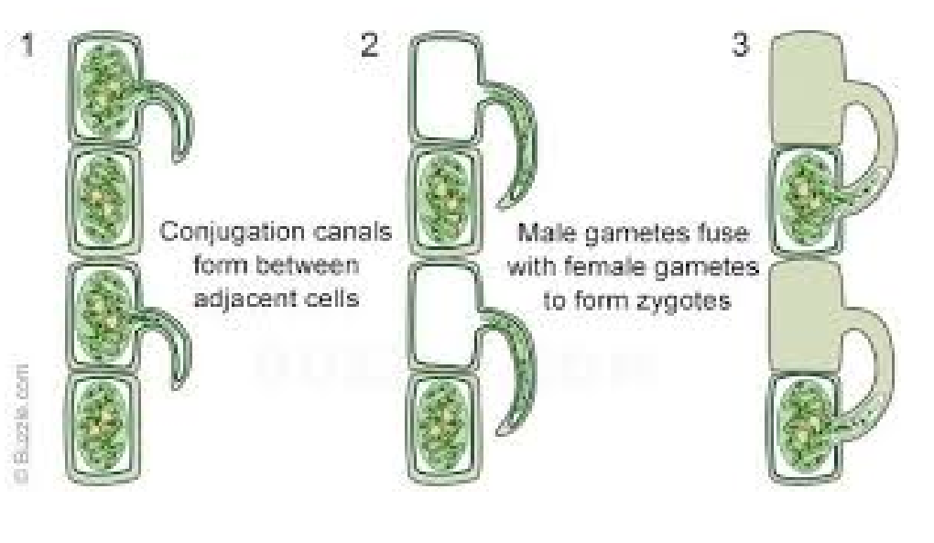
Spirogyra Reproduction
a-scalariform conjugation
b-lateral conjugation

Slide 8
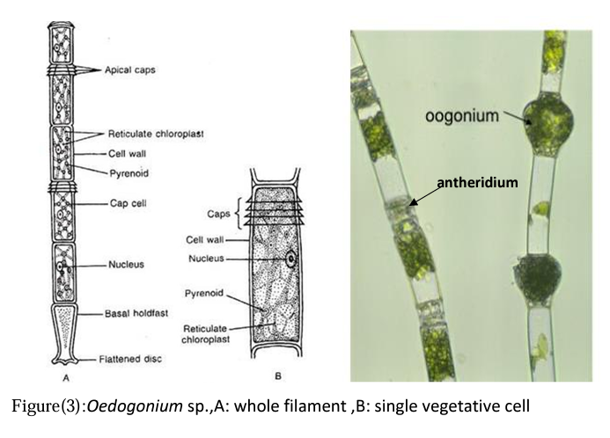
Oedogonium
It is a common freshwater filamentous green unbranched alga and is found attached with the different substrates like stones, wood, leaves of aquatic plants, with the help of basal holdfast .
Reproduction:
A. Vegetative reproduction
B. Asexual reproduction takes place by formation of multiflagellate zoospores. Zoospore formation usually occurs in cap cell(Most of the cells at distal end possess annular striations at the apical end).

Slide 9
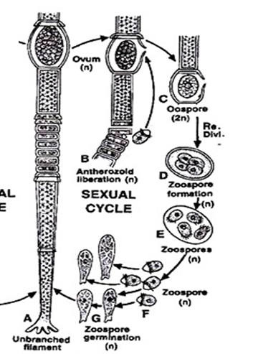
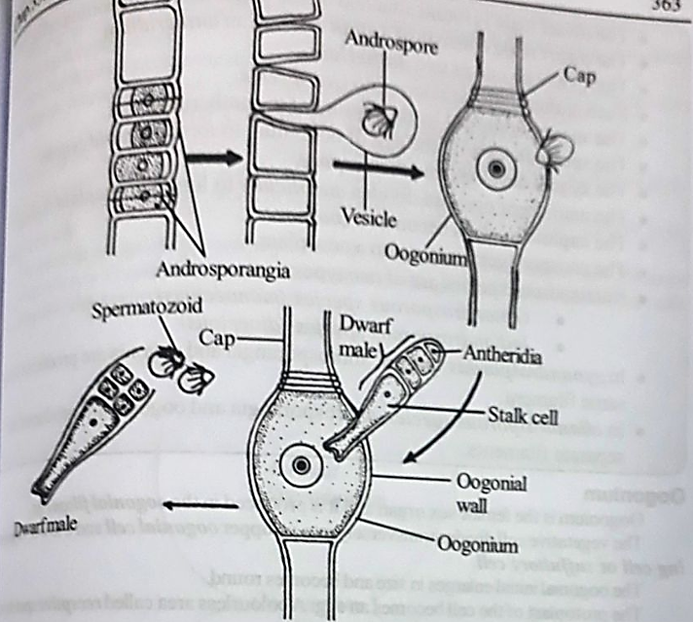
C. Sexual reproduction is oogamous type:
(i) macrandrous type with antheridia produced on normal filament
(ii) nannandrous type in which antheridia are produced on dwarf male filament
i
ii

Slide 10
