Slide 1
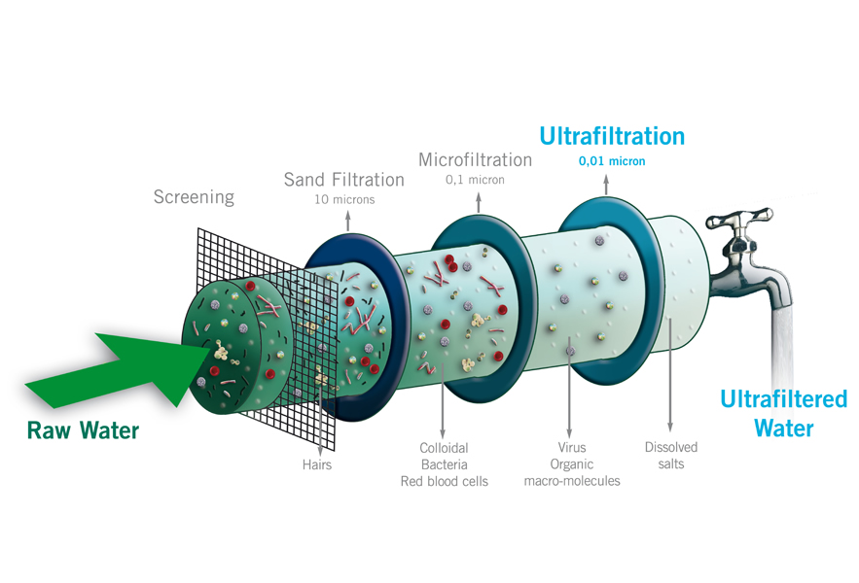
Clarification and Filtration

Slide 2
Introduction
Filtration is a separation process in which a solid-liquid mixture called the feed (or the suspension) is forced through a porous medium on which the solids are deposited or in which they are entrapped.
The porous medium which allows the liquid to go through while retaining the solids is called the filter.
The retained solid is called "the residue" or "the cake".
The clarified liquid is called "the effluent" or the "filtrate".
Filtration can be broadly classified into three categories according to the purpose of it: (see Fig. 1).

Slide 3
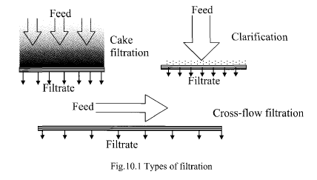
Fig1- type of filtrations

Slide 4
If recovery of solids from high solid content slurry is desired, the process is called cake filtration.
The term clarification is applied when the solid content in the feed does not exceed 1 %.
In a clarification process the filtrate is the primary product.
The third type of filtration is called cross-flow filtration in which the liquid flows parallel to the filtration medium
Cross-flow filtration ( ultrafiltration) is separation of intermicellar liquid from solids by use of pressure on semipermeable membrane.
sterilization is the method of choice for seperation of micoorganisms from solution which is physically and chemically unstable under heating condition.

Slide 5
Application of solid/liquid filtration
1- Improvement of the appearance of solutions, mouth washes, etc.....
2- Removal of potential irritants, e.g. from eye drop preparations or solutions applied to mucous membranes.
3- Recovery of desired solid material from suspension or slurry ,e.g. to obtain drug after crystallization process.
4- Certain operations, such as the extraction of vegetable drugs with a solvent, may yield a turbid product with a small quantity fine suspended colloidal matter; this can be removed by filtration.
5- Detection of microorganisms present in liquids, This can be achieved by analyzing a suitable filter on which the bacteria are retained .This method can also be used to assess the efficiency of preservatives.

Slide 6
Mechanism of filtration:
Based on the mechanisms by which solids are retained by a filter .we have these type of filteration :
  Surface filtration: The particles are retained by a screening action and held on the external surface of the filter. The mechanisms are straining and impingement
  The particles are not allowed to enter the filtration medium.
- Depth filtration: Particles are allowed to penetrate pores and pore networks present in the filtration medium to point where diameter of solid particle is greater than the diameter of tortuous void or channel. The solids are retained by physical restriction or by adsorption properties of the medium.

Slide 7
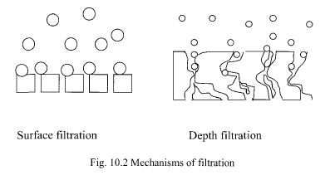
Fig 2- Mechanisms of filtration

Slide 8
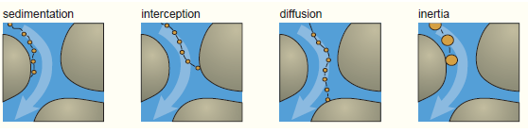
In depth Filtration, the mechanisms are:
Diffusion deposition
Direct interception
Inertial deposition
Electrostatic deposition
Gravitational deposition

Slide 9
Theory of filtration
The mathematical model for flow through porous medium , cake filtration and granular bed filtration may differ, but all follow this basic rule. The energy lost in filtration is proportional to the rate of flow per unit area.
rate = driving force/ resistance
The rate can express by “ Poiseuilles equation”
dV = A P
dT µ( αW/A + R)
V= volume of filtrate . T= time , A = filter area
P= total pressure drop through cake and filter medium,
µ= viscosity of filtrate , α= average specific cake resistance
W= weight of dry cake , R= resistance of filter medium

Slide 10
Rate of Filtration:
the object of the operation is to filter the slurry as quickly as possible.
The Previous equation can be simplified by another equation which summarized the factors affecting rate of filtration is known as Darcy”s law and may be expressed as:
dV / dt = K A P / u l
where
V= volume of filtrate, t = time of filtration , K = constant for the filter medium and filter cake , A = area of filter medium , P = pressure drop across the filter medium and filter cake , u = viscosity of the filtrate , and l = thickness of cake.
k is proportional constant depend on porosity and specific area of particles.
Factors affecting rate of filtration :
1- Permeability coefficient: The constant (K) represents the resistance of both the filter medium and the filter cake. As the thickness of the cake increase, the rate of filtration will decrease. Also the surface area of the particles .the porosity of the cake, and rigidity or compressibility of the particles could affect the permeability of the cake.

Slide 11
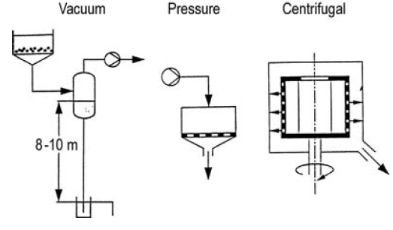
2 - Pressure drop; The rate of filtration is proportional to the pressure difference across both the filter medium and filter cake.
The pressure drop can be achieved in a number of ways:
  Gravity: A pressure difference could be obtained by maintaining a head of slurry above the filter medium. The pressure developed will depend on the density of the slurry.
  Vacuum: The pressure below the filter medium may be reduced below atmospheric pressure by connecting the filtrate receiver to a vacuum pump and creating a pressure difference across the filter.
  Pressure: The simplest method being to pump the slurry into the filter under pressure.
  Centrifugal force: The gravitational force could be replaced by centrifugal force in particle separation,
Fig- driving force in filtration.

Slide 12
  3- Area of filter medium: The total volume of filtrate flowing from the filter will be proportional to the area of the filter. The area can be increased by using larger filters. In the rotary drum filter, the continuous removal of the filter cake will give an infinite area for filtration.
4- Viscosity of filtrate:
It would be expect that an increase in the viscosity of the filtrate will increase the resistance of flow , so that the rate of filtration is inversely proportional to the viscosity of the fluid.
5- Thickness of filter cake;
The rate of flow of the filtrate through the filter cake is inversely proportional to thickness of the cake.
(area of filter) x (pressure difference)
rate of filtration=
( viscosity) x ( resistance of cake and filter)

Slide 13
Filter Media
The surface upon which solids are deposited in a filter is called the “Filter medium”
Properties of ideal filter medium:
1- It must be capable of delivering a clear filtrate at a suitable production rate.
2- It must withstand the mechanical stresses without rupturing or being compressed.
3- No chemical or physical interactions with the components of the filtrate should occur.
4- It must retain the solids without plugging at the start of filtration.
5- Sterile filtration imposes a special requirement since the pore size must not exceed the dimension of bacteria or spores.

Slide 14
Classification of filter media
1- Woven filters: these include a- natural. Cotton, b- synthetic, nylon.
Cotton is a common filter ,however, Nylon is superior for pharmaceutical use, since it is unaffected by mold, fungus or bacteria and has negligible absorption properties .
Both cotton and nylon are suitable for coarse straining in aseptic filteration.
Monofilament nylon cloth : strong , opening as small 10 micron
Teflon superior for most liquid filteration
Wire screening e.g. stainless steel is durable, resistance to plugging and easily cleaned
2- Non- woven filters:
Felt are fibrous mass, give high flow rate with low pressure drop, function as depth media and recommended where gelatinous solution or fine particulate matter are involve
Bonded fabrics are not found wide acceptance in production of dosage forms

Slide 15
Kraft paper is pharmaceutical standard. Although limited use in plate and frame filter , and horizontal filter
it offers controlled porosity, limited absorption characteristic, and low cost.
white paper preferred, can crinkled to produce large surface area.
A support of cloth or wire mesh is required in large filter pass to prevent rupture of paper with pressure.
Porous stainless steel filter use in clarification. For example milk, syrup, sulfuric acid and hot caustic soda . Easy clean and repeatedly sterilized
3-Membrane filters: These are basic tools for micro-filtration and ultrafiltration, useful in the preparation of sterile solutions.
These filters are made by casting of various esters of cellulose, or from nylon, Teflon, polyvinyl chloride. Polyamide , polysulfone or silver
The filter is a thin membrane with millions of pores per square centimeter of filter surface.

Slide 16
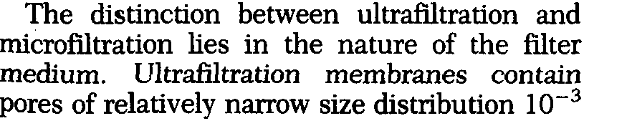
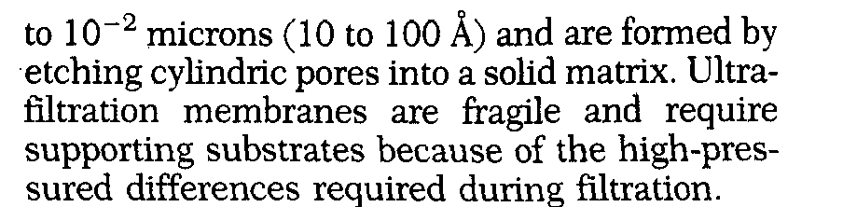

Slide 17
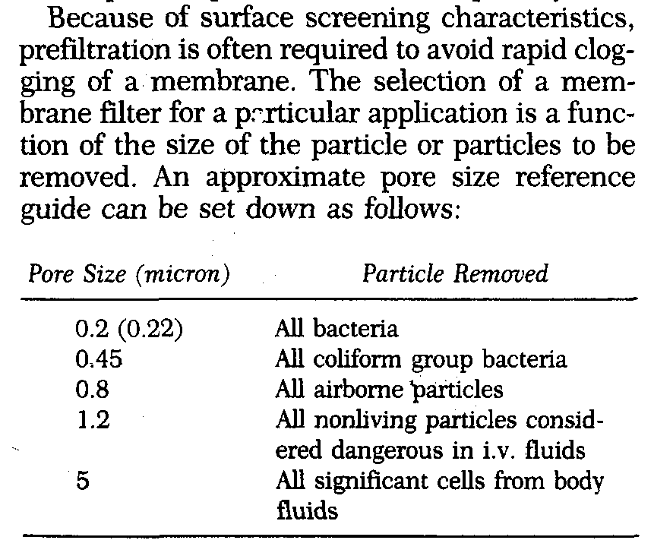

Slide 18
4- Cartilage unit: economic and convenient when used to remove small percent of solids range in particle size 100 - ˂ 0.2 micron
It may be surface or depth filter and consist of porous medium integral with plastic or metal structural hardware.
synthetic and natural fibers, cellulose ester and fiber glass, fluorinated HC polymers, nylon, and ceramic are employed for manufacture of disposable cartilages.
Porous materials for cleanable and reusable cartilages use stainless steel, monel, ceramic , fluorinated HC polymers and exotic metals

Slide 19
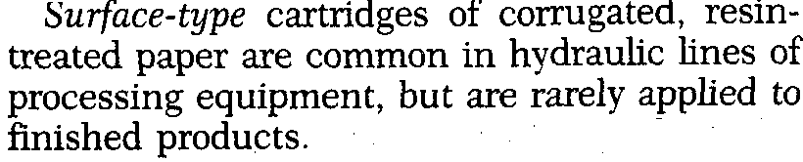
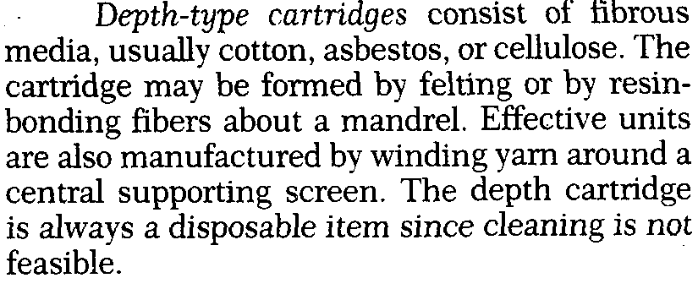

Slide 20
Filter medium
Commonly used filter media are:
  - Filter paper
- Woven material (e.g. cheese cloth, woven polymer fiber,
woven glass fiber)
- Non-woven fiber pads
- Sintered and perforated glass
  - Sintered and perforated metal
  - Ceramics
  - Synthetic membranes

Slide 21
Filter Aid
Usually, the resistance to flow due to the filter medium itself is very low, but will increase as a layer of solids builds up , blocking the pores of the medium and forming a solid cake.
The object of the filter aid is to prevent the medium from becoming blocked and to form an open, porous cake, so reducing the resistance to flow of the filtrate.
The important characteristics for filter aids are:
It should have a structure that permits formation of previous cake
It should have a particle size distribution suitable for retention of solids
It should remain suspended in liquid
it should be free from impurities and should be inert to liquid being filtered
The particles of filter aids must be inert, insoluble, incompressible, and irregular shaped.
Types of filter aids are: a) fine filter aids “ mean size range 4-6 microns”
b) coarse filter aids “ mean size range 20-40 microns”

Slide 22
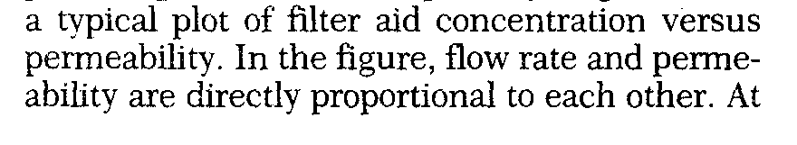
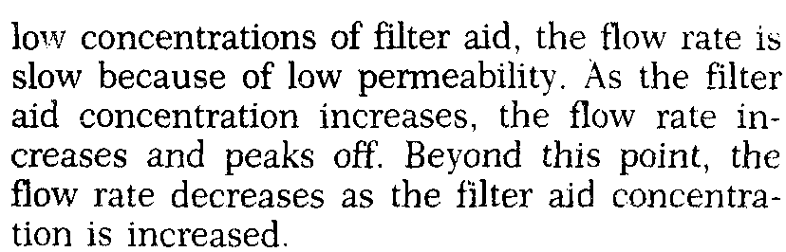

Slide 23
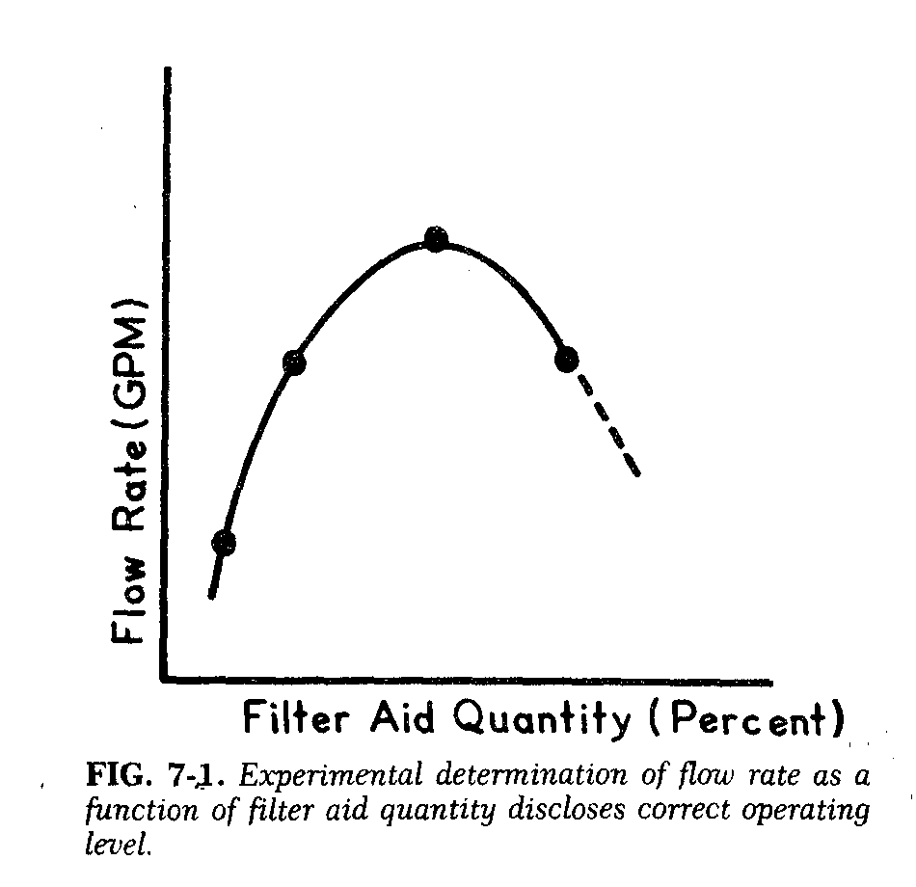

Slide 24
Filter aids may be used in either or both two ways:
1-Pre- coating technique:
by forming a pre-coat over the filter medium by filtering a suspension of the filter aid .
2-Body- mix technique:
A small proportion of the filter aid (0.1-0.5 %) is added to the slurry to be filtered. This slurry is recirculated through the filter until a clear filtrate is obtained, filtration then proceeds to completion.
The following filter aids may be used:
Diatomite ( diatomaceous earth ) , obtained from natural siliceous deposites.
Perlite , it is an aluminium silicate.
Cellulose
Asbestos
Non- activated charcoal

Slide 25
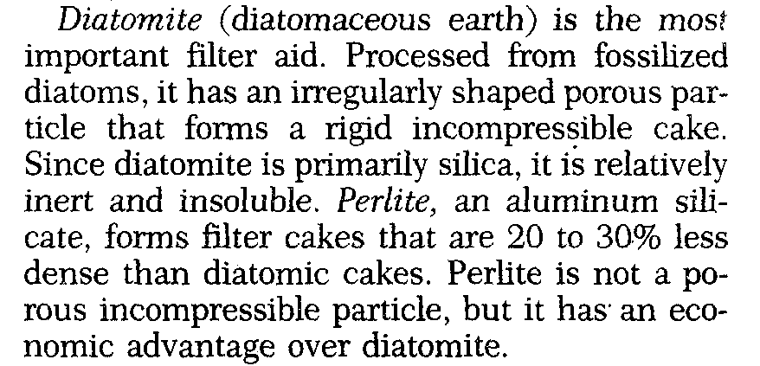

Slide 26
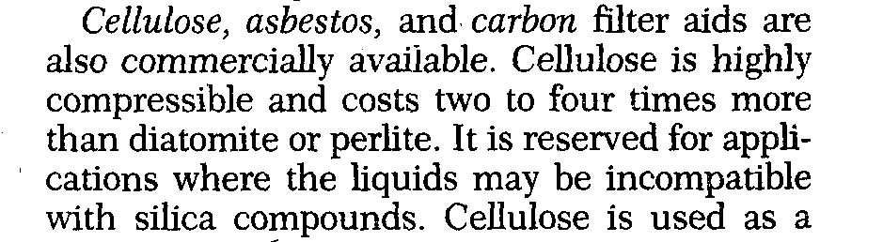


Slide 27
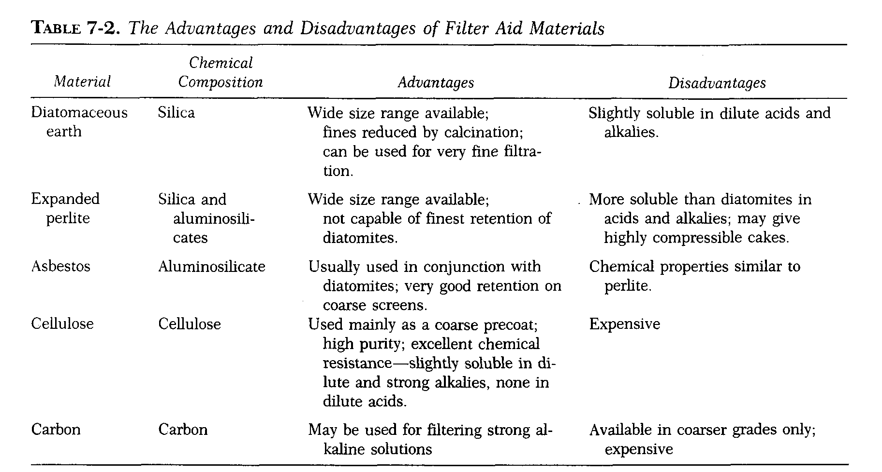

Slide 28
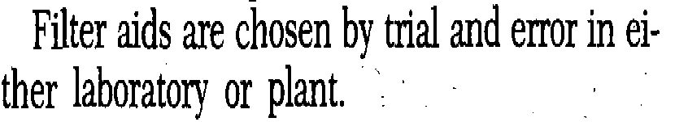
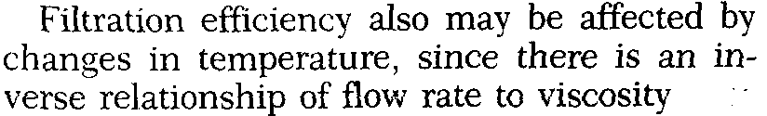

Slide 29
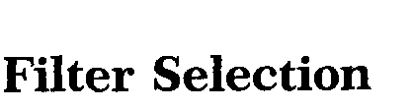
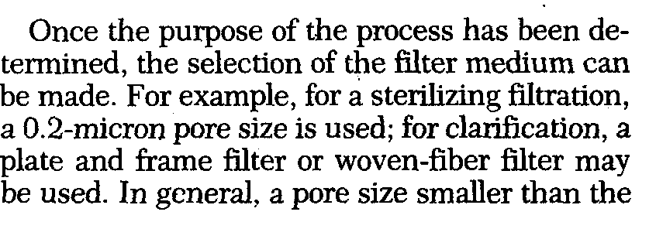
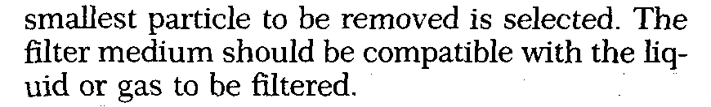

Slide 30

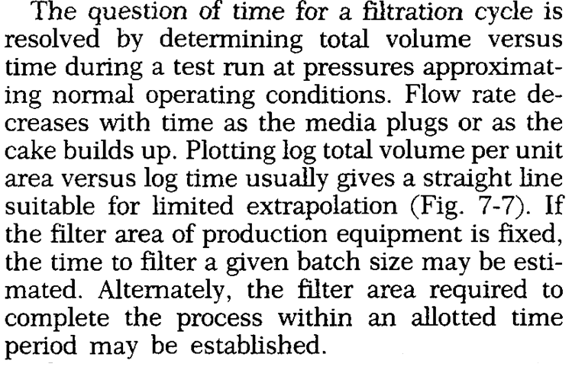

Slide 31
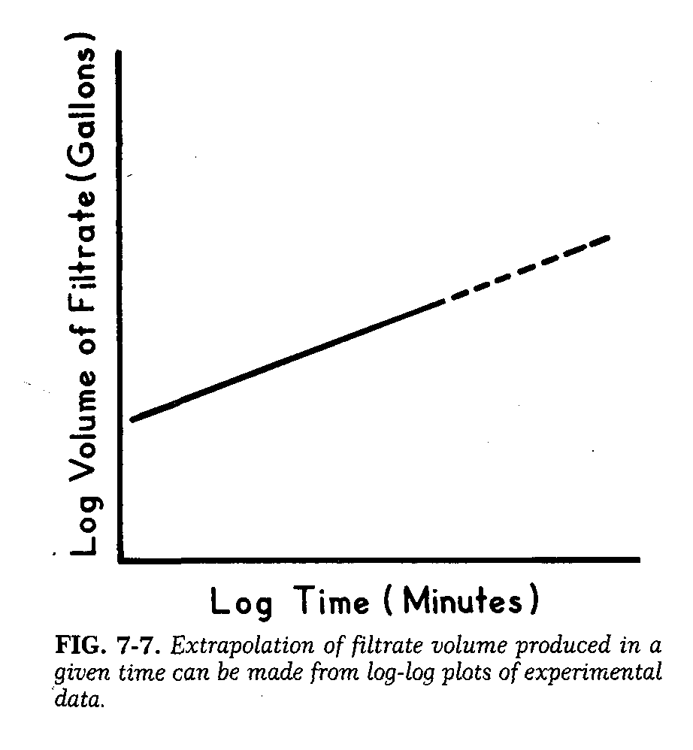

Slide 32
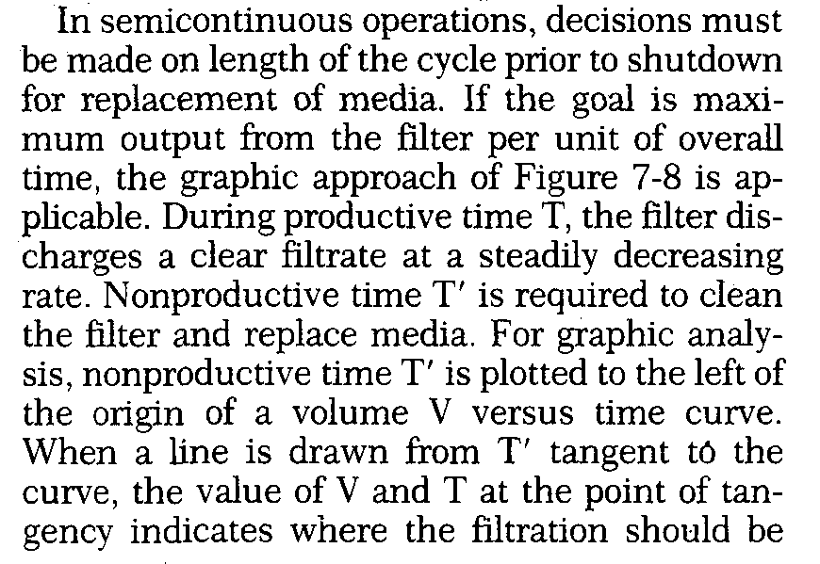

Slide 33
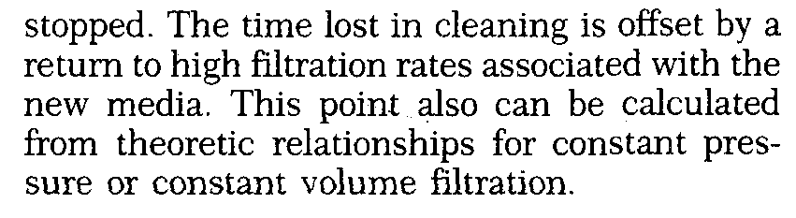

Slide 34
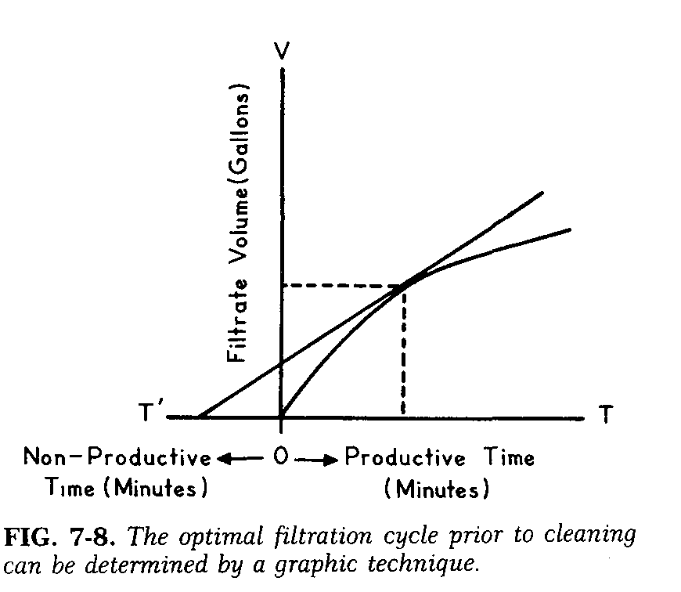

Slide 35

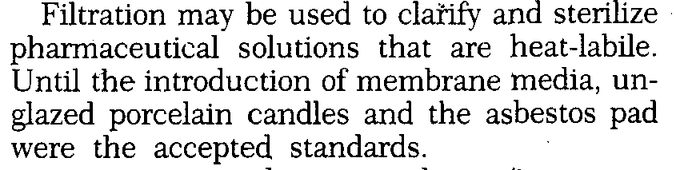

Slide 36
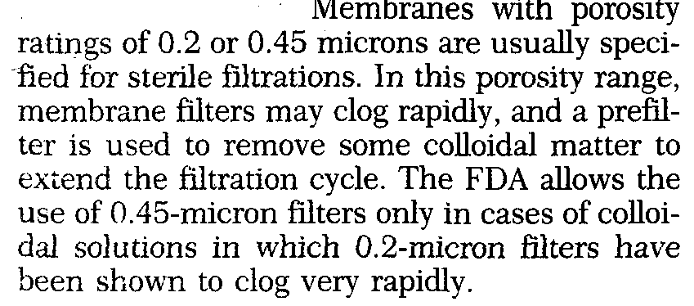

Slide 37
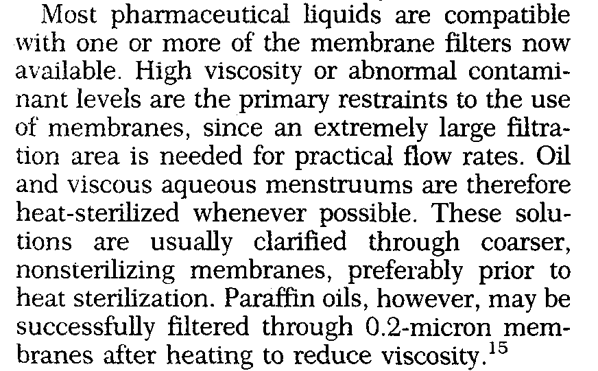

Slide 38
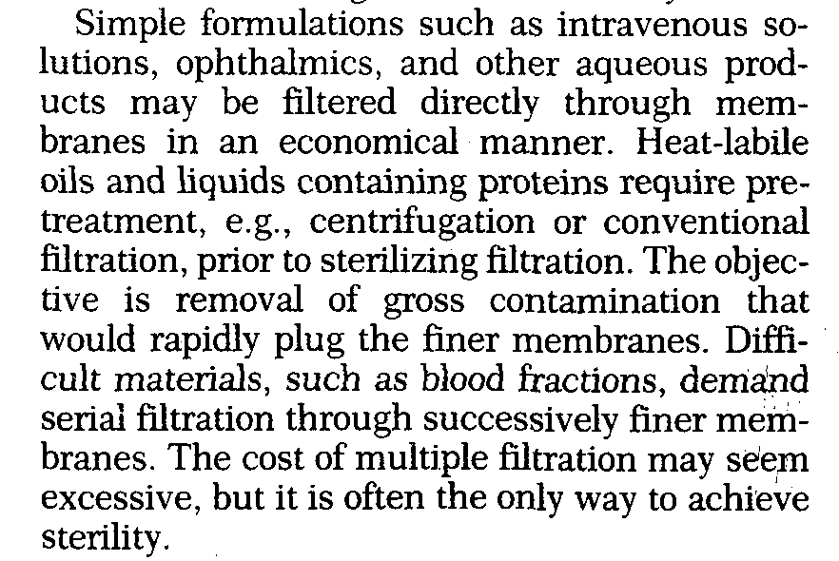

Slide 39
Filter evaluations & testing
Integrity testing: Integrity testing sterilizing filters is fundamental requirement of critical process filtration applications in the pharmaceutical industry.
Two classifications of integrity testing are destructive and nondestructive. There are three types of non-destructive testing which are available to show that the system has no leaks and is correctly assembled. These are referred to as the bubble point test, the diffusion test, and the forward flow test .

Slide 40
What is Membrane Integrity?
Integral Membrane
Non-Integral Membrane
Contaminants
larger than
pores upstream
Contaminants
larger than expected
pores upstream
No downstream
contamination
Downstream
contamination
Notes:
Idealized look at bubble point. On the left the integral membrane pores a filled with liquid which is held there by capillary forces. This liquid and these forces present a barrier to air flow. On the right, the air pressure has exceeded the capillary forces of the largest pore, air flows freely through the pore, and can be seen downstream. Remember that this is an "idealized" model.

Slide 41
Bubble point test: The bubble point is a direct measure of the largest pore in the filter. The membrane or cartridge is first wetted and has aliquid above(liquid is held inside the channel by surface tension) and agas below.Since the pors are full of liquids,there will be no passage of gas at zero pressure.(The minimum pressure required to force the liquid outside the capillary shoud be sufficient to over come the surface tension). There is still no passage of gas if pressure is increased slightly.When the bubble point pressure is reached,asmall bubble forms at the largest opening .As the pressure is further increased ,rapid bubbling begins to occure.Bubble point pressure for agiven membrane is different for different liquids.

Slide 42
Diffusion test: This test is usually recommended for multicartridge or other systems with high filtration areas. When pressure is applied to a wetted membrane filter, air dissolves in the liquid, diffuses through the film, and is released on the low pressure side in the form of bubbles in an inverted burette.

Slide 43
What is Pressure Hold/Bubble Point?
Water Wet
Integral Membrane
Water Wet
Non-Integral Membrane
Air pressure
upstream
greater than specification
Air pressure
upstream
less than specification
psi
psi
Water in pores is a
barrier to gas flow:
No gas flow observed
downstream until upstream pressure exceeds critical value
Gas will flow through
large opening and is
easily observed downstream
Notes:
Idealized look at bubble point. On the left the integral membrane pores a filled with liquid which is held there by capillary forces. This liquid and these forces present a barrier to air flow. On the right, the air pressure has exceeded the capillary forces of the largest pore, air flows freely through the pore, and can be seen downstream. Remember that this is an "idealized" model.

Slide 44
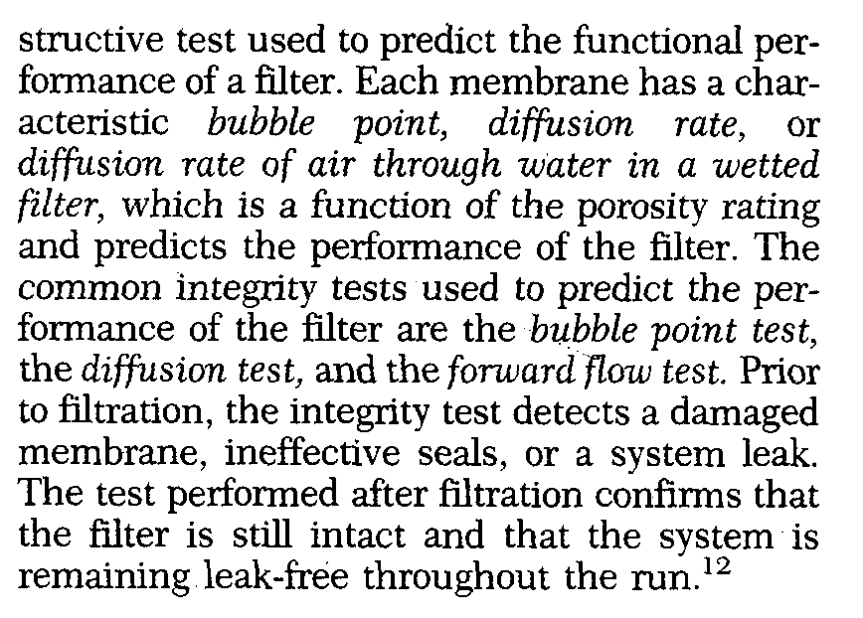
Forward flow test :
Is based upon measurement of the diffusion rate of air flow through water in a wetted filter at a pressure below the bubble point pressure.
The forward flow test is done before , during and after

Slide 45
Filtration Equipments
Commercial equipments are classified according to:
Driving force:
gravity, pressure , vacuum and centrifugal
Method of operating :
batch and continuous
End product desired:
filtrate and cake solid

Slide 46
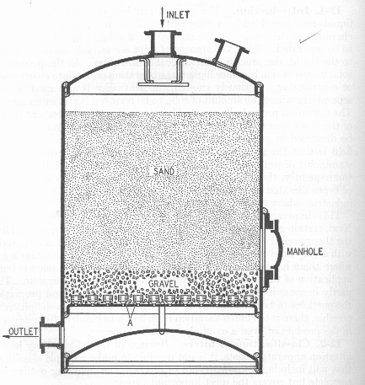
Filtration Equipment and systems
- gravity filters:
Employing thick granular beds
are widely used in water
filtration prior to distilation or deionization e.g. e.g: Sand Filter
gravity bag filters is applied to concentration
of magmas, such as milk of magnesia
- vacuum filters:
Are employed on alarge scale ,but rarley used for collection of crystalline precipitates or for sterile filtration.
Continuous drum filter system , it is a cheap method and we can collect large quantity in a short time.

Slide 47
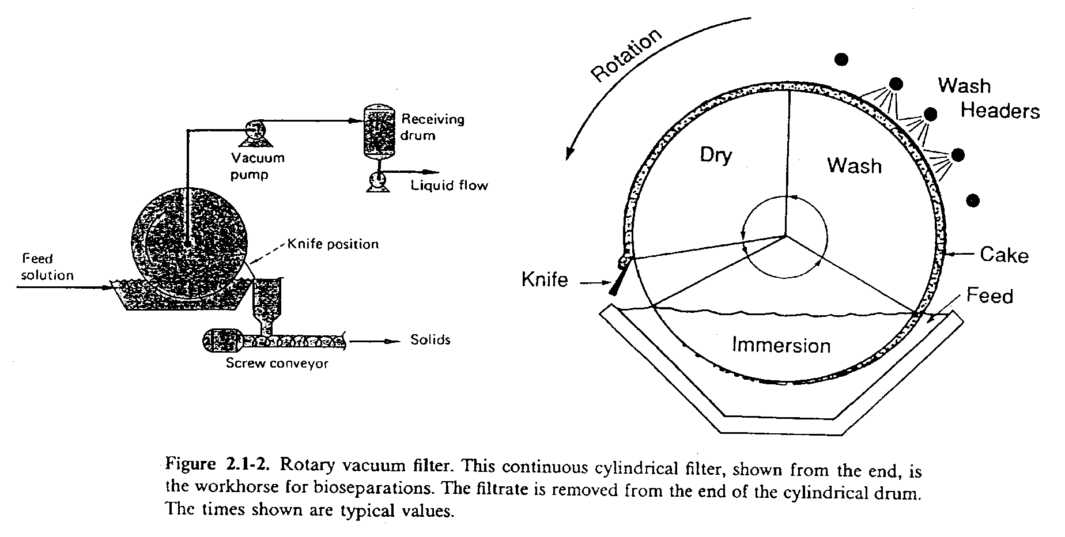
Rotary Vacuum Filter:
* Rotate at a low speed during the operation.
* Pressure inside the drum is a partial vacuum.
 Liquid is sucked through the filter cloth and solids are retained on the surface of the drum.

Slide 48
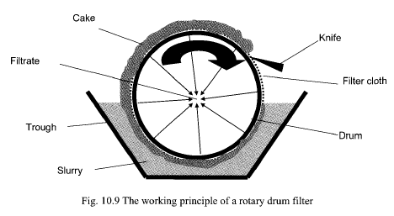
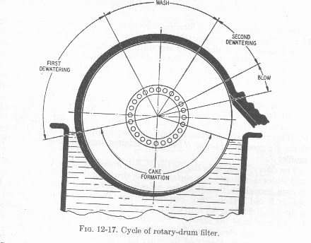
Rotary vacuum filter (Rotary filter)
The drum is dipped into the slurry and vacuum applied to the outlet, which is connected to the filtrate receiver. When the cake has formed, the cake drained or partially dried by vacuum.
The drum is sprayed with water to wash the cake. Retaining the vacuum connection drains the cake and produces partial dryness then, removed by a knife.
When the solids of the slurry are too much that the filter cloth becomes blocked with the particles, a pre-coat filter may be used. A pre-coat of filter aid is deposited on the drum prior to the filtration process.
Uses:
1- The rotary filter for continuous operation on large quantities of slurry.
2- Suitable for slurry contains considerable amounts of solids in the range 15-30%.

Slide 49
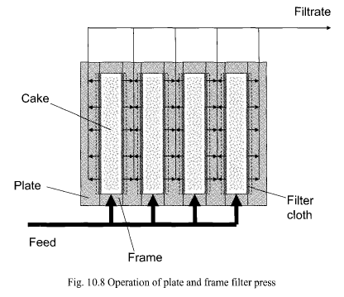
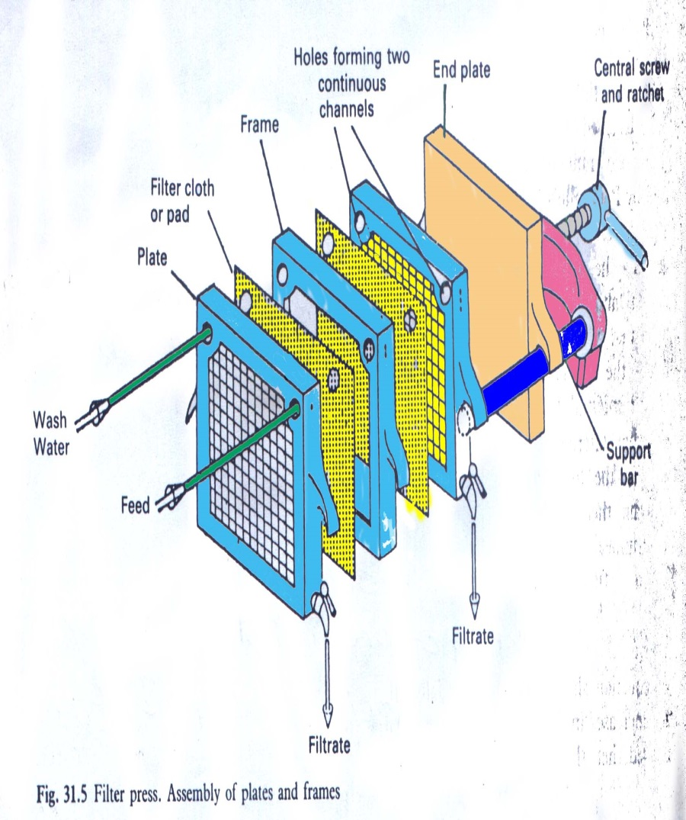

- Pressure Filters:
Example is plate and frame filter press.
The most common type, but less common for bioseparations.
* Used where a relatively dry cake discharge is desired.
* Cake removal: open the whole assembly

Slide 50
Plate and Frame Filter Press
This press is made up of two units, known respectively as plates and frames, with a filter medium, usually filter cloth, between the two.
The frame is open, with an inlet for the slurry, while the plate has grooved surface to support the filter cloth, and with an outlet for the filtrate.
The operation
The slurry enters the frame from the feed channel,
The filtrate passes through the filter medium on to the surface of the plate while the solids form a filter cake in the frame.
The filtrate then drained down the surface of the plate , between the projections on the surface and escapes from the outlet.
Filtration is continued until the frame is filled with filter cake, when the process is stopped , the frame emptied, and the cycle re-started.

Slide 51
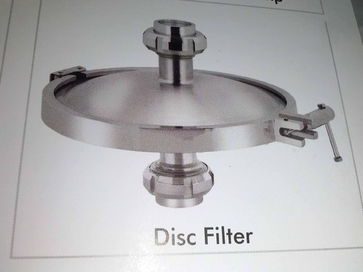
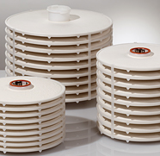
Disc filter :
is applied to assemblies of felt or paper filter discs sealed into pressure case.
The discs may be preassembly into self- supporting unit or each disc may rest on an individual screen or plate.
Compactness, portability and cleanliness are obvious advantages of it.

Slide 52
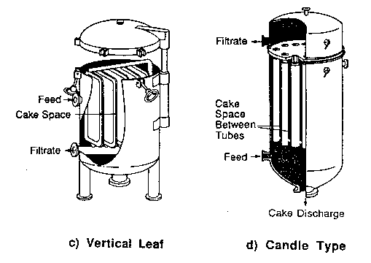
Vertical Leaf Filter and Candle Type Vertical Tank Filter :
* Have a relatively high filtration area per volume.
 Require only a small floor area.
* Filter cake is formed on the external surface of the tubes.
* The tubes are cleaned by backwashing.

Slide 53
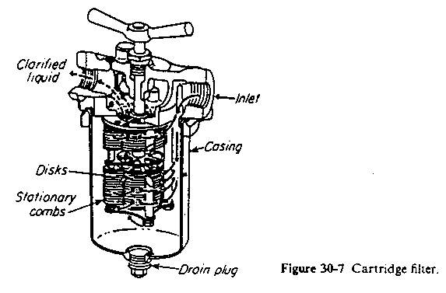
Cartilage filter:
Used for filtration and sterilization for large scale, they are either disposal or permanent cartilage, also there is metalic edge filters with self- cleaning device.

Slide 54
- Centrifugal Filters:
A centrifuge consists of a basket in which mixture of solid and liquid , or mixture of two liquids is rotated at high speed so that it is separated into its constituents by the action of centrifugal force.
Types of baskets:
  A- Imperforated, in which the liquid is removed through a skimming tube , while the solid particles, sediment to the wall.
In pharmacy, the centrifuge is commonly used for drying crystals and for separating emulsions into their constituent liquids.
  B- Perforated basket, in which the liquid passes out through the holes.
-The perforated basket centrifuge:
A vessel about 1m. in diameter and its outer wall is perforated. It is mounted on a vertical shaft by means it can be rotated at a high speed. An outer casing with an outlet collects the liquid thrown out from the basket.
-The pusher-type centrifuge:
This type of centrifuge is used for the separation of suspensions, continuously operated apparatus, and is fitted with a perforated basket.

Slide 55
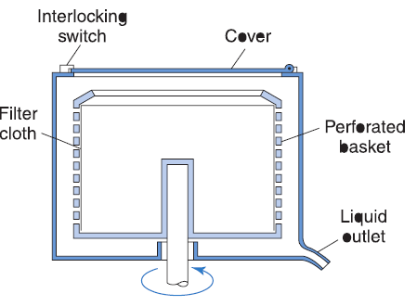
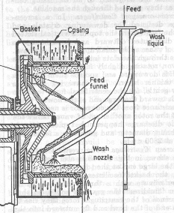
Perforated basket centrifuge
The pusher-type centrifuge

Slide 56

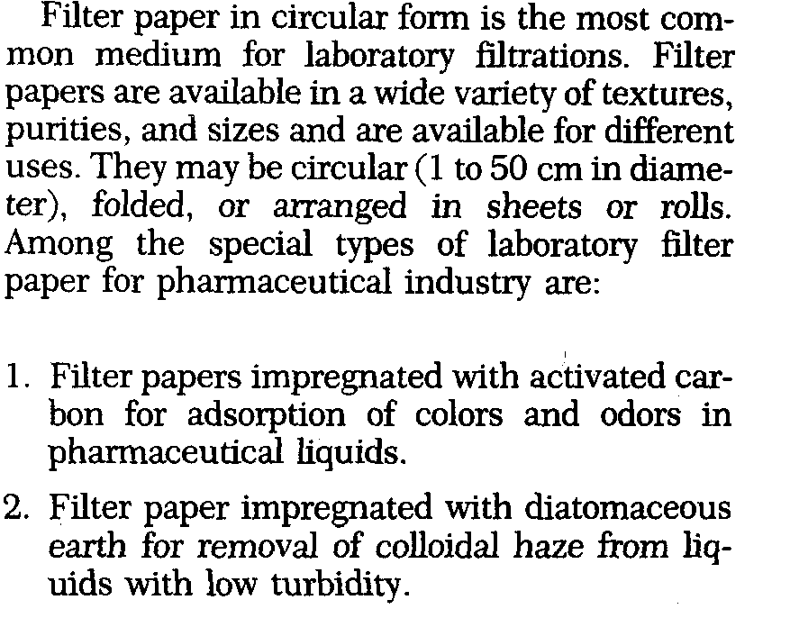

Slide 57
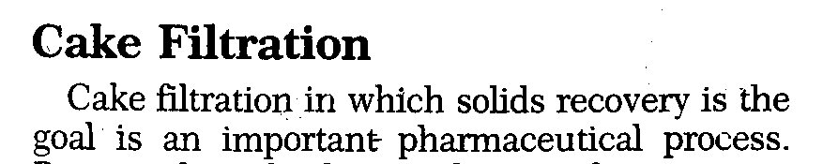
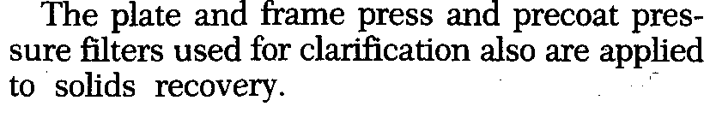
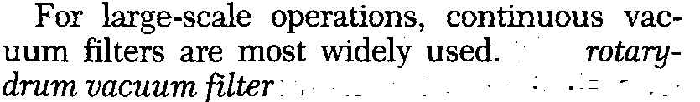


Slide 58
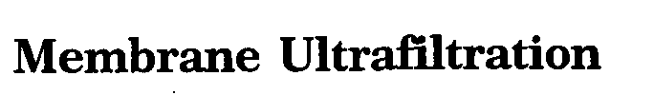



Slide 59
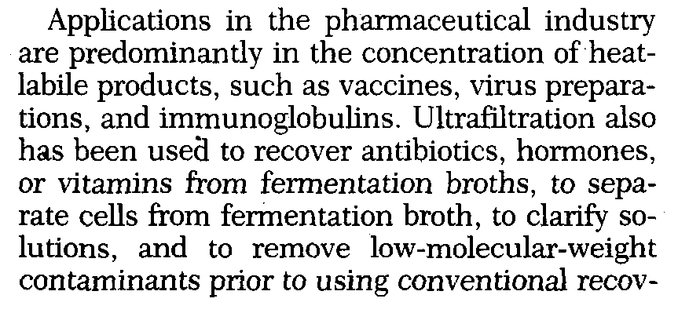
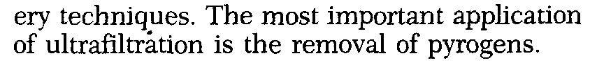

Slide 60


Slide 61


