Slide 1
Technical Drawing :
Part one - Visual Science for Technical Graphics
Introduction to Technical graphics
Engineering Design Process
Technical Drawing Tool
Sketching and Text
Design Visualization

Slide 2
Part two - Fundamentals of Technical Graphics
6. Engineering Geometry and Construction
7. Multiview Drawings I
8. Multiview Drawings II
9. Multiview Drawings III
10. Axonometric and oblique drawings
11. Isometric Drawings I
12. Isometric Drawings II
13. Section Views
14. Fundamentals of Descriptive Geometry
15. Dimensioning.

Slide 3
Chapter One
Introduction to Graphics Communications
Chapter 1
is an introduction to the graphics language of the engineer and technologist.

Slide 4
What is graphics communication?
For one thing, it is an effective means of communicating technical ideas and problem solutions. The process of engineering design starts with the ability to visualize, seeing the problem and the possible solutions. Visualizing, sketching, modelling, and detailing are how engineers and technologists communicate as they design new products and structures for our technological world.

Slide 5
Why the language of graphics communications influence the way you think to solve problems?
Thinking in the language of technical graphics, you will visualize problems more clearly and will use graphic images to find solutions with greater ease.

Slide 6
Why in engineering, it is estimated that 92% of the design process is graphically based. The other 8% is divided between mathematics and written and verbal communications.
Because graphics serves as the primary means of communication for the design process. Figure 1.1 shows that Drafting and documentation, along with design modelling, comprise more than 50% of the engineering time. Engineering analysis depends largely on reading technical graphics, and manufacturing engineering and functional design require the production and reading of graphics.

Slide 7
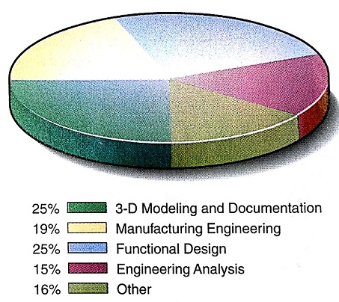
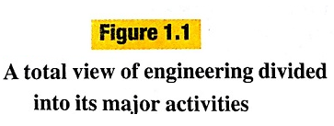

Slide 8
-- The graphics come into every phase of the engineer’s job.
-- Graphics play a very important role in all areas of engineering. For documentation, communications, design, analysis, and modelling.
-- The cars and aircraft would be impossible to create without computer graphics models and drawings. The 3-D model is used to design and visualize the car or aircraft. The engineering drawing are used to communicate and document the design process.
-- Technical drawing are a nonverbal method of communicating information. Descriptions of complex products or structures must be communicated with drawings. A designer uses a visual, nonverbal process. A visual image is formed in the mind, reviewed, modified, and ultimately communicated to someone else, all using visual and graphics processes.

Slide 9
-- Engineers are creative people who use technical means to solve problems. They design product, systems, devices, and structures to improve our living conditions.
-- Technologists assist engineering and are concerned with the practicable aspects of engineering in planning and production. Technologists must be to communicate quickly and accurately using graphics by sketching design problems and solutions, analysing design solutions, and specifying production procedures.

Slide 10
Human Communications Systems
Spoken language: is a highly refined communications system
Writing: is another highly developed communications system based on the use of a formal system of symbols (picture communications)
Mathematics is an abstract, symbol- based communications system build on formal human logic (chemistry also).
Graphics is a visual communications language incorporating text, images, and numerical information
A successful engineer is one who can effectively use all these forms of communication, especially technical drawing.

Slide 11
The Importance of Technical graphics
Technical graphics is a real and complete language used in the design process for
Visualization, Communication, and Documentation.
A drawing is a graphical representation of objects and structures and is done using freehand, mechanical, or computer method.

Slide 12
Visualization
a powerful tool for design engineers is the ability to see in their minds the solution to problems. Design engineers with good visualization ability not only are able to picture things in their minds, but also are able to control that mental image allowing them to move around the image, change the form, and look inside and other movement as if they were holding the object in their hand. (Greatest engineers and scientists… Einstein, Maxwell, Thomas Edison,…). Your ability to visualize should improve as you solve the problems located at the end of every chapter in this book. Visualization and the resulting sketch is the first phase in the whole process of graphics being used in the design process.

Slide 13
Communication
the second phase in the graphics produced to support the design process is communication drawing and models. In this phase, your goal is to refine your initial sketches so your design solution can be communicated to other without ambiguity. In other word, you must be able to improve the clarity of your graphics to such an extent that others are able to visualize your design. This is done by adding more detail to your sketches, then creating a 3-D model using CAD software.

Slide 14
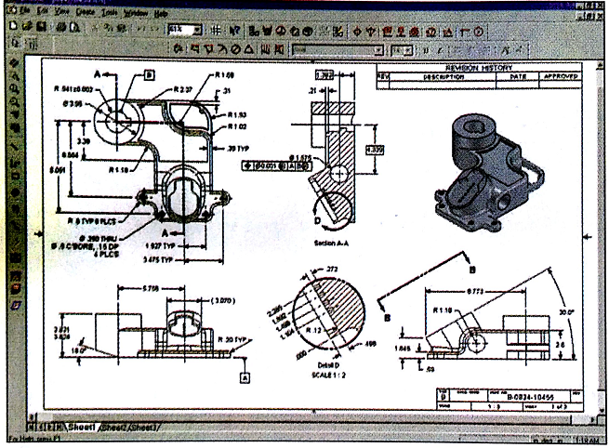
Documentation
after the design solution is finalized; graphics is the most effective way to permanently record that solution. Before 3-D modelling, documentation drawings were 2-D detail drawings that were copied through a process called blueprinting. These blueprints were then used to produce the design see the figure

Slide 15
Geometry
Geometry is the foundation for technical graphics, just as grammar is for language. Geometry includes the following:
Plane geometry. The geometry of planar figures, such as circles and triangles, and their relationships

Slide 16
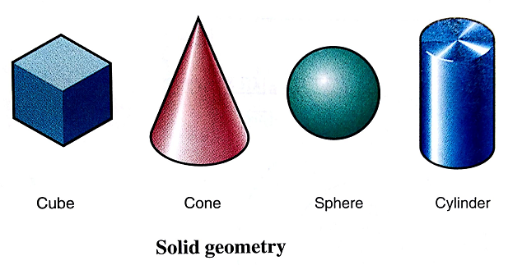
Solid geometry. The geometry of three-dimensional objects, such as cylinders, cubes, and spheres, and their relationships .
Analytic geometry. The analysis of geometric structures and properties, principally using algebraic operations and position coordinates.
Descriptive geometry. The analysis of space distances and relationships, using graphics.

Slide 17
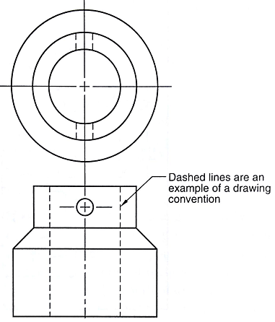
Standards and Conventions
There is no effective communication without an agreed-upon standard of signs or symbols. Standards and Conventions ’alphabet’ of technical drawings, and plane, solid, and descriptive geometry are the science that underlines the graphics language.
Convention are commonly accepted practices, rules, or method. In technical drawing, an example of a convention is the use of dashed lines on Multiview drawing to designate a feature hidden from the current viewpoint.

Slide 18
Standards
Are sets of rules that govern how technical drawing are represented. For example, mechanical drawings are dimensioned using an accepted set of standard, such as placing the dimension text such that it is read from the bottom of the sheet ( ). Standards allow for the clear communication of technical ideas. In the United States, the American National Standards Institute (ANSI) is the governing body. Example ANSI standards in technical drawing include
ANSI Y14.1-1980(R1987), Drawing Sheet Size and format (see the next chapter). Other standards are from the International Standards Organization (ISO), Japanese Standard (JIS) and so on.

Slide 19
