Slide 1


Microbiology Lab. 1st Term
2024-2025
Practical Medical Bacteriology
By
Assistant Lecturer
Mohammad Hassan

Slide 2
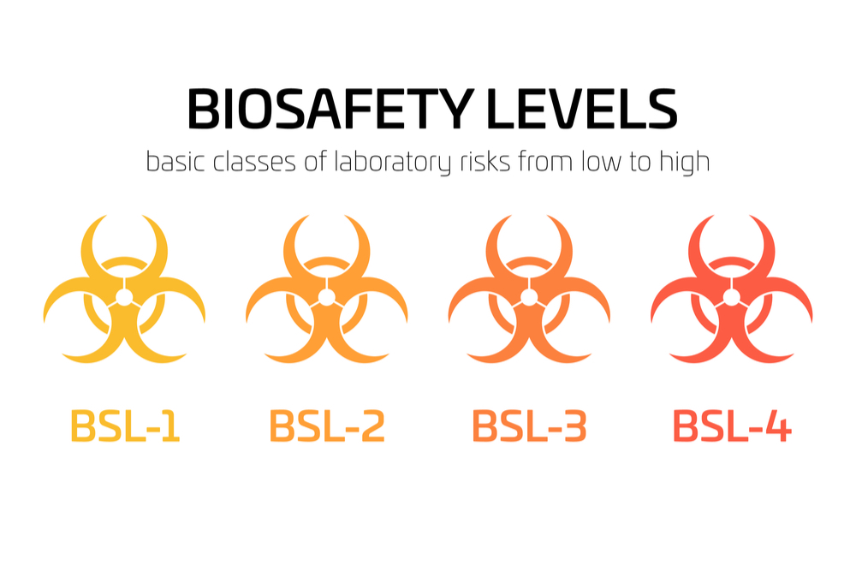
Biosafety
Biosafety is the application of safety precautions that reduce the risk of exposure to harmful microbes, limit contamination of work environment and our community.

Slide 3
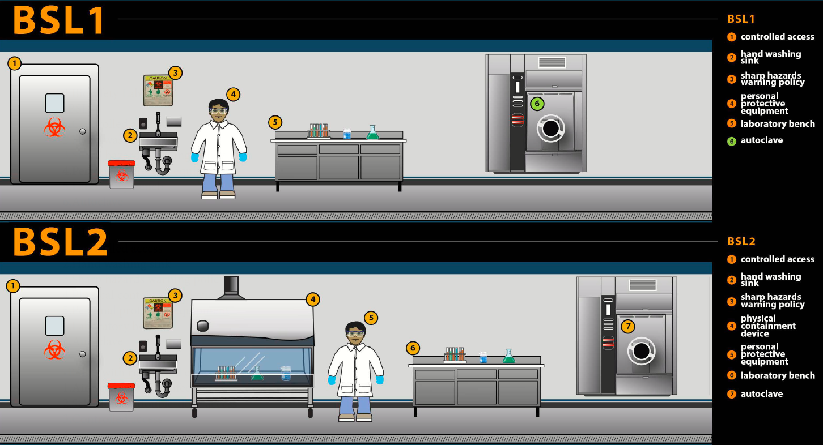

Slide 4
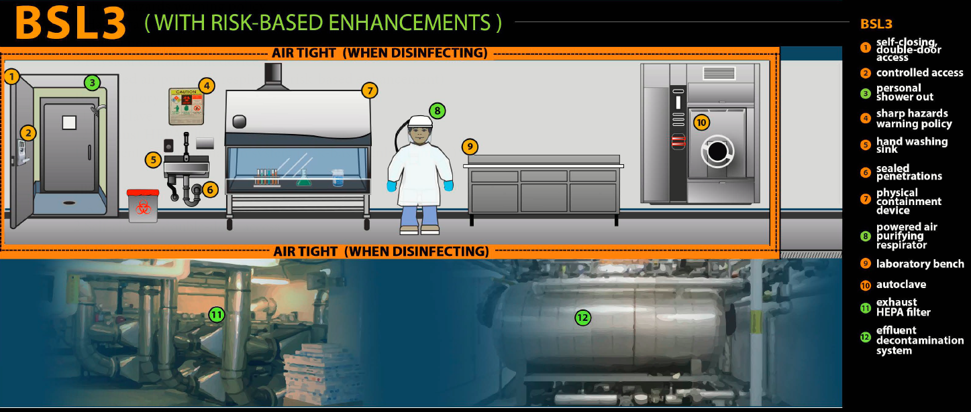

Slide 5
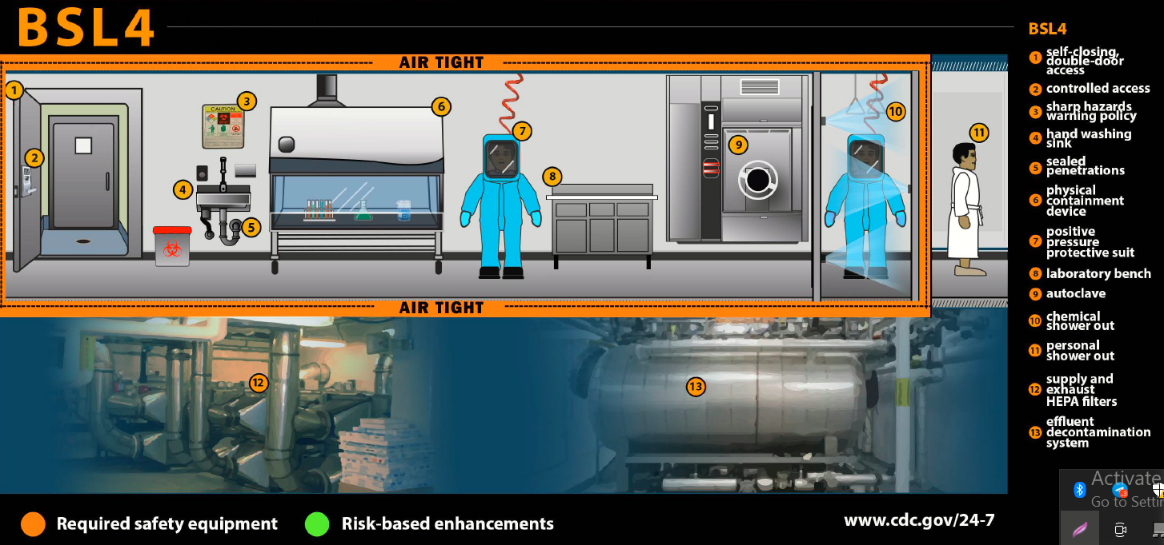
Source: CDC Infographic: Biosafety Lab Levels
https://www.cdc.gov/orr/infographics/biosafety.htm

Slide 6
Lab. safety rules for students
Report all accidents, injuries, and breakage of glass or equipment to instructor immediately.
Long hair (chin-length or longer) must be tied back to avoid catching fire.
Wear sensible clothing including footwear. Loose clothing should be secured so they do not get caught in a flame or chemicals.
Leave your work station clean and in good order before leaving the laboratory.
Learn the location of the fire extinguisher and first aid kit.
Fooling around or "horse play" in the laboratory is absolutely forbidden.
Do not lift any solutions, glassware or other types of apparatus above eye level.
Learn how to transport all materials and equipment safely.
No eating or drinking in the lab at any time!

Slide 7
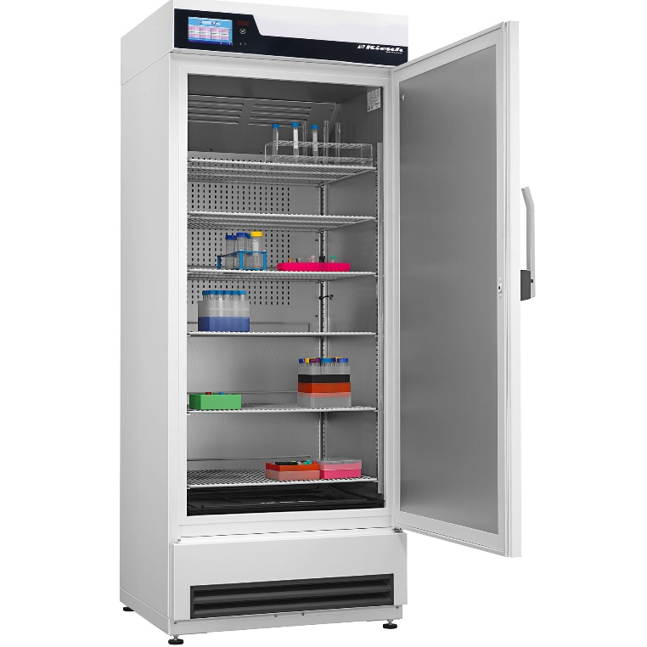
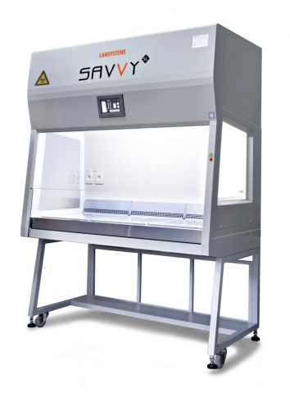
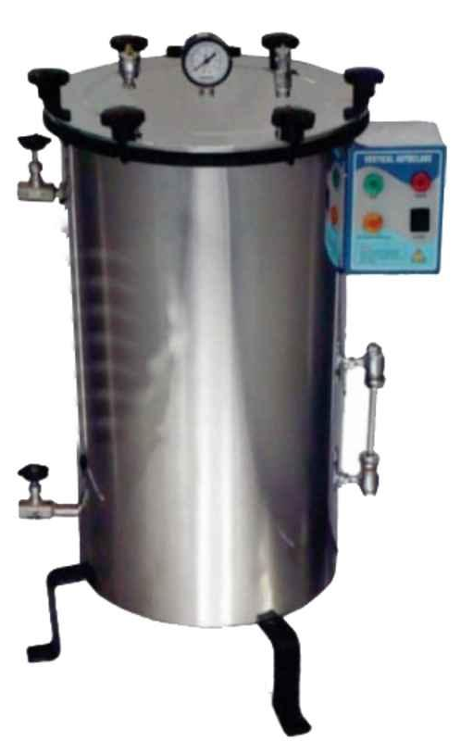
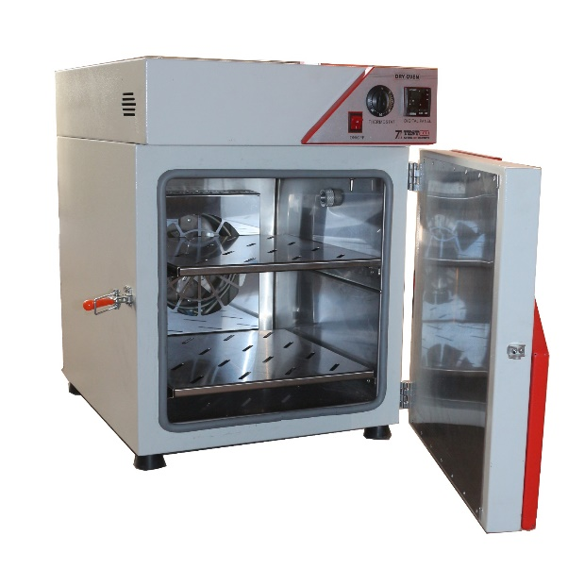
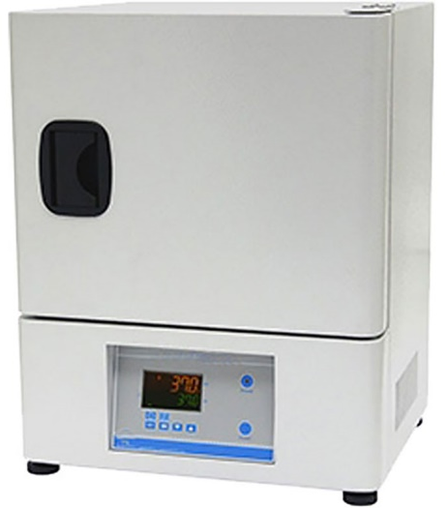
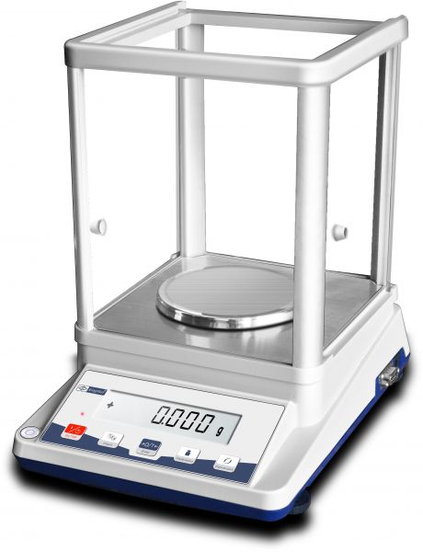
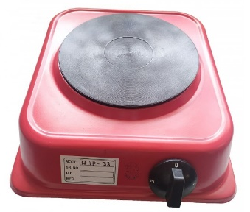
Laboratory Devices
Lab Refrigerator
Hood
Oven
Hot plate
Autoclave
Balance
Incubator

Slide 8
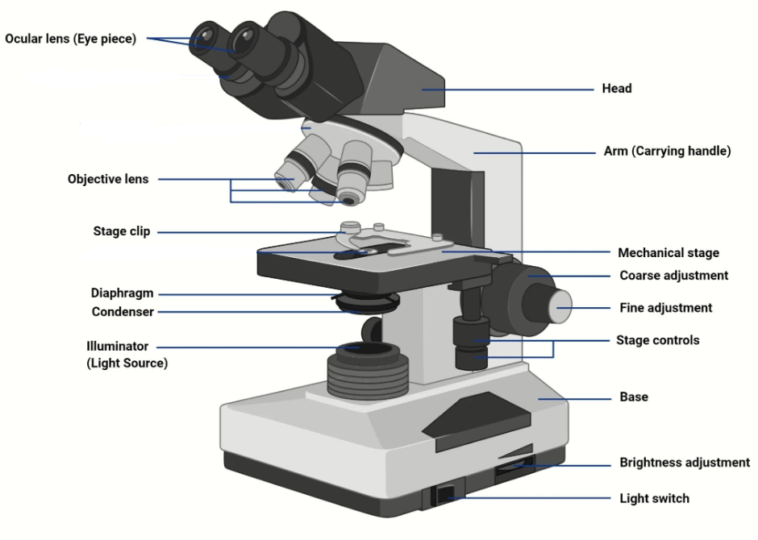
Microscope parts

Slide 9
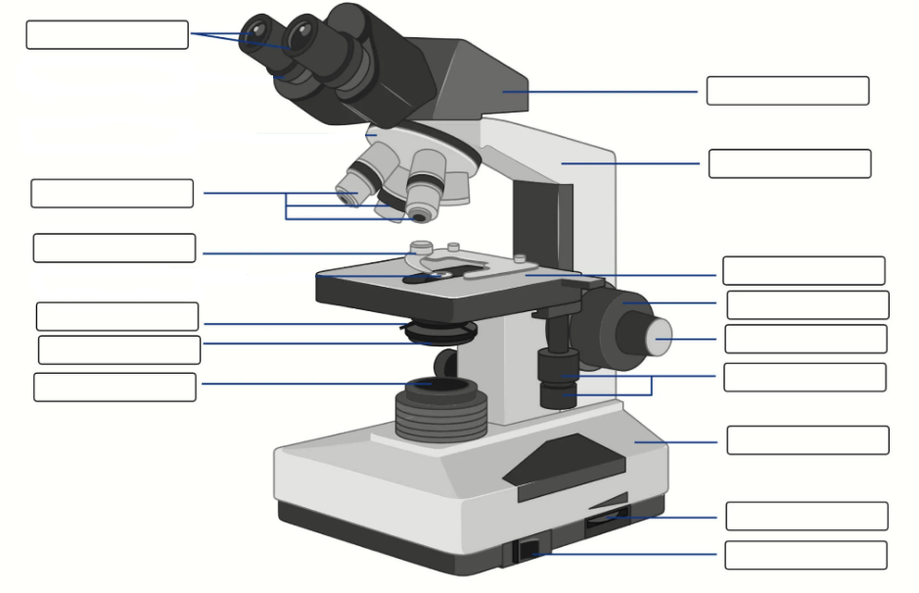
Microscope parts worksheet

Slide 10
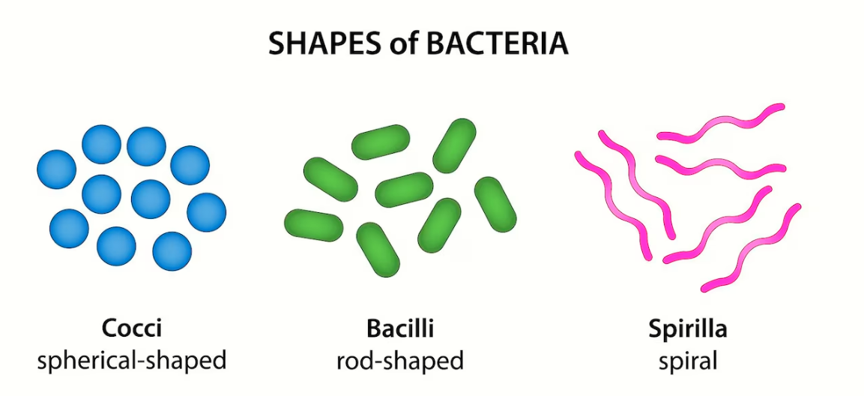

Slide 11
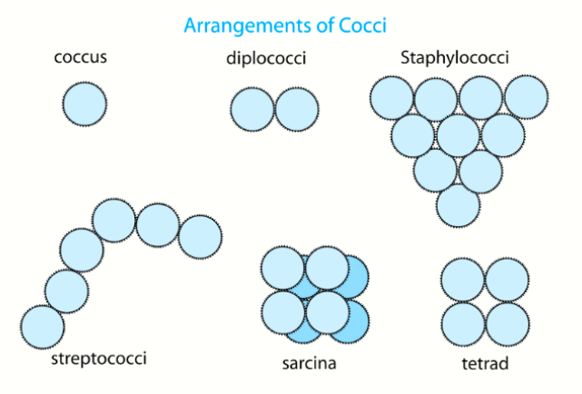

Slide 12
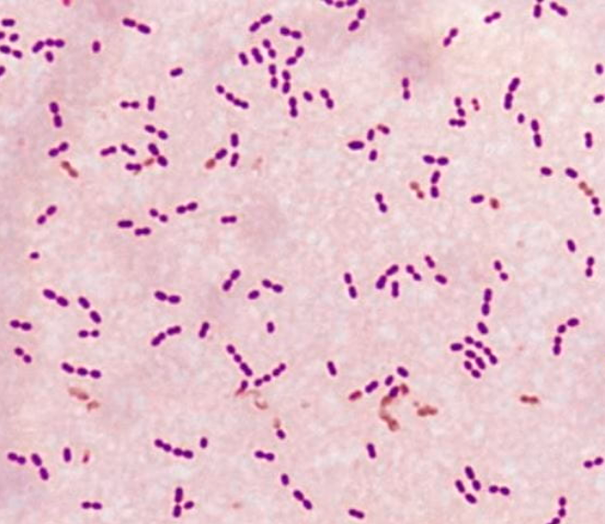
Diplococcus arrangement:
Streptococcus pneumonia
rounded bacteria (cocci) that usually occur in pairs and sometimes short chains. Their blue color indicates they are Gram-positive.

Slide 13
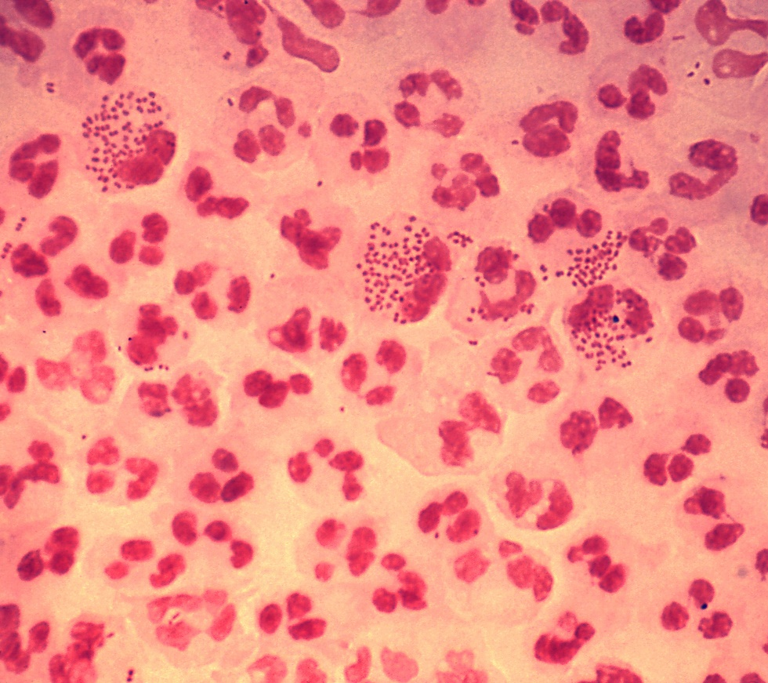
Diplococcus arrangement:
Neisseria gonorrhoeae
gonococcal urethritis using Gram-stain technique. This slide is used to demonstrate the distribution of gram negative gonococci among polymorphonuclear neutrophils. Note that there are both intracellular and extracellular bacteria in the field of view.

Slide 14
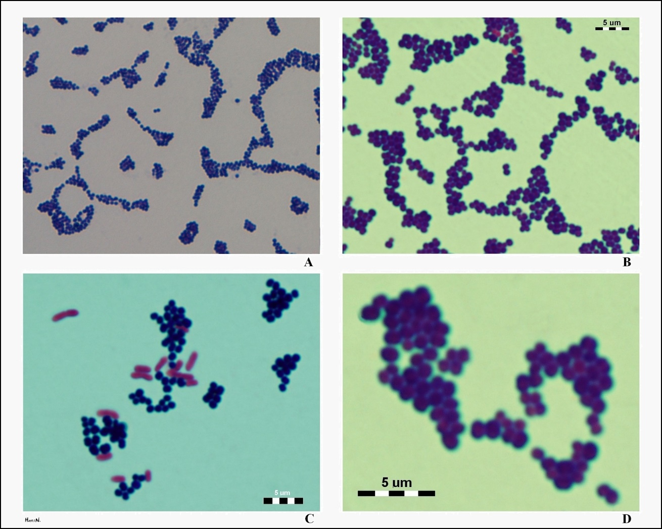
Staphylococcus arrangement:
Staphylococcus aureus
A and B). S. aureus are gram-positive cocci, often appearing in irregular clusters.They are generally perfectly spherical unlike streptococci which are more irregular and form chains of cocci.
C) S. aureus viewed microscopically alongside E. coli, a gram-negative bacillus.
D) close view of S. aureus showing their spherical shape and clustering formation.

Slide 15
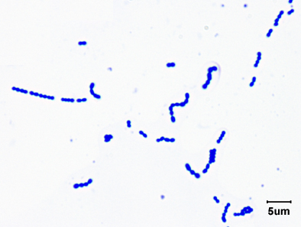
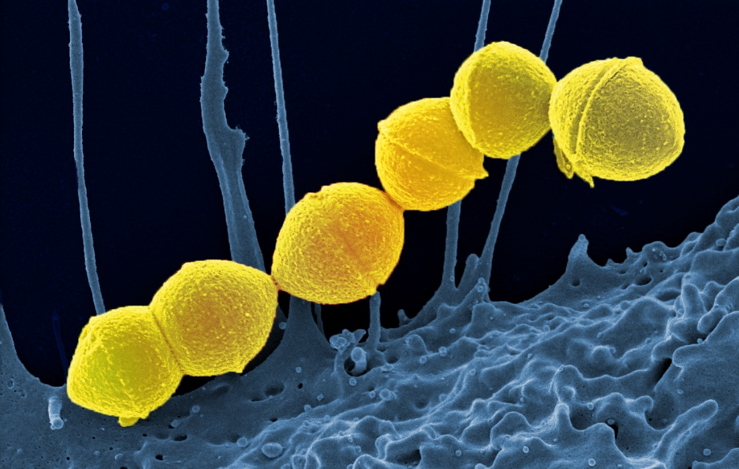
Streptococcus arrangement:
Streptococcus pyogenes
Gram Stain of Streptococcus pyogenes (gram-positive).
Colorized scanning electron micrograph Streptococcus pyogenes bacteria (yellow) and a human neutrophil (blue).

Slide 16
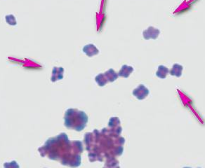
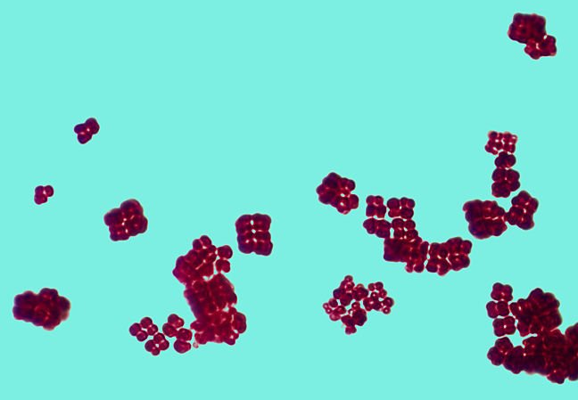
Tetrad Arrangement:
(Gram Stain) of Micrococcus spp. grows in squared packets of cells, evident even when they are bunched together.
Sarcina arrangement:
Cubic structures of Sarcina spp. under a microscope stock photo.

Slide 17
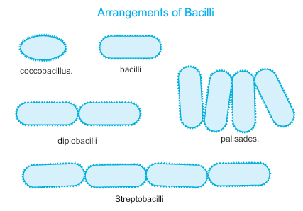

Slide 18
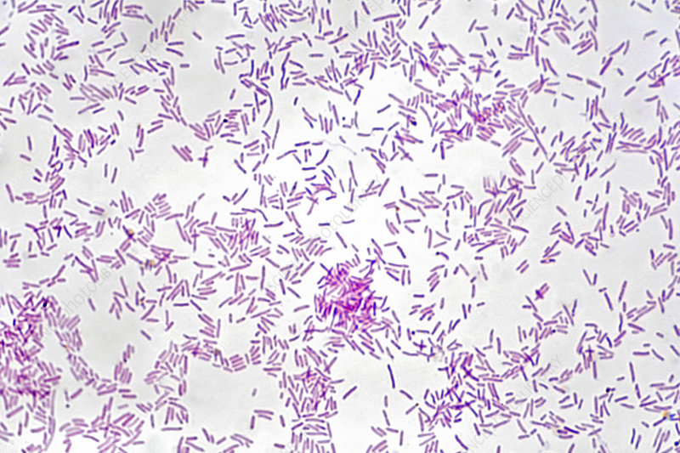
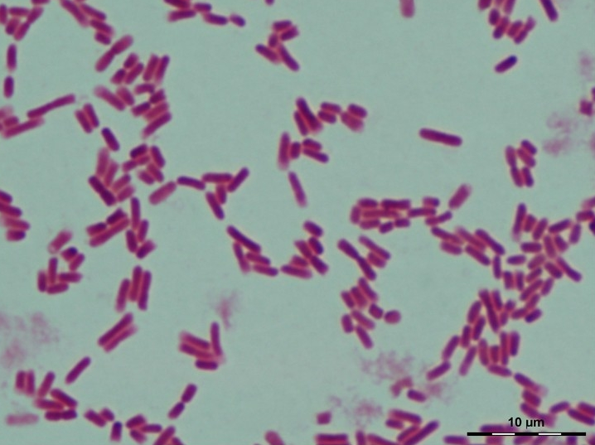
Bacilli
Rod-shaped
Gram-negative
Salmonella typhi
Escherichia coli (Coccobacilli shape)

Slide 19
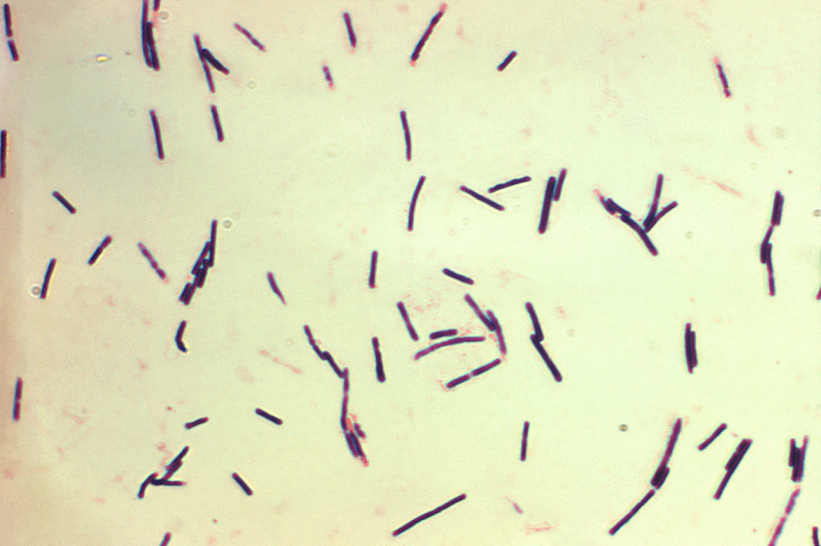
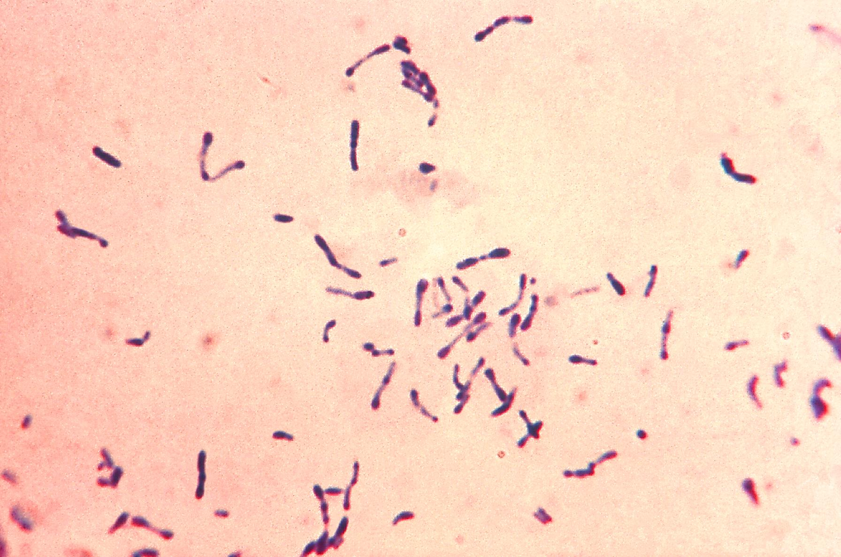
Bacilli
Rod-shaped
Gram-positive
Clostridium perfringens
Corynebacterium diphtheriae

Slide 20
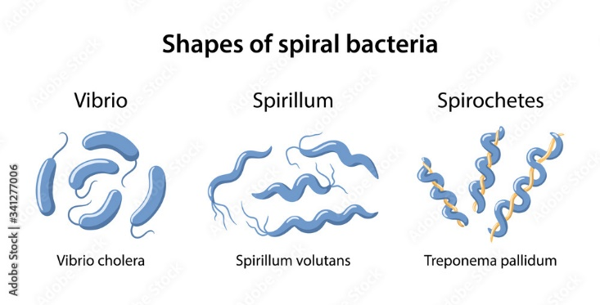
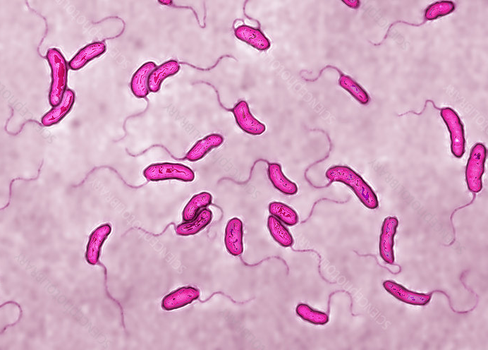
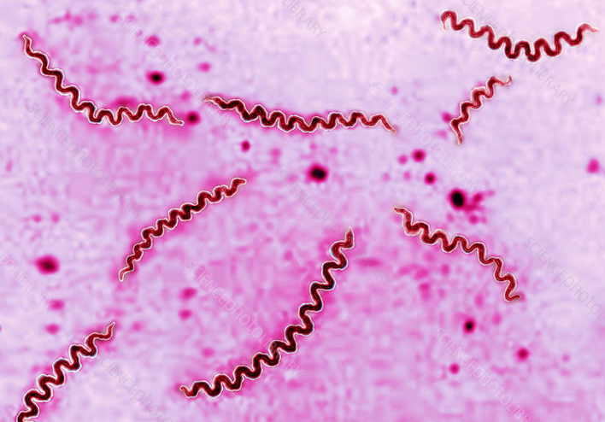
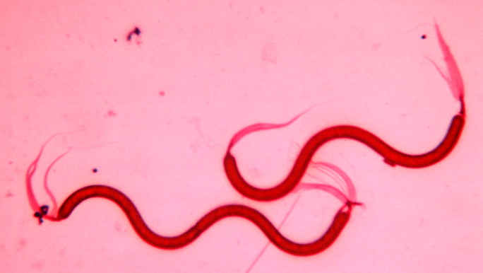

Slide 21
Identification methods
The most important task of a bacteriologist is to identify the pathogens from the clinical sample so that appropriate treatment can be done.
There are several methods to identified the different type of bacteria:
1. Isolation in pure form
2. Staining reaction
3. Culture media
4. Morphology and characteristics of the bacterial colony
5. Metabolism
6. Biochemical tests
7. Antibiotic sensitivity test

Slide 22
1. Isolation in pure form
Studies on the biochemical, antigenic and other characters of bacteria can be done only if the organism available in the pure form.
Technique:
a. Plating on solid culture media‐clinical sample is streaked onto a solid medium (like: MacConkey agar, nutrient agar or blood agar) in such a way so as to ensure isolated discrete colonies.
b. Use of selective growth condition‐most important example of this is the growth of anaerobic bacteria which will not take place in an environment having oxygen.

Slide 23
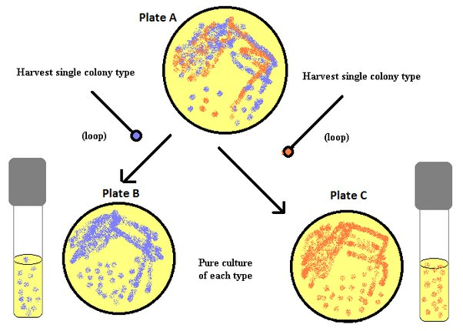

Slide 24
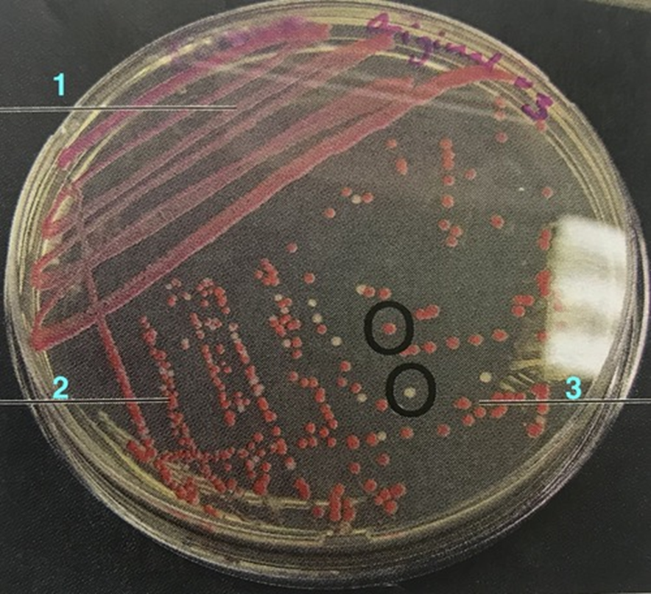

Slide 25
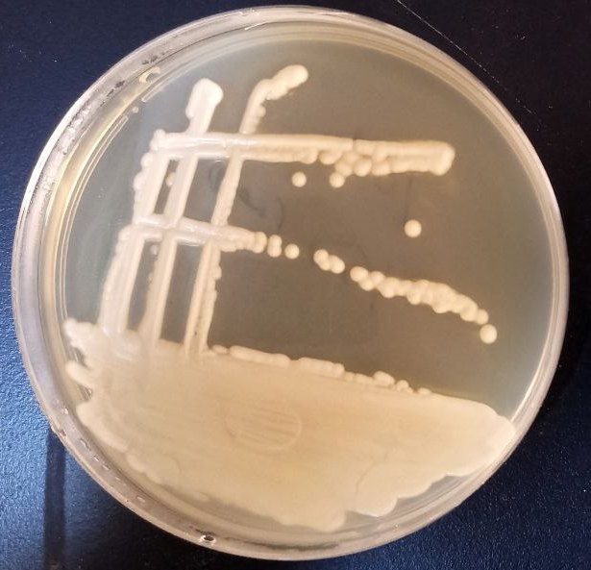
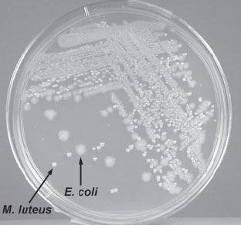

Slide 26
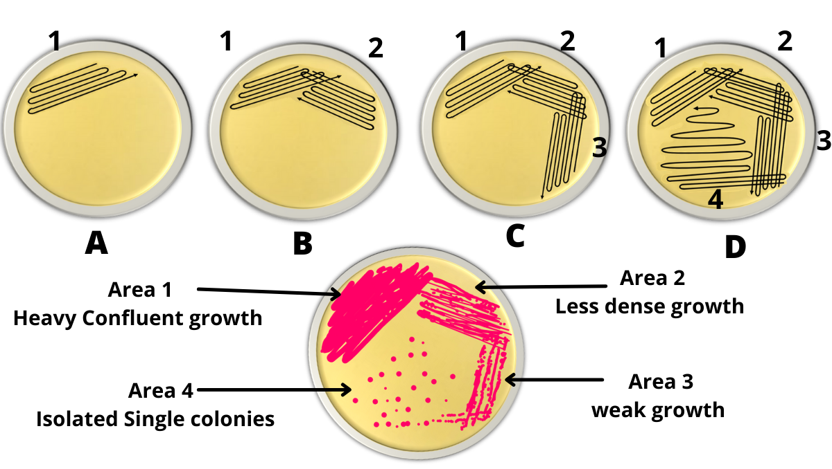
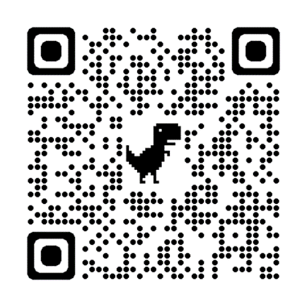

Slide 27
How to Prepare a Bacterial smear
In order to observe a bacteria under the light microscope, a smear must be prepared from a fresh culture(broth or agar). This smear is prepared on a clean glass slide. There are 2 types of smears
A- WET SMEAR
B- DRY SMEAR

Slide 28
A- WET SMEAR
The wet mount is a preparation of a culture to observe motility (movement). The bacteria remains alive.
Use a sterile inoculating loop to place a loopful of a motile Bacillus or Proteus culture on a slide. Cover immediately with a coverslip. Do not allow the preparation to dry out. Observe under the microscope.

Slide 29
B- DRY SMEAR
A dry smear is prepared in order to stain the bacteria (the bacteria will be killed during the process without distorting it’s shape)
Procedure:
1- An amount of water (distilled or tap) is transferred via wire loop onto the surface of a clean glass slide.
2- A small amount of bacteria is transferred via wire loop from a fresh culture and mixed with the water drop on the slide (Note: if broth culture is used, no need to use water) then leave to dry at room temperature.
3- the slide to passed quickly through a flame 3-4 times in order to fix the smear (warning: do not overheat the slide or steam it before the drop is dried at room temperature).
ADVANTAGES OF HEAT FIXATION
1- Kill the bacteria .
2- stick the bacteria on the slide.
3- Rendering the cell permeability (cell wall permeability).
4- Stop autolysis or autolytic activity.

Slide 30
Simple Stain
The simple stain can be used to determine cell shape, size, and arrangement. True to its name, the simple stain is a very simple staining procedure involving only one stain. You may choose from methylene blue, Gram safranin (RED), and Gram crystal violet. Basic stains, such as methylene blue, Gram safranin, or Gram crystal violet are useful for staining most bacteria.
Since the surface of most bacterial cells is negatively charged, these positively charged stains adhere readily to the cell surface.

Slide 31
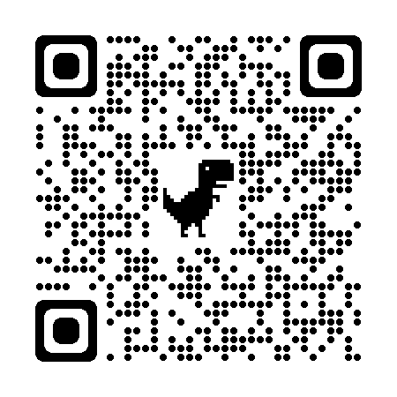
Simple Stain Procedure
Place your fixed smear slides on the stain rack over the sink.
Cover the smear with any of the basic dyes available to you.
Let the stain sit for 1-5 minutes.
Tilt the slide over the sink and rinse the stain off with a stream of water from the wash bottle.
  Be sure to spray above the smear and let it dribble down.
  If you spray directly on the smear you are liable to wash the smear off the slide.
  Rinse till the water runs clear or is only slightly colored.
Touch the edge of the slide to a paper towel to remove excess water. You can now let it air dry. Alternately you can dry it with blotting paper by placing it in the blotting paper book and pressing lightly. While this method is quicker, you can also blot off a poorly adhered smear.

Slide 32
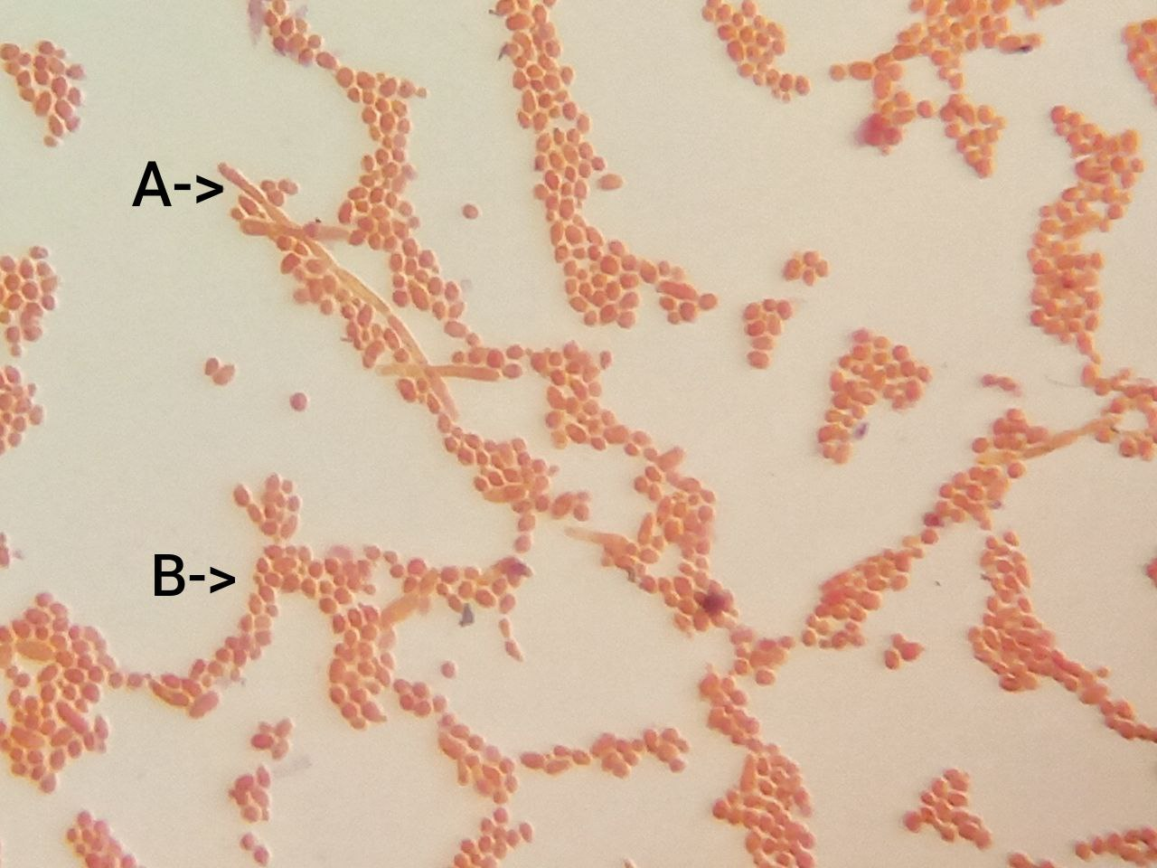
Candida albicans (fungi) under light microscope 1000x (oil immersion lens) using simple stain (safranin).
A- Pseudohyphae, B- Budding yeast cells.

Slide 33
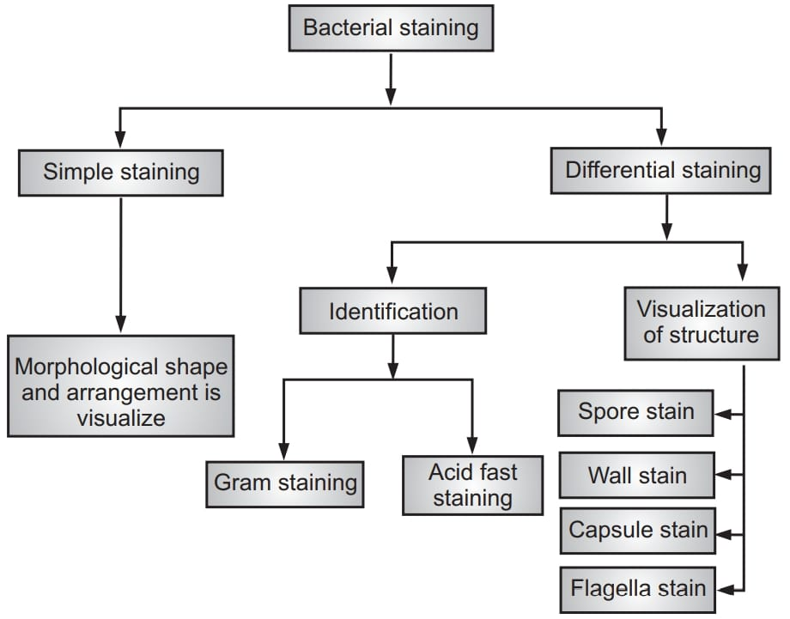
2. Staining reaction
Simple stains bring out the best morphology.
Differential and special stains are necessary to bring out characteristics like: gram negative and gram positive bacteria, Acid fast and non acid fast , spirochetes, capsule and Flagella, etc.

Slide 34
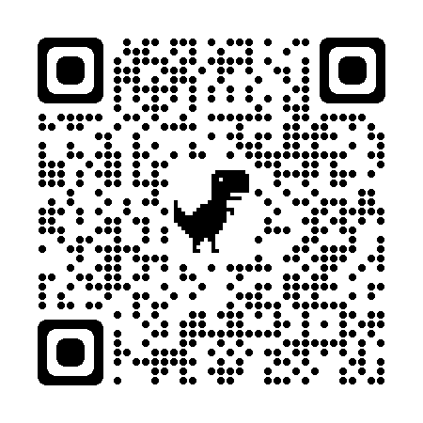
a. Gram stain
Gram stain divides the bacteria into Gram positive & Gram negative.
Procedure:
  Take a heat fixed bacterial smear.
  Flood the smear with CRYSTAL VIOLET for 1 minute, then wash with water.
  Flood the smear with IODINE for 1 minute, then wash with water.
  Flood the smear with ETHANOL‐ACETONE, quickly, then wash with water.
  Flood the smear with SAFRANIN for 1 minute, then wash with water.
  Blot the smear, air dry and observe.

Slide 35
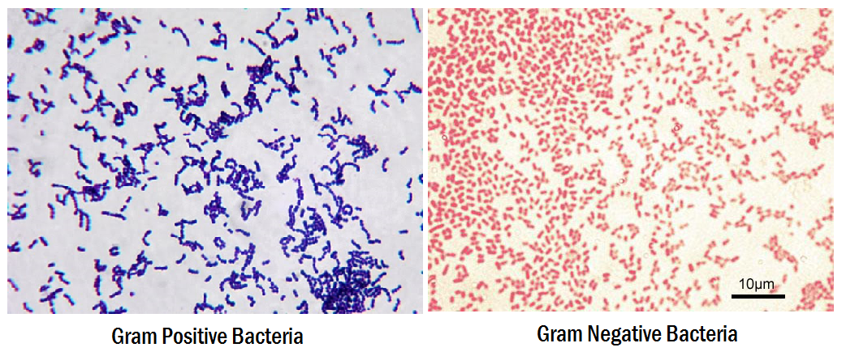

Slide 36
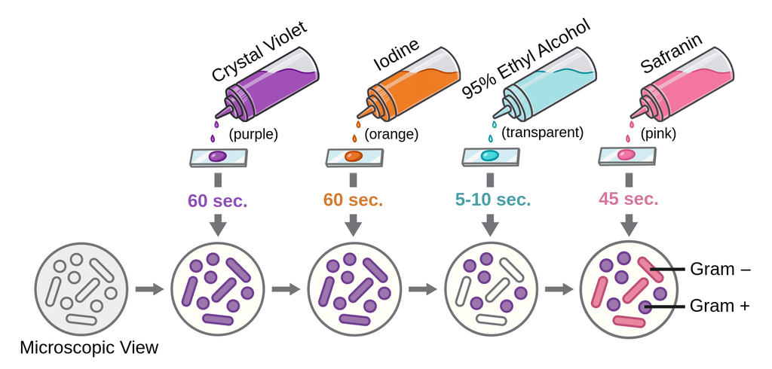
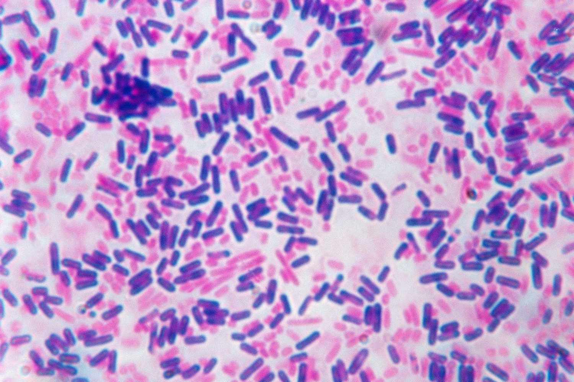

Slide 37
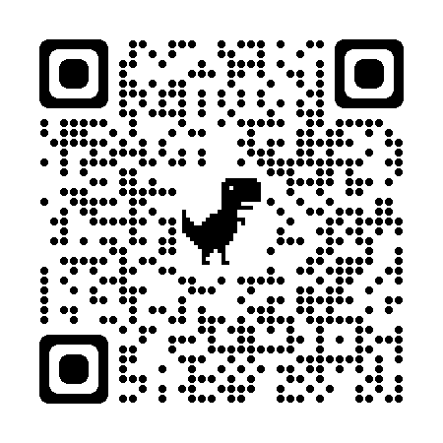
b. Ziehl-Neelsen stain
The Ziehl-Neelsen stain, also known as the acid-fast stain, is a bacteriological staining technique used to identify particularly members of the Mycobacterium genus.
Procedure:
On a clean sterile microscopic slide, make the smear of the sample culture and heat fix the smear over blue heat.
Over the smear, pour and flood the smear with carbol fuschin and heat gently until it produces fumes.
Allow it to stand for 5 minutes and wash it off with gently flowing tap water.
Add 20% sulphuric acid and leave it for 1-2 minutes. Repeat this step until the smear appears pink in color.
Wash off the acid with water.
Flood the smear with methylene blue dye and leave it for 2-3 minutes and wash with water.
Air dry and examine the stain under the oil immersion lens.

Slide 38
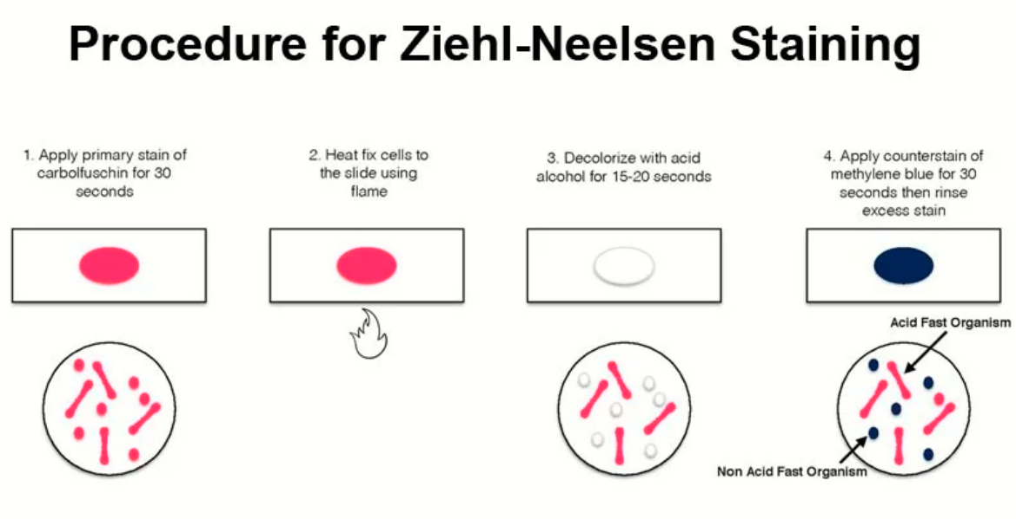

Slide 39
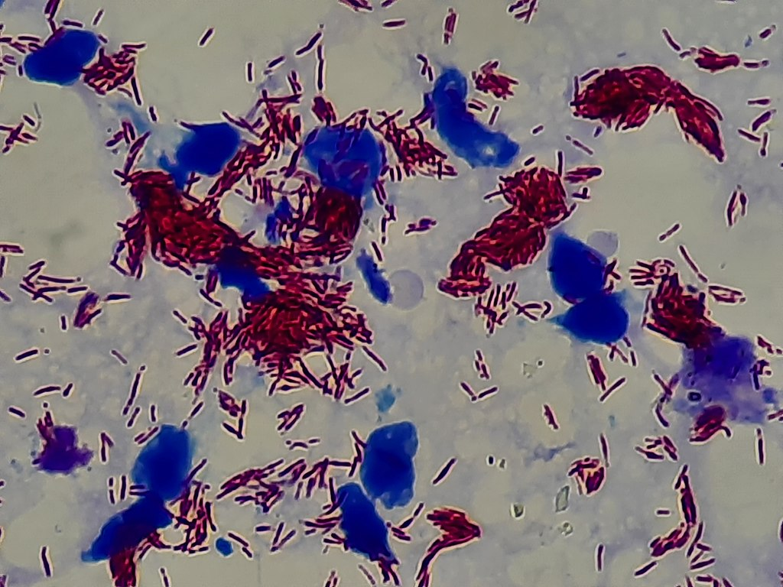
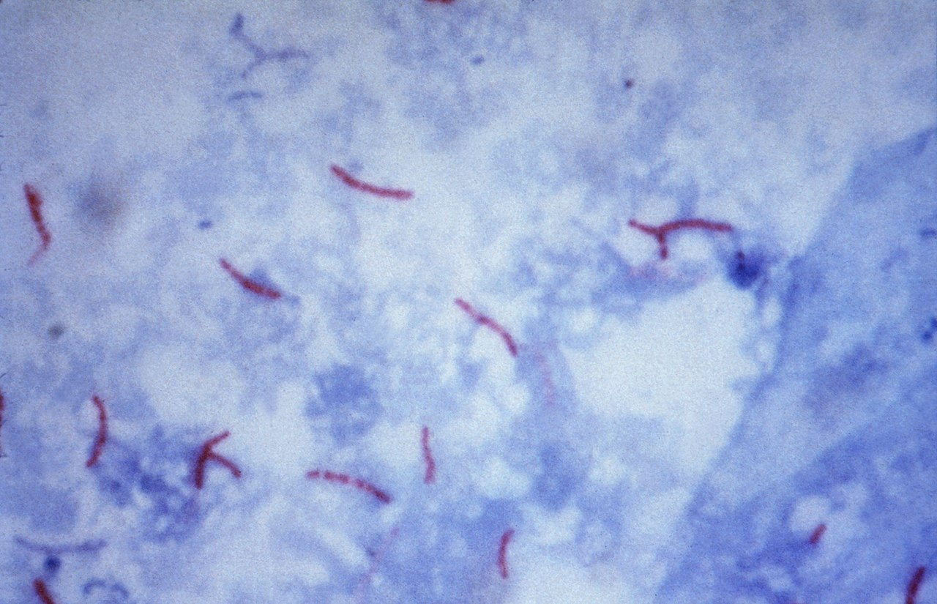
Microscopic visualisation of the acid-fast bacteria Mycobacterium tuberculosis (left) and Mycobacterium leprae (right) and background cellular material in blue using the Ziehl–Neelsen stain

Slide 40
3. Culture Media
Culture media are used for recognition and identification (diagnosis) of microorganisms. The media are contained in plates (Petri dishes), in test tubes, flasks or screw capped bottles.
Types of culture media regarding their consistency:
1- Liquid media e.g., Nutrient broth, Peptone water.
2- Solid media, e.g., Nutrient agar, MacConkey agar.
3- Semi-solid media : e.g., motility media.

Slide 41
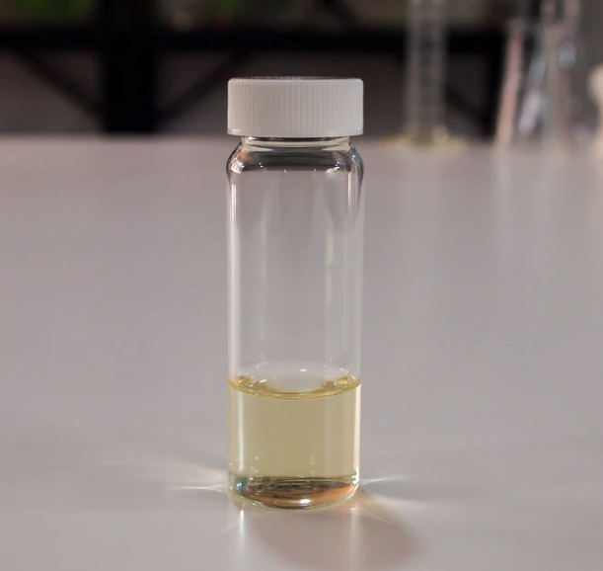
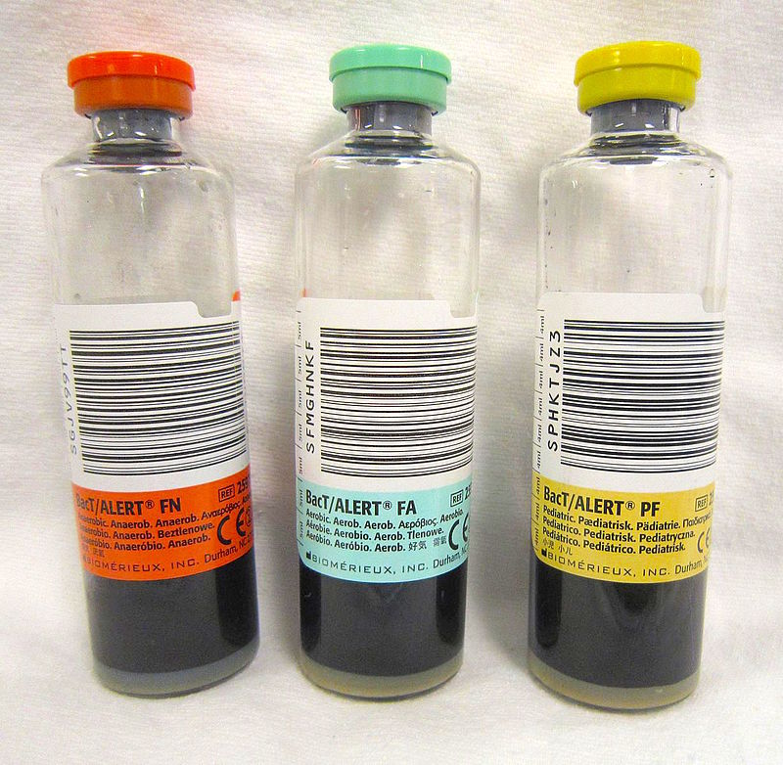
Liquid media examples:
Nutrient Broth as shown above,
Blood culture bottles on the right.

Slide 42

Solid media examples:

Slide 43

Semi-solid media (Mainly used for motility test)
The tube on the left was inoculated with the motile bacterium Proteus mirabilis and shows a positive test for motility.
The tube on the right was inoculated with the nonmotile bacterium Staphylococcus aureus and shows a negative test for motility.

Slide 44
Classification based on the basis of purpose/ functional use/ application:
many special purpose media are needed to facilitate recognition, enumeration, and isolation of certain types of bacteria. To meet these needs, numerous media are available.
1. General purpose media/ Basic media (simple media)
Basal media are basically simple media that supports most non-fastidious bacteria.
Ex. Peptone water, nutrient broth and nutrient agar considered basal medium.
These media are generally used for the primary isolation of microorganisms.

Slide 45

2. Enriched medium (Added growth factors)
Addition of extra nutrients in the form of blood, serum, egg yolk etc., to basal medium makes them enriched media. Enriched media are used to grow nutritionally exacting (fastidious) bacteria.
Ex. Blood agar, chocolate agar.
Blood agar is preparing by adding 5-10% (by volume) to a basal medium such as nutrient agar or other blood agar bases. Chocolate agar is also known as heated blood agar or lysed blood agar.

Slide 46


Blood agar shows 3 types of hemolysis

Slide 47
3. Selective medium
Selective medium is designed to suppress the growth of some microorganisms while allowing the growth of others (i.e., they select for certain microbes).
Examples:
Thayer Martin Agar used to recover N.gonorrhoeae contains Vancomycin, Colistin and Nystatin.
Mannitol Salt Agar used to recover S.aureus contain 10% NaCl.
MacConkey’s Agar used for Enterobacteriaceae members contains Bile salt that inhibits most gram positive bacteria.

Slide 48


Slide 49



Slide 50

MacConkey’s Agar

Slide 51
4. Differential medium
Certain media are designed in such a way that different bacteria can be recognized on the basis of their colony color. Such media are called differential media or indicator media .
Differential media allow the growth of more than one microorganism of interest but with morphologically distinguishable colonies.
Examples of differential media include:
Thiosulfate–citrate–bile salts–sucrose agar (TCBS) for Vibrio cholera which produces yellow colonies due to fermentation of sucrose.
Eosin methylene blue (EMB) for E. coli which produce black colonies and gives a distinctive metallic green sheen due to ferment lactose

Slide 52


Slide 53


E.coli
On Eosin Methylene Blue (EMB) Agar, as E. coli gives metallic green sheen on it. that’s why sketched a tree on EMB agar. Leaves of that tree were drawn with E. coli while its trunk with Staphylococcus sp. which gave brown on that media.

Slide 54

What type of hemolysis in this blood culture?

Slide 55
MacConkey agar is a selective and differential culture medium. Why?
Blood agar is an enriched and differential culture medium. Why?
Is the slant tube media solid or liquid media?

Slide 56

4. Morphology and characteristics of the bacterial colony

Slide 57

How do we describe the morphology of bacterial colonies?
Form: circular, irregular, filamentous or rhizoid.
Size: The size in mm
Elevation: raised, convex, flat, umbonate, crateriform
Margin: Entire, wavy, lobate, filiform
Surface: smooth, wavy, rough, granular, papillate, glistening etc.
Texture: dry, moist, mucoid, brittle, viscous, butyrous (buttery).
Color: colorless, pink, black, red, bluish-green.

Slide 58


Examples

Slide 59

Describe the morphology of the colonies
Form: circular, irregular, filamentous or rhizoid. (……….............../…………….…………)
Elevation: raised, convex, flat, umbonate, crateriform (…………………………./……..…………………..)
Margin: Entire, wavy, lobate, filiform (…………………………/……………………………)
Surface: smooth, wavy, rough, granular, papillate, glistening etc. (…………..……………../………………………………)
Texture: dry, moist, mucoid, brittle, (…………………………/……………………………..) viscous, butyrous (buttery).
Color: colorless, pink, black, red, bluish-green. (…………..……………/…….………………….)
Figure: Bacterial colonies of S.aureus (yellow pigmented) and S.agalactiae on CAP agar (blood agar with colistin and aztreonam).
Atypical colonies of Streptococcus agalactiae (GBS).Cultivation 48 hours, aerobic atmosphere enriched with 5% carbon dioxide, 37°C.

Slide 60

Describe the morphology of the colonies
Form: circular, irregular, filamentous or rhizoid. (………...............…………….…………)
Elevation: raised, convex, flat, umbonate, crateriform (………………………….……..…………………..)
Margin: Entire, wavy, lobate, filiform (……………………………………………………)
Surface: smooth, wavy, rough, granular, papillate, glistening etc. (…………..……………..………………………………)
Texture: dry, moist, mucoid, brittle, (………………………………………………………..) viscous, butyrous (buttery).
Color: colorless, pink, black, red, bluish-green. (…………..………………….………………….)

Slide 61

Describe the morphology of the colonies
Form: circular, irregular, filamentous or rhizoid. (………...............…………….…………)
Elevation: raised, convex, flat, umbonate, crateriform (………………………….……..…………………..)
Margin: Entire, wavy, lobate, filiform (………………………………………………………)
Surface: smooth, wavy, rough, granular, papillate, glistening etc. (…………..……………..………………………………)
Texture: dry, moist, mucoid, brittle, (………………………………………………………..) viscous, butyrous (buttery).
Color: colorless, pink, black, red, bluish-green. (…………..………………….………………….)

Slide 62



5. METABOLISM
To classify the differentiate species following aspects are studied
Requirement of oxygen
The need of co2
Capacity to form pigments
Power of hemolysis

Slide 63

6. Biochemical tests
Catalase test
Coagulase test
Oxidase test
Urea hydrolysis
Lactose fermentation
Sucrose fermentation
Glucose fermentation
Triple sugar iron(TSI) test
Indole
Methyl Red/Voges Proskauer
citrate

Slide 64

1. Catalase test
This test is used to identify organisms that produce the enzyme, catalase. This enzyme detoxifies hydrogen peroxide by breaking it down into water and oxygen gas.
Used to determine whether the Gram + cocci is a staphylococci or a streptococci.
The bubbles resulting from production of oxygen gas clearly indicate a catalase positive result.

Slide 65


Slide method(left), tube method(right).

Slide 66
2. Coagulase test
Property it tests for: This tests for the bacteria’s ability to clot blood plasma using the enzyme coagulase.
Media and Reagents: This media contains rabbit plasma dissolved in buffer.
The coagulase test is one way to differentiate the highly pathogenic S. aureus from the other less pathogenic staphylococcal species on the human body.

Slide 67


If the organism is has coagulase it will clump the plasma.
If the organism does not have coagulase it will not clump the plasma.

Slide 68


3. Oxidase test
The oxidase test is used to determine if an organism possesses the cytochrome c oxidase enzyme. The test is used as an aid for the differentiation of Neisseria, Moraxella, Campylobacter and Pasteurella species (oxidase positive). It is also used to differentiate pseudomonads from related species.

Slide 69
4. Urea hydrolysis
Property it tests for: This test is done to determine a bacteria’s ability to hydrolyze urea to make ammonia using the enzyme urease.
Media and Reagents Used: Urea broth contains a yeast extract, monopotassium phosphate, disodium phosphate, urea, and phenol red indicator.
How to Perform Test: Inoculate Urea broth with inoculating loop.
Reading Results: Urea broth is a yellow-orange color. The enzyme urease will be used to hydrolyze urea to make ammonia. If ammonia is made, the broth turns a bright pink color, and is positive. If test is negative, broth has no color change and no ammonia is made.

Slide 70


Urease Test
Left is Slant Agar on right Urea Broth

Slide 71
5. Lactose Fermentation
Property it tests for: This tests for the bacteria’s ability to ferment lactose.
Media and Reagents Used: Lactose broth contains beef extract, gelatin peptone, and lactose. A phenol red indicator is added to indicate acid production from fermentation.
How to Perform Test: Inoculate lactose broth with inoculating loop.
Results
A positive result is yellow after indicator is added (indicating lactose fermentation)
A negative result will have no color change or will be reddish.

Slide 72
6. Sucrose Fermentation
Property it tests for: This test is done to help differentiate species of the family Enterobacteriaceae. This tests for the bacteria’s ability to ferment sucrose and production of acid end-product
Media and Reagents Used: Sucrose broth contains beef extract, gelatin peptone, and sucrose. Phenol red indicator is added to indicate an acid end-product.
How to Perform Test: Inoculate sucrose broth with inoculating loop.
Results
A positive result is yellow after indicator is added (indicating sucrose fermentation)
A negative result has no color change or is reddish.

Slide 73
7. Glucose Fermentation & Gas Production
Property it tests for: This test is done to help differentiate species of the family Enterobacteriaceae. This tests for the bacteria’s ability to ferment glucose and produce gas and/or an acid end-product..
Media and Reagents Used: Glucose broth contains beef extract, gelatin peptone, and glucose. A phenol red indicator is added to indicate an acid end-product. A Durham tube is added to indicate gas production.
How to Perform Test: Inoculate broth with inoculating loop.
Results
A positive result for acid is yellow after indicator is added (indicating glucose fermentation)
A positive result for gas is a bubble in the Durham tube.
A completely negative result has no color change or reddish color and no bubble.

Slide 74

Cont.
From left to right:
uninoculated tube;
Escherichia coli, a glucose fermenter with gas production (visible air bubble in the inverted Durham tube);
Shigella sonnei, a glucose fermenter without gas production (no visible air bubble in the inverted Durham tube);
Pseudomonas aeruginosa, nonfermenter

Slide 75

8. Triple sugar iron (TSI) test
TSI is used for the presumptive identification of Enterobacteriaceae based on the fermentation of glucose, lactose, sucrose and the production of gas and H2S.
Procedure:
Obtain a slant of TSIA.
Using an inoculating needle, stab your assigned organism into the butt of the TSIA slant. As you remove the inoculating needle, drag it in a zigzag pattern up the surface of the slant portion of the tube.
Incubate the slant for 24-48 hours.
After the incubation period, record any changes in the tube.

Slide 76

RED= Alkaline=K = No fermentation
Yellow=Acedic=A=Fermentation

Slide 77


Slide 78


Slide 79
9. Indole Test
Property it tests for: This test is performed to help differentiate species of the family Enterobacteriaceae.
Media and Reagents Used: Tryptone broth contains tryptophan. Kovac’s reagent—contains hydrochloric acid, dimethylaminobenzaldehyde, and amyl alcohol—yellow in color.
How to Perform Test: Inoculate Tryptone broth with inoculating loop.
Reading Results: Kovac’s reagent reacts with indole and creates a red color at the top part of the test tube.

Slide 80



Slide 81
10. Methyl Red / Voges Proskauer (MR/VP)
Properties these test for: Both tests are used to differentiate species of the family Enterobacteriaceae.
Media and Reagents Used:
Glucose Broth
Methyl Red indicator for acid
Voges Proskauer reagents—A: 5% Alpha-Naphthol, & ethanol, B: Potassium Hydroxide, & Deionized Water.
How to Perform Tests: Inoculate 2 glucose broths with inoculating loop. After 48 hours of incubation, add a few drops of MR to one tube, and VP reagents to the other tube.
MR—tests for acid end products from glucose fermentation.
VP—tests for acetoin production from glucose fermentation.

Slide 82

MR/VP continued
Reading Results:
MR— a + result is red (indicating pH below 6) and a – result is yellow (indicating no acid production)
VP—A + result is red after VP reagents are added (indicating the presence of acetoin) and a – result is no color change.
Methyl Red: left – and right +
VP: left + and right –

Slide 83
11. Citrate Utilization test
Inoculation method: streak and stab slant with needle Contains: citrate as sole carbon source, ammonium salts as sole nitrogen source,
bromthymol blue pH indicator: neutral pH = green, alkaline = prussian blue.
Media; Simmon’s citrate agar.
Discriminates organisms that can produce citrase to metabolize citrate into oxaloacetate and pyruvate.
These organisms are forced to utilize ammonium salts as the nitrogen source producing alkaline ammonia waste.
Results: Prussian blue slant and or butt = positive for citrase production Green = negative for citrase production

Slide 84



Slide 85
Gram positive flowchart

Slide 86
Gram negative flowchart

Slide 87

Key identification characteristics for Enterobacteriaceae

Slide 88

7. Antibiotic sensitivity test
is the measurement of the susceptibility of bacteria to antibiotics.
The method provides a basis for classification of a bacterial strain as “susceptible,” “resistant,” or “intermediate” according to the dimension of the inhibition zone.
The disc diffusion method involves selecting a strain of bacteria, placing it on an agar plate, and observing bacterial growth near antibiotic-impregnated discs.
Why we identify bacteria first before applying antibiotic sensitivity test?

Slide 89



Disc Diffusion Method

Slide 90



