Slide 1
BIOLOGY COURSE-1st STAGE
GENETICS
Ass. Prof. Dr. AJWAD ASSUMAIDAEE Ph.D
2024-2025

Slide 2
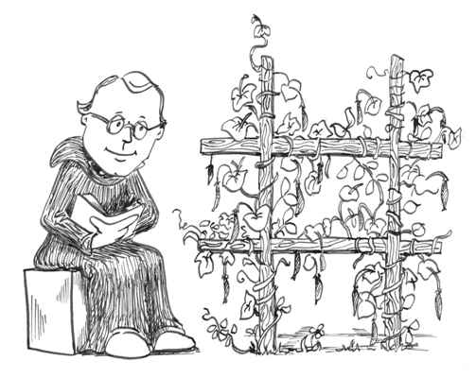
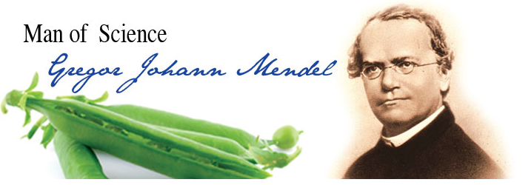
Genetics Notes
Who is Gregor Mendel?
Principle of Independent Assortment – Inheritance of one trait has no effect on the inheritance of another trait
“Father of Genetics”
Trait means the genetically distinguishing
Quality that determined characteristics

Slide 3
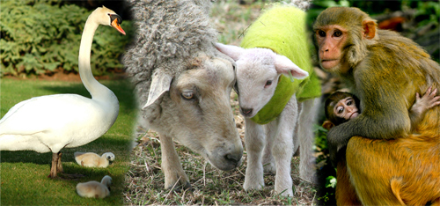
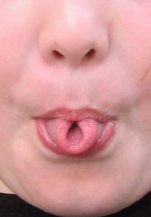
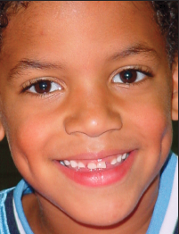
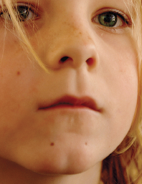
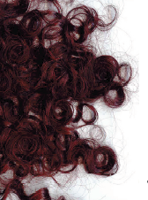
Traits
Genetics – study of how traits are passed from parent to offspring

Slide 4
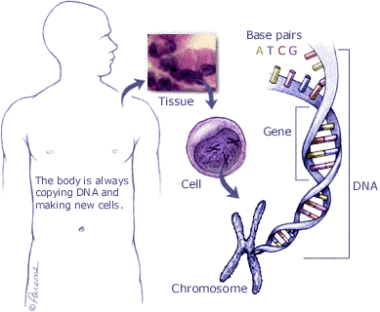
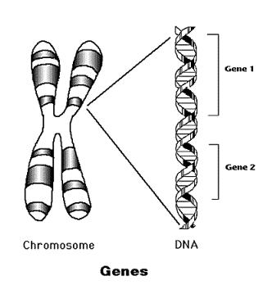
Traits are determined by the genes on the chromosomes. A gene is a segment of DNA that determines a trait.
Embedded within the DNA sequence of each chromosome are the organism’s genes

Slide 5
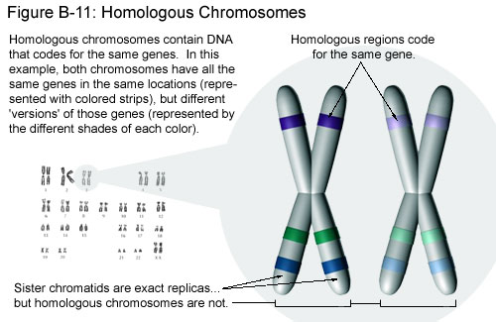
Chromosomes come in homologous pairs, thus genes come in pairs.
Homologous pairs – matching genes – one from female parent and one from male parent
Example: Humans have 46 chromosomes or 23 pairs.
One set from dad – 23 in sperm
One set from mom – 23 in egg

Slide 6
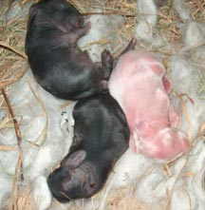
Alleles – different genes (possibilities) for the same trait –
ex: blue eyes or brown eyes
Dominant and Recessive Genes
Gene that prevents the other gene from “showing” – dominant
Gene that does NOT “show” even though it is present – recessive
Symbol – Dominant gene – upper case letter – T
Recessive gene – lower case letter – t
Dominant color

Slide 7

CHROMOSOMES
DEFINITION OF CHROMOSOME
It is a combination of two words, i.e., “Chroma”-means ‘colour’ and “Somes”-means ‘body’.So the
coloured thread like bodies present in the nucleoplasm of the living cells, which helps in the
inheritance (transmission) of characters in form of Genes from generation to generation are known
as CHROMOSOMES.
NUMBER OF CHROMOSOMES The number of chromosomes per organism is always a deﬁnite
number, Which is said as Diploid (2n) no., but gametes, sperms, ova etc. carry Haploid (n) number.
■ Chromosomes within the cell nuclei of higher organisms typically are
linear.
■ The chromosomes of mitochondria and some bacteria are circular.
■ The Chromosome
■ Each chromosome of a living cell is a DNA double helix. The atoms that
make up DNA are organized into two primary molecular components: bases and pentose sugars with attached phosphate groups. The bases are the key informational components of DNA, the letters of the DNA alphabet. The bases of DNA include adenine (A), cytosine (C), guanine (G), and thymine(T). Each base consists of a nitrogen-containing component called an amine.
The pentose sugars and phosphate groups serve as the links that connect the bases in a string, or strand, of DNA. When DNA strands form a double-stranded molecule, two strands of DNA are joined together through hydrogen bonds that form between the bases. In the double-stranded DNA molecule, an A base always pairs with a T base and a C base always pairs with a G base. Once joined, the bases are referred to as base pairs.
■
Embedded within the DNA sequence of each chromosome are the
organism’s genes. The chromosome can be thought of as the DNA
scaffolding within which the genes reside. An organism’s set of
chromosomes is called its genome. Genes are interspersed unevenly along
the lengths of most eukaryotic chromosomes. Across the human genome, for
example, there are gene-rich regions and gene-poor regions.

Slide 8
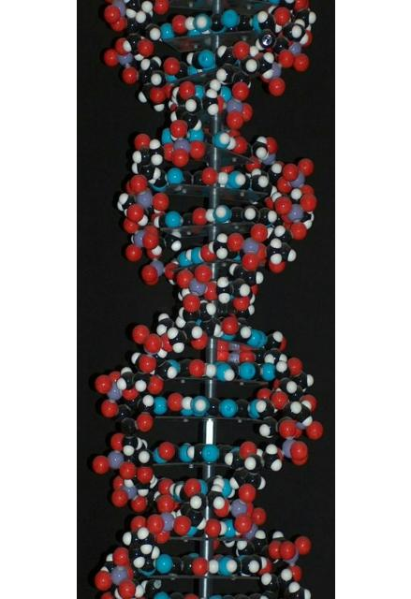
■ As such, the genes of mitochondria, bacteria and viruses typically lack many of the complex non-coding elements commonly found in the nuclear genes of eukaryotes.
■ Each chromosome within a living cell is a DNA double helix.
■

Slide 9
Chromosome
• Genes, the unit of inheritance are located on the chromosomes of the gametes.
• Passed from parents to progeny.
•Number of chromosomes is fixed in each cell but varies from species to species.
• In human beings, the total number is 46 or 23 pairs named as ‘diploid’ (2n).
• While in gametes (male or female) the number is 23 i.e. ‘haploid’ (n).
• 22 pair chromosomes are autosomes while 1 pair is sex chromosome.

Slide 10
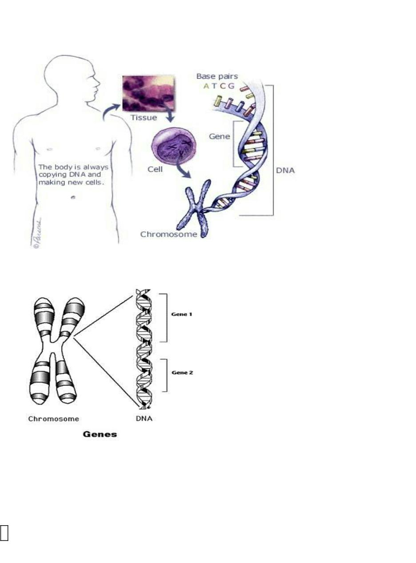
TYPES OF CHROMOSOMES TELOCENTRIC:- The centromere is
present at the end of the chromosomes.LONG ARMCENTROMERESHORT ARMCENTROMERE2.
ACROCENTRIC:-The centromere is almost terminal. It has one large and another very small
arm.LONG ARM
TYPES OF CHROMOSOMES (CONTINUED)
3. SUB-METACENTRIC:- Here the centromere is not at the middle position of the chromosomes. So
the arms are unequal and it is ‘L-Shaped’ in appearance.SHORT ARMCENTROMERELONG

Slide 11


ARM TWO EQUAL ARMS4. METECENTRIC:- The centromere is at the middle position. So the arms
are equal and it is ‘V-Shaped’ in appearance.CENTROMERE
CHEMICAL STRUCTURE
Chemically the chromosomes are made of proteins and nucleic acids.
PROTEINS It is mainly Protamines, Histones and smaller amount of acidic proteins .NUCLEIC
ACIDS It is de-oxy ribose Nucleic Acids (DNA). Genes are nothing but the segments of DNA.
FUNCTION OF CHROMOSOMES
[I]- The chromosomes are capable of self-duplication. During duplication process the DNA strands
unwind. As unwinding starts, each template of DNA forms its complementary strand in double-helix
nature. The conversion of the old DNA molecule into two new molecules, helps in duplicating the
chromosomes.
SELF DUPLICATION OF DNA MOLECULE
(IT HELPS IN THE DUPLICATION OFCHROMOSOMES )
Function of chromosomes (continued)…
[II]- They help in expression of diﬀerent characters in an organism by synthesizing proteins in cells.
A deﬁnite protein is accumulated to produce a deﬁnite character.
Function of chromosomes (continued)…
[III]- As carrier of genes they transmit characters from generation to generation , i.e. parents to
oﬀspring.[IV]- The chromosomes control the physiological and biochemical processes in the body of
the organism.
Chromosomes & Karyotyping
Most chromosome structures form from virtually any DNA sequence, but centromeres and telomeres are both composed of specific DNA sequences complexed with specific binding proteins.
PHYSICAL STRUCTURE
1- Size varies from 1 to 30 micron in length and diameter from 0.2 to 2 micron.
2. CENTROMERE:- The non-stainable part of the chromosome making a primary constriction.
3. CHROMATIDS:- Two chromatids join at the centromere to form a chromosome.

Slide 12
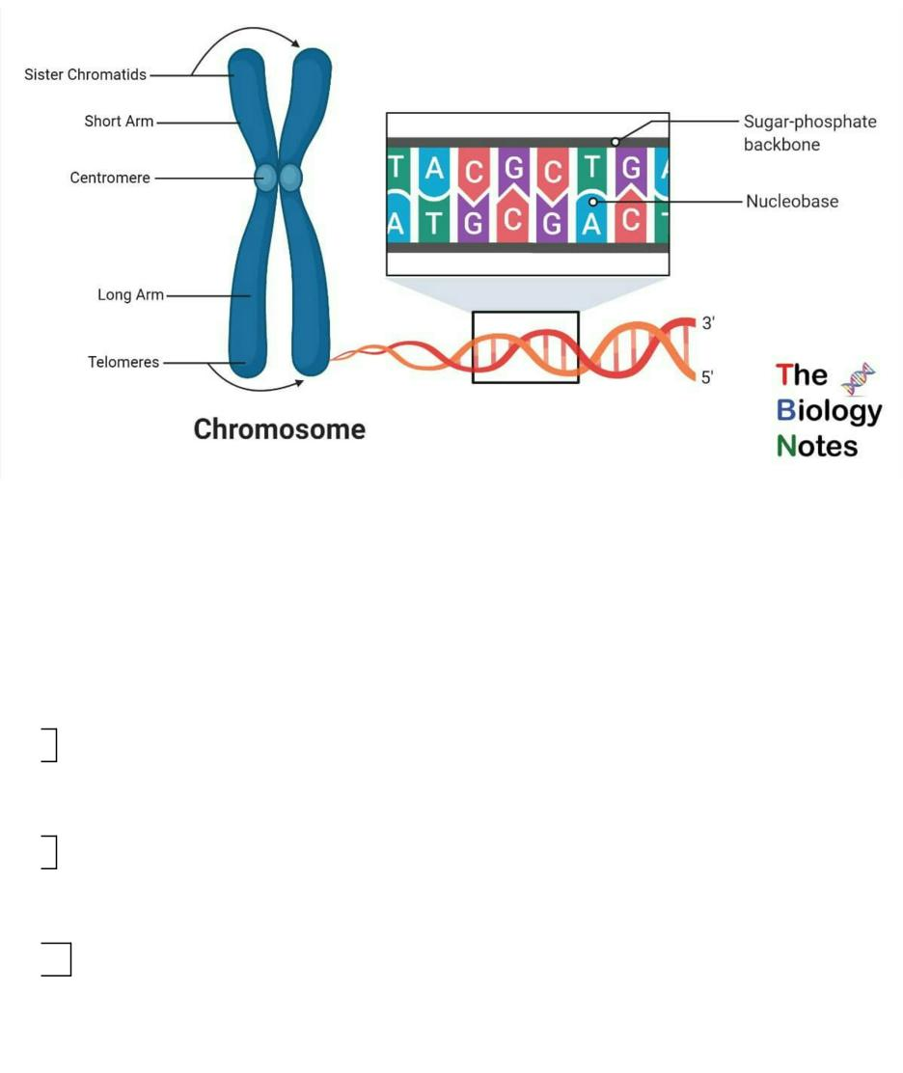
5. GENES:- Each chromomeres contains genes, the unit of inheritance of character.
6. SATELLITE:- In some chromosomes a round and elongated satellite is present.
7. CONSTRICTION:- Presence of centromere shows the primary constriction.
Chromosomes are composed of double-stranded DNA associated with speciﬁc proteins. The
nuclei of normal human somatic cells each contain 23 pairs of chromosomes.1 set came from
the mother “maternal ”, 1 set came from the father ” paternal ”. During metaphase,
chromosomes become condensed and stain intensely with basic dyes.
8. Human Chromosomes 1 set are the sex chromosomes
22 of these sets are called autosomes (or “self-chromosomes”) chromosomes, are numbered
from 1 to 22 approximating decreasing size order.1 set are the sex chromosomes A female
carries two X chromosomes (XX)A male carries an X chromosome and a Y chromosome
(XY)
9. Why do scientists look at chromosomes?
Scientists can diagnose or predict genetic disorders by looking at chromosomes. This kind of
analysis is used in prenatal testing and in diagnosing certain disorders, such as Down
syndrome, or in diagnosing a speciﬁc types of leukemia.
10. Chromosome abnormalities
Chromosome abnormalities can be numerical, as in the presence of extra or missing
chromosomes Structural as in translocations, inversions, large scale deletions or
duplications.
11.
Situations where analysis is strongly recommended
Problems with early growth & development Fertility problems Neoplasia Pregnancy in older
women Chorionic villus sampling (CVS) is a form of prenatal diagnosis to determine
chromosomal or genetic disorders in the fetus. It entails getting a sample of the chorionic
villus (placental tissue) and testing it.

Slide 13


12.
13.
What is a Karyotype? A display or photomicrograph of an individual’s somatic-cell
metaphase chromosomes that are arranged in a standard sequence (usually based on
number, size, and type)
Performing a Karyotype
The slides are scanned for metaphase spreads and usually 10 to 30 cells are analyzed
under the microscope by a cytogeneticist. When a good spread (minimum number of
overlapping chromosomes) is found, a photograph is taken or the analysis is done by a
computer.The chromosomes are arranged in a standard presentation format of longest to
shortest.Actually chromosome 21 is smaller than chromosome 22.
14. How Do Scientists Identify Chromosomes?
Three key features to identify their similarities and diﬀerences:
Size. This is the easiest way to tell two diﬀerent chromosomes apart.
Banding pattern. The size and location of Giemsa bands on chromosomes make each
chromosome pair unique.
Centromere position. Centromeres are regions in chromosomes that appear as a constriction. Using these key features, scientists match up the 23 pairs
15.
In metacentric chromosomes, the centromere lies near the center of the chromosome.
Submetacentric & very Submetacentric chromosomes, have a centromere that is oﬀ-center, so that one chromosome arm is longer than the other. In acrocentric chromosomes, the centromere resides very near one end.
What are all 4 types of chromosomes?
On the basis of the location of the centromere, chromosomes are classified into four types: metacentric, submetacentric, acrocentric, and telocentric ?. As previously mentioned, the centromere is easily visualized as the most constricted region of a condensed mitotic chromosome.
Parts of a chromosome • All human chromosomes have two arms • the short arm is referred to as the __P__ arm (petite) • the long arm as the __q_arm • The central region where the chromatids are joined is called the centromere • The ends are called telomeres P Q
Why is karyotyping done? • Determine if an adult has a genetic defect that can be passed
down • Determine if a genetic defect is preventing pregnancy or causing miscarriages •
Determine if a genetic defect is present in a fetus • Determine the cause of a stillbirth •
Determine the cause of a birth defect

Slide 14
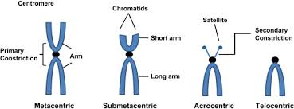
In the metacentric chromosome, the centromere is in the middle of the chromosomes.
The acrocentric chromosome has a centromere close to the end of the chromosome.
In the submetacentric chromosome, the centromere is slightly away from the middle of the chromosome.
Telocentric chromosome has terminal centromere.

Slide 15


10. How is karyotyping done? • Cells are collected (blood, amniotic fluid or placental cells) • Go
to cytogenetics lab • Isolate dividing cells • Grow cells in culture for 1 week • Treat cell culture
with chemical that stops cells in Metaphase
11. How to karyotype, cont. 6. Put cells on microscope slide and treat with a solution that bursts
cells 7. Wash cell debris away, chromosomes stick to slide 8. Stain chromosomes with dye 9.
Take picture of chromosomes and analyze for number, sex, size, etc
12. Normal Karyotype
13. Terms to Know • Any abnormal chromosome number is called aneuploidy. • A trisomy
karyotype has one extra chromosome (2n +1). • A monosomy karyotype has one missing
chromosome (2n - 1)
14. Some Aneuploid Chromosomal Disorders • Patau Syndrome • Edward Syndrome •
Klinfelter’s Syndrome • Turner Syndrome • Super Male Syndrome • Super Female Syndrome
15. 47, XY, +13 • serious eye, brain, circulatory defects as well as cleft palate. 1:5000 live births.
Children rarely live more than a few months. • Patau Syndrome
16. Cleft Palate
19. Edward Syndrome • almost every organ system affected 1:10,000 live births. Children with
full Trisomy 18 generally do not live more than a few months.
21. Klinefelter’s Syndrome • Male sex organs; unusually small testes, sterile. Breast
enlargement and other feminine body characteristics. Normal intelligence.
Turner Syndrome • the ONLY viable monosomy Down’s syndrome –
(Trisomy 21) 47 chromosomes, extra chromosome at pair #21
22.
24. Super Male and Super Female • - Has an XXX- Fertile females with normal intelligence •
Has an XYY- Tall male with heavy acne- Some tendency to mental retardation • Aggressive
tendency???
25. Typical human cells contain 23 pairs of chromosomes.
26. Variations in the number or structure of human chromosomes can cause a variety of
genetic disorders.
27. Variations in the number of chromosomes within a cell are called aneuploidies.

Slide 16
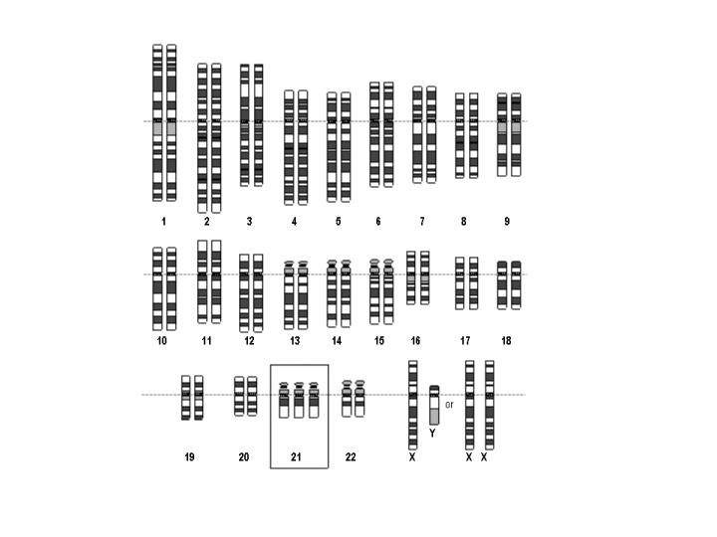
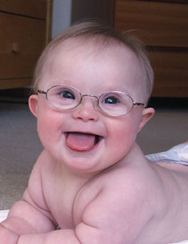
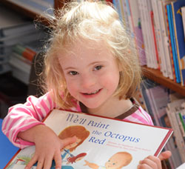


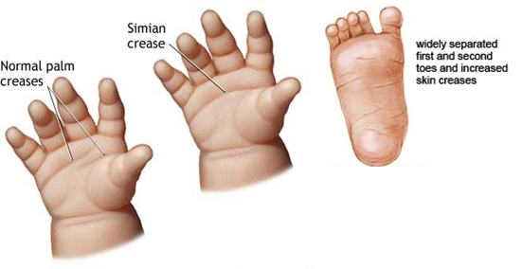
Examples:
Down’s syndrome – (Trisomy 21) 47 chromosomes, extra chromosome at pair #21

Slide 17

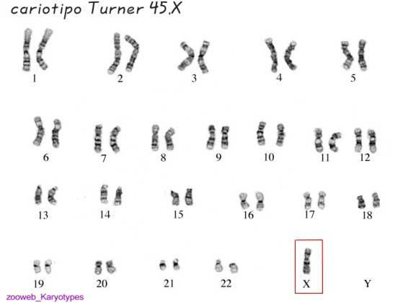
Turner’s syndrome – only 45 chromosomes, missing a sex chromosome (X)
Girls affected – short, slow growth, heart problems

Slide 18
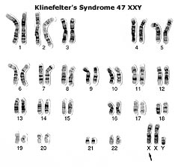
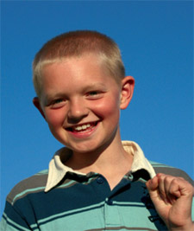

Klinefelter’s syndrome – 47 chromosomes, extra X chromosomes (XXY)
Boys affected – low testosterone levels, underdeveloped muscles, sparse facial hair

Slide 19
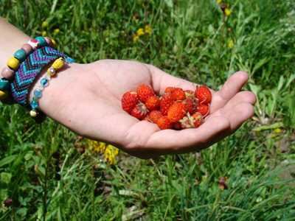
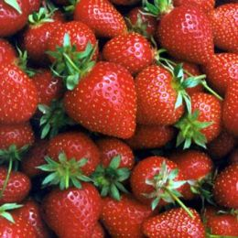
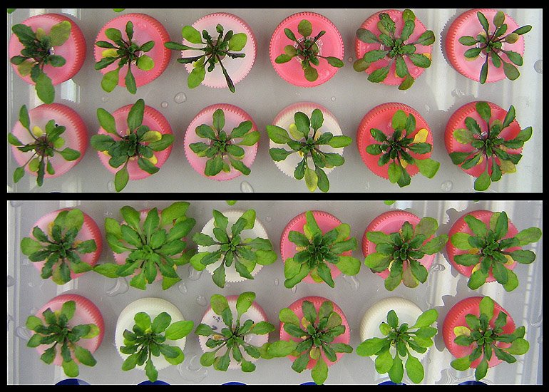
Having an extra set of chromosomes is fatal in animals, but in plants it makes them larger and hardier.
Hardier

Slide 20
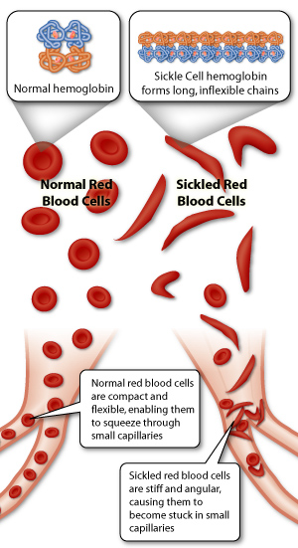
Examples:
Recessive gene mutations:
Sickle cell anemia – red blood cells are sickle shaped instead of round and cannot carry enough oxygen to the body tissues – heterozygous condition protects people from malaria

Slide 21
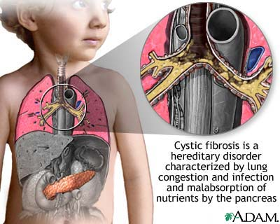
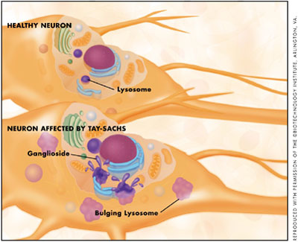
Cystic fibrosis – mucous builds up in the lungs
Tay-Sachs Disease – deterioration of the nervous system – early death
Mutated genes produce enzymes that are less effective than normal at breaking down fatty cell products known as gangliosides. As a result, gangliosides build up in the lysosomes and overload cells. Their buildup ultimately causes damage to nerve cells.

