Slide 1
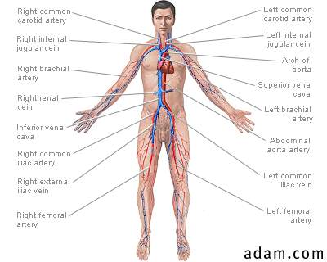
What is the urinary system?
The urinary system consists of two kidneys, two ureters, one bladder, and one urethra. It is an excretory system for urine and the wastes it carries. It extracts wastes from the bloodstream, converts them to urine, then transports and eliminates it.

Slide 2
KIDNEY: Position and Associated Structures
Position, weight, and size
–Lie against posterior abdominal wall at level of T12 to L3
–Right kidney is slightly lower due to large right lobe of liver
–Rib 12 crosses the middle of the left kidney
–Retroperitoneal along with ureters, urinary bladder, renal artery and vein, and adrenal glands

Slide 3
Gross Anatomy
•Shape and size
–About the size of a bar of bath soap
–Lateral surface is convex, and medial is concave with a slit, called the hilum
•Receives renal nerves, blood vessels, lymphatics, and ureter
•Three protective connective tissue coverings
–Renal fascia immediately deep to parietal peritoneum
•Binds it to abdominal wall
–Perirenal fat capsule: cushions kidney and holds it into place
–Fibrous capsule encloses kidney protecting it from trauma and infection
•Collagen fibers extend from fibrous capsule to renal fascia

Slide 4
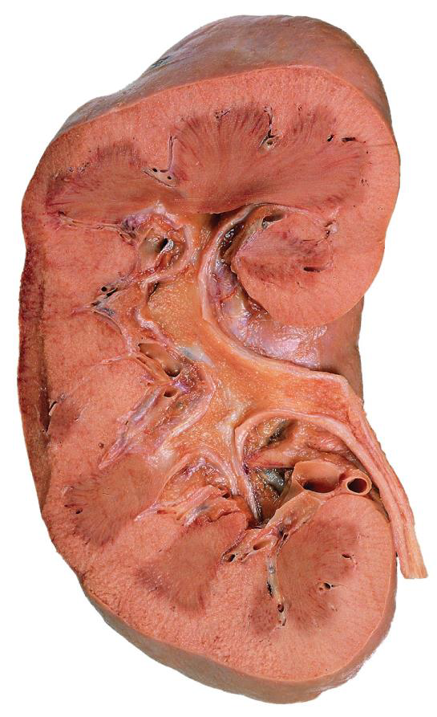

Slide 5
Renal Innervation
–Carries sympathetic innervation from the abdominal aortic plexus
•Stimulation reduces glomerular blood flow and rate of urine production
•Respond to falling blood pressure by stimulating the kidneys to secrete renin, an enzyme that activates hormonal mechanisms to restore blood pressure
–Carries parasympathetic innervation from the vagus nerve; increases rate of urine production

Slide 6
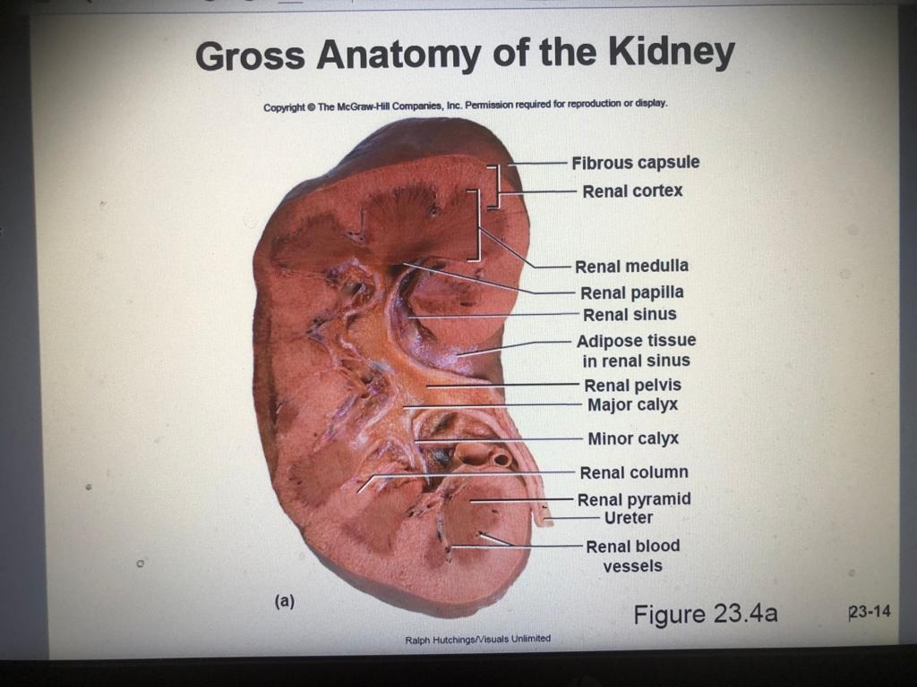

Slide 7
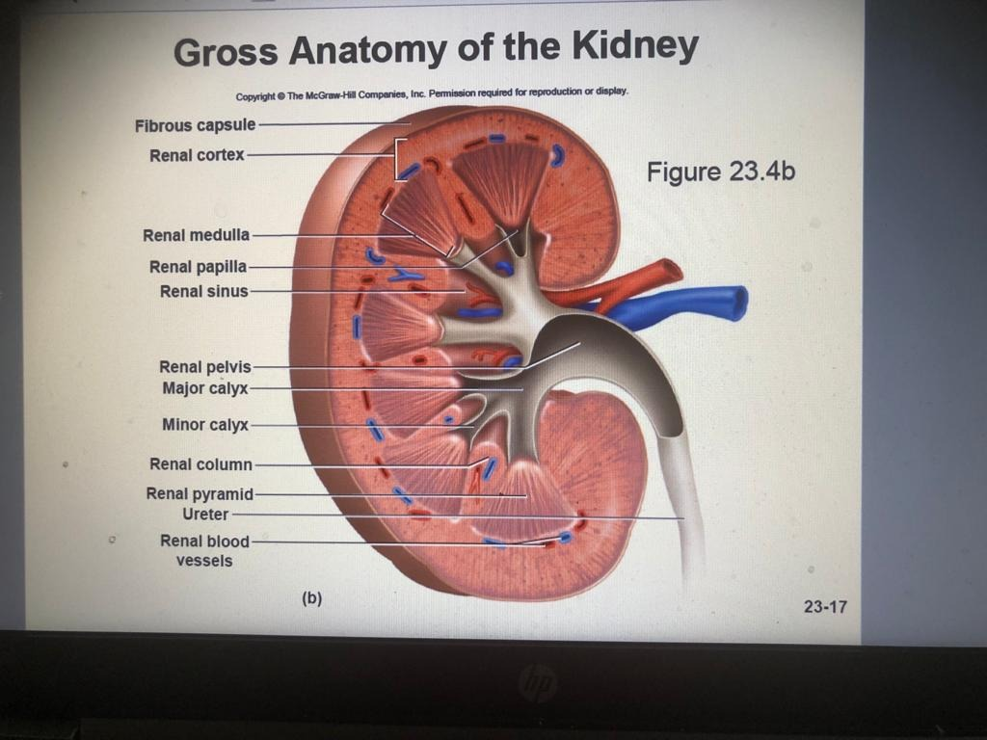

Slide 8
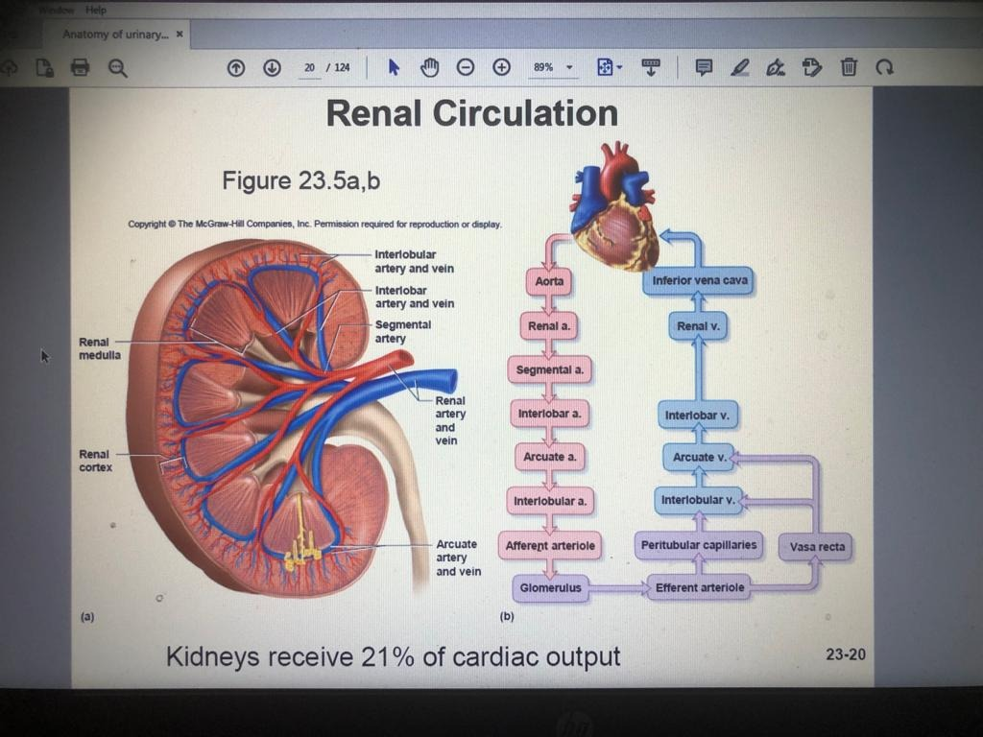

Slide 9
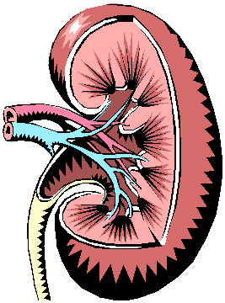
The kidneys…
The kidneys are bean-shaped organs located at the back of the abdominal cavity, lying on each side of the spinal column just above the waistline.
Three layers surround each kidney: the true capsule is a smooth, fibrous membrane adhering to the kidney surface; the perirenal fat is adipose tissue surrounding each kidney;
the renal fascia is fibrous tissue that anchors the kidney to surrounding structures.

Slide 10
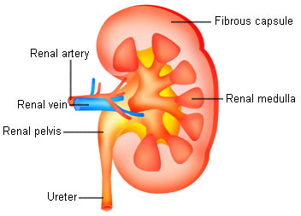
The kidneys…
Renal cortex
The notch in the concave area of the kidney is called the hilum The renal artery, renal vein, nerves, and lymphatic vessels enter and leave through the hilum. The ureter also widens into a collection sac called the renal pelvis in the hilum area.
The renal cortex is the outside portion; the medulla is the inside.

Slide 11
The kidneys…
The notch in the concave area of the kidney is called the hilum (HĪ lum). The renal artery, renal vein, nerves, and lymphatic vessels enter and leave through the hilum. The ureter also widens into a collection sac called the renal pelvis in the hilum area.
Renal cortex
The renal cortex is the outside portion; the medulla is the inside.

Slide 12
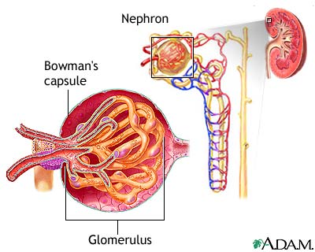
Each kidney contains
about 1 million nephrons, (NEF rahn) the structural and functional units of the kidney. Each Renal copuscle contains a Bowman’s capsule (BŌ mun’s) and a glomerulus (glah MAIR you lus).
The kidneys…
The nephron filters approximately 1,000 ml. of blood per minute… a little over a liter per minute. The waste is mixed with water to create urine: 5% solids in 95% water.

