Slide 1
COLLEGE OF PHARMACY
ANATOMY OF RESPIRATORY SYSTEM
Ass. Prof. Dr. AJWAD ASSUMAIDAEE

Slide 2
Organs of the Respiratory System
Nose
Pharynx
Larynx
Trachea
Bronchi
Lungs—alveoli

Slide 3
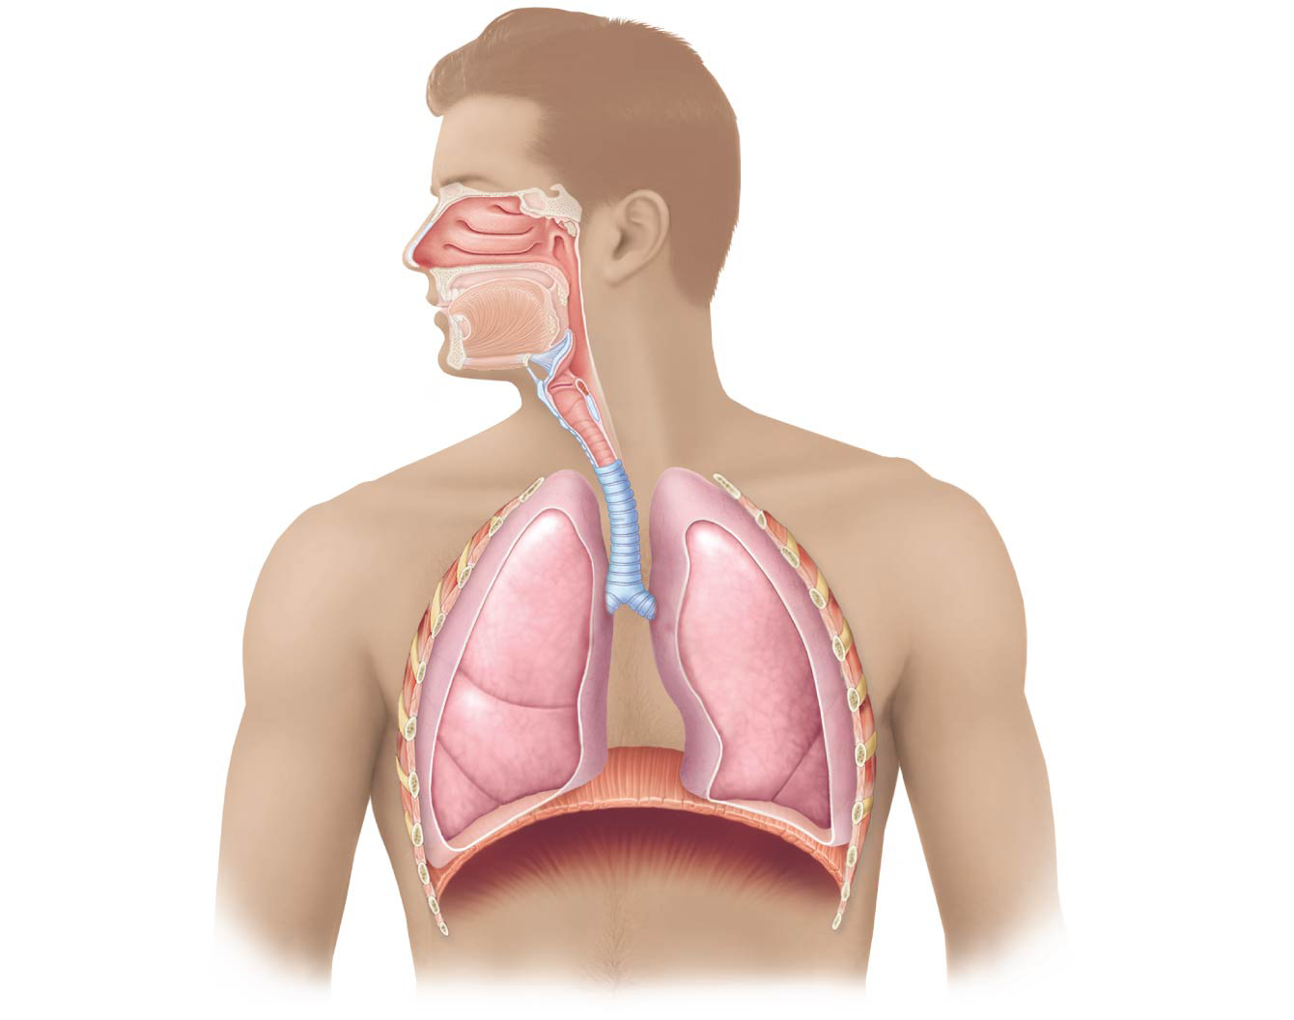
Figure 13.1 The major respiratory organs shown in relation to surrounding structures.
Nasal cavity
Oral cavity
Nostril
Pharynx
Larynx
Trachea
Left main
(primary)
bronchus
Right main
(primary)
bronchus
Left lung
Right lung
Diaphragm

Slide 4
Functions of the Respiratory System
Gas exchanges between the blood and external environment
Occur in the alveoli of the lungs
Passageways to the lungs purify, humidify, and warm the incoming air

Slide 5
The Nose
The only externally visible part of the respiratory system
Air enters the nose through the external nostrils (nares)
Interior of the nose consists of a nasal cavity divided by a nasal septum

Slide 6
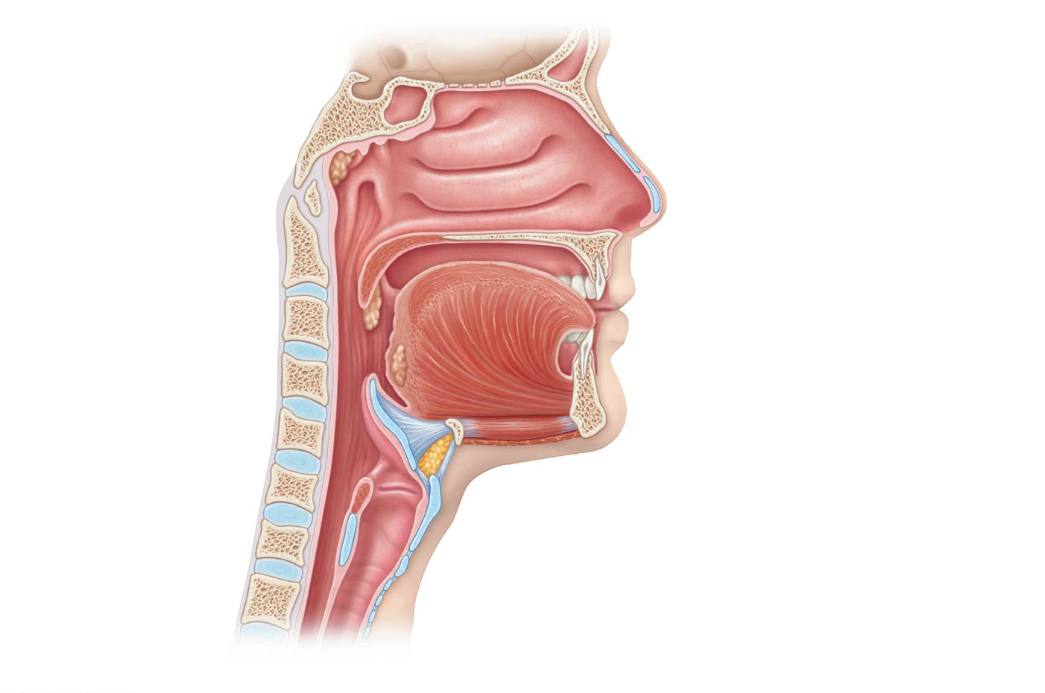
Figure 13.2b Basic anatomy of the upper respiratory tract, sagittal section.
Cribriform plate
of ethmoid bone
Sphenoidal sinus
Frontal sinus
Posterior nasal
aperture
Nasal cavity
Nasal conchae (superior,
middle and inferior)
Nasopharynx
Pharyngeal tonsil
Nasal meatuses (superior,
middle, and inferior)
Opening of
pharyngotympanic
tube
Nasal vestibule
Nostril
Uvula
Hard palate
Oropharynx
Soft palate
Palatine tonsil
Tongue
Lingual tonsil
Larynx
Hyoid bone
Laryngopharynx
Epiglottis
Esophagus
Thyroid cartilage
Trachea
Vocal fold
Cricoid cartilage
(b)
Detailed anatomy of the upper respiratory tract

Slide 7
The Nose
Olfactory receptors are located in the mucosa on the superior surface
The rest of the cavity is lined with respiratory mucosa, which:
Moistens air
Traps incoming foreign particles

Slide 8
The Nose
Lateral walls have projections called conchae
Increase surface area
Increase air turbulence within the nasal cavity
The nasal cavity is separated from the oral cavity by the palate
Anterior hard palate (bone)
Posterior soft palate (unsupported)

Slide 9
Paranasal Sinuses
Cavities within bones surrounding the nasal cavity are called sinuses
Sinuses are located in the following bones:
Frontal
Sphenoid
Ethmoid
Maxillary

Slide 10
Paranasal Sinuses
Functions of the sinuses:
Lighten the skull
Act as resonance chambers for speech
Produce mucus that drains into the nasal cavity

Slide 11
Pharynx (Throat)
Muscular passage from nasal cavity to larynx
Three regions of the pharynx:
Nasopharynx—superior region behind nasal cavity
Oropharynx—middle region behind mouth
Laryngopharynx—inferior region attached to larynx
The oropharynx and laryngopharynx are common passageways for air and food

Slide 12
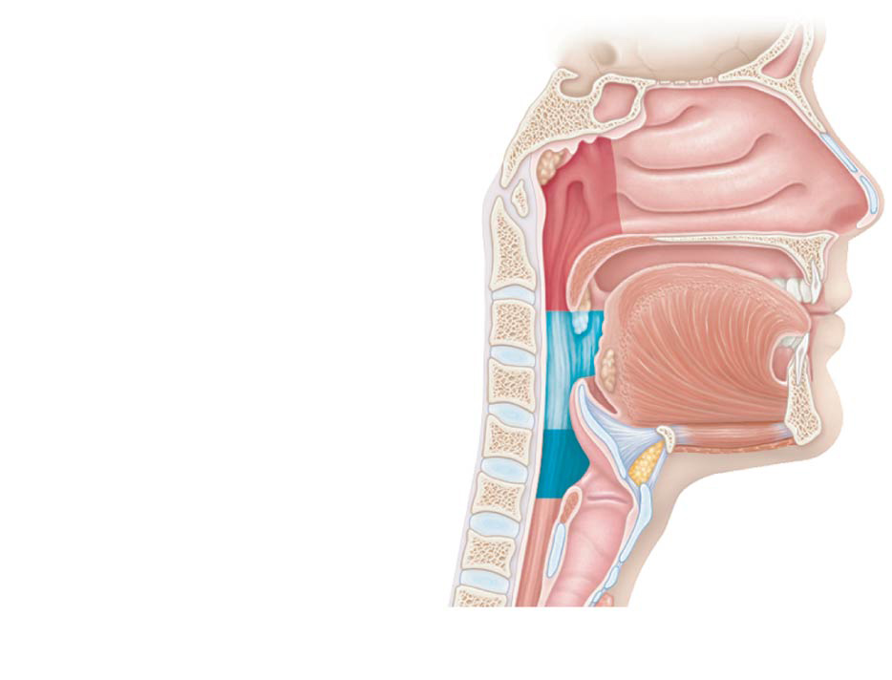
Figure 13.2a Basic anatomy of the upper respiratory tract, sagittal section.
Pharynx
Nasopharynx
Oropharynx
Laryngopharynx
(a)
Regions of the pharynx

