Slide 1

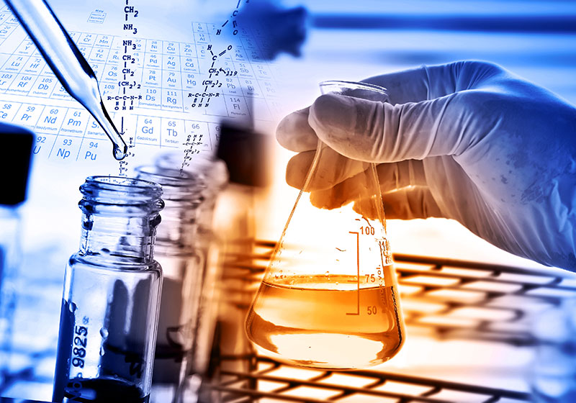

Preparation & Standardization
of 0.1 N HCl Solution
م.م رنا م.م هالة

Slide 2
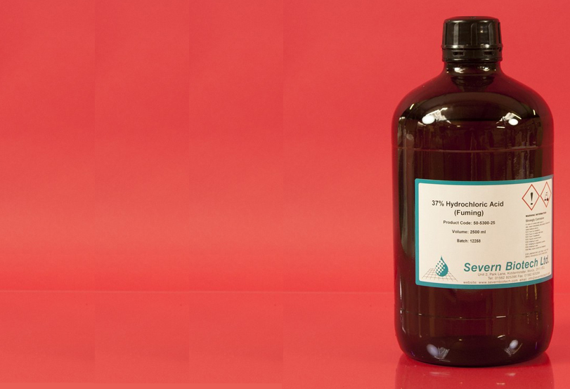
A reagent bottle of concentrated HCl has the following informations on it's lable:
Molar mass = 36.5 g/mol
sp.gr = 1.18
37% HCl (w/w)
How could you prepare: 1L of 0.1 N HCl solution from this conc. HCl ?

Slide 3
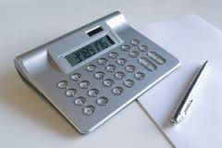
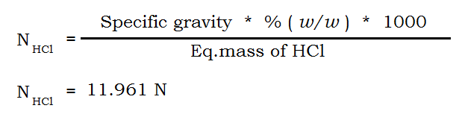
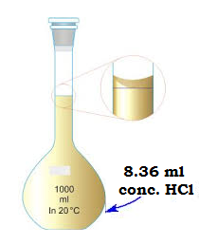
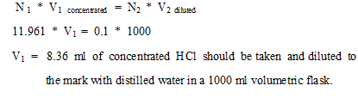
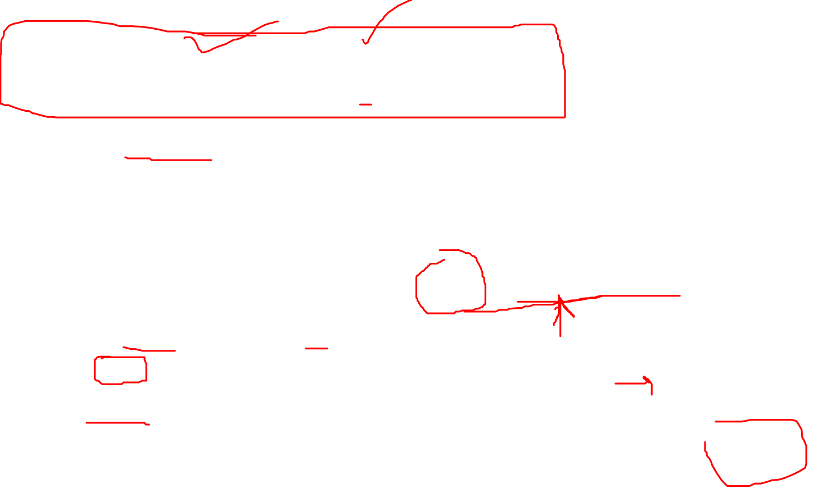
1- Calculation of the Normality of
the concentrated HCl:
2- Calculation of the volume of 11.961N HCl that
should be taken to prepare 1L of 0.1N HCl soln.

Slide 4
3. Standardization of the prepared
HCl solution HOW???
Principle :
HCL is standardized against primary standard Na₂CO₃
If the chemical is available in a pure state, e.g. anhydrous Na2CO3 , weigh out an exact quantity, dissolve it in water up to volume.
We need to know how to prepare solution of Na₂CO₃ …….

Slide 5
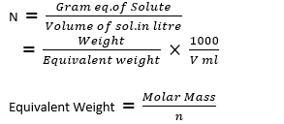
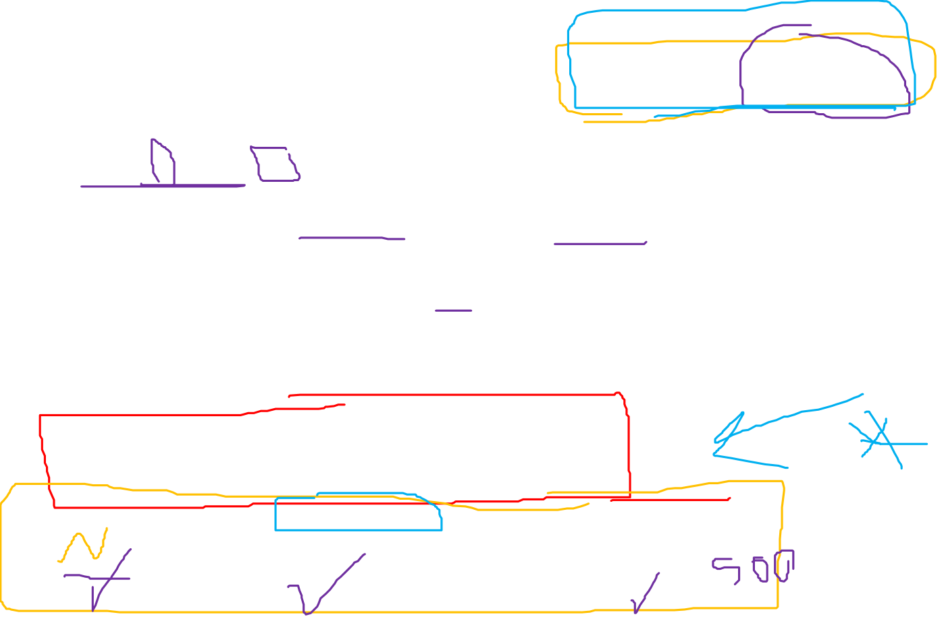
How could you prepare 0.5 L of 0.1 N Na₂CO₃? Knowing that, atomic masses of Na = 23, O = 16 and C = 12.
Practice it with numbers and units …..

Slide 6

Summary
1. Calculate the normality (N) of conc. HCL solution in the reagent bottle. HOW?
2. Prepare diluted HCL solution from conc. HCL that is found in the reagent bottle. HOW ?
3. Prepare primary standard (Na₂CO₃) solution. HOW?
4. Standardization of the diluted HCL solution by titration against primary standard (Na₂CO₃) solution…….HOW ?

Slide 7
Practice
Post Lab Exercise:
A bottle of concentrated HCl has the following information on it's label: molar mass is 36.5 g/mol, sp.gr. 1.18 and 40% HCl ( w/w ).
a- What is the normality of the HCl in the bottle?
b- How could you prepare 2 liters of about 0.1 N HCl solution from the concentrated reagent?

Slide 8
Practical part
Name of experiment :
Standardization of HCL solution with Na₂CO₃ standard.
Objective:
To determine the exact normality of a hydrochloric acid solution.

Slide 9
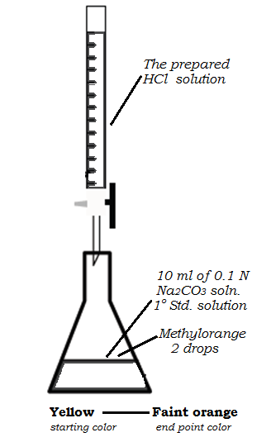

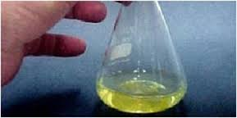
Procedure:
1- Fill the burette with the prepared HCl soln.
2- Transfer 10 ml of exactly 0.1 N Na₂CO₃ solution ( 1º - standard ) in to a conical flask by using a 10 ml bulb pipette.
3- Add 2 drops of methyl orange as
indicator. Yellow color is obtained.

Slide 10
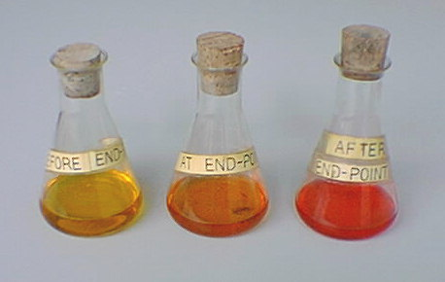

4- Titrate with HCl soln. drop by
drop from the burette in to the
conical flask until a faint orange
color is obtained.
5- The exact normality can be calculated from the following equation:

Slide 11
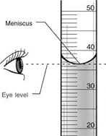
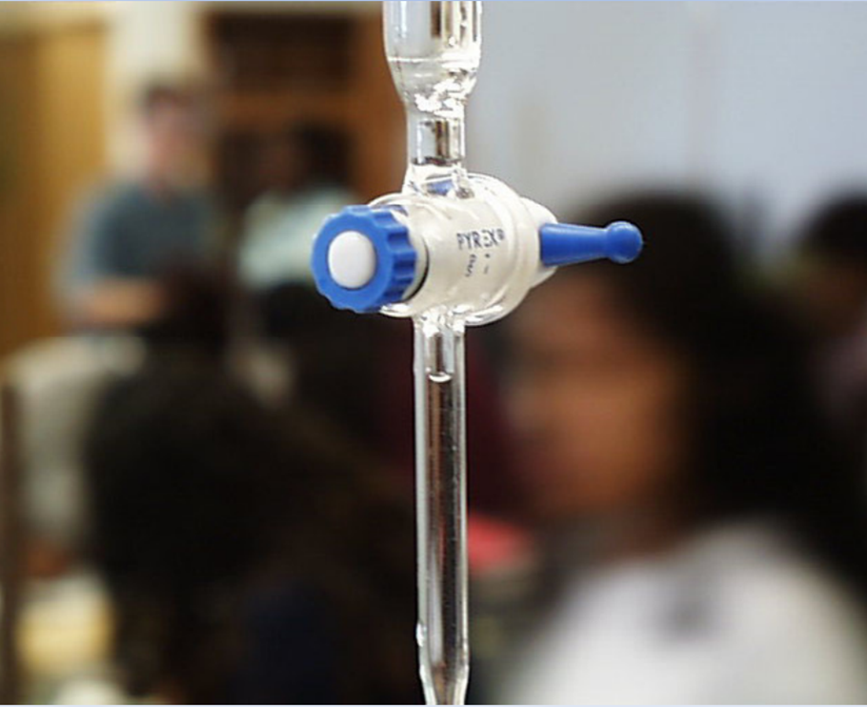
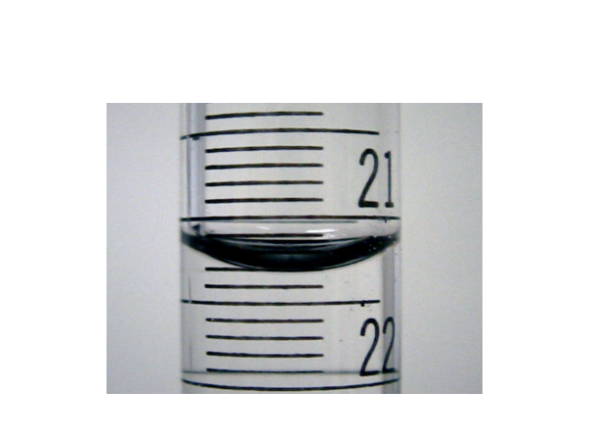
Directions for reading a volumetric equipment:
Burette adjustment
Avoiding a parallax
Notes:
Avoiding a parallax:
The top surface of a liquid confined
in a narrow tube exhibits a marked
curvature, meniscus.

Slide 12
*In the next slide you will see a practical demonstrative video of HCL titration with sodium carbonate, primary standard solution.
*At end, you will learn how to calculate the exact normality of the prepared diluted HCL solution ….
((Do not miss watching before your experiment as well as before your exam)).
See you in your lab this week…..

Slide 13
