Slide 1

Assay of Ferrous Sulfate
FeSO4.7H2O Mwt.=278gm/mole

Slide 2
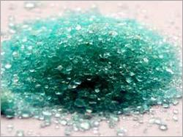
Appearance: The blue-green heptahydrate is the most common form of ferrous sulfate ,it is bluish green crystals, freely soluble in water.
Content: Ferrous Sulfate (crystal) contains 98.0－104.0% of ferrous sulfate heptahydrate (FeSO4･7H2O)
Used in the prevention and treatment of iron deficiency.

Slide 3
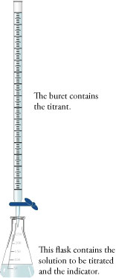
Procedure:
H2SO4 should be added to maintain a reasonably
constant H ions concentration as explained previously
≈ 0.1N KMnO₄
Unknown powder
20ml of diluted(2.5% vlv) H2SO4
End point: colorless pink

Slide 4
Chemical principle:
10FeSO4+2KMnO4+8H2SO4 2MnSO4+5Fe2(SO4)3+K2SO4+
8H2O
Or MnO4¯ +8 H⁺+5Fe⁺² Mn⁺² +4H2O+5 Fe⁺³
Ferrous sulfate is a reducing agent.
It will be titrated against standard solution of potassium permanganate(oxidizing agent) in acidic media.
Note: you must write the oxidation and reduction equations by each.
Chemical factor:
Derive the ch. Factor from the previous chemical equation.
1ml. of 0.1N KMnO4 ≡ 0.0278gm of FeSO4

Slide 5
Calculation:
Correct the volume of KMnO4 consumed=V'
Then multiply the corrected volume (V') by the Ch. Factor.
to get the weight;
V' x ch. Factor =gm of FeSO4 in the unknown.

